Slide 1
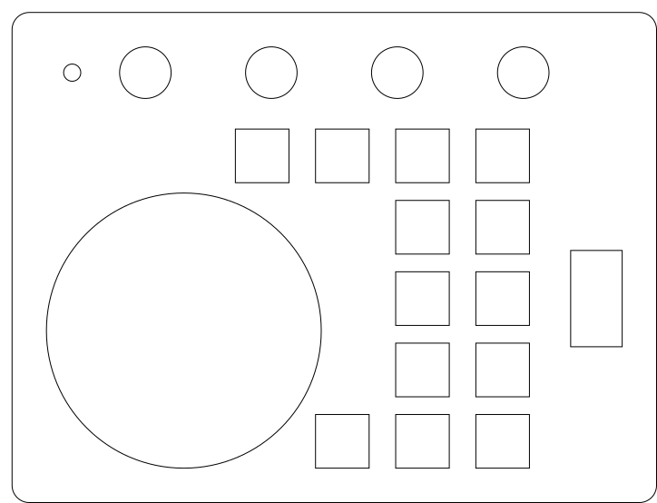
YouTube forwards
Vol
Steam
Chrome
Rick Roll
Email
Task Manager
Cura
MID
File Explorer
Scroll
Google Selected
Pause/Play
CTRL-W
YouTube Backwards
YouTube forwards
Full Screen

Slide 2
Vol
Open Arduino
Indent
Reverse Indent
UP
Scroll
Verify
Upload
Monitor
Plotter
Serial print
(SHIFT- no ln)
IF
While

Slide 3
DOWN

