Slide 1




Science Foundation Ireland Centre for Research Training in Foundations of Data Science
Piecewise Exponential Distributional Regression Model for Survival Analysis
Jack Moore, Shirin Moghaddam, Kevin Burke
University of Limerick
moore.jack@ul.ie
05/09/2024

Slide 2
Content
Introduction
Why consider the Piecewise Exponential Model (PEM)?
Expanding the PEM
Inclusion of covariates
Estimation Techniques
Comparisons
Simulation Study
Real World Data
Conclusions &
Future Work
Comparison Conclusions
PH assumption
Future Expansions

Slide 3
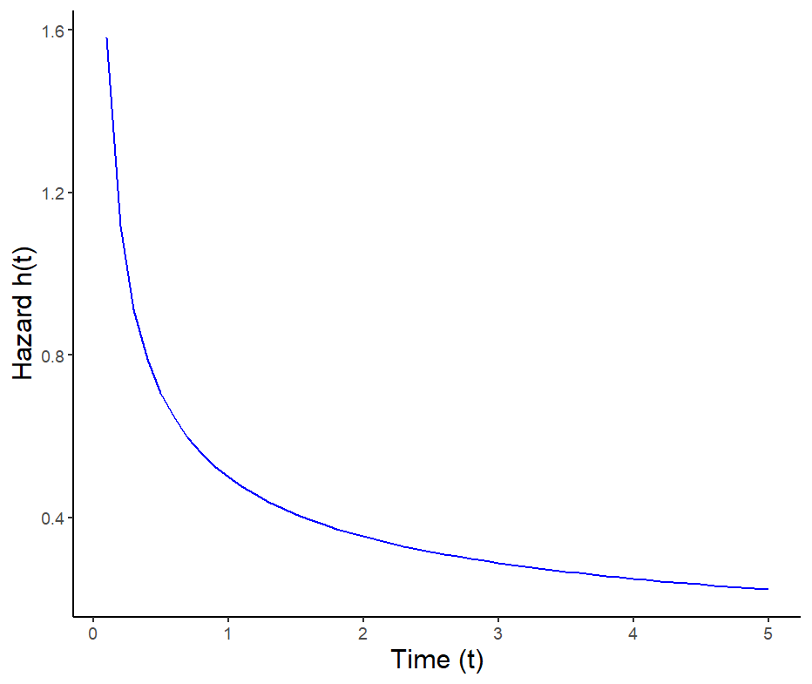

Why Piecewise Exponential?
Within survival analysis we have:
Survivor Function
Hazard Function
Common distributions include:
Exponential
Weibull
Application Issues:
Non-monotonic?
Unknown Data?
Weibull ($γ=0.5,λ=1$)

Slide 4
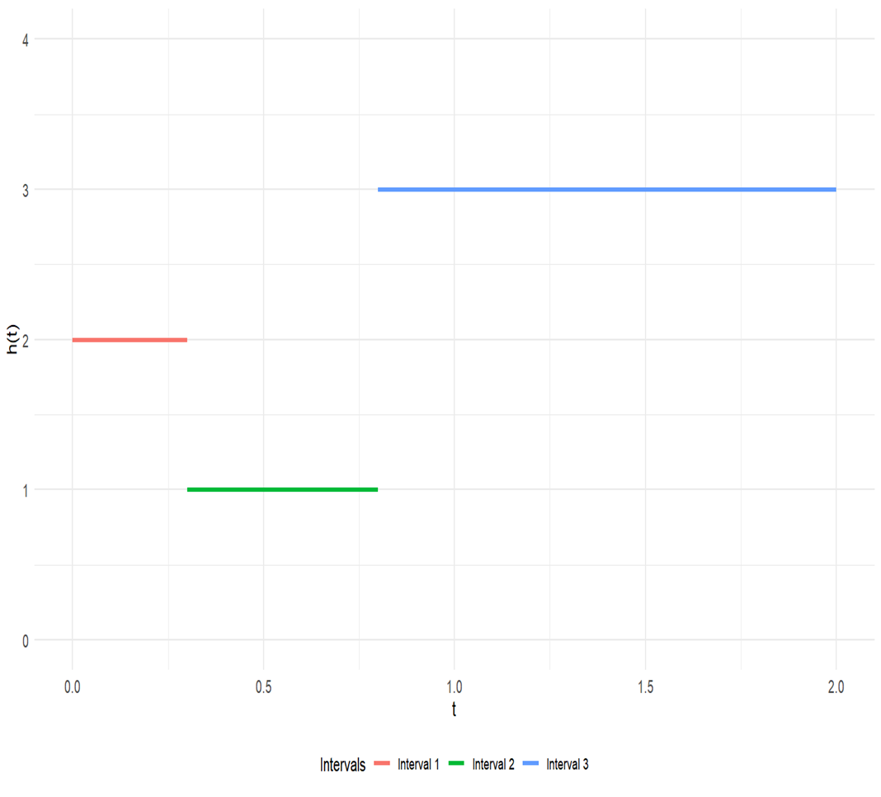
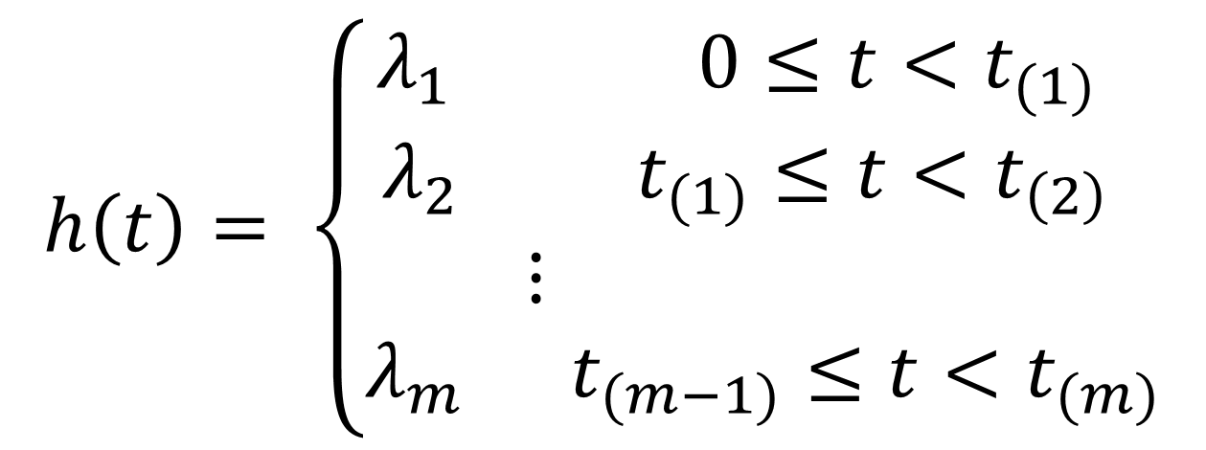
Piecewise Exponential Model
Piecewise Exponential Hazard Definition
Piecewise Exponential Hazard Example

Slide 5
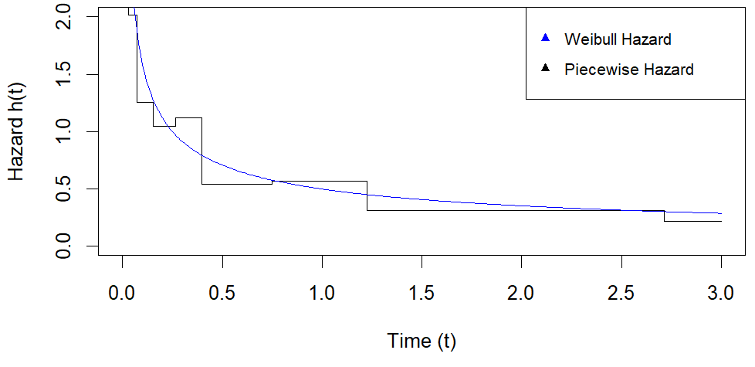
Fitted PEMs

Slide 6
Cox PH Model
Model Flexibility
Does not require prior knowledge of the baseline hazard function.
Inclusion of Covariates
Allows for analysis of their effect on survival time
Proportional Hazards Assumption
Assumes Hazard ratios between groups are constant

Slide 7
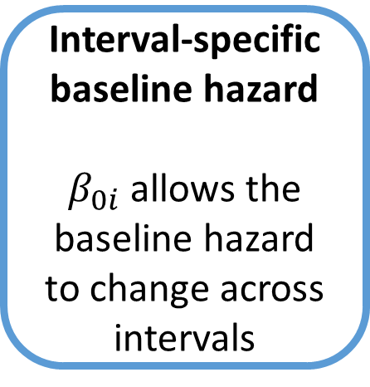
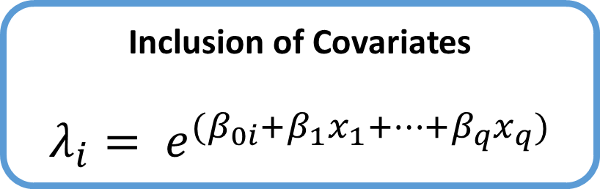
Expanding the PEM
{
Interval-specific baseline hazard
$β_{0i}$allows the baseline hazard to change across intervals
Inclusion of Covariates
$$λ_{i}= e^{(β_{0i}+β_{1}x_{1}+…+β_{q}x_{q})}$$
Proportional Hazard Model
Hazard ratios between covariate levels are constant

Slide 8

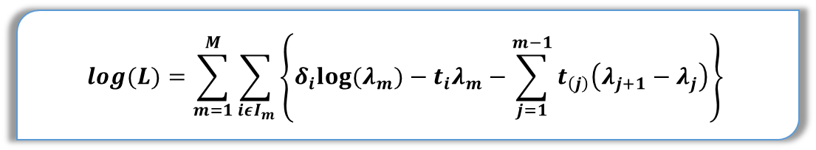
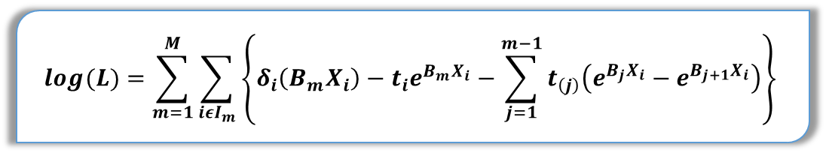
Estimation Techniques
$$Log\left(L\right)= \prod_{i=1}^{n}{{h\left(t_{i}\right)}^{δ_{i}}S(t_{i})}$$
$$log(L)=\sum_{m=1}^{M}{\sum_{iεI_{m}}{\left\{δ_{i}log⁡(λ_{m}){ − t}_{i}λ_{m}−\sum_{j=1}^{m−1}{t_{\left(j\right)}\left(λ_{j+1}−λ_{j}\right)}\right\}}}$$
$$log(L)=\sum_{m=1}^{M}{\sum_{iεI_{m}}{\left\{δ_{i}\left(B_{m}X_{i}\right){ − t}_{i}e^{B_{m}X_{i}}−\sum_{j=1}^{m−1}{t_{\left(j\right)}\left(e^{B_{j}X_{i}}−e^{B_{j+1}X_{i}}\right)}\right\}}}$$

Slide 9
Simulation Study
Survival data was simulated using 3 known covariate effects
2 Binomial Covariates, 1 Continuous Covariate
Cox and PH-PEM estimates of these effects were compared over 100 simulations

Slide 10
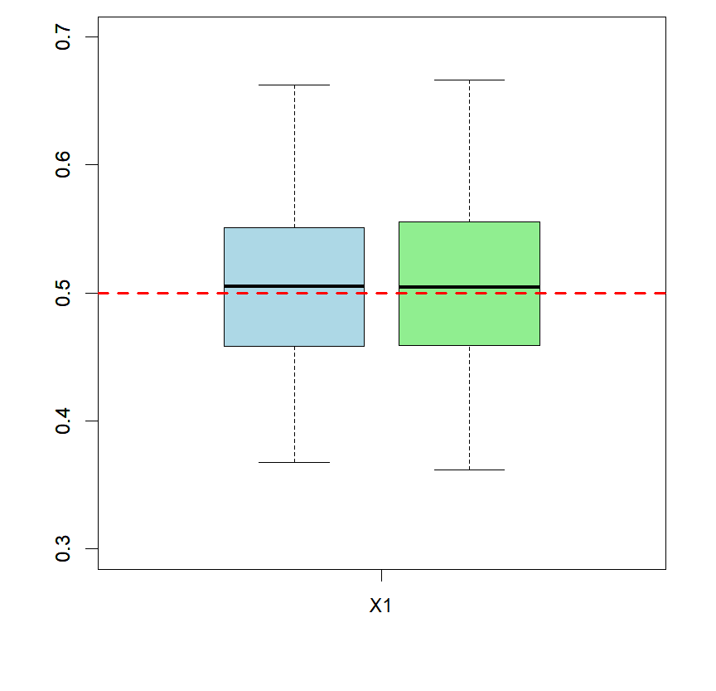
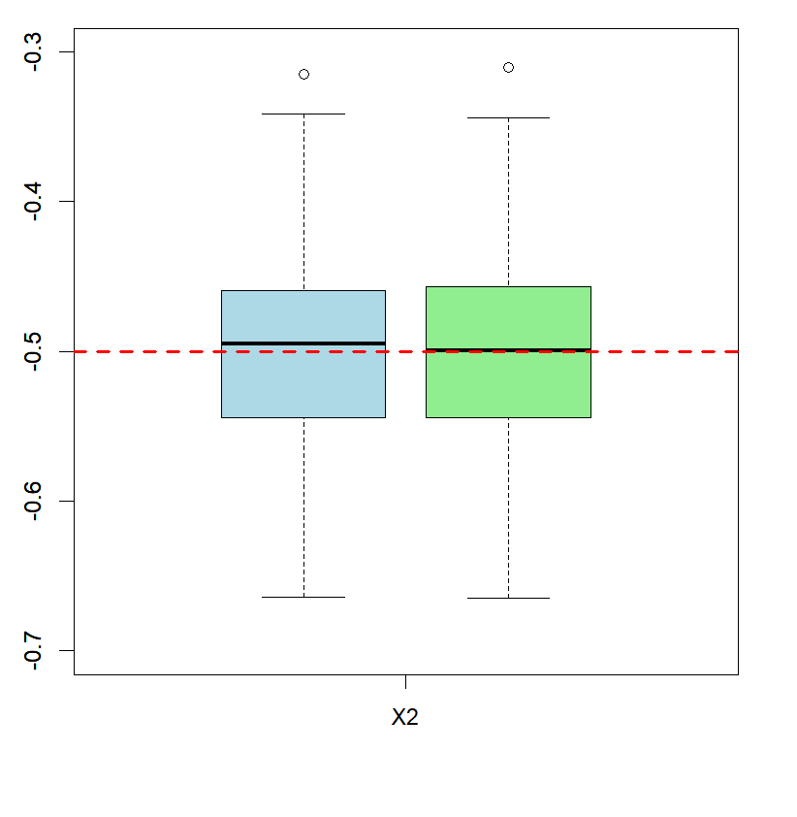
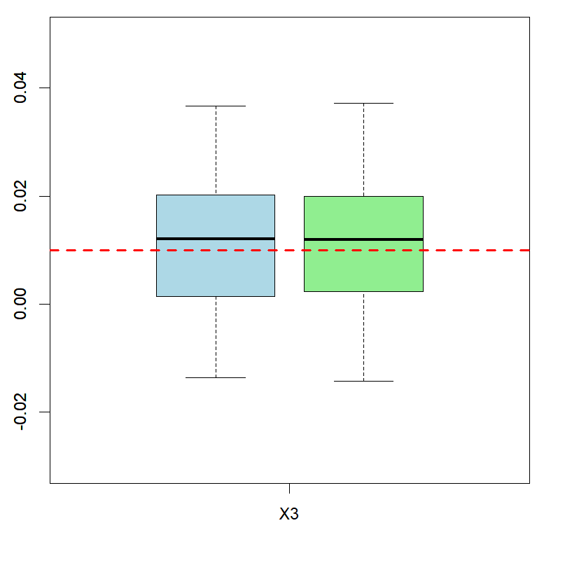
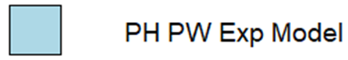
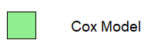
Simulation Study

Slide 11
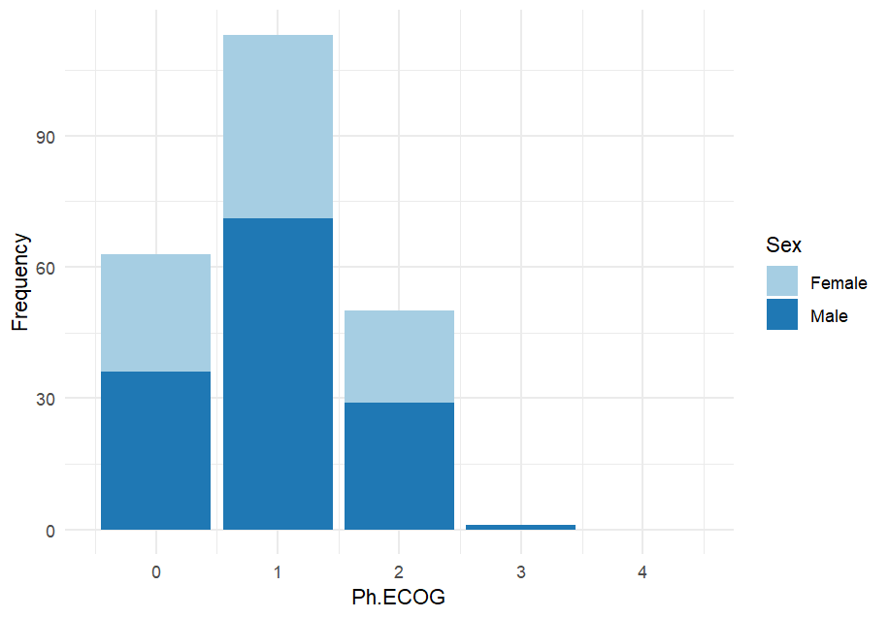
Cancer Data
Considered Lung cancer data from the North Central Cancer Treatment Group.
Used covariates Sex and ECOG score.
Sample size: 227

Slide 12
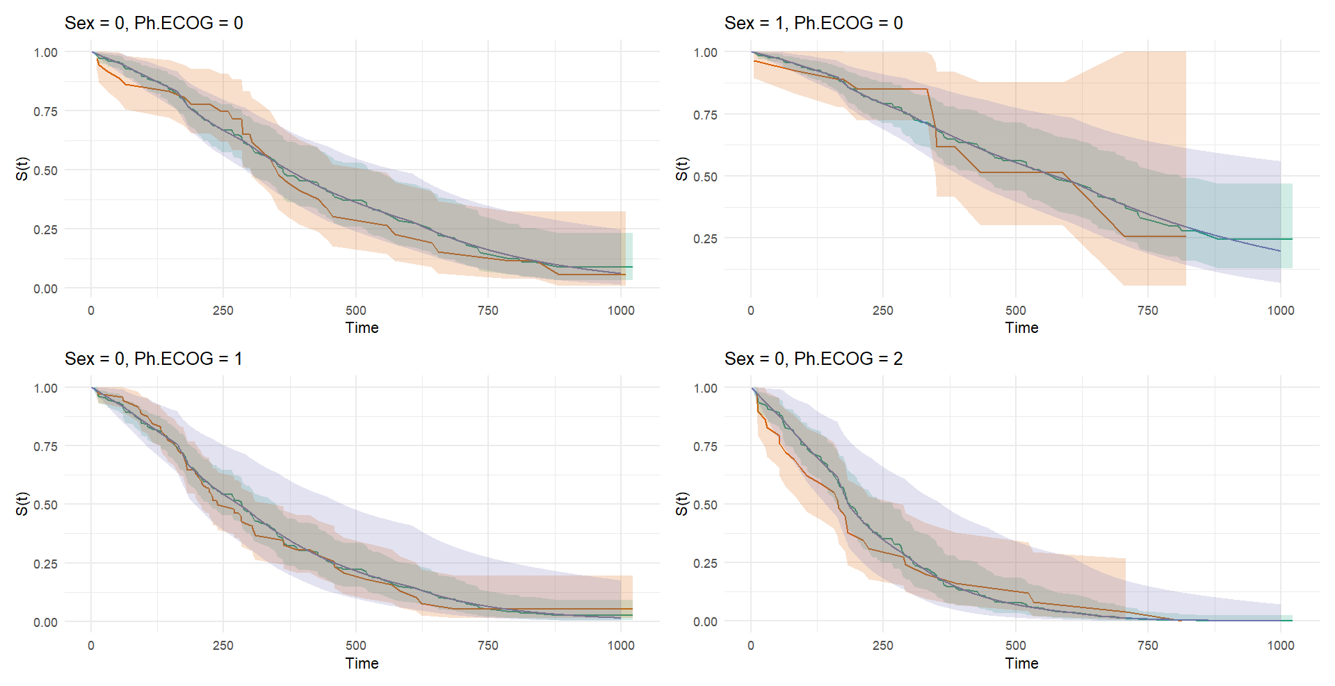
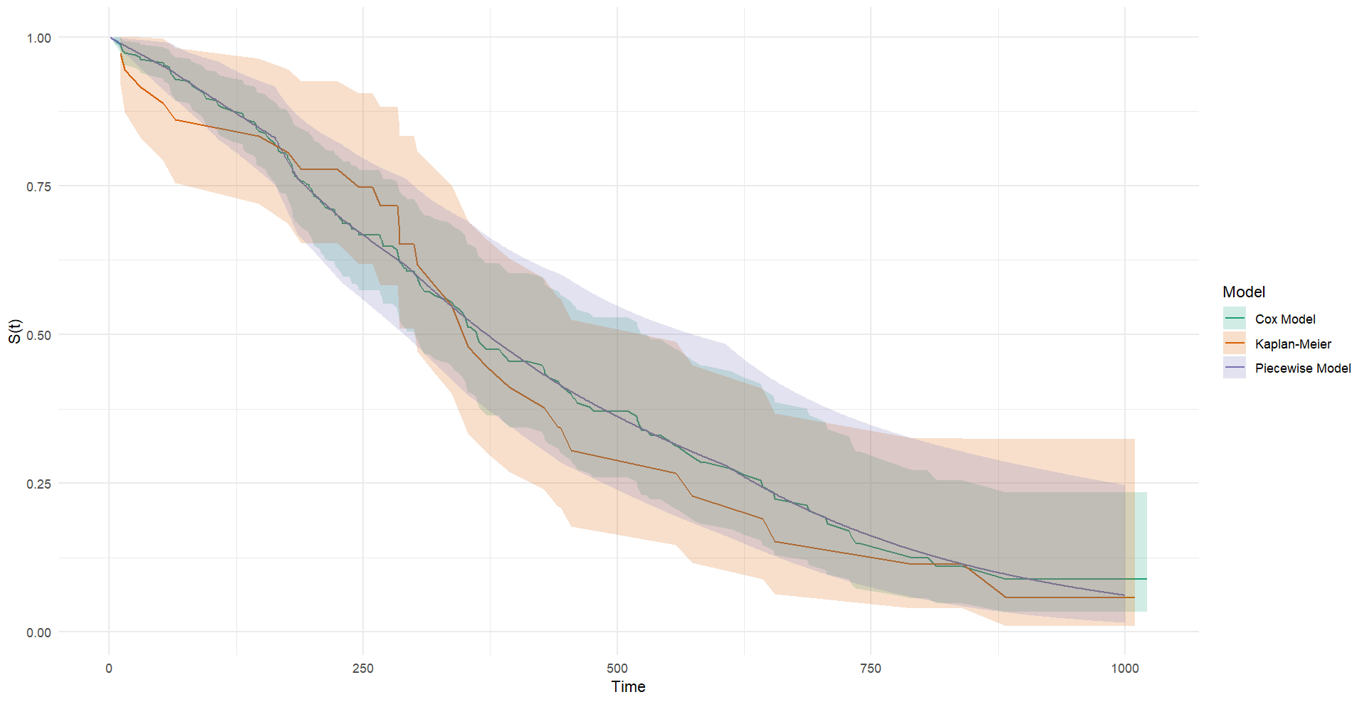
Cancer Data

Slide 13
Comparison Conclusions
Cox PH and PH PEM were comparable across all metrics
PH PEM can provide a parametric hazard
Both Cox and PH PEM were limited by the PH assumption

Slide 14
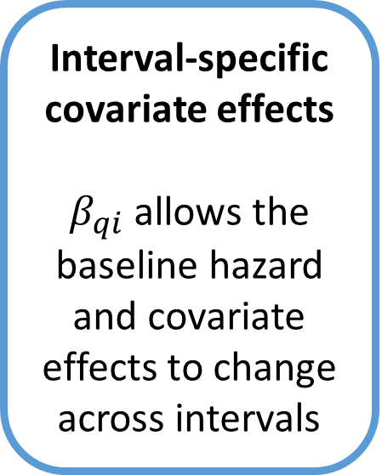
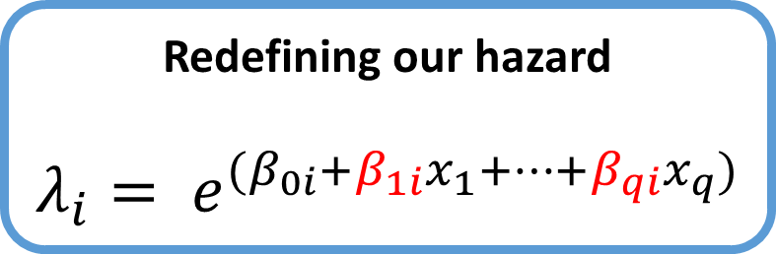
Distributional PEM
Interval-specific covariate effects
$β_{qi}$allows the baseline hazard and covariate effects to change across intervals
No Proportional Hazard Assumption
This model no longer requires covariate effects to remain constant.
Redefining our hazard
$$λ_{i}= e^{(β_{0i}+β_{1i}x_{1}+…+β_{qi}x_{q})}$$

Slide 15
Future Work
Interval Selection
Penalisation of Interval Choice
Applications

Slide 16
References
Ramjith, J., Bender, A., Roes, K.C. and Jonker, M.A., (2024). Recurrent events analysis with piece-wise exponential additive mixed models. Statistical Modelling, 24(3), pp.266-287.
Bender, Andreas & Scheipl, Fabian. (2018). pammtools: Piece-wise exponential Additive Mixed Modeling tools.
Kleinbaum, David G. & Klein, Mitchel. (2012). Survival Analysis: A Self-Learning Text. Third edition.
Email: moore.jack@ul.ie

