Slide 1
Term project Presentation

Slide 2
Overview
Goals of the project
Where we got our data from – data source
The reason we chose Mongodb
Other technologies that we used
Briefly discuss MongoDB aggregation framework
How we used MongoDB aggregation framework to do our analysis.
Closing comments – how we generalized this job search to take any type of job and do similar analysis.
Reproducible research.

Slide 3
Goals of the project
Understand the demand for data scientists in US
Breakdown of the number of jobs in US per state
What are the top 20 companies hiring data scientist in the US
Who is hiring more data scientists within a state
What is the total number of unique employers in US hiring a data scientist
Total number of jobs which require SAS, R, Python, Javascript, Mongodb

Slide 4
Data source
Initially we looked into API’s like
LinkedIn API – needs API key – but limited in scope
CareerBuilder API – needs to be partner
Glassdoor API – needs API key – limited in scope
Indeed API – needs to be partner
Settled on Dice API
Simple, Elegant and decent in scope.
Notes:
Show the github table with a list of available Job website API’s.
We wanted to find API’s that return a JSON response.

Slide 5
Dice API
service.dice.com
http://service.dice.com/api/rest/jobsearch/v1/simple.json?text=mongodb
parameters
direct - (optional) if the value of this parameter is "1" then jobs returned will be direct hire
areacode - (optional) specify the jobs area code
country - (optional) specify the jobs ISO 3166 country code
state - (optional) specify the jobs United States Post Office state code
skill - (optional) specify search text for the jobs skill property
city - (optional) specify the jobs United States Post Office ZipCode as the center of 40 mile radius
text - (optional) specify search text for the jobs entire body
age - (optional) specify a posting age (a.k.a. days back)
page - (optional) specify a page number of the results to be displayed (1 based)
pgcnt - (optional) specify the number of results per page

Slide 6
Sample response
{"count":354,"firstDocument":1,"lastDocument":50,"nextUrl":"/api/rest/jobsearch/v1/simple.json?areacode\u003d\u0026country\u003d\u0026state\u003d\u0026skill\u003d\u0026city\u003d07059\u0026text\u003dR\u0026ip\u003d\u0026diceid\u003d\u0026page\u003d2","resultItemList":[{"detailUrl":"http://www.dice.com/job/result/10378739/050424?src\u003d19","jobTitle":"R Programmer","company":"Atyeti","location":"New York, NY","date":"2017-08-14"},{"detailUrl":"http://www.dice.com/job/result/cybercod/CS9-13868335?src\u003d19","jobTitle":"Data Scientist - Python, R","company":"CyberCoders","location":"New York, NY","date":"2017-08-14"},{"detailUrl":"http://www.dice.com/job/result/cybercod/LF2-137252113?src\u003d19","jobTitle":"Senior Data Scientist - R, Python, Hadoop","company":"CyberCoders","location":"New York, NY","date":"2017-08-14"},{"detailUrl":"http://www.dice.com/job/result/10364413/114295?src\u003d19","jobTitle":"Data Scientist - SQL/R/Python - Capital Markets - up to $300k","company":"Botsford Associates LLC","location":"New York, NY","date":"2017-08-14"},{"detailUrl":"http://www.dice.com/job/result/primusga/datascientistnj?src\u003d19","jobTitle":"Data Scientist, Machine Learning, R, Python, Sparks, Predictive Model","company":"Primus Software Corp","location":"warren, NJ","date":"2017-08-14"},{"detailUrl":"http://www.dice.com/job/result/primusga/deeplearningnj?src\u003d19","jobTitle":"Deep Learning, Python, R, Machine Languague, Scientist, Tensor, Thean","company":"Primus Software Corp","location":"warren, NJ","date":"2017-08-14"}

Slide 7
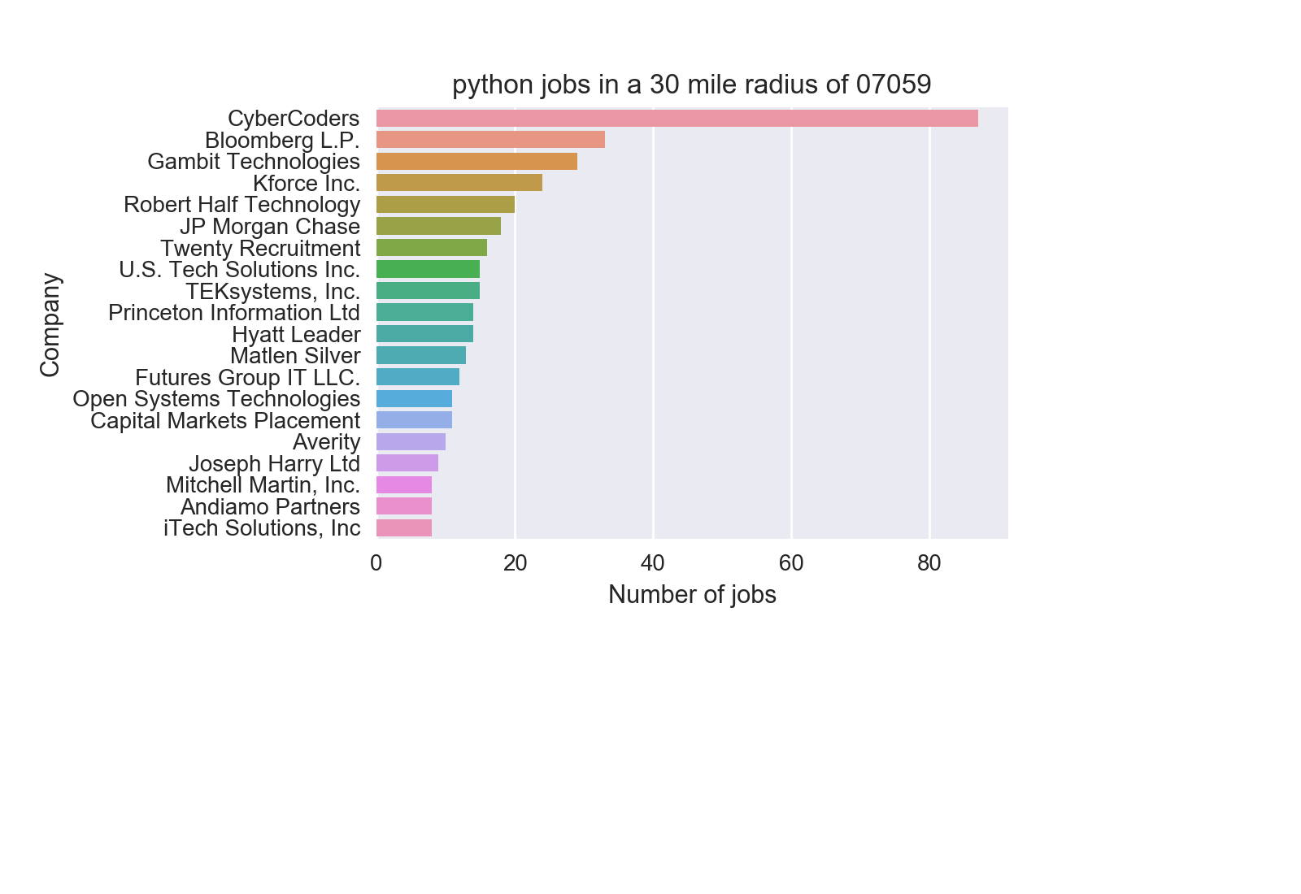
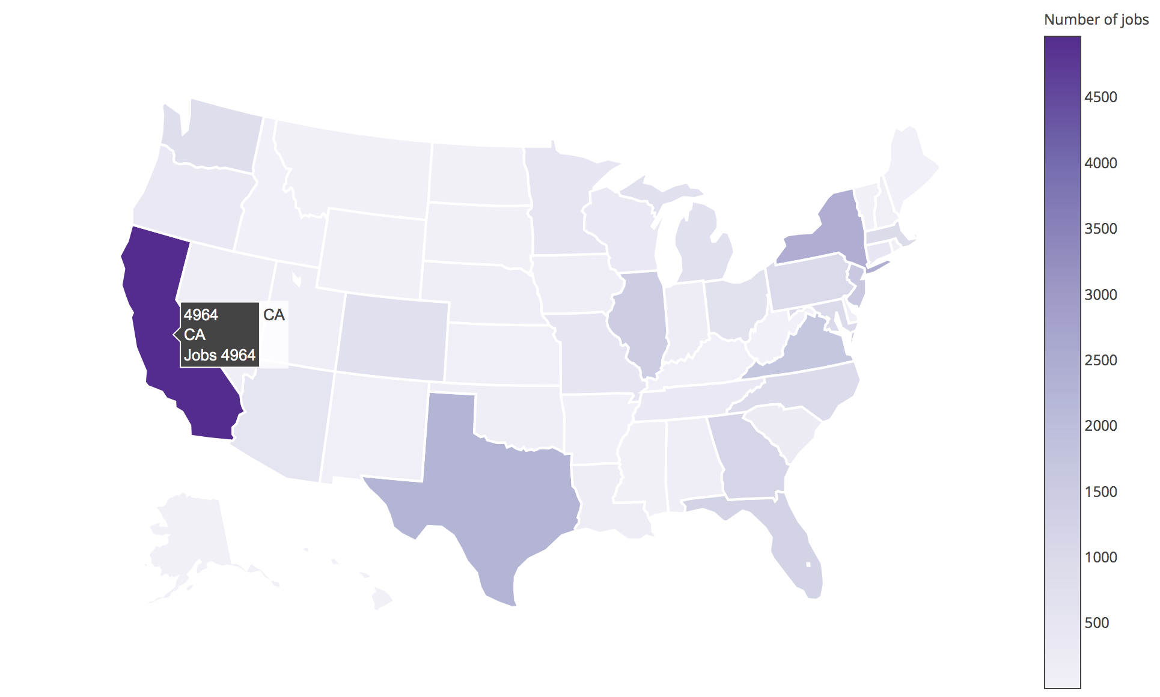
End Result

Slide 8
Technologies Used
MongoDB
Python
Pymongo
Pandas
Matplotlib
Seaborn
Plotly
Notes:
MongoDB is central to make all of this possible.

Slide 9
Visualize the architecture
Dice API
Using Python
Python
request package
Pymongo
retrieve the data
request package
MongDB
Notes:
work in progress

Slide 10
MongoDB aggregation framework
Central to our analysis is MongoDB aggregation framework

Slide 11
Structure of the inserted document

Slide 12
Question 1:
Show Mongodb query used and explain
Show the output

Slide 13
Question 2:
Show the mongodb query used
Show the output

Slide 14
Question 3:
Show the mongodb query
Show the output

Slide 15
Question 4:
Query
Output

Slide 16
Question 5:
Query
Output

Slide 17
Additional Points
Interesting insights
What other API’s offer
Is there anything similar to this already done
Where does Dice get its information
Closing remarks
Q & A

