Slide 1

Introduction to JavaScript-based Simulation
Luis Gustavo Nardin
Summer Simulation Conference 2019
Berlin, 22 July 2019

Slide 2
Outline
Web-Based Simulation (WBS)
Architectures
Enabling Technologies
General-Purpose Platforms
Performance
Advantages and Disadvantages
JavaScript-Based Simulation with OESjs
Introduction to JavaScript
Purchasing Model Description
Purchasing Model Implementations

Slide 3
Web-based Simulation
Broadly defined as the integration of web technologies with the field of simulation
Web resources and technologies are used to implement the interaction between
simulation engines and visualization components
simulation tools and users
The web browser, in particular, plays a central role in
the interaction with users
performing other simulation tasks depending on the architecture adopted
Notes:
The downloading of a simulation package from a server to the client’s computer and its execution as an application wholly independent of the browser and the Web is not included in the Web-based simulation category:

Slide 4
Architectures
There are three main web-based simulation architectures depending where the simulation engine and visualization components are executed:
Local: both components are downloaded to and executed locally in the client computer’s web browser
Remote: both components are executed in the server, while the web browser in the client computer works as an interface for submitting simulation jobs and displaying their results
Hybrid: the simulation engine is executed in the server, while the visualization components are executed in the client computer's web browser

Slide 5
Local Architecture
Client
Visualization Engine
Simulation Engine
Require no communication between the client and server after the initial loading phase
The simulation execution relies entirely on the client computer's processing power and there is no dependency on the communication infrastructure
Simulation server is a central distribution point to the simulation, but it does not perform any real simulation task
Advantage: Network latency between the user and the simulator is non-existent
Disadvantage: Simulation execution depends completely on the power of the client machine
Internet
Server
(Byrne et al. 2010)

Slide 6
Remote Architecture
Client
Require no communication between the client and server after the initial simulation request phase
The simulation execution relies entirely on the server computer's processing power and there is no dependency on the communication infrastructure
Client is used to access the visual interface with the server, but it does not perform any real simulation task
Advantage: Support to run larger simulations and easier maintenance
Disadvantage: Users cannot observe dynamic processes at work or interrupt a running simulation in real-time
Internet
Visualization Engine
Simulation Engine
Server
(Byrne et al. 2010)

Slide 7
Hybrid Architecture
Client
Visualization Engine
Combination of Local and Remote architectures best features
The server executes the simulation, while the client receives and displays the simulation results
Client is able to observe and interact with the simulation in real-time
Advantage: Support to run larger simulations and easier maintenance
Disadvantage: High volume of data exchange between the client and server during the simulation run
Internet
Simulation Engine
Server
(Byrne et al. 2010)

Slide 8
Enabling Technologies
Adobe Flash (deprecated) is a multimedia software platform used for production of rich Internet applications and embedded web browser video players
Java Applet (deprecated) is a small application compiled to Java bytecode that is executed within a Java Virtual Machine in a process separate from the web browser
Web Services is a web technology used for machine-to-machine communication, more specifically for transferring machine-readable file formats such as XML and JSON
JavaScript is an interpreted programming language, one of the core technologies of the World Wide Web, that is executed by a dedicated JavaScript engine in the web browser
WebAssembly is an open standard that defines a portable binary code format for executable programs and interfaces to facilitating interactions between such programs and their host environment

Slide 9
General-Purpose Platforms
Despite the promising of the web-based simulation, there are few active general-purpose platforms available
Anylogic Cloud
NetLogo Web
Insight Maker
OESjs

Slide 10
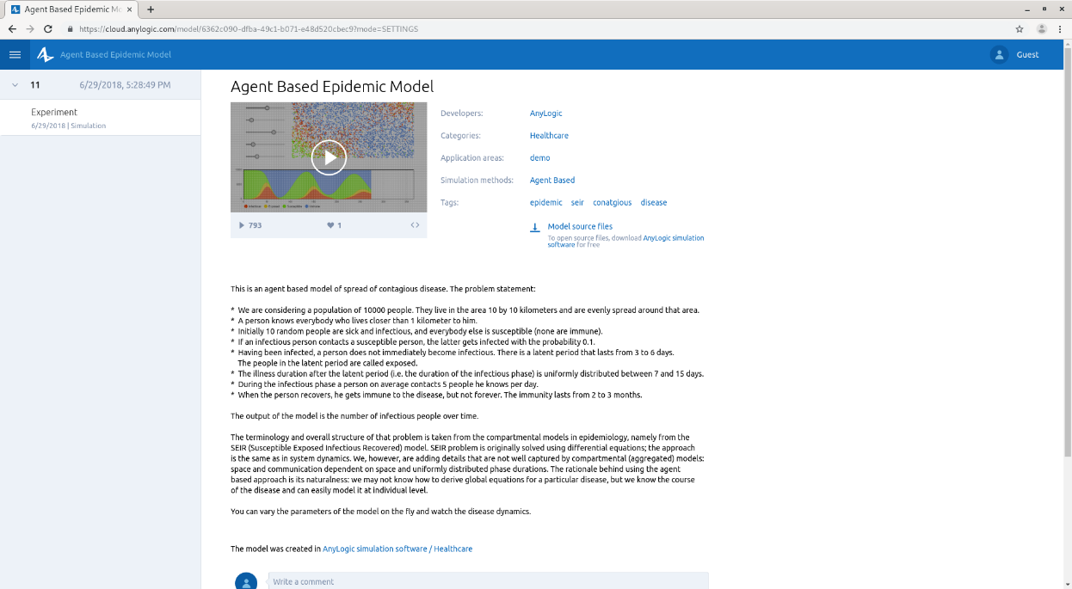
AnyLogic Cloud
http://cloud.anylogic.com
AnyLogic Cloud is a web service for simulation analytics
Allow users to store, access, run, and share simulation models online as well as analyze experiment results
Enable to embed 2D and 3D AnyLogic model animation in HTML5 web pages
The web interface retains allow users to change the speed of the model, watch 2D animation and navigate through 3D scenes
Support System Dynamics, Agent Based and Discrete Event simulation and a combination of them

Slide 11
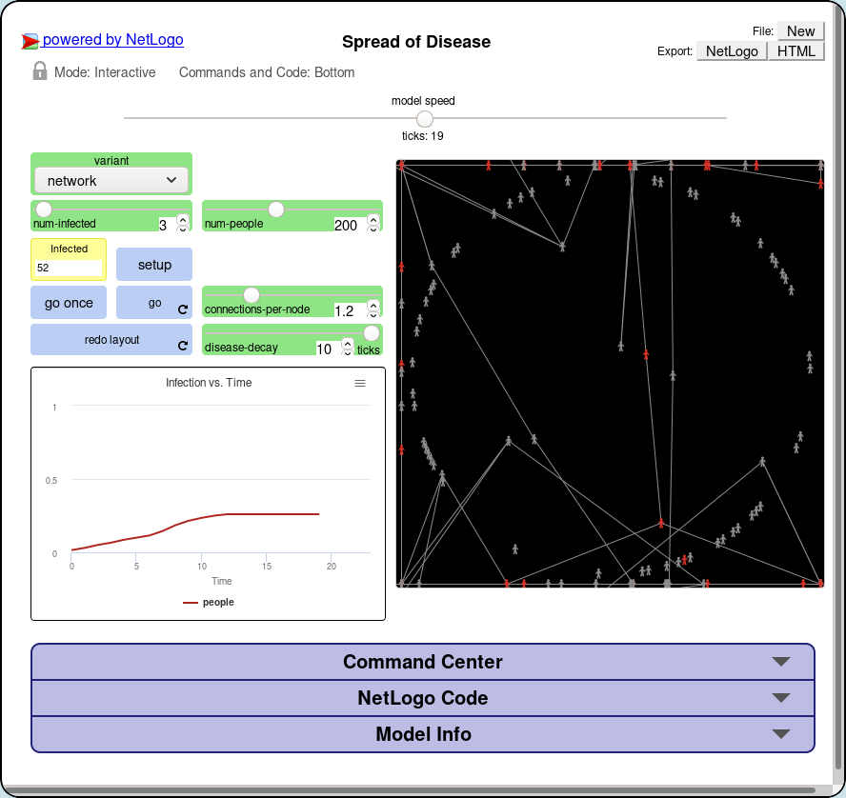
NetLogo Web
https://netlogoweb.org
A version of the NetLogo that runs entirely in the web browser
NetLogo is a open source, free multi-agent programmable modeling environment fully programmable using a Logo dialect
NetLogo Web does not support all features of the NetLogo yet
Large library of built-in functions
Allow to import and use models developed in NetLogo
Support Agent Based simulation

Slide 12
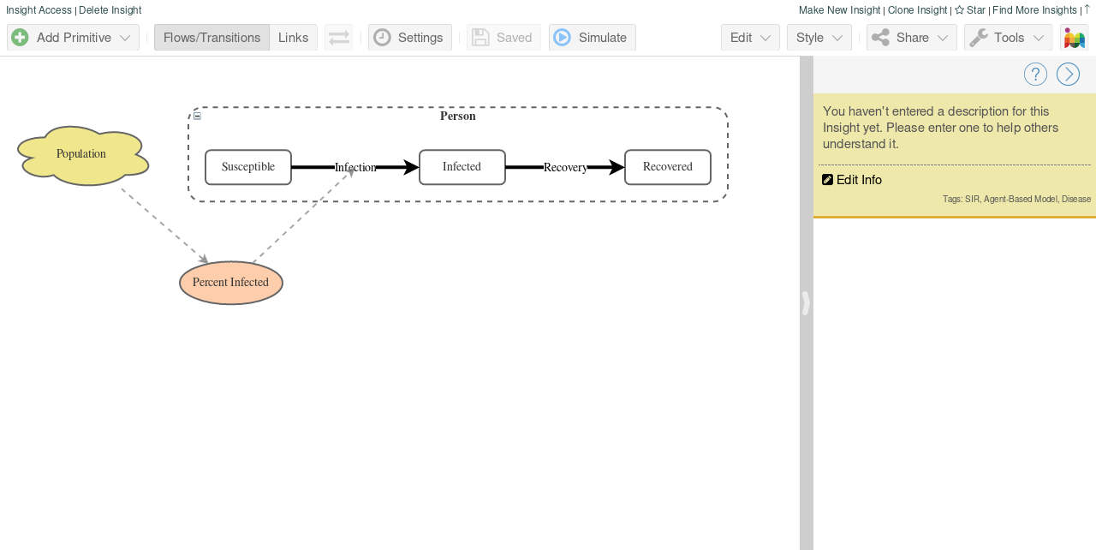
Insight Maker
https://insightmaker.com
Powerful open source, free simulation tool that runs in the web browser
Provide a set of features for building, running and sharing simulation models
Support extensive diagramming and modeling features that make easy the representation of a system
Large library of built-in functions
Support System Dynamics and Agent Based simulation

Slide 13
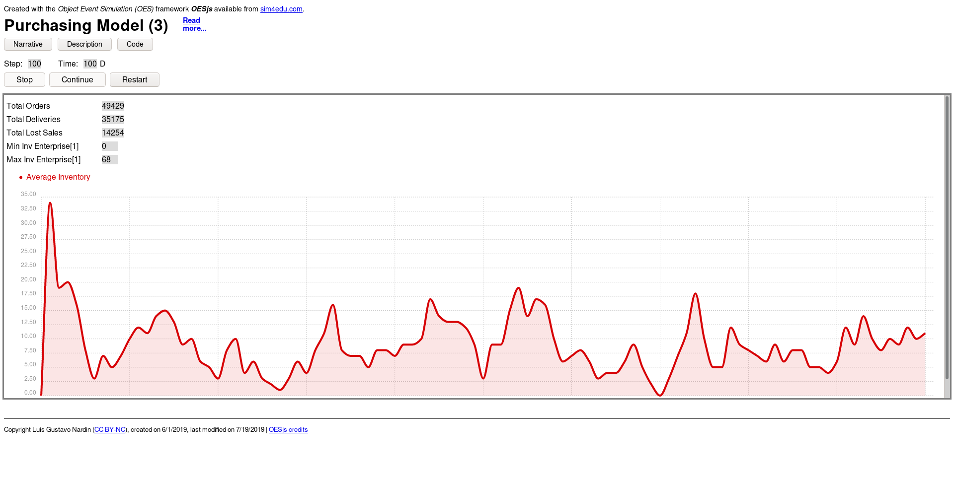
Object-Event Simulator JavaScript (OESjs)
https://sim4edu.com
Open source and free web-based simulator developed using open source technologies (HTML, CSS, and JavaScript)
JavaScript-based simulation framework implements the Object-Event Simulation paradigm, representing a general Discrete Event Simulation approach based on object-oriented modeling and event scheduling
Supports two forms of simulations
Standalone simulation scenario
Experiments
Support Discrete Event simulation

Slide 14

The Simulation for Education (Sim4edu) project supports web-based simulation with open source technologies for science and education
Purposes
provide technologies, such as simulation libraries, frameworks, and simulators, as well as a collection of simulation model examples
facilitate building state-of-the-art user interfaces without requiring simulation developers to learn all the recent web technologies involved (e.g., HTML5, CSS3, SVG and WebGL)
http://www.sim4edu.com

Slide 15
Performance
Tool | Licensing | Modeling | Architecture | Download (MB) | Memory (MB) | Execution (MB)
AnyLogic Cloud | Commercial | Offline | Hybrid | 0.68 | 2.80 | 22.00+
Insight Maker | Free | Online | Local | 1.50 | 22.50 | ~0.00
NetLogo Web | Free | Online, Offline | Local | 1.20 | 34.10 | ~0.00
OESjs | Free | Offline | Local | 0.16 | 2.90 | ~0.00
Results generated using the same underlying epidemiology SIR (Susceptible-Infected-Recovered) model
AnyLogic Cloud – Agent Based Epidemic Model
https://cloud.anylogic.com/model/6362c090-dfba-49c1-b071-e48d520cbec9?mode=SETTINGS
Inishight Maker – SIR Model
https://insightmaker.com/insight/156381/SIR-Model
NetLogo Web – Spread of Disease
https://netlogoweb.org/launch#https://netlogoweb.org/assets/modelslib/IABM%20Textbook/chapter%206/Spread%20of%20Disease.nlogo
OESjs – Susceptible-Infectious-Recovered (SIR) Model
https://sim4edu.com/sims/25/index.html

Slide 16
Advantages
Easy of use
Collaboration
License and deployment model
Model reuse
Cross-platform capability
Controlled access
Wide availability
Versioning, customization and maintenance
Integration and interoperability
(Byrne et al. 2010)

Slide 17
Disadvantages
Loss of speed
Graphical user interface limitations
Security vulnerability
Web-based simulation application stability
Licensing restriction
Difficulty in simplifying simulation
(Byrne et al. 2010)

Slide 18
JavaScript-Based Simulation with OESjs

Slide 19
Introduction to JavaScript
JavaScript was developed in May 1995 by Brendan Eich
JavaScript is a scripting language
Lightweight programming language
Programming code is embedded in HTML
Can be executed by all modern web browsers
JavaScript is weakly typed and dynamic
JavaScript is object-oriented, but in a different way than classical OO languages, e.g.,
objects can be created directly without instantiating any class
properties can be added to an object or class definition at run-time

Slide 20
Object-Event Simulator JavaScript (OESjs)
JavaScript-based simulation framework that implements the Object-Event Simulation (OES) paradigm
The models is composed of two basic types of entities
Object Types
Event Types
OESjs supports two forms of simulations
Standalone simulation scenario
Simulation experiments, which define a set of simulation scenarios by defining value sets for certain model variables, such that an experiment run consists of a set of scenario runs

Slide 21
Purchasing Model Description
The model represents a simple purchase order transaction of a single type of item between Enterprises and Consumers
On each day, Enterprises produce a quantity of a single type of item and update the unit item price
On each day, Consumers decide whether to order new items. If so, they decide which Enterprise to purchase from the Enterprise with the lowest item price in its list of preferred Enterprises and the quantity of items to purchase
If the ordered quantity of items is in stock, the Enterprise delivers the items to the Consumer
Otherwise, the Enterprise delivers the quantity of products it has in stock and registers the remaining quantity as lost sales

Slide 22
Purchasing Model
Available at https://github.com/gnardin/PurchasingModel/
Download
Release https://github.com/gnardin/PurchasingModel/releases/tag/SSC19
or
Clone git clone https://github.com/gnardin/PurchasingModel.git
Navigate to the PurchasingModel/OESjs/01 folder
Open the simulation.html using Firefox
Click on Run Scenario to execute the simulation

Slide 23
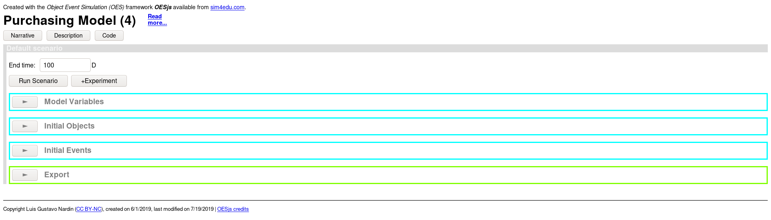
Web Interface

Slide 24
Web Interface
Narrative description
Code visualization and download
Conceptual description

Slide 25
Web Interface
Length of the simulation

Slide 26
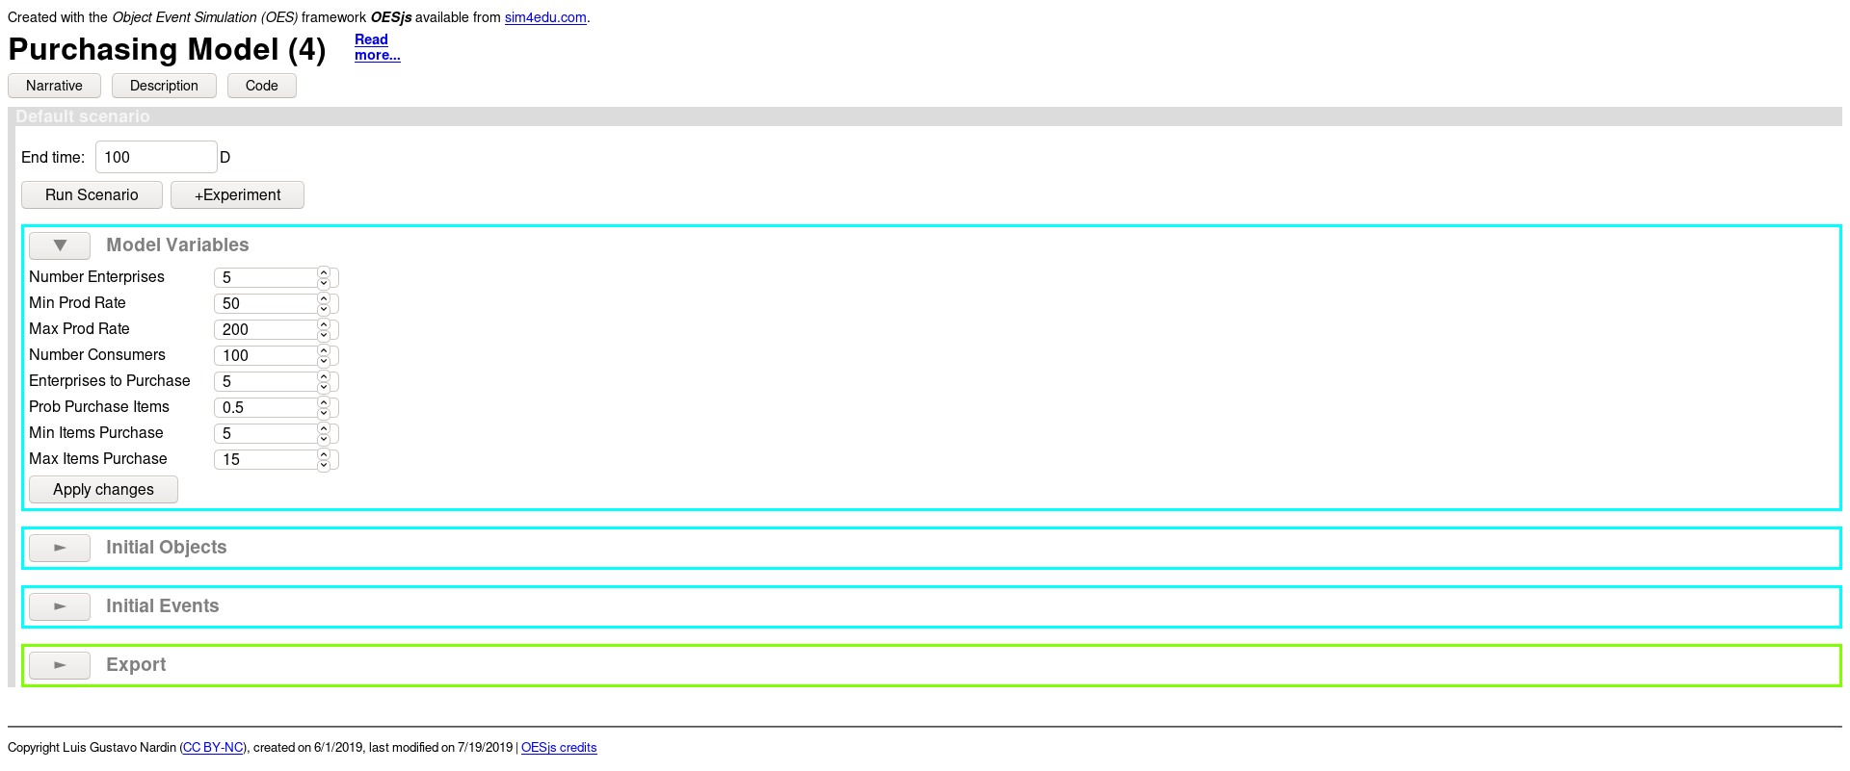
Web interface
Configuration model parameters

Slide 27
Web Interface
Execute the simulation

Slide 28
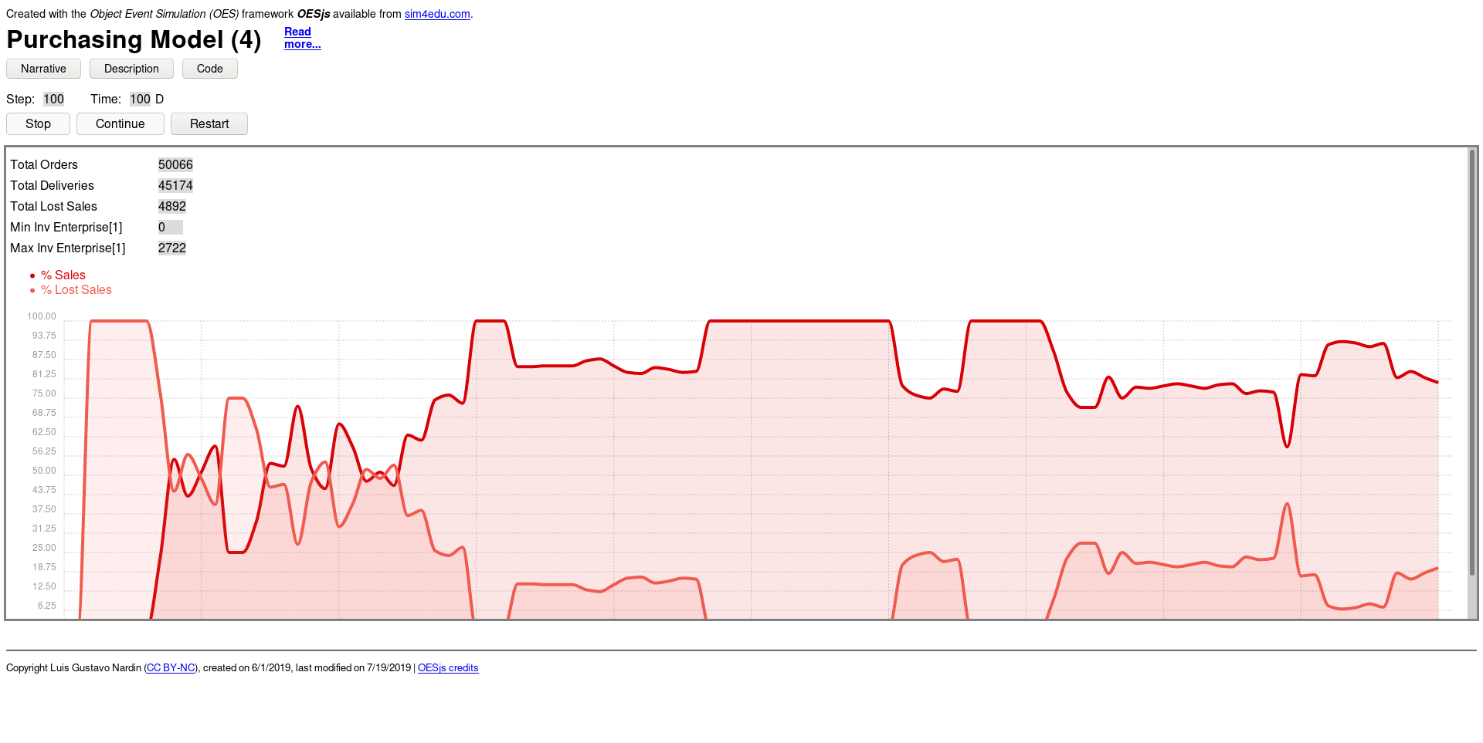
Web Interface

Slide 29
Files and Folder Structure
Framework Folder/File | Description
loadManager.js | Load the simulator and the necessary simulation model files
loadManagerConfig.js | Configuration file for the Load manager
framework/ | Contain the OESjs framework source-code
Simulation Model Folders | Description
01 | Basic purchasing simulation model containing only object types
02 | Purchasing simulation model containing object and event types
03 | Purchasing simulation model composed of multiple instances of Enterprise and Consumer
04 | Purchasing simulation model in which the Consumer makes a more elaborate decision from whom to purchase products

Slide 30
Simulation Model Files
File | Description
simulation.html | Launch the simulation model
description.html | Contain the description of the simulation model
metadata.js | Contain the meta-data information about the simulation model
simulation-worker.js | Responsible for loading the simulation model in the Web worker
simulation.js | Define the simulation model
… | Dependent on the model implemented, usually they are Object and Event Type class definitions

Slide 31
Meta-data Information (metadata.js)
Contains the meta-data information about the Simulation model
Property | Description
sim.model.name | Name of the simulation model
sim.model.title | Title of the simulation model
sim.model.systemNarrative | Description of the system modeled
sim.model.shortDescription | Short description of the simulation model
sim.model.source | Citation of the document where the model is officially defined
sim.model.license | License associated to the simulation model
sim.model.creator | Name of the creator(s) of the simulation model
sim.model.created | Date of creation
sim.model.modified | Date of last modification

Slide 32
Simulation Time Progression (simulation.js)
Time progression supported
Discrete
Continuous
Discrete time progression
fixed-increment time progression
next-event time progression
A model with pure fixed-increment time progression defines an OnEachTimeStep procedure and a timeIncrement parameter
Property | Description
sim.model.time | Define the time model (i.e., “discrete” or “continuous”)
sim.model.timeUnit | Define the model’s time unit (i.e., “ms”, “s”, “m”, “h”, “D”, “W”, “M” or “Y”)
sim.model.timeIncrement | Support the fixed-time increment time progression used to trigger the onEventTimeStep function

Slide 33
Scenario Parameters (simulation.js)
Define the default simulation parameters
Property | Description
sim.scenario.simulationEndTime | Length of the simulation
sim.scenario.randomSeed | Seed of the random generator

Slide 34
Purchasing Model – Version 1
https://gnardin.github.io/PurchasingModel/01.html
Single Enterprise produces and sells one single type of item
Single Consumer purchases items from the Enterprise
On each day
the Enterprise produces a finite quantity of items
the Consumer orders a specific quantity of items from the Enterprise
If the ordered quantity is in stock, the Enterprise delivers the quantity items to the Consumer and the order is fulfilled
Otherwise, the Enterprise delivers the quantity of items in stock to the Consumer (i.e., order is partially fulfilled) and registers the non-fulfilled quantity as lost sales

Slide 35
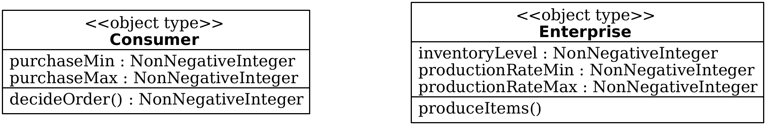
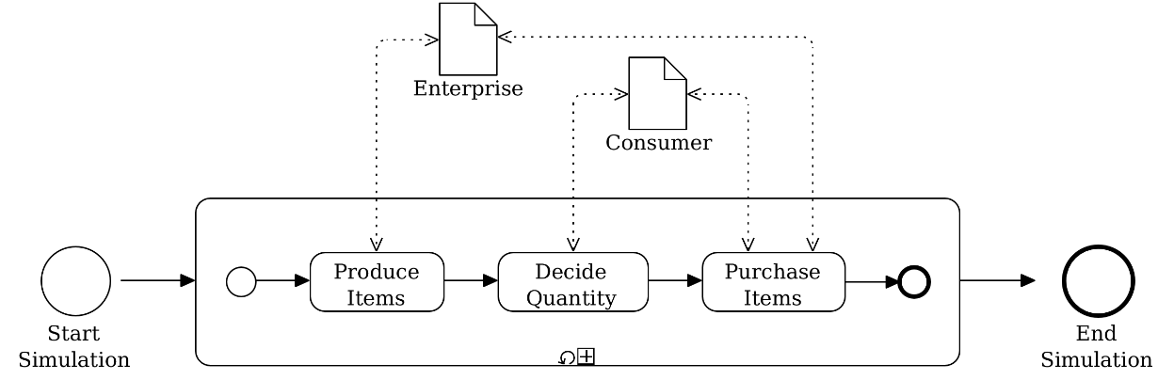
Purchasing Model – Version 1
https://gnardin.github.io/PurchasingModel/01.html
Class diagram
BPMN diagram

Slide 36
Object Types
Object types are defined in the form of classes
Each object type should reside in a file with the same name
Consumer Object Type class
var Consumer = new cLASS( {
Name: “Consumer",
shortLabel: “Consumer",
supertypeName: "oBJECT",
properties: {
“purchaseMin": { range: "NonNegativeInteger", label: "Min Items Purchase" },
“purchaseMax": { range: "NonNegativeInteger", label: "Max Items Purchase" }
},
methods: {
“decideOrder": function () {
return rand.uniformInt( this.purchaseMin, this.purchaseMax );
}
}
} );

Slide 37
Data Types
Data Type | Description
String | String
NonEmptyString | Non-empty string
Integer | Integer
NonNegativeInteger | Positive Integer including 0
PositiveInteger | Positive Integer excluding 0
Decimal | Decimal
Boolean | Boolean
Object Type class | Any object type class defined in the simulation model

Slide 38
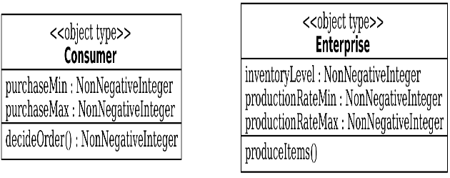
Object Types
Object types are defined in the form of classes
Each object type should reside in a file with the same name
Enterprise Object Type class
var Enterprise = new cLASS( {
Name: “Enterprise",
shortLabel: “Enterprise",
supertypeName: "oBJECT",
properties: {
“inventoryLevel": { range: "NonNegativeInteger", label: “Inventory Level" },
“productionRateMin": { range: "NonNegativeInteger", label: “Min Prod Rate" }
“productionRateMax": { range: "NonNegativeInteger", label: “Max Prod Rate" }
},
methods: {
"produceItems": function () {
this.inventoryLevel += rand.uniformInt( this.productionRateMin,
this.productionRateMax );
}
}
} );

Slide 39
Probability Distribution Functions
Probability Distribution Function | OESjs Library Method | Example
Uniform | uniform(lower, upper) uniform() | rand.uniform( 0.5, 1.5 ) rand.uniform()
Discrete Uniform | uniformInt(lower, upper) | rand.uniformInt( 1, 6 )
Triangular | triangular(lower, upper, mode) | rand.triangular( 0.5, 1.5, 1.0 )
Exponential | exponential(rate) | rand.exponential( 0.5 )
Gamma | gamma(shape, scale) | rand.gamma( 1.0, 2.0 )
Normal | normal(mean, stdDev) | rand.normal( 1.5, 0.5 )
Paretto | paretto(shape) | rand.paretto( 2.0 )
Weibull | weibull(scale, shape) | rand.weibull( 1, 0.5 )

Slide 40
Simulation Model (simulation.js)
Property | Description
sim.model.objectTypes | Define the list of object types
sim.model.eventTypes | Define the list of event types
/* Object and Event types */
sim.model.objectTypes = [ “Enterprise", “Consumer" ];
sim.model.eventTypes = [];

Slide 41
Simulation Initial State (simulation.js)
Define the objects created
Define the events scheduled
// Initial Objects
sim.scenario.initialState.objects = {
"1": { typeName: “Enterprise", name: “enterprise", inventoryLevel: 0, productionRateMin: 5, productionRateMax: 15 },
"2": { typeName: “Consumer", name: “consumer", purchaseMin: 5, purchaseMax: 15 }
};
//Initial Events
sim.scenario.initialState.events = [];
//Initial Functions
sim.scenario.setupInitialState = function () {}

Slide 42
Simulation Process (simulation.js)
sim.model.OnEachTimeStep = function () {
var quantity;
var enterprise = cLASS[ "Enterprise" ].instances[ "1" ];
var consumer = cLASS[ "Consumer" ].instances[ "2" ];
// Enterprise produces items
enterprise.produceItems();
// Consumer defines the quantity of items to order
quantity = consumer.decideOrder();
sim.stat.itemsOrdered += quantity;
if ( enterprise.inventoryLevel >= quantity ) {
enterprise.inventoryLevel -= quantity;
sim.stat.itemsDelivered += quantity;
} else {
sim.stat.lostSales += quantity - enterprise.inventoryLevel;
sim.stat.itemsDelivered += enterprise.inventoryLevel;
enterprise.inventoryLevel = 0;
}
}
BPMN diagram

Slide 43
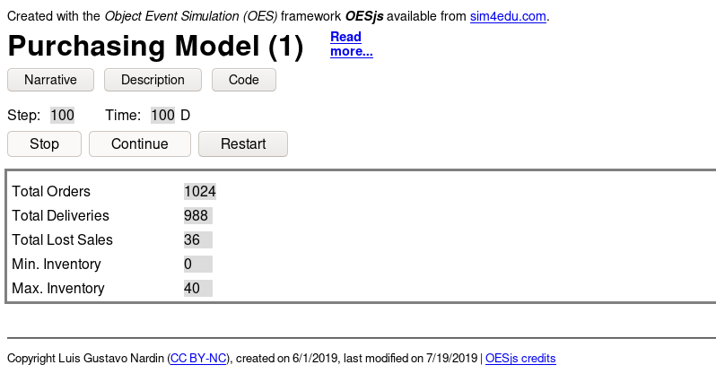
Output Statistics (simulation.js)
sim.model.statistics = {
...
"lostSales": {
range: "NonNegativeInteger",
label: "Total Lost Sales",
initialValue: 0
},
"minInventory": {
objectType: "Enterprise",
objectIdRef: 1,
property: "inventoryLevel",
aggregationFunction: "min",
label: "Min. Inventory"
},
"maxInventory": {
objectType: "Enterprise",
objectIdRef: 1,
property: "inventoryLevel",
aggregationFunction: "max",
label: "Max. Inventory"
}
};

Slide 44
Purchasing Model – Version 2
https://gnardin.github.io/PurchasingModel/02.html
Single Enterprise produces and sells one single type of item
Single Consumer purchases items from the Enterprise
On each day
the Enterprise generates a Produce event to produce a finite quantity of items
the Consumer generates a DecidePurchase event that generate a Purchase event with 50% probability to order a specific quantity of items from the Enterprise
If the ordered quantity is in stock, the Enterprise delivers the quantity items to the Consumer and the order is fulfilled
Otherwise, the Enterprise delivers the quantity of items in stock to the Consumer (i.e., order is partially fulfilled) and registers the non-fulfilled quantity as lost sales

Slide 45
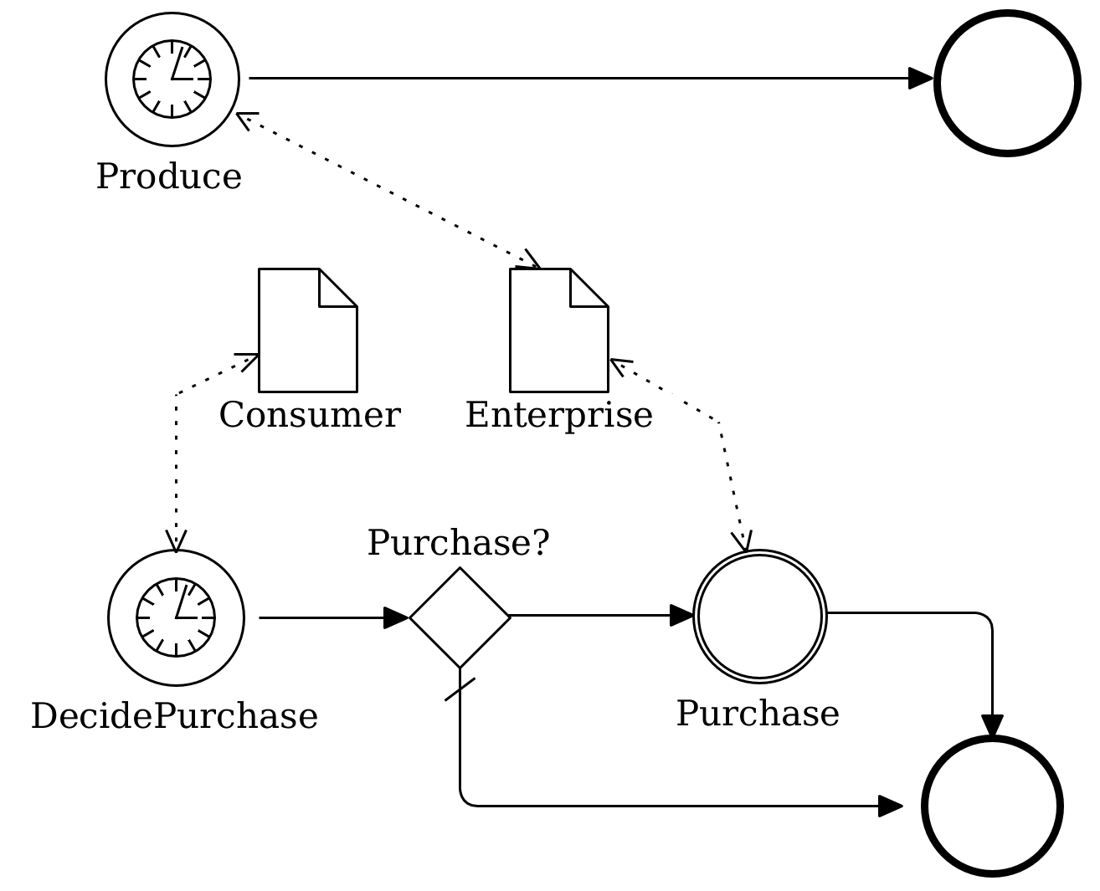
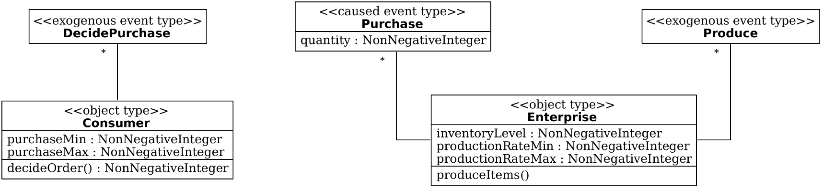
Purchasing Model – Version 2
https://gnardin.github.io/PurchasingModel/02.html
Class diagram
BPMN diagram

Slide 46
Event Types
Event types are defined in the form of classes
We distinguish between two kinds of events
caused events are caused by other events occurring during a simulation run
exogenous events are caused by factors external to the simulation model

Slide 47
Exogenous Event Type
var DecidePurchase = new cLASS({
Name: “DecidePurchase",
supertypeName: "eVENT",
properties: {
“consumer": { range: “Consumer“ }
},
methods: {
"onEvent": function () {
...
}
}
});
DecidePurchase.priority = 0;
DecidePurchase.recurrence = function () {
return 1;
};
"onEvent": function () {
var followupEvents = [];
// Quantity to purchase
var quantity = this.consumer.decideOrder();
// Whom to purchase from
var enterprise = cLASS[ "Enterprise" ].instances[ "1" ];
followupEvents.push( new Purchase( {
occTime: this.occTime + 1,
enterprise: enterprise,
quantity: quantity
} ) );
return followupEvents;
}
}
Event Rule

Slide 48
Caused Event Type
var Purchase = new cLASS({
Name: “Purchase",
supertypeName: "eVENT",
properties: {
“enterprise": { range: “Enterprise“ }
},
methods: {
"onEvent": function () {
...
}
}
});
Purchase.priority = 2;
"onEvent": function () {
var followupEvents = [];
sim.stat.itemsOrdered += this.quantity;
if ( this.enterprise.inventoryLevel >= this.quantity ) {
this.enterprise.inventoryLevel -= this.quantity;
sim.stat.itemsDelivered += this.quantity;
} else {
sim.stat.itemsDelivered += this.enterprise.inventoryLevel;
sim.stat.lostSales += this.quantity –
this.enterprise.inventoryLevel;
this.enterprise.inventoryLevel = 0;
}
return followupEvents;
}
}
Event Rule

Slide 49
Simulation Model (simulation.js)
Property | Description
sim.model.objectTypes | Define the list of object types
sim.model.eventTypes | Define the list of event types
/* Object and Event types */
sim.model.objectTypes = [ “Enterprise", “Consumer" ];
sim.model.eventTypes = [ “DecidePurchase”, “Purchase”, “Produce” ];

Slide 50
Simulation Initial State (simulation.js)
Define the objects created
Define the events scheduled
// Initial Objects
sim.scenario.initialState.objects = {
"1": { typeName: “Enterprise", name: “enterprise", inventoryLevel: 0, productionRateMin: 5, productionRateMax: 15 },
"2": { typeName: “Consumer", name: “consumer", purchaseMin: 5, purchaseMax: 15 }
};
//Initial Events
sim.scenario.initialState.events = [
{ typeName: "Produce", occTime: 1, enterprise: 1 },
{ typeName: “DecidePurchase", occTime: 1, consumer: 2 }
];
//Initial Functions
sim.scenario.setupInitialState = function () {}

Slide 51

Purchasing Model – Version 2
https://gnardin.github.io/PurchasingModel/02.html

Slide 52
Purchasing Model – Version 3
https://gnardin.github.io/PurchasingModel/03.html
Multiple Enterprises produce and sell one single type of item
Multiple Consumers purchase items from Enterprises
On each day
Enterprises generate a Produce event to produce a finite quantity of items
Consumers generates a DecidePurchase event that generates a Purchase event with a probability to order a specific quantity of items from one Enterprise
If the ordered quantity is in stock, the Enterprise delivers the quantity items to the Consumer and the order is fulfilled
Otherwise, the Enterprise delivers the quantity of items in stock to the Consumer (i.e., order is partially fulfilled) and registers the non-fulfilled quantity as lost sales

Slide 53
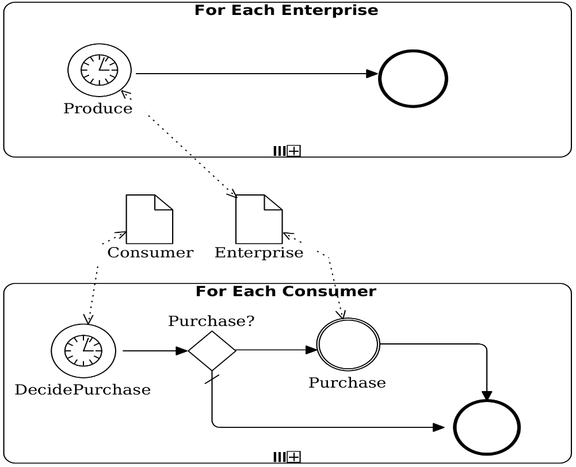
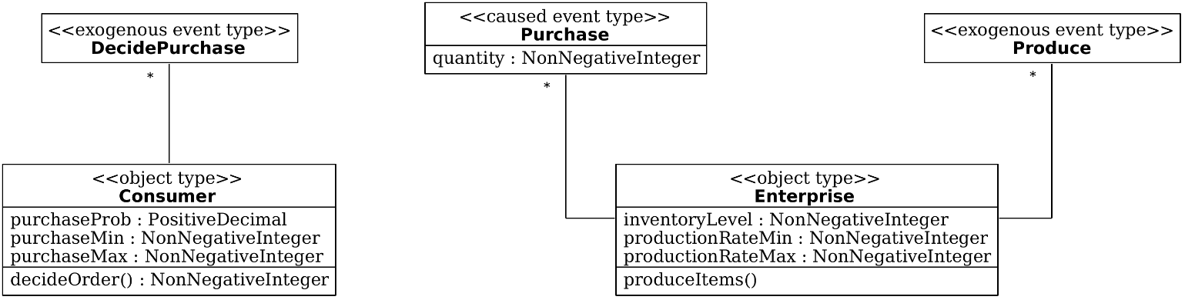
Purchasing Model – Version 3
https://gnardin.github.io/PurchasingModel/03.html
Class diagram
BPMN diagram

Slide 54
Global Variables (simulation.js)
To refer to these variables in the simulation code use sim.v.<name> instead of sim.model.v.<name>
/* Global Variables */
sim.model.v.nmrOfEnterprises = {
range: "NonNegativeInteger",
initialValue: 10,
label: "Number Enterprises",
hint: "The number of enterprises"
};
sim.model.v.purchaseProb = {
range: "Decimal",
initialValue: 0.5,
decimalPlaces: 2,
label: "Prob Purchase Items“,
hint: "Probability of consumer purchase items"
};

Slide 55
Simulation Initial State (simulation.js)
// Initial Objects
sim.scenario.initialState.objects = {};
//Initial Events
sim.scenario.initialState.events = [];
//Initial Functions
sim.scenario.setupInitialState = function () {
var i, objId;
for(i = 1; i <= sim.v.nmrOfEnterprises; i += 1) {
objId = i;
sim.addObject( new Enterprise( {
id: objId,
name: "enterprise" + i,
inventoryLevel: 0,
productionRateMin: sim.v.productionRateMin,
productionRateMax: sim.v.productionRateMax
} ) );
sim.scheduleEvent( new Produce( {
occTime: 1,
enterprise: objId
} ) );
}
for (; i <= sim.v.nmrOfEnterprises+sim.v.nmrOfConsumers; i+=1) {
objId = i;
sim.addObject( new Consumer( {
id: objId,
name: "consumer" + ( i - sim.v.nrmOfEnterprises + 1),
purchaseProb: sim.v.purchaseProb,
itemPurchaseMin: sim.v.purchaseMin,
itemPurchaseMax: sim.v.purchaseMax
} ) );
sim.scheduleEvent( new DecidePurchase( {
occTime: 1,
consumer: objId
} ) );
}
};

Slide 56
Output Statistics (simulation.js)
sim.model.statistics = {
...
"avgInventory": {
range: "PositiveInteger",
label: "Average Inventory",
initialValue: 0,
showTimeSeries: true,
computeOnlyAtEnd: false,
expression: function () {
var total = 0;
var enterprises = cLASS[ "Enterprise" ].instances;
Object.keys( enterprises ).forEach( function ( objId ) {
total += enterprises[ objId ].inventoryLevel;
} );
return total / Object.keys( enterprises ).length;
}
}
};

Slide 57
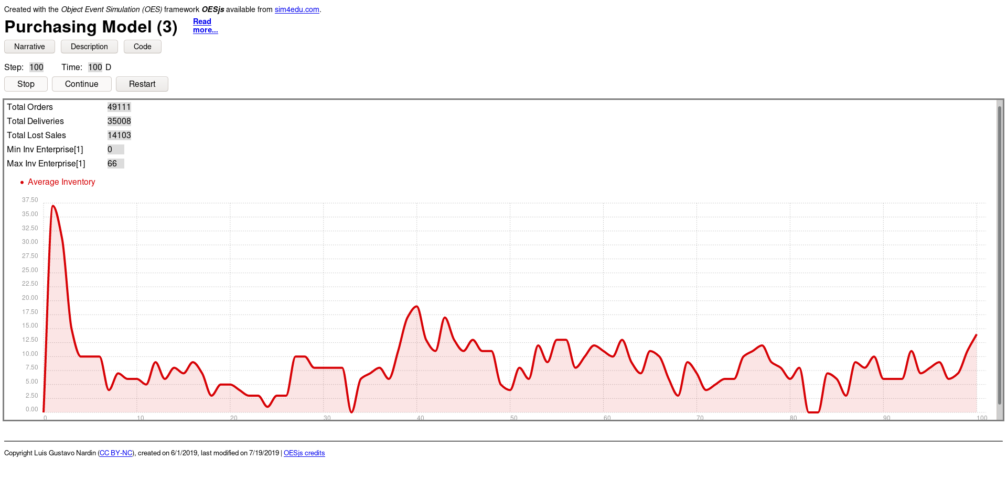
Purchasing Model – Version 3
https://gnardin.github.io/PurchasingModel/03.html

Slide 58
Purchasing Model – Version 4
https://gnardin.github.io/PurchasingModel/04.html
Multiple Enterprises produce and sell one single type of item
Multiple Consumers purchase items from a preferred set of Enterprises
On each day
Enterprises generate a Produce event to produce a finite quantity of items
Consumers generates a DecidePurchase event that generates a Purchase event with a probability to order a specific quantity of items from the Enterprise with lowest price in its preferred list
If the ordered quantity is in stock, the Enterprise delivers the quantity items to the Consumer and the order is fulfilled
Otherwise, the Enterprise delivers the quantity of items in stock to the Consumer (i.e., order is partially fulfilled), the Enterprise registers the non-fulfilled quantity as lost sales, and the Consumer replace the Enterprise from its preferred list by another Enterprise

Slide 59
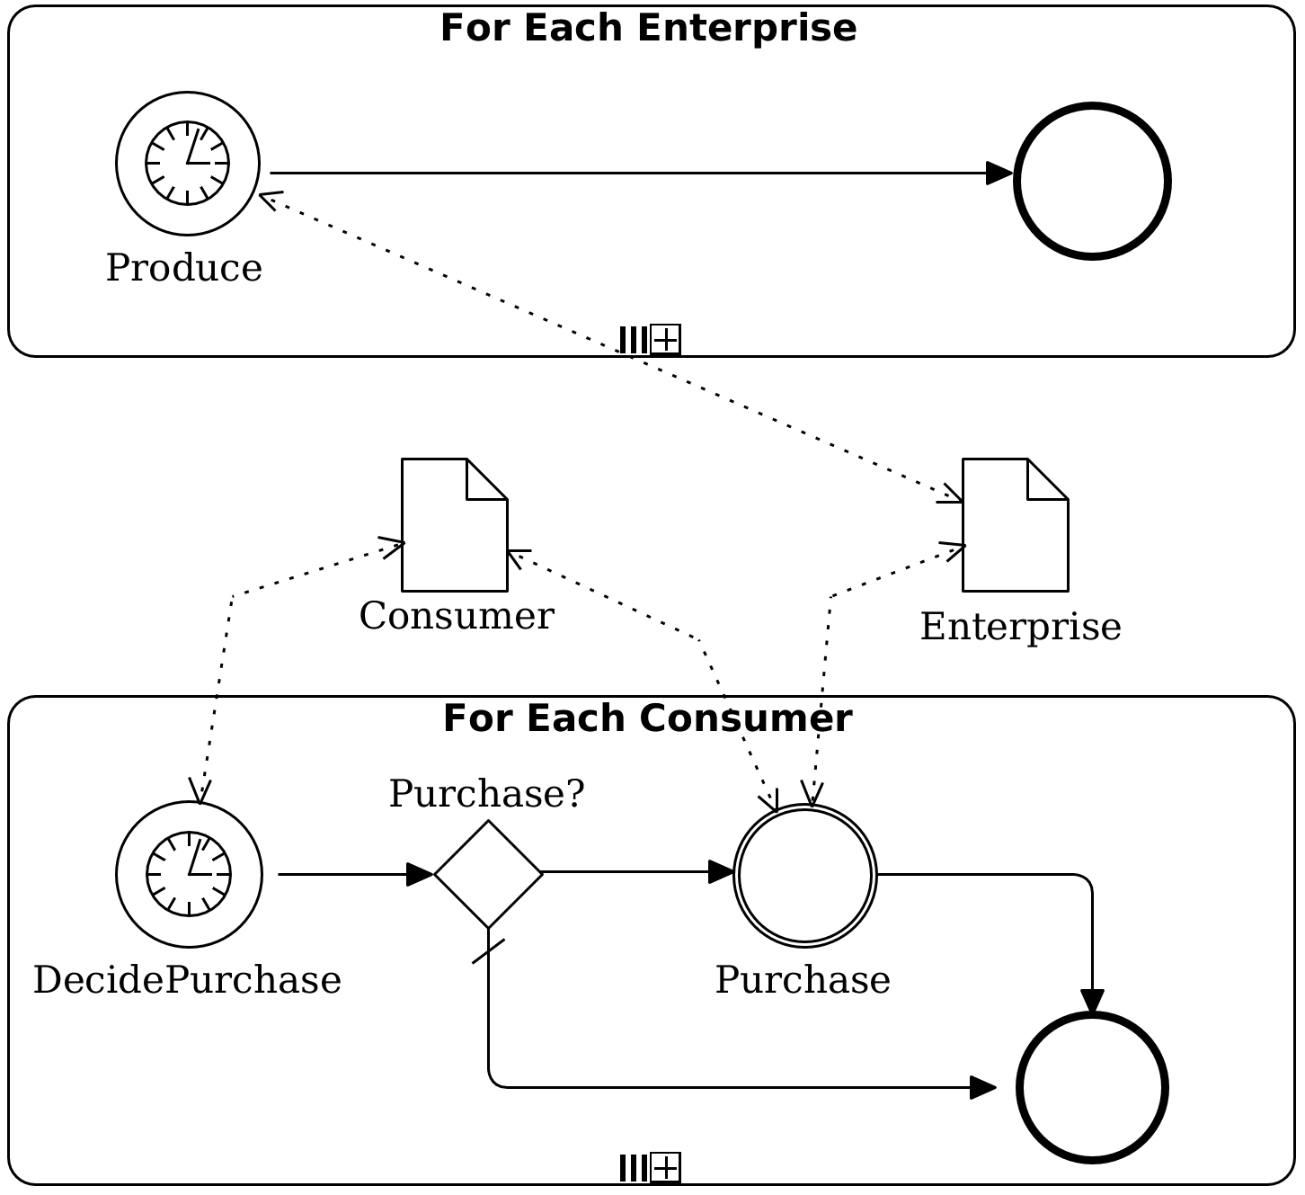
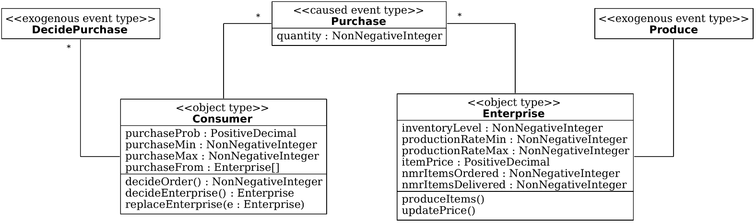
Purchasing Model – Version 4
https://gnardin.github.io/PurchasingModel/04.html
Class diagram
BPMN diagram

Slide 60
Consumer Object Type
var Customer = new cLASS( {
Name: "Customer",
shortLabel: "Customer",
supertypeName: "oBJECT",
properties: {
“purchaseProb": { range: "PositiveDecimal", label: "Purchase Prob“ },
“purchaseMin": { range: "NonNegativeInteger", label: "Min Items Purchase“ },
“purchaseMax": { range: "NonNegativeInteger", label: "Max Items Purchase“ },
“purchaseFrom": { range: “Enterprise", minCard: 0, maxCard: Infinity }
},
methods: {
“decideEnterprise": function () {
var i, e, enterprise, minPrice = Infinity;
// Select the Enterprise selling the cheapest
for ( i = 0; i < this.purchaseFrom.length; i += 1 ) {
e = this.purchaseFrom[ i ];
if ( minPrice > e.itemPrice ) {
minPrice = e.itemPrice;
enterprise = e;
}
}
return enterprise;
}, ...

Slide 61
Output Statistics (simulation.js)
sim.model.statistics = {
...
"percSales": {
range: "Decimal",
label: "% Sales",
initialValue: 0,
showTimeSeries: true,
computeOnlyAtEnd: false,
expression: function () {
var totalOrdered = 0;
var totalDelivered = 0;
var enterprises = cLASS[ "Enterprise" ].instances;
Object.keys( enterprises ).forEach( function ( objId ) {
totalOrdered += enterprises[ objId ].nmrItemsOrdered;
totalDelivered += enterprises[ objId ].nmrItemsDelivered;
} );
return ( totalDelivered / totalOrdered ) * 100;
}
},
};

Slide 62
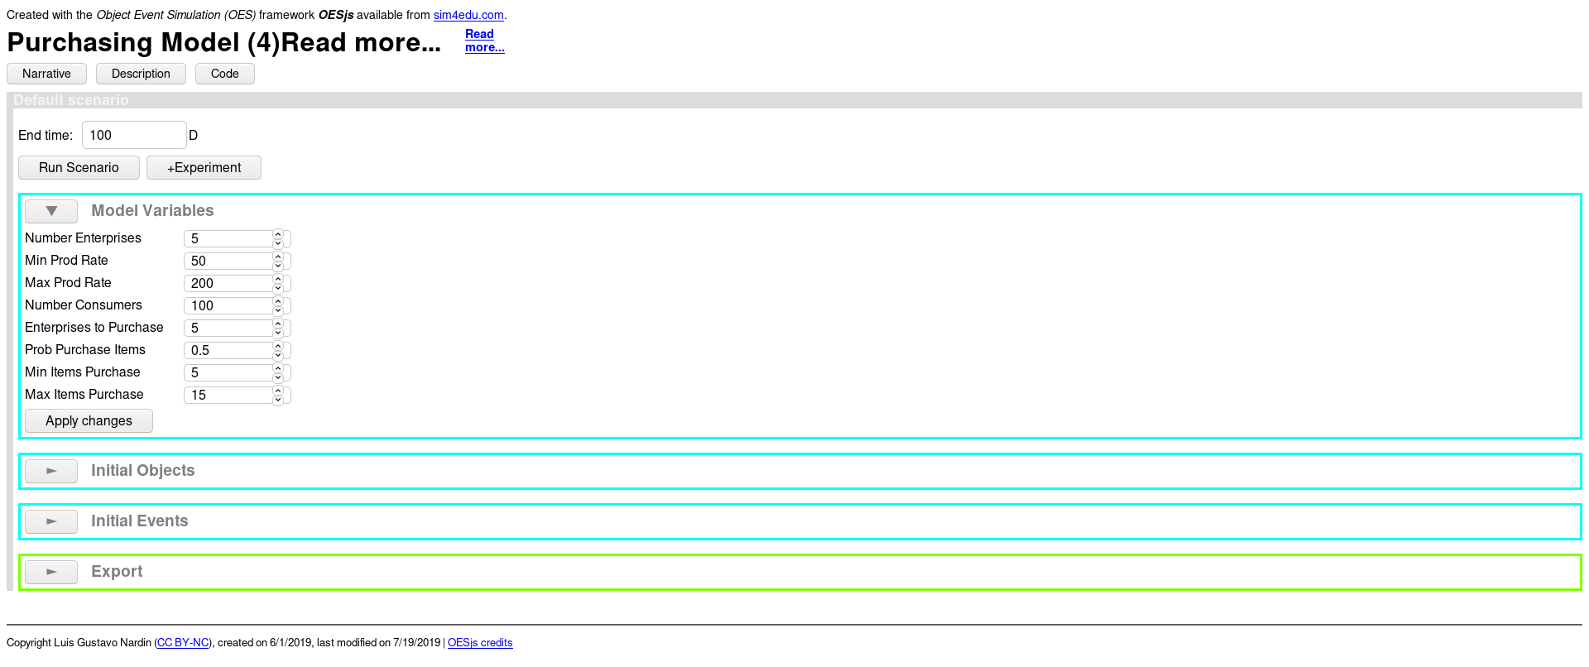
Purchasing Model – Version 4
https://gnardin.github.io/PurchasingModel/04.html

Slide 63
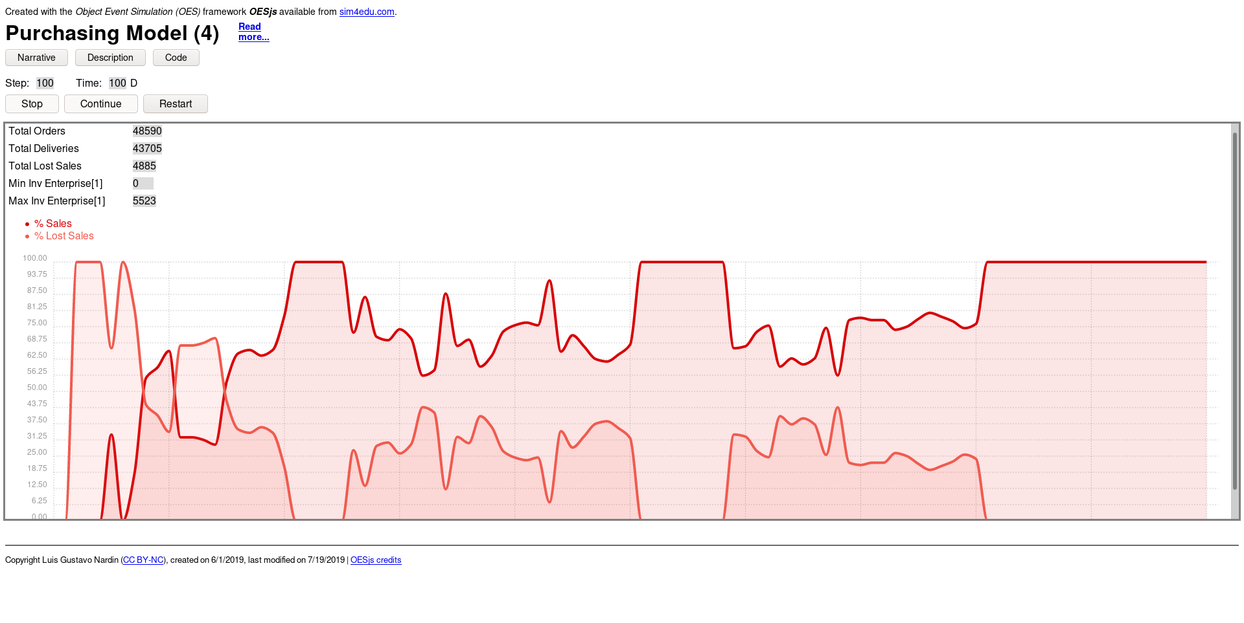
Purchasing Model – Version 4
https://gnardin.github.io/PurchasingModel/04.html

Slide 64
References
Byrne, J., Heavey, C., & Byrne, P. J. (2010). A review of web-based simulation and supporting tools. Simulation Modelling Practice and Theory, 18, 253-276. DOI: 10.1016/jsimpat.2009.09.013.

Slide 65
Thank You!

Slide 66
Appendix

Slide 67
Object-Event Modeling

Slide 68
Object-Event Modeling
Any Discrete Event Simulation (DES) model has to describe a state transition system in some form
Object-Event Modeling (OEM) represents a general DES approach based on object-oriented modeling and event scheduling
OEM allows the description of discrete event system as a state transition system in terms of
object types, e.g., in the form of classes of an object-oriented language
event types, e.g., in the form of classes of an object-oriented language
causal regularities (disposition types) e.g., in the form of event rules

Slide 69
Object-Event Modeling
OEM is formed of different models
Conceptual information modeling: describe the relevant entity types of a domain and the relationships between them
Information design modeling: describe the platform-independent data structures providing a logical design of a system
Data/class modeling: describe the platform-specific data structures for implementing a system

Slide 70
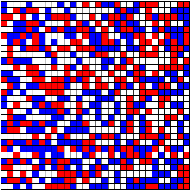
Schelling Segregation
Residential segregation results from the behavior of residents as members of some group, being either satisfied or unsatisfied with their neighborhood depending on the number of residents of the same group in the neighborhood
Periodically, all residents check if they are content with their neighborhood, based on their degree of tolerating neighbors of a different group
If they are not satisfied, they move to a location where they are satisfied, or leave the area if they don't find such a location

Slide 71
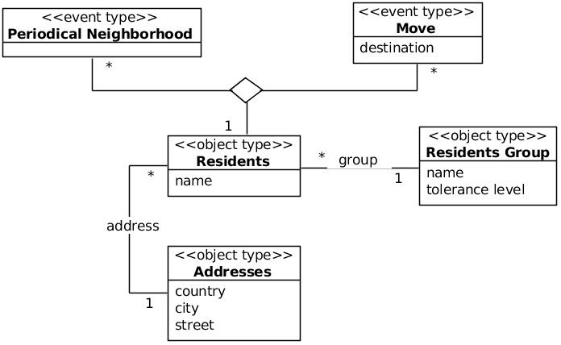
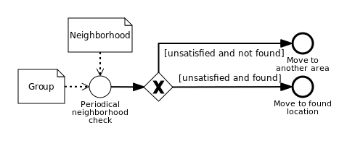
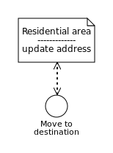
Conceptual Modeling
Identify the Object Types
Model object as stereotyped classes in a UML class diagram
Add associations among object types
Add associations between object types and event types whenever objects (of some type) participate in events (of some type)
Model event using Business Process Management Notation

Slide 72
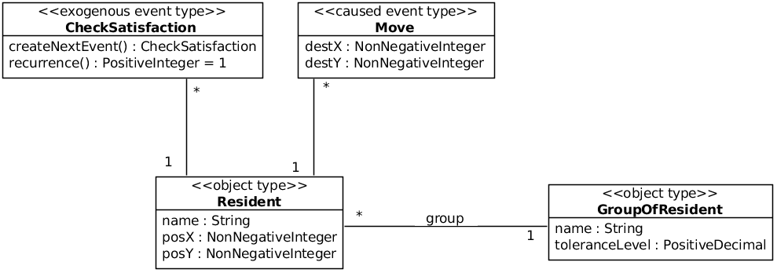
Design Modeling
Describe the platform-independent data structures providing a logical design of a system
Simplify the model to answer to a specific research question
Include properties and functions to the object types and event types

Slide 73
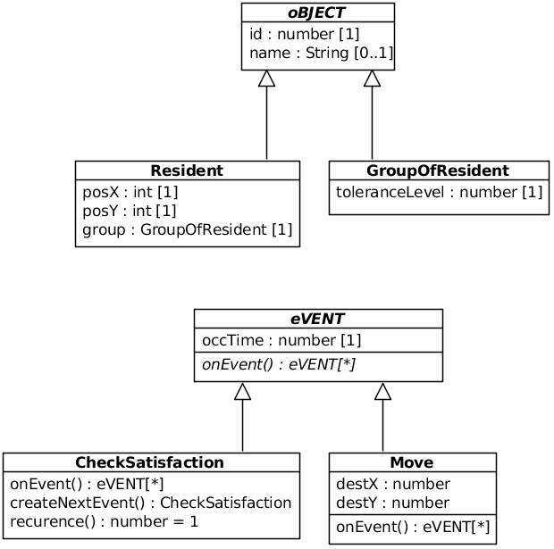
Data/Class Modeling
Derive platform-specific class models from the Design Model
Use data types specific to the implementation platform
Associate the object types and event types to the Abstract classes in the OESjs

Slide 74
Object-Event Modeling
Model object and event types as stereotyped classes in a UML class diagram
Add associations among object types
Add associations between object types and event types whenever objects (of some type) participate in events (of some type)
Model random variables as stereotyped operations constrained to implement a certain probability distribution
Model event rules in an event rule table associating a triggering event expression with an event routine specified in pseudo-code
Model each event rule from the event rule table in the form of an "atomic" BPMN process diagram
Model the sequencing of events by merging all "atomic" BPMN process diagrams into one BPMN process diagram, if possible
Wagner, G. (2018). Information and Process Modeling for Simulation – Part I: Objects and Events. Journal of Simulation Engineering, 1, 1:1-1:25. URL: https://articles.jsime.org/1/1/Modeling-for-Simulation-Part-I

Slide 75
JavaScript Introduction

Slide 76
Introduction to JavaScript
JavaScript was developed in May 1995 by Brendan Eich
JavaScript is a scripting language
Lightweight programming language
Programming code is embedded in HTML
Can be executed by all modern web browsers
JavaScript is weakly typed and dynamic
JavaScript is object-oriented, but in a different way than classical OO languages, e.g.,
objects can be created directly without instantiating any class
properties can be added to an object or class definition at run-time

Slide 77
Introduction to JavaScript
JavaScript is case-sensitive. Keywords are in lowercase
Program statements are terminated by semicolons
Curly brackets {...} are used to define statement blocks
Program text between /* and */ or after // is treated as a comment
Variables should be declared at the start of a function using the var keyword
There are only two kinds of scope for variables: global scope and function scope
= is used for assigning values to variables
For testing the equality (or inequality) of two primitive data values, use the strict equality predicate === (and !==) instead of the == (and !=)
2 == “2” (output true) 2 === “2” (output false)

Slide 78
Introduction to JavaScript
JavaScript has only three primitive data types
String
var single = ‘Just single quotes’;
var double = “Just double quotes”;
Number
var num = 10;
var decimal = 19.8;
Boolean
var stop = false;
var active = true;
To test the type of a variable holds typeof(…) function
typeof(num) (output number)

Slide 79
Introduction to JavaScript
JavaScript has essentially three reference types
Object is a set of property-value-pairs
var person1 = {
lastName: “Smith”,
firstName: “John”
}
Properties can be accessed in two ways:
Using the dot notation: person1.lastName = "Smith"
Using an "associative array" notation: person1["lastName"] = "Smith“
Looping over the keys of an object:
Object.keys( person1 ).forEach( function ( objId) { ... } );

Slide 80
Introduction to JavaScript
JavaScript has essentially three reference types
Array
var a1 = [1, 2, “Name”, true]
Index starts at 0
a1[2] = “Name”
Array has a length property
a1.length (output 4)
Arrays can grow dynamically
a1[6] = 7

Slide 81
Introduction to JavaScript
JavaScript has essentially three reference types
Function
var myF = function theNameOfMyF () {...}
procedures are called “functions”, no matter if they return or not a value
functions can be stored in a variable
can be passed as arguments to functions
can be returned by functions
function name can be omitted (e.g., omit theNameOfMyF), then the function can be invoked using the variable it is assigned to, like myF()

Slide 82
Other Model Configuration

Slide 83
simulation.html
Standard file that launches the simulation model, requires small changes
Tab title
Front title
<head>
<meta charset="utf-8"/>
<title>Purchasing Model (1)</title>
<div id="frontMatter">
<div id="sim4eduinfo">Created with the <i>Object Event Simulation (OES)</i> framework <b><i>OESjs</i></b> available from
<a href='https://sim4edu.com'>sim4edu.com</a>.</div>
<h1>Purchasing Model (1)</h1>
</div>

Slide 84
description.html
Standard file that contains the description of the simulation model
Tab title
Description
<head>
<meta charset="utf-8"/>
<title>Purchasing Model (1)</title>
<body onload="oes.ui.setupDescription()">
<div id="frontMatter">
<h1>Purchasing Model</h1>
<p><strong>Classification tags</strong>: business operations management, DES, next-event time progression</p>
<section id="shortDescription">
</section>
</div>
...
</body>

Slide 85
Simulation Model Configuration (simulation.js)
Property | Description
sim.config.stepDuration | Time in ms between timesteps
sim.config.createLog | Enable/Disable the simulator log on the screen
sim.config.visualize | Enable/Disable the visualization of the simulation execution (Note: Enable only if the model has visualization)
sim.config.userInteractive | Enable/Disable the user interactivity feature (Note: Enable only if the model has user interactivity)

Slide 86
Global Functions (simulation.js)
Because functions do not change during the simulation execution, to call a global function use the sim.model.f.<name>
/* Global Functions */
sim.model.f.produceItems = function( e ) {
e.inventoryLevel += rand.uniformInt( e.productionRateMin, e.productionRateMax);
};

Slide 87
Space Configuration (simulation.js)
OESjs allows to represent the space as a 2D-Grid
The grid dimensions are defined by the sim.model.space object
Property | Description
Sim.model.space.type | Define the type of space to be represented (IntegerGrid)
sim.model.space.xMax | Width of the grid
sim.model.space.yMax | Height of the grid
// Space model
sim.model.space.type = "IntegerGrid";
sim.model.space.xMax = 120;
sim.model.space.yMax = 60;

Slide 88
Grid Space Configuration (simulation.js)
To access the content of the grid cells
To loop over all cells of the grid
sim.space.grid[(y-1)*xMax + x-1]
oes.space.grid.0.getCellValue(x,y)
oes.space.grid.forAllCells( function (x,y) {
var g = oes.space.grid.0.getCellValue(x,y), tol = 0;
if (g > 0) {
tol = groups[String(g)].toleranceLevel;
if (neighbDiffLevel(x,y,g) > tol) {
sim.v.uncontentResidents.push([x,y]);
}
}

