Slide 1

Jack O'Hare jmohare@cn.edu | 0589474 Major: Computer Science CSC20
Cybersecurity News Headline Scraper

Slide 2

Reasons for this project
Being up to date on cybersecurity news is part of the job
Having to cycle through different websites can be overwhelming/time consuming

Slide 3
Plans for the project
Make a program that goes through recent stories on news websites relating to cybersecurity
Pull the links and headlines of these stories
Display them on the side of the screen as a clickable link and will rotate between stories every 5 seconds
Update the list of stories every hour to current ones

Slide 4
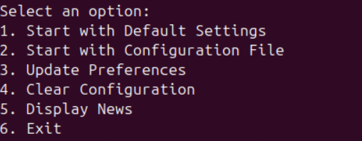
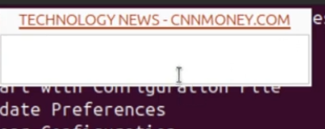
Input
Output
Menu Driven
User can specify keywords
User can specify RSS feeds
Data is stored in text files
GUI Based
Clickable Titles and Links

Slide 5
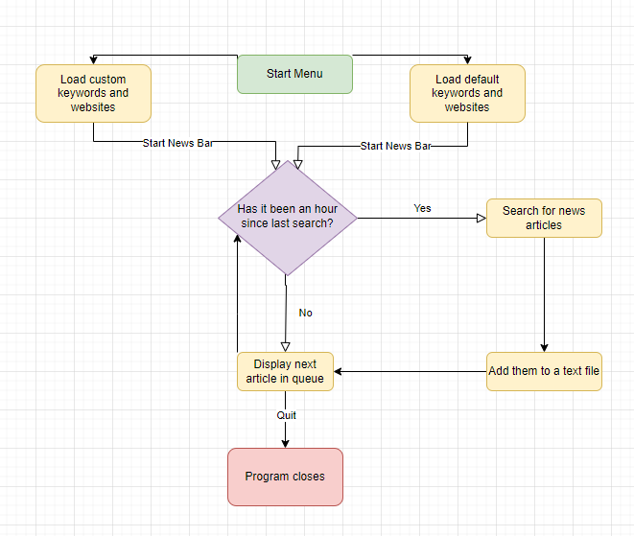
Flowcharting the Project

Slide 6
Supplies used
Bash
YAD(GUI)
RSS Feeds
Linux
Curl
Grep

Slide 7

YAD
"Yet Another Dialog"
GUI: Allows for message boxes
Supports HTML formatting(hyperlinks)

Slide 8

RSS Feeds
"Really Simple Syndication"
Standardized way to receive news information. Like an API
Made up of HTML tags

Slide 9
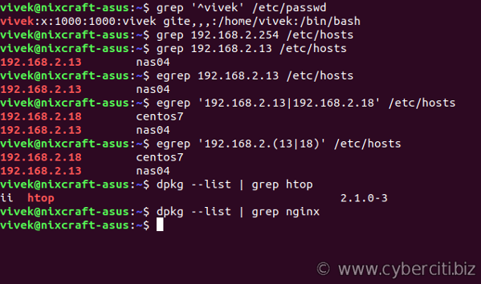
grep
"Global Regular Expression Print"
Bash command used to search for text patterns

Slide 10
curl
"Client URL"
Bash command used to transfer data from a server using various protocols (http,ftp,ftps)
Use to interact with web services, download files, or send data over internet

Slide 11
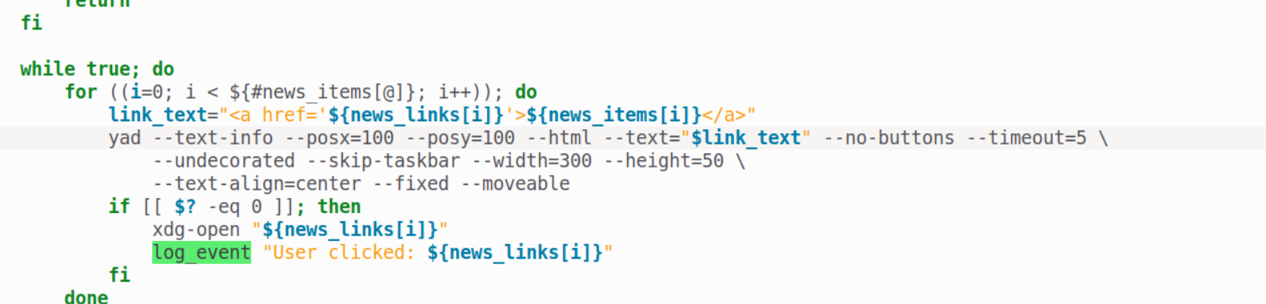
Code Review – Displaying Info

Slide 12
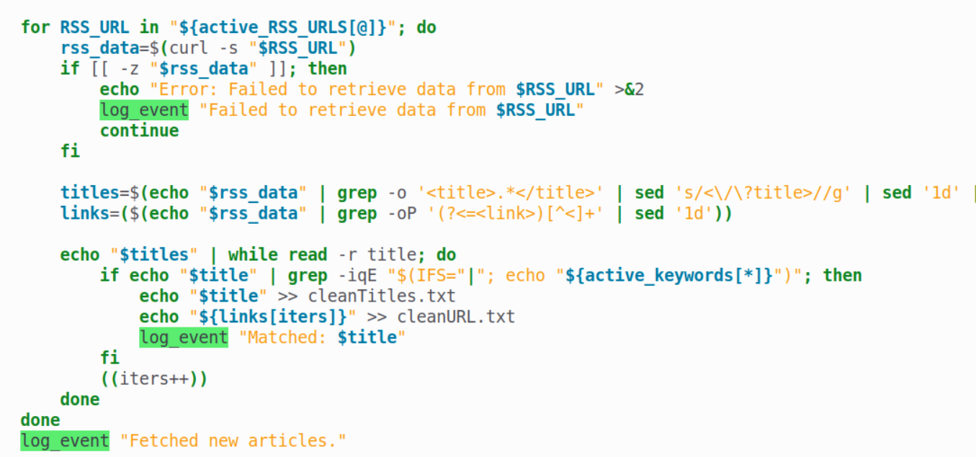
Cont.
Matching keywords

Slide 13
Demonstration
https://youtu.be/vhm29e6LUzg

Slide 14
Challenges and Thoughts
The project overall was successful in what I envisioned
Problem: I felt like I needed to add more during the project
Solution: Custom keywords and RSS feeds
Finding out how to implement web scraping turned out to be more challenging than I expected
RSS feed version means different formatting

Slide 15
Q&A

Slide 16
Sources
Code/Syntax
https://curl.se/docs/tutorial.html
https://rss.com/blog/how-do-rss-feeds-work/
https://yad-guide.ingk.se/
https://www.geeksforgeeks.org/grep-command-in-unixlinux/
Photos:
https://t4.ftcdn.net/jpg/04/79/39/21/360_F_479392118_SyGDm9Rewoxp5kpSiQBMVd96nl2M4GZs.jpg
https://upload.wikimedia.org/wikipedia/en/thumb/4/43/Feed-icon.svg/800px-Feed-icon.svg.png
https://www.cyberciti.biz/media/new/faq/2007/08/grep-command-examples-for-Linux-and-Unix-users-1.png

