Slide 1


Jack O'Hare jmohare@cn.edu | 0589474 Major: Computer Science CSC406
Live Weather Dashboard and SMS Feed

Slide 2

Reasons for this project
Create a texting service that can use weather data to provide user customized alerts every hour

Slide 3
Plans for the project
Design a GUI allowing a user to see current weather
Allow user to choose which place they want to see current weather
Allow a user to add/remove phone numbers to text
Texting service that takes parameters to notify the list of numbers

Slide 4
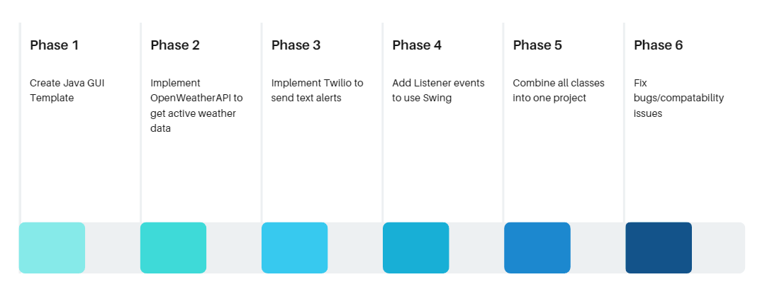
Phases for the project

Slide 5
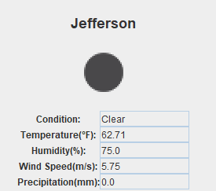
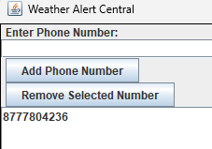
Input
Output
Menu Driven
Text Input Phone Numbers
Button Based Interaction
Terminal-Based Input
GUI Based
Receivable texts

Slide 6
Supplies used
Twilio
Java Swing
Java
OpenWeatherAPI

Slide 7

OpenWeatherAPI
Weather Service Management
Allows calls to weather database

Slide 8

Twilio
Texting and Call API
Allows us to make texts to users when weather alerts occur

Slide 9
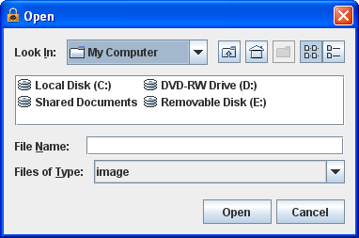
Java Swing
GUI for Java
Input boxes, buttons, switches, images

Slide 10
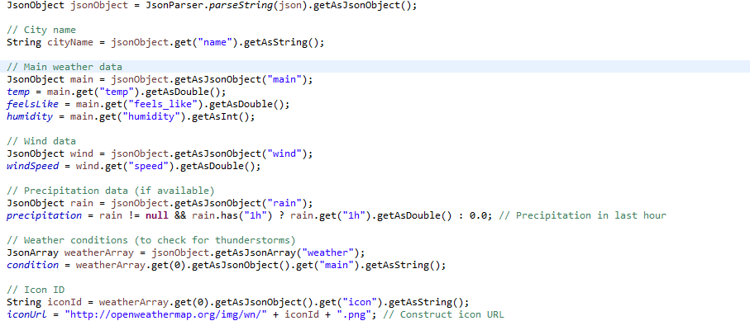
Code Review – Grabbing Weather

Slide 11
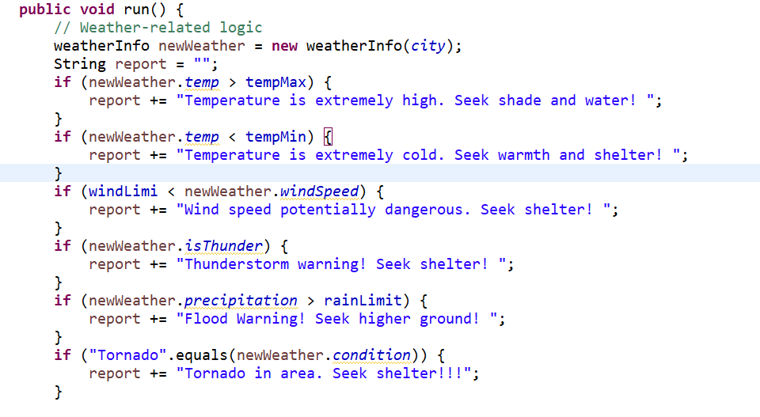
Code Review – Forming Message

Slide 12
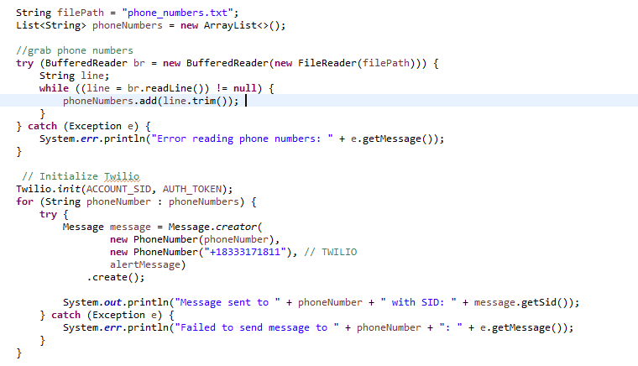
Cont.
Send text alerts

Slide 13
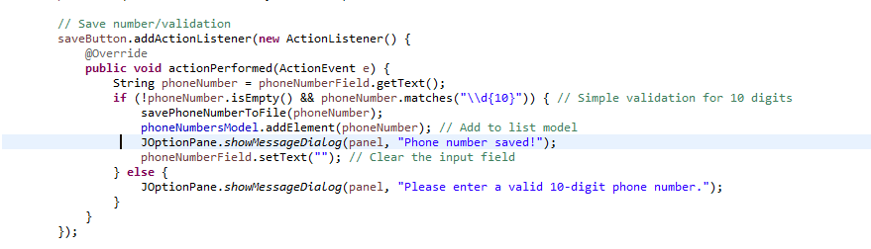
Cont.
Saving Phone Numbers

Slide 14
Demonstration
https://www.youtube.com/watch?v=0sXtZaMqyXo

Slide 15
Challenges and Thoughts
Formatting UI turned out to be a lot more of a challenge than I anticipated
I believe I was able to successfully complete my goal with creating this project and its purpose of giving weather updates to users

Slide 16
Q&A

Slide 17
Sources
Code/Syntax
https://openweathermap.org
https://www.geeksforgeeks.org/introduction-to-java-swing
https://www.geeksforgeeks.org/parse-json-java
https://www.twilio.com/docs
https://www.geeksforgeeks.org/java-util-timer-class-java/
Photos:
https://openweathermap.org/themes/openweathermap/assets/img/mobile_app/android-app-top-banner.png
https://smbhd.com/wp-content/uploads/2022/02/Twilio-Logo-1.png
https://web.mit.edu/6.005/www/sp14/psets/ps4/java-6-tutorial/ui-FileChooserM.png
https://cdn-icons-png.flaticon.com/512/1467/1467470.png
https://cdn-icons-png.flaticon.com/512/678/678310.png
https://cdn2.iconfinder.com/data/icons/weather-flat-14/64/weather02-512.png

