Slide 1
Wifi-Mapper
by Jack Power
IoT Standards & Protocols Semester 4 Project

Slide 2
The Goal
In order to address the widespread problem of poor Wi-Fi coverage, I wanted to create a device to record the characteristics of wireless networks in an area.
This would help the user to find nearby networks that they may be able to access.
This could also help the organisation that owns the network become aware of any areas which may need changes to its infrastructure.

Slide 3
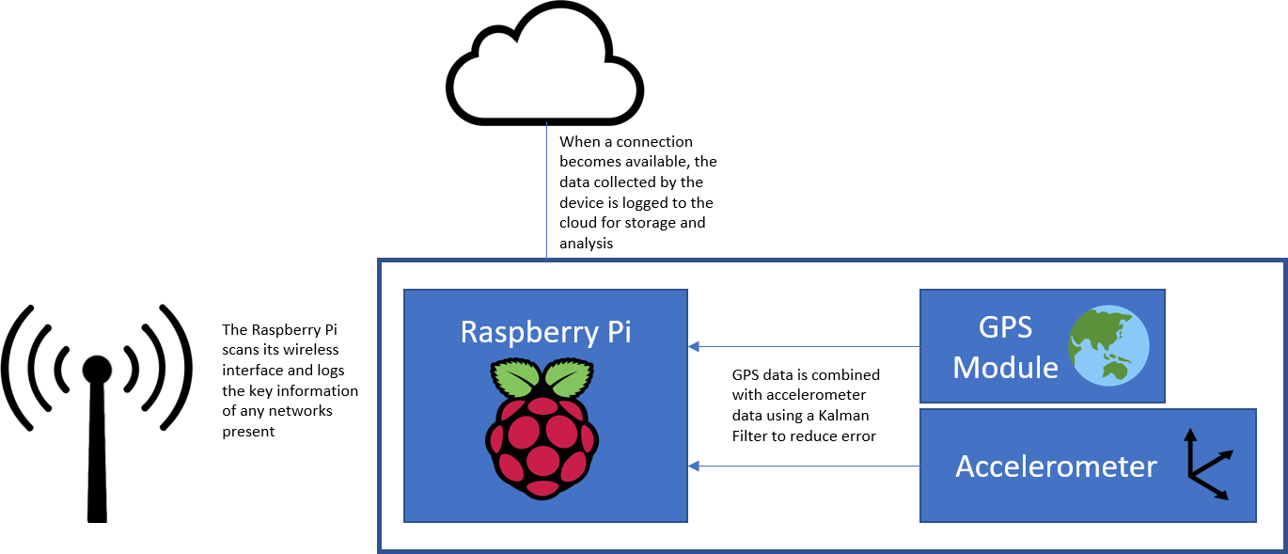
The Design
I would use a Raspberry Pi to scan for wireless networks and a GPS to determine position. This would then be sent to the cloud once a connection was available.
I later decided to use an accelerometer to correct the GPS data, which I learned was prone to error inside buildings

Slide 4
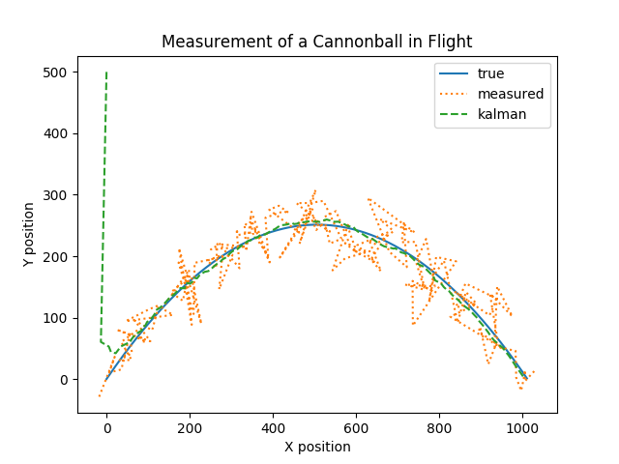
The Indoor Positioning Problem
Common solutions include pedometer algorithms, infrastructure based methods, sound or vision systems and Kalman filtering. A Kalman Filter uses knowledge of the system to make predictions about its state.
I would use a GPS signal and correct it using accelerometer data which would follow the laws of linear motion.
Accelerometers are typically not good for positioning because of double integration leading to large errors over time, this is solved using a Kalman Filter.
Image generated using Python code by Greg Czerniak

Slide 5
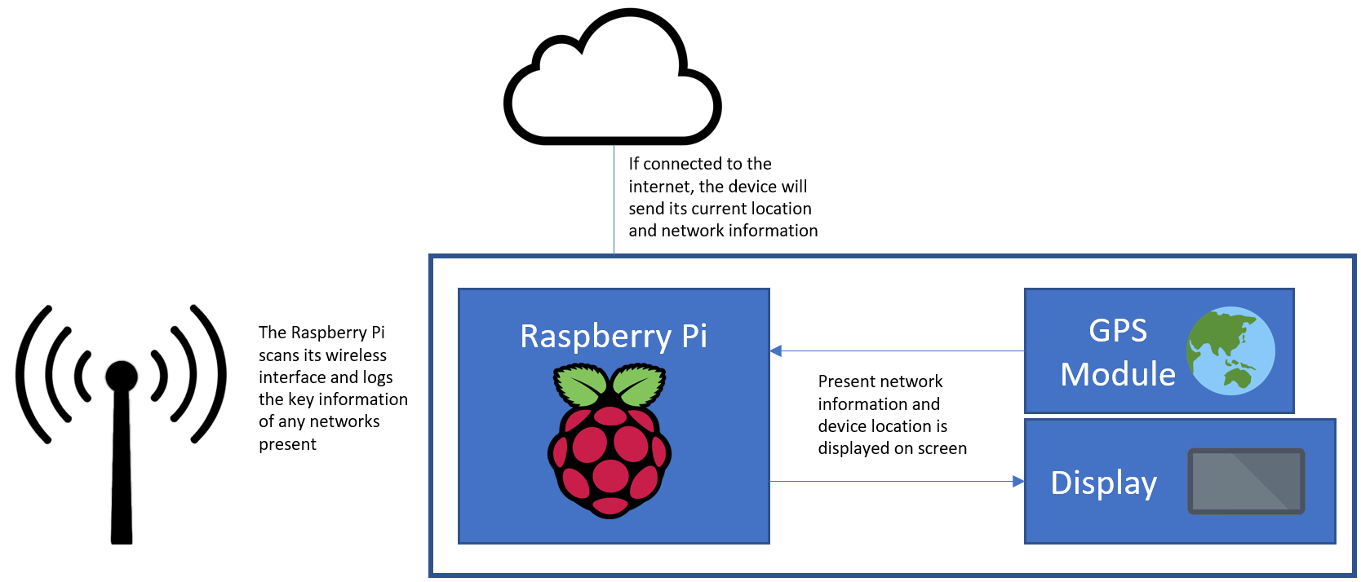
The Result
The device scans wireless networks and displays the information on a display, along with current position. If the device is connected to the internet, it can also send this data to Wia.
Kalman filtering proved impractical without a source of directional data (gyroscope, magnetometer).
Some features could not be implemented due to software restrictions.

Slide 6
Questions?
by Jack Power
IoT Standards & Protocols Semester 4 Project

