Slide 1
Visual Features
Self-Attention
Add&Norm
Cross-Attention
Add&Norm
Bi-LSTM
Bi-LSTM
Bi-LSTM
Output
Landmark Features
Self-Attention
Add&Norm
Cross-Attention
Add&Norm

Slide 2
Landmark Features
Bi-LSTM
Bi-LSTM
Bi-LSTM
Output

Slide 3
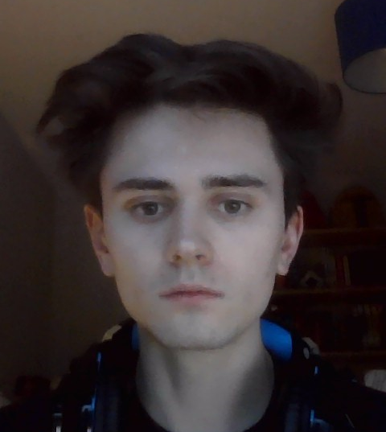
Words Spoken: My name is…

Slide 4
Extract Lip-Only Landmarks
Normalise Landmarks
Input Video Feed
Get Landmarks
(MediaPipe)
Pass Through ANN
Process Output
Display Identified Word
Find Mouth Crop
Feature Extraction

Slide 5
CHANCE
BELIEVE
FAMILY
ABOUT

