Slide 1

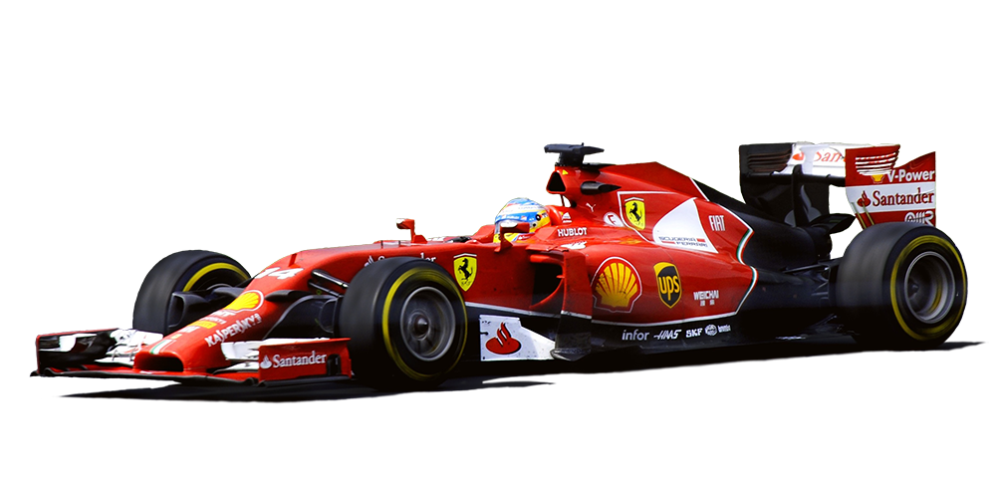
Formula 1 Project
Jack Wilson

Slide 2
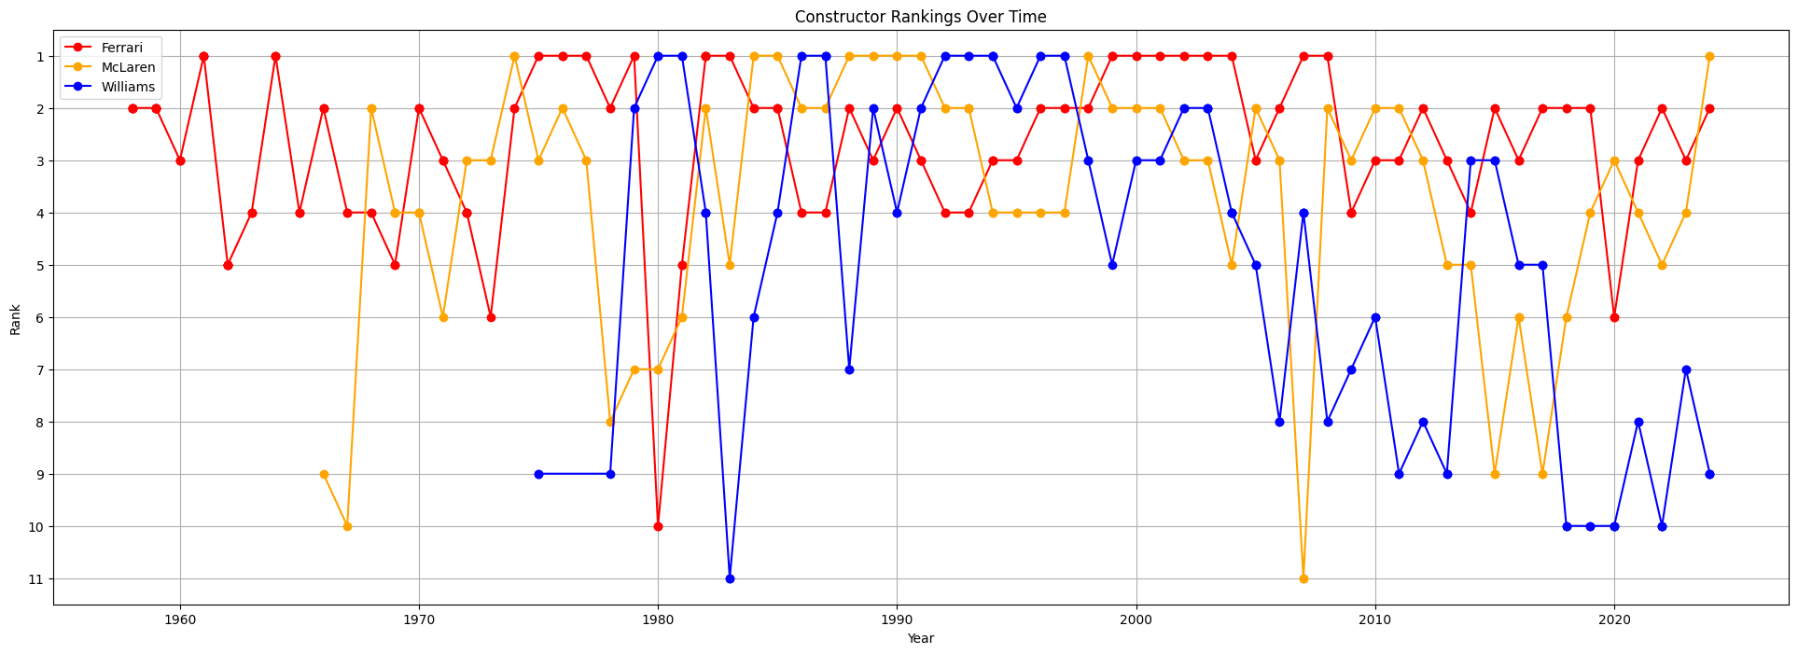
Question 1a:
How have constructor rankings correlated over time? Is one team consistently dominant?
There is little correlation between team ranking and time. The wealthier and more well-known teams stay in the top 5 for the most part, and go on occasional 2-3 season runs where they remain in first.

Slide 3
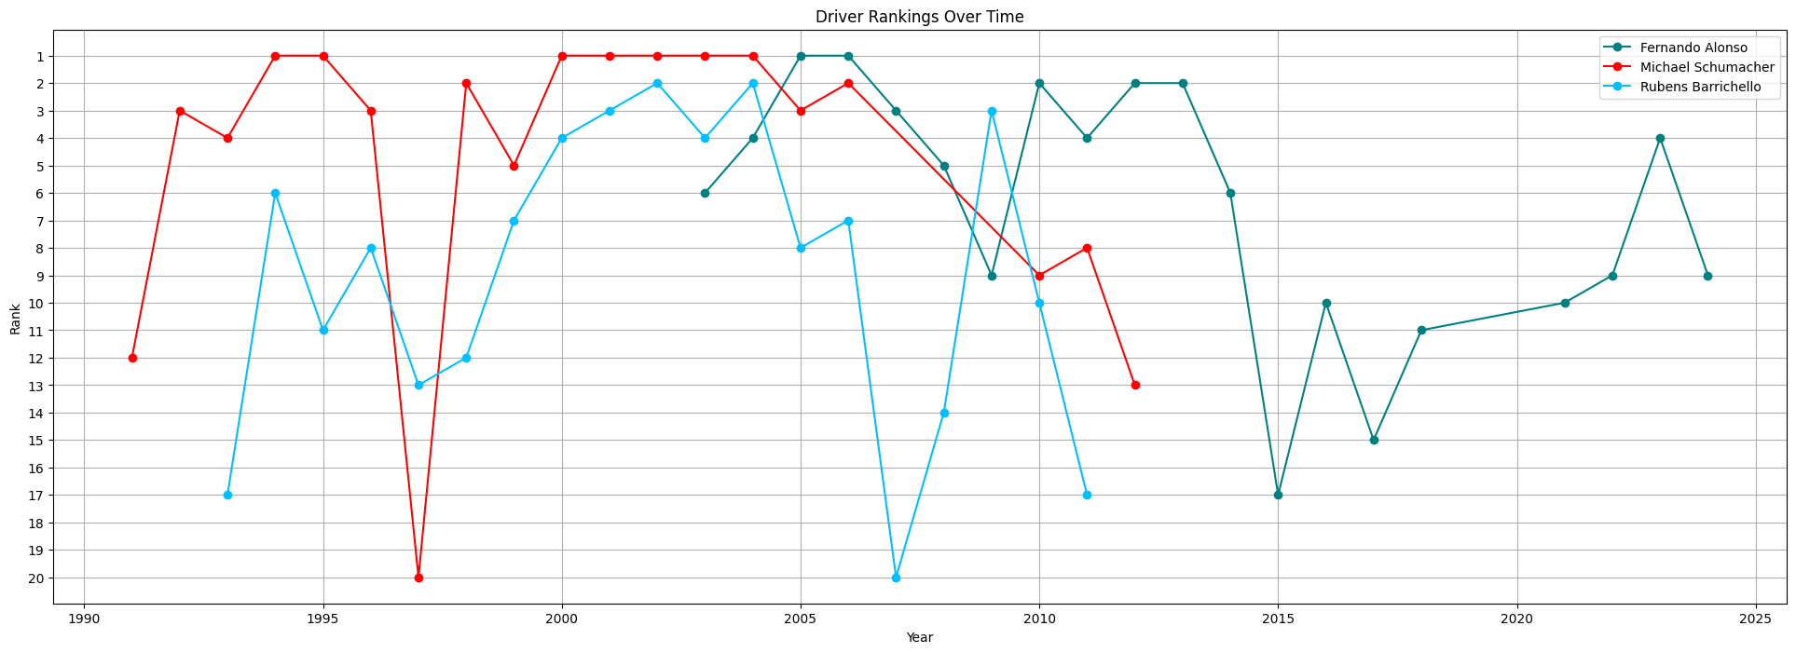
Question 1b:
How have driver rankings correlated over time? Is one driver consistently dominant?
There is little correlation between driver ranking and time. Driver rankings vary a lot from season to season, but drivers will go on 2+ season runs where they remain in first. Many drivers have a “prime” in their middle years and a falloff as they get older.

Slide 4
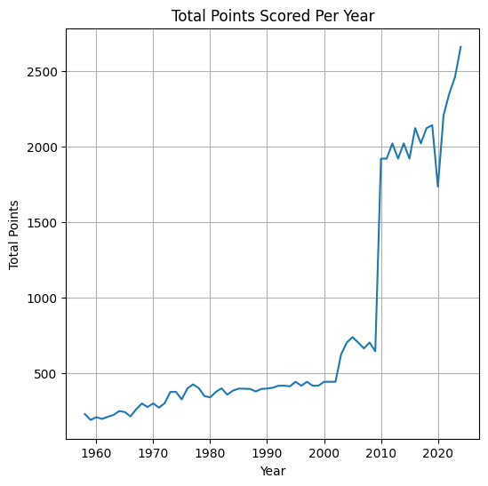
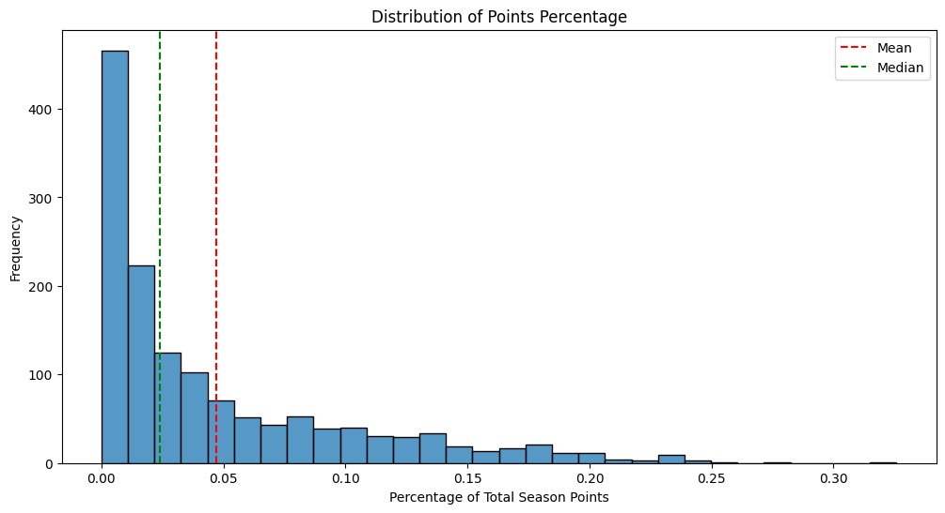
Challenges:
Point Inflation:
Points have inflated throughout the seasons, so comparing raw points isn’t a fair metric. Had to standardize it with % of season points. On average a driver will score 4.71% of the total season points.

Slide 5
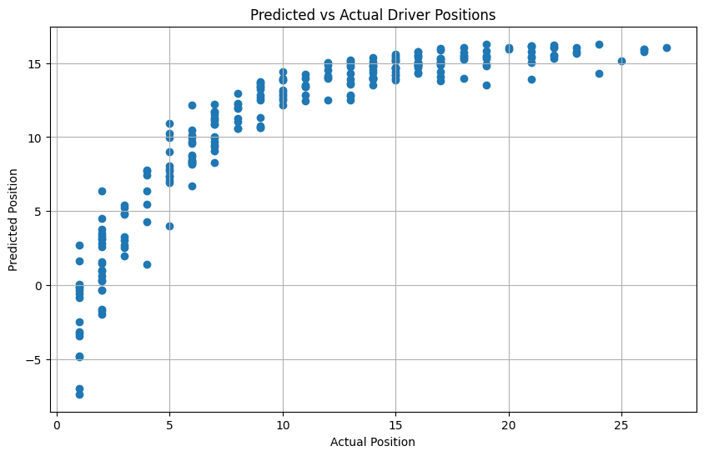
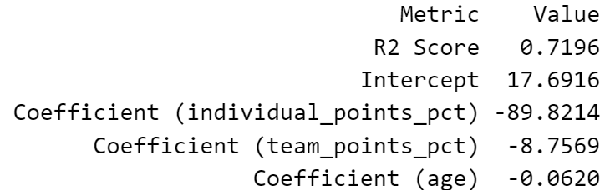
Challenges:
Limited Features:
I have a limited number of features to work with that can be used for machine learning. Points, position, and age are the only real numerical values I have, so machine learning models are inaccurate. I might try to scrape all races and aggregate data to obtain more features.

Slide 6
Road Map:
Try to scrape races to obtain more features. Could get features like number of podiums, fastest laps, average points per race, DNF rate, start and finish position averages, etc.
F1 is a British sport, so maybe turn nationality into a new column – British, not British or divide by continent. Can then compare how diverse the sport is and what nationalities/continents dominate the sport.
From what I’ve analyzed so far, it seems like drivers are middle/bottom of the pack at the start of their career, then they go into their prime and become a frontrunner for a few years, then they drop towards the middle/bottom of the pack at the tail end of their career. I want to analyze this further and see if there’s a common age where drivers are in their prime, and maybe look at what age is most common to enter/exit the sport.
Work on more machine learning models. Can maybe try to predict if a team will keep their driver for the next season or not based on current and historic performance.

