Slide 1
The Grid’s Balancing Act
U.S. Electricity Demand & Generation
What decides how much electricity we need?
Supply
Demand

Slide 2
Someone must balance the grid

Slide 3
Someone must balance the grid
Balancing Authority
Matches supply and demand in real time

Slide 4
Someone must balance the grid
Balancing Authority
Matches supply and demand in real time
A balancing authority (BA) matches supply and demand across its region in real time. Think air traffic control for the power grid

Slide 5
Someone must balance the grid
Balancing Authority
Matches supply and demand in real time
Customers
Demand from homes and businesses
A balancing authority (BA) matches supply and demand across its region in real time. Think air traffic control for the power grid

Slide 6
Someone must balance the grid
Power Plants
Supply from gas, nuclear, coal, wind, and solar plants
Balancing Authority
Matches supply and demand in real time
Customers
Demand from homes and businesses
A balancing authority (BA) matches supply and demand across its region in real time. Think air traffic control for the power grid

Slide 7
Someone must balance the grid
Power Plants
Supply from gas, nuclear, coal, wind, and solar plants
Balancing Authority
Matches supply and demand in real time
Customers
Demand from homes and businesses
A balancing authority (BA) matches supply and demand across its region in real time. Think air traffic control for the power grid

Slide 8
What impacts demand?

Slide 9
What impacts demand?
Area?
1

Slide 10
What impacts demand?
Area?
1
Weather?
2

Slide 11
What impacts demand?
Area?
1
Weather?
2
Population?
3

Slide 12
What impacts demand?
Area?
1
Weather?
2
Population?
3
Income?
4

Slide 13
What impacts demand?
Area?
1
Weather?
2
Population?
3
Income?
4
Planetary alignment of the stars and galaxies?
5

Slide 14
What impacts demand?
Area?
1
Weather?
2
Population?
3
Income?
4

Slide 15
What impacts demand?
Area?
1
Weather?
2
Population?
3
Income?
4

Slide 16
What impacts demand?
Area?
1
Weather?
2
3
Population?
4
Income?
5

Slide 17
What impacts demand?
How does demand and generation vary by area?
1
How does weather affect demand, generation, and renewables?
2
Can weather help predict electricity use?
3
Does population affect electricity use?
4
Do higher income areas use more electricity?
5
Notes:
And now that we know what impacts we want to look at, we can collect the data

Slide 18
Hourly grid and weather data
EIA Open Data API
Hourly demand and generation by fuel type
Open-Meteo API
Hourly weather for each location

Slide 19
Hourly grid and weather data
EIA Open Data API
Hourly demand and generation by fuel type
Open-Meteo API
Hourly weather for each location
Static Datasets
Population, income, power plants, BA territories

Slide 20
Hourly grid and weather data
EIA Open Data API
Hourly demand and generation by fuel type
100Ks
rows from APIs
Open-Meteo API
Hourly weather for each location
10ks
rows per static dataset
Static Datasets
Population, income, power plants, BA territories

Slide 21
Automated pipeline, every hour
Sources
Airflow Orchestration
EIA API
Extract
Transform
Load
App
Weather API
Airflow task
Clean, join
PostgreSQL
Query stored data
Static Data
(only on first run)

Slide 22
Lights off, dark mode
(App demo)
Backup

Slide 23
What the data says

Slide 24
What the data says
How does demand and generation vary by area?
1
2
3
4
5

Slide 25
What the data says
How does demand and generation vary by area?
1
2
3
4
5
  Demand/generation scale with BA size

Slide 26
What the data says
How does demand and generation vary by area?
1
2
3
4
5
  Demand/generation scale with BA size
  Demand consistent across the U.S. when normalized

Slide 27
What the data says
How does demand and generation vary by area?
1
2
3
4
5
  Demand/generation scale with BA size
  Demand consistent across the U.S. when normalized
  Most BAs demand more than they generate

Slide 28
What the data says
1
How does weather affect demand, generation, and renewables?
2
3
4
5

Slide 29
What the data says
1
How does weather affect demand, generation, and renewables?
2
3
4
5
  Demand follows temperature, balance point of 50°F

Slide 30
What the data says
1
How does weather affect demand, generation, and renewables?
2
3
4
5
  Demand follows temperature, balance point of 50°F
  Wind speed has a weak positive correlation with wind generation

Slide 31
What the data says
1
How does weather affect demand, generation, and renewables?
2
3
4
5
  Demand follows temperature, balance point of 50°F
  Wind speed has a weak positive correlation with wind generation
  Cloud cover has no correlation with solar generation

Slide 32
What the data says
1
2
Can weather help predict electricity use?
3
4
5

Slide 33
What the data says
1
2
Can weather help predict electricity use?
3
4
5
  Demand varies with temperature making forecasting useful

Slide 34
What the data says
1
2
Can weather help predict electricity use?
3
4
5
  Demand varies with temperature making forecasting useful
  Weather conditions have an overall low impact

Slide 35
What the data says
1
2
3
Does population affect electricity use?
4
5

Slide 36
What the data says
1
2
3
Does population affect electricity use?
4
5
  No – no relationship with demand

Slide 37
What the data says
1
2
3
4
Do higher income areas use more electricity?
5

Slide 38
What the data says
1
2
3
4
Do higher income areas use more electricity?
5
  No – almost no relationship with demand

Slide 39
A few limitations to consider

Slide 40
A few limitations to consider
Weather Mapping
Weather is mapped to only 3 locations per BA

Slide 41
A few limitations to consider
Weather Mapping
Weather is mapped to only 3 locations per BA
Limited Historical Window
Short historical range covered

Slide 42
A few limitations to consider
Weather Mapping
Weather is mapped to only 3 locations per BA
Limited Historical Window
Short historical range covered
Estimated Demographics
Population and income are estimates

Slide 43
A few limitations to consider
Weather Mapping
Weather is mapped to only 3 locations per BA
Limited Historical Window
Short historical range covered
Estimated Demographics
Population and income are estimates
BA-level View
Everything measured by BA

Slide 44
What’s next?

Slide 45
What’s next?
Weather Depth
Analyze precipitation and UV effects on generation
1

Slide 46
What’s next?
Weather Depth
Analyze precipitation and UV effects on generation
Demand Prediction
Build a temperature-based demand prediction model
1
2

Slide 47
What’s next?
Weather Depth
Analyze precipitation and UV effects on generation
Demand Prediction
Build a temperature-based demand prediction model
More Regions
Expand coverage and compare to more regions
1
2
3

Slide 48
The Grid’s Balancing Act
U.S. Electricity Demand & Generation
What decides how much electricity we need?
Supply
Demand

Slide 49
The Grid’s Balancing Act
U.S. Electricity Demand & Generation
What decides how much electricity we need?
Temperature
Supply
Demand

Slide 50
The Grid’s Balancing Act
U.S. Electricity Demand & Generation
What decides how much electricity we need?
Temperature
Questions?
Supply
Demand

Slide 51
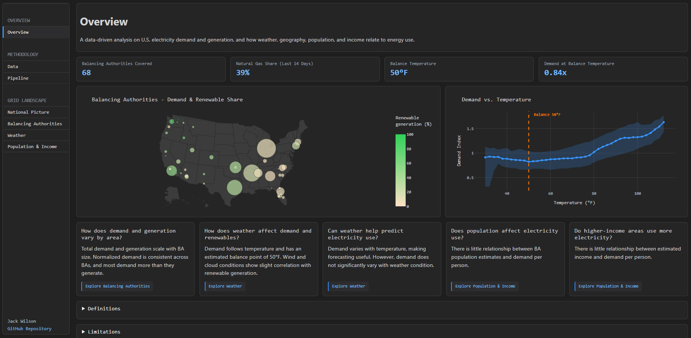
Overview

Slide 52
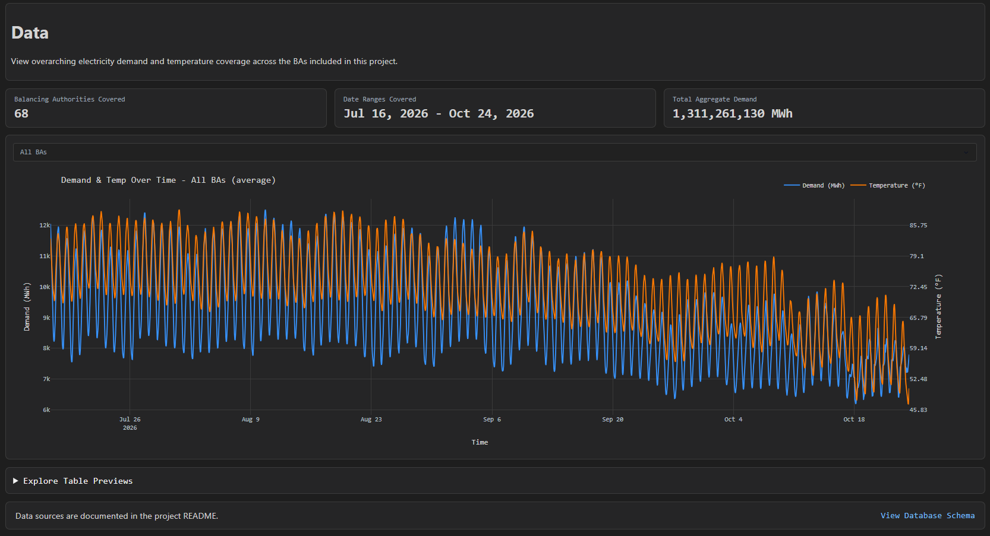
Data

Slide 53
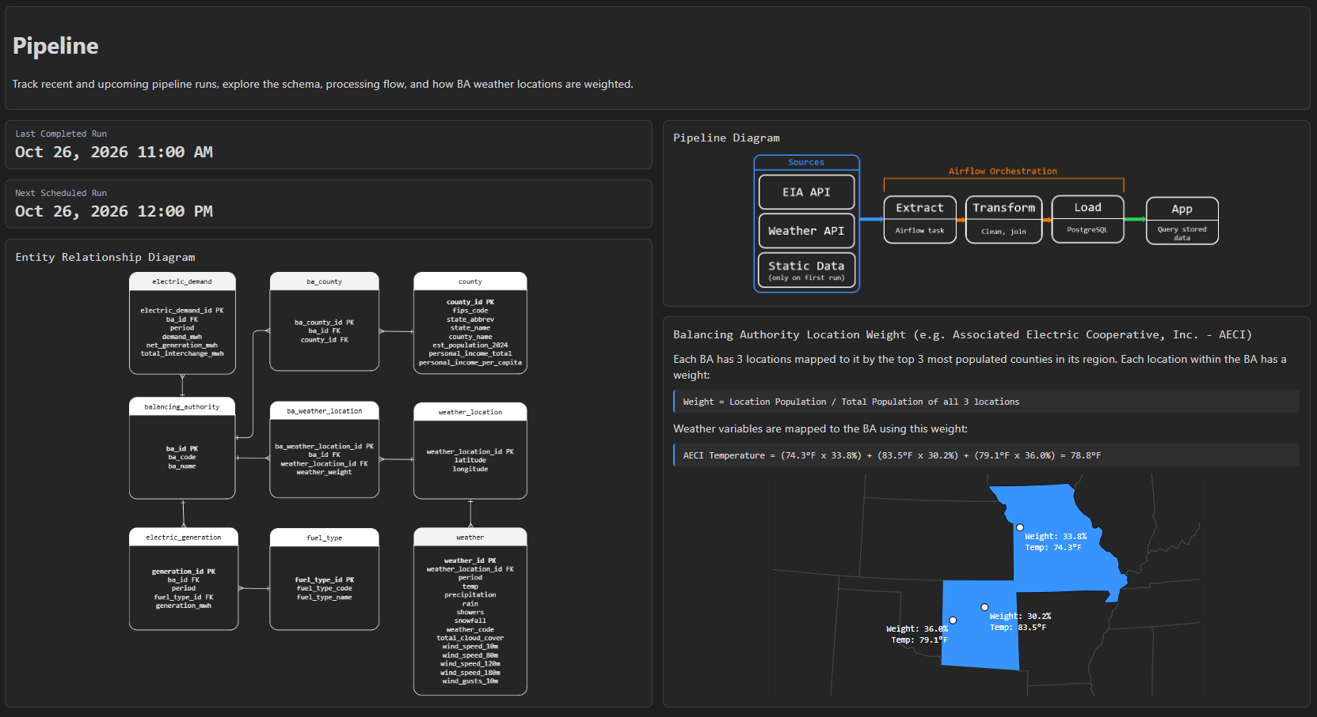
Pipeline

Slide 54
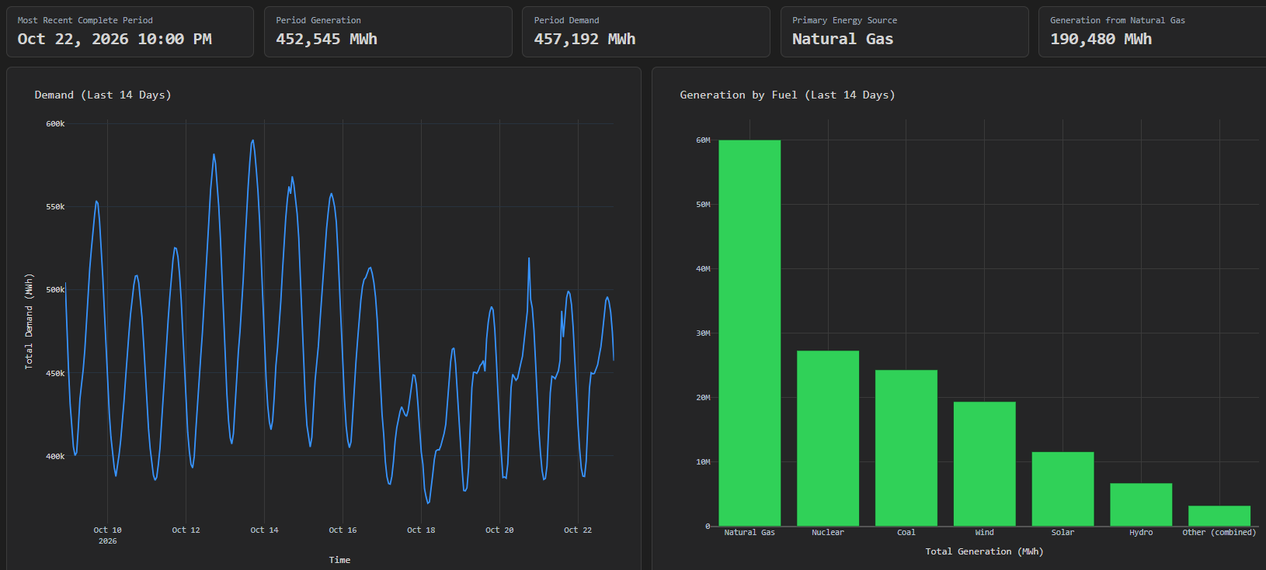
National Picture

Slide 55
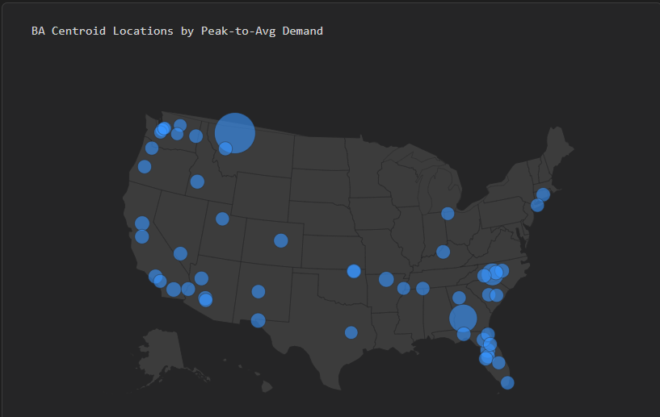
Balancing Authorities

Slide 56
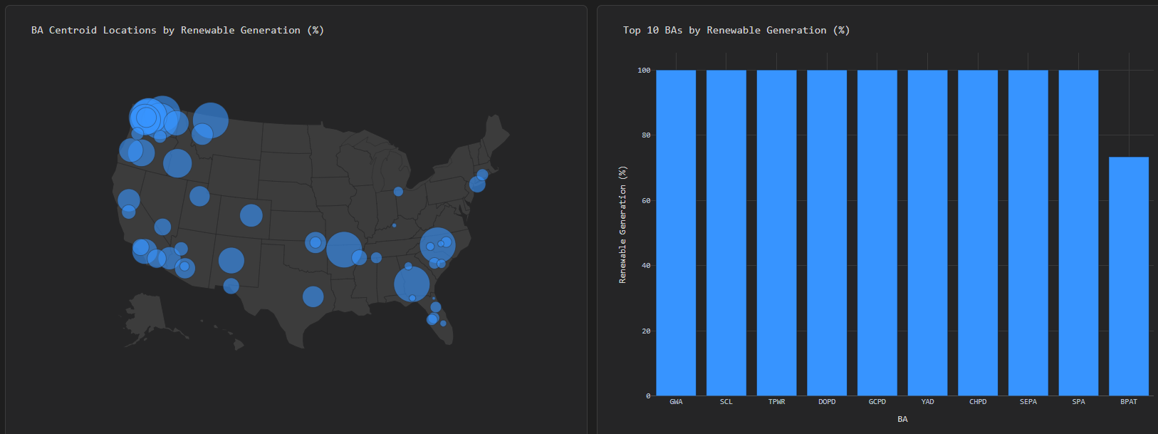
Balancing Authorities

Slide 57
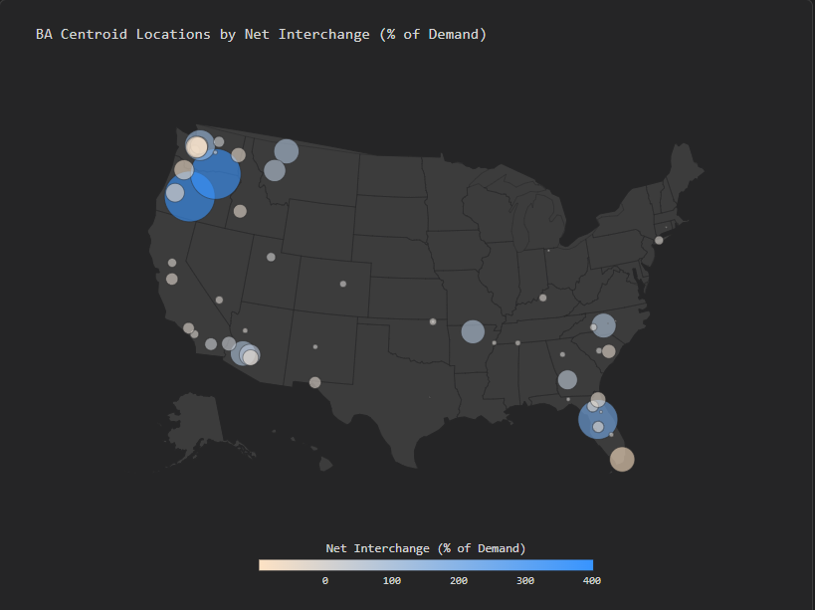
Balancing Authorities

Slide 58
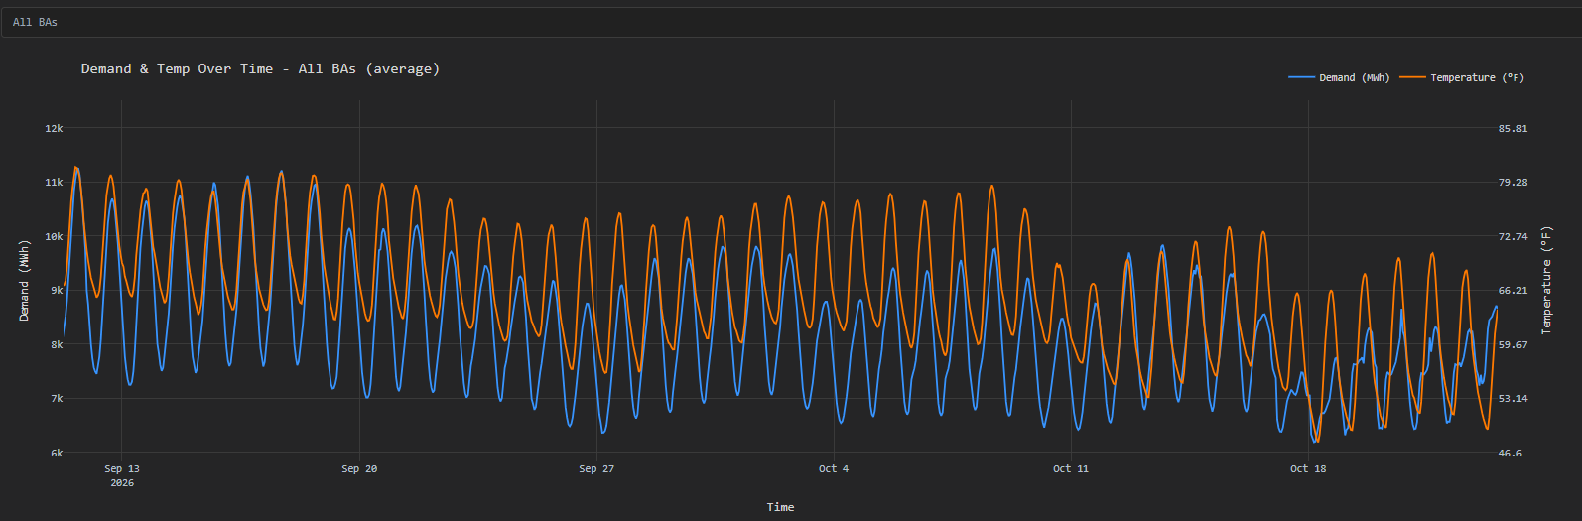
Weather

Slide 59
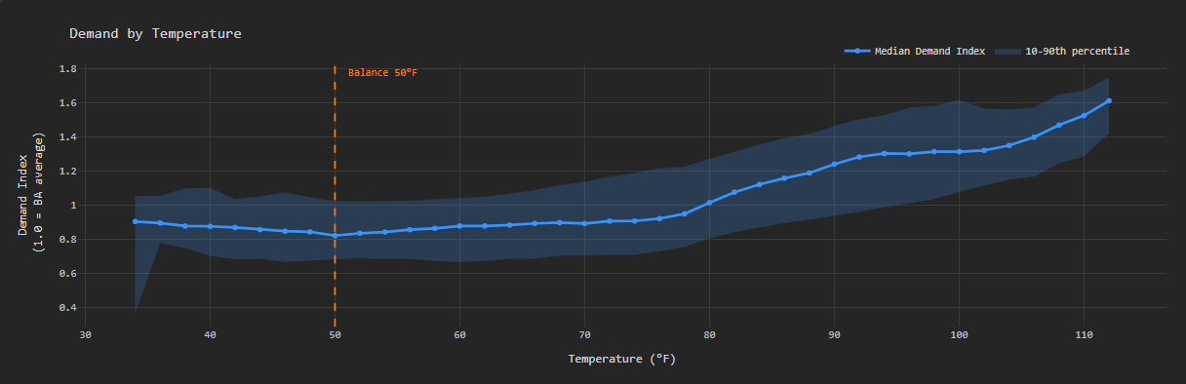
Weather

Slide 60
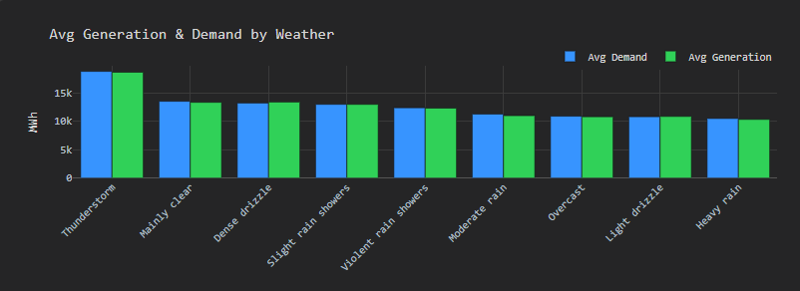
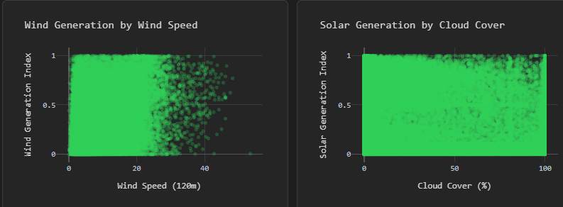
Weather

Slide 61
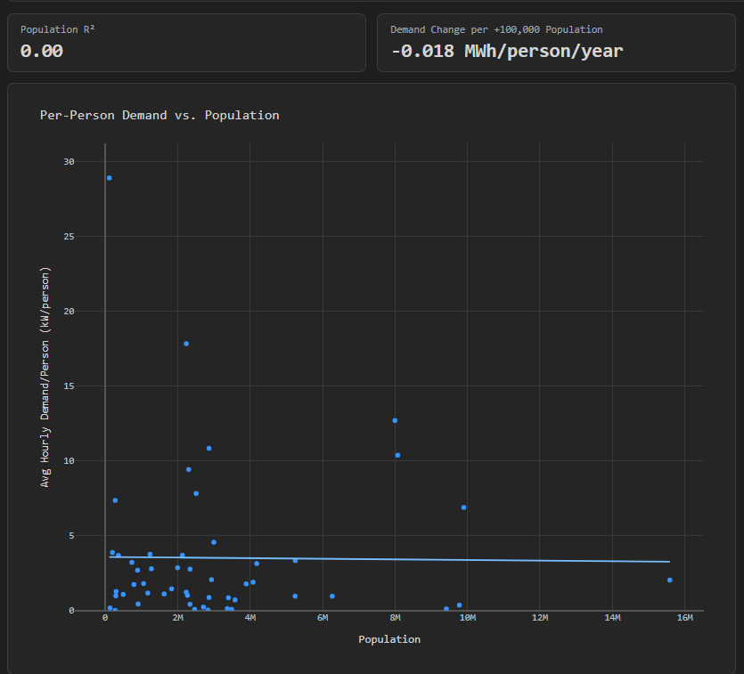
Population & Income

Slide 62
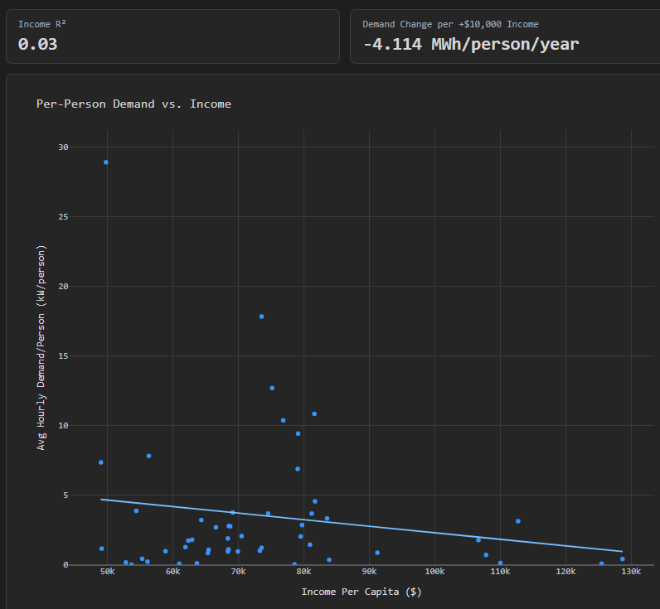
Population & Income

