Slide 1

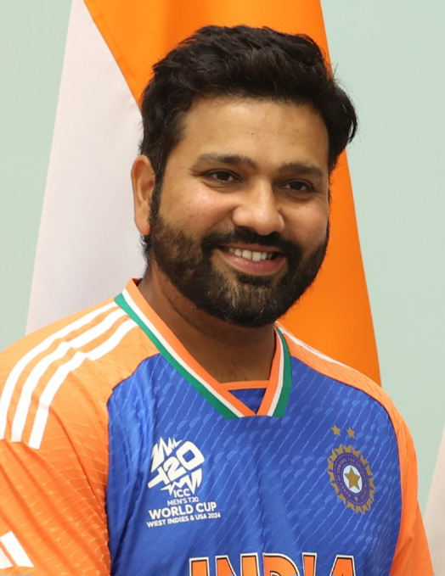


COLLEGE PROJECT DEMO
IIITN
FANTASY
ARENA
Fantasy League & Watch Party Platform
A unified campus experience for drafting teams, joining contests, tracking live scores, streaming watch parties, and getting AI coaching.
CRICKET
FOOTBALL
F1
HACKATHON
React + Express + Prisma + Socket.IO + Streaming + AI
Notes:
Introduce the project as a sports and events platform built for a college demo, not just a fantasy picker.

Slide 2
MOTIVATION
Campus events are exciting, but the digital experience is split
The project brings prediction, live viewing, scores, and community into one flow.
Watch
Predict
Track
Discuss
Streaming links or screen share happen outside the event app.
Fantasy team strategy is separate from the live match context.
Scores, standings, and leaderboards need manual checking.
Users still need help understanding rules and setup.
Need: one arena where participation continues before, during, and after the event.
ONE
ARENA
MOTIVATION
02
Notes:
Frame the motivation as fragmentation: watching, prediction, scoring, and help are usually in different places.

Slide 3
OBJECTIVE
Build a playable event platform, not only a scoreboard
The objective is to turn IIITN events into interactive live experiences.
Let every viewer become a manager.
Fantasy + Streaming + Live Data + AI
Pre-event
Live event
Post-event
Browse matches, choose sport, create team before deadline
Watch stream, track scores, follow contest position
Leaderboard, rankings, points, and learning loop
OBJECTIVE
03
Notes:
Use this slide to state the project objective in product language before moving into features.

Slide 4
OVERVIEW
One platform, six connected modules
Each module maps directly to a route or service in the current app.
AI Coach
Watch Party
Champak guidance
OBS and screen share
Matches
Live Scores
Dashboard and match detail
Cricket and F1 tracking
IIITN
Fantasy Arena
Team Draft
Contests
11-player selection rules
Entry fees and rankings
OVERVIEW
04
Notes:
Explain that these are not imagined modules; they are visible in the current app routes and backend endpoints.

Slide 5
USER JOURNEY
From match discovery to leaderboard in one session
The flow is designed around a student opening the app before a live event.
1
2
3
4
5
Discover
Draft
Enter
Watch
Track
Filter cricket, football, F1, or hackathon events.
Build an 11-member team within credits and role limits.
Join mega, head-to-head, practice, or winner-takes-all contests.
Stream via OBS or browser screen share.
Follow scores, rankings, and AI tips.
The product keeps users inside the event loop instead of sending them to separate tools.
USER JOURNEY
05
Notes:
Walk the review panel through the product as a user experience, not as isolated pages.

Slide 6
FANTASY TEAM CREATION
Drafting uses Dream11-style constraints
The app validates credits, roles, team balance, captain, and vice-captain choices.
CREATE TEAM
Budget guard: a player cannot be selected if credits are insufficient.
100
11
Role guard: each sport has minimum and maximum composition rules.
Total credits
Players required
Team guard: max seven players from one real-world side.
WK
min 1
BAT
min 3
AR
min 1
BOWL
min 3
Auth guard: only logged-in users can lock teams and join contests.
Captain = 2x points
Vice-Captain = 1.5x points
Source: CreateTeam.jsx role config and backend /api/team endpoint.
FANTASY TEAM CREATION
06
Notes:
This slide shows the rules that make team creation a real fantasy workflow rather than a simple checklist.

Slide 7
CONTESTS & LEADERBOARD
Competition layers sit on top of every match
Users choose contests, spend wallet balance, and climb rankings based on points.
Mega Contest
Rank
Manager
Points
Entry: 49 | Large pool
1
Top scorer
980
2
Chaser
910
Head to Head
Entry: 25 | Two players
3
Rising team
870
Practice Match
1
Entry: 0 | Free mode
2
3
Winner Takes All
Entry: 100 | Top prize
Contest entries connect User + FantasyTeam + Contest, so one scoring update can reorder the board.
CONTESTS & LEADERBOARD
07
Notes:
Explain how wallet, contests, entries, points, and rankings work together.

Slide 8
LIVE MATCH CENTER
Scores and standings keep the event active
The app includes dedicated live views for cricket, football, and Formula 1 tracking.
LIVE DATA
Dedicated sport cards route users to the relevant live page.
CSK 184/5
RCB chasing
P1 Verstappen
Cricket and F1 data are fetched through backend endpoints.
P2 Leclerc
Live score context supports team decisions and contest engagement.
Auto refresh every 30 seconds
P3 Norris
The design keeps live data visually separate from fantasy selection.
LIVE MATCH CENTER
08
Notes:
Mention the live endpoints and the user-facing Live Match Center screens.

Slide 9
WATCH PARTY & STREAMING
The platform supports both OBS and browser screen sharing
The watch party module is built for live campus broadcasting and shared viewing.
OBS Studio
Node Media Server
Watch Party UI
Viewers
RTMP input
rtmp://host:1935/live
Tracks active stream
FLV playback on :8888
Video player, status,
copyable stream settings
Socket.IO presence
or WebRTC screen share
LIVE WATCH PARTY: OBS stream or direct browser broadcast
Source: WatchParty.jsx, NodeMediaServer setup, and Socket.IO signaling in server.js.
WATCH PARTY & STREAMING
09
Notes:
Explain the two modes: OBS Studio for formal streaming and WebRTC/screen share for quick browser broadcasting.

Slide 10
AI COACH: CHAMPAK
An in-app guide reduces confusion during live play
Champak answers questions about drafting, scoring, OBS setup, and fantasy strategy.
CHAMPAK AI ONLINE
Backend intelligence
Ask me about drafting teams, scoring rules, live streams, or OBS setup.
Frontend chat state keeps the experience conversational.
Tips for picking a Captain?
Backend /api/chat calls Gemini when API key is available.
Pick high-form players with reliable scoring. Captain earns 2x points.
Fallback responses keep the demo usable even without AI config.
Suggested questions guide users toward high-value help.
AI COACH: CHAMPAK
10
Notes:
Champak shows how the app helps users understand both fantasy rules and streaming setup without leaving the platform.

Slide 11
ADMIN SCORING WORKFLOW
A scoring log turns real event actions into fantasy points
Admins update player performance, which changes leaderboards through stored fantasy entries.
Admin selects player
Logs action + points
Player total updates
Teams recalculate
Leaderboard shifts
PerformanceLog stores playerId, action, pointsAdded, notes, and timestamp.
ADMIN SCORING WORKFLOW
11
Notes:
This is the control loop that makes fantasy scoring updateable in a live demo.

Slide 12
SYSTEM ARCHITECTURE
React UI, Express APIs, real-time services, and data storage
The stack separates user experience, application logic, live signaling, streaming, AI, and persistence.
React + Vite frontend
Express backend
Prisma + SQLite
Routes: Dashboard, Match Detail, Create Team, Live, Watch Party, Leaderboard, Admin, Auth
REST APIs, JWT auth, contest joins, team creation, scoring logs
Users, players, matches, contests, teams, entries, logs
Socket.IO
Node Media Server
Gemini integration
WebRTC signaling and watch party presence
RTMP ingest and HTTP-FLV playback
AI coach responses through /api/chat
Production build serves the React app from the backend, with API and live services sharing the same Node server.
SYSTEM ARCHITECTURE
12
Notes:
Talk through frontend, REST backend, database, real-time, streaming, and AI services.

Slide 13
DATABASE MODEL
The schema supports fantasy play around matches and contests
Prisma models connect users, players, teams, contests, entries, and performance logs.
User
FantasyTeam
Match
Contest
wallet, rank,
totalPoints
theme, budget,
captain, VC
sport, teams,
status, deadline
entryFee,
spotsLeft, type
Player
PerformanceLog
ContestEntry
role, credits,
points, team
action,
pointsAdded
rank, points,
teamId, userId
Key relationship: ContestEntry links the selected FantasyTeam to a Contest and User, enabling rank and points tracking.
DATABASE MODEL
13
Notes:
Use the database model to prove the app has real persistence and relationships, not just UI screens.

Slide 14
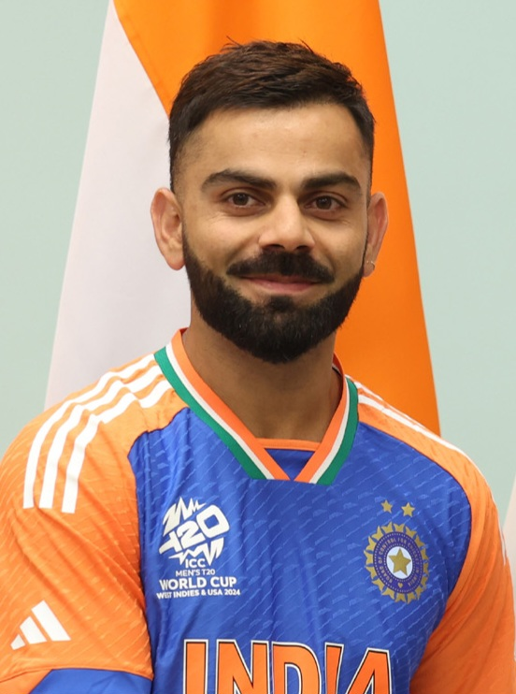
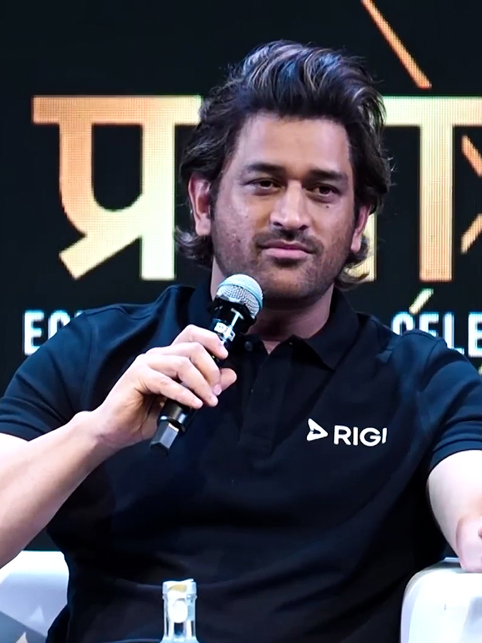
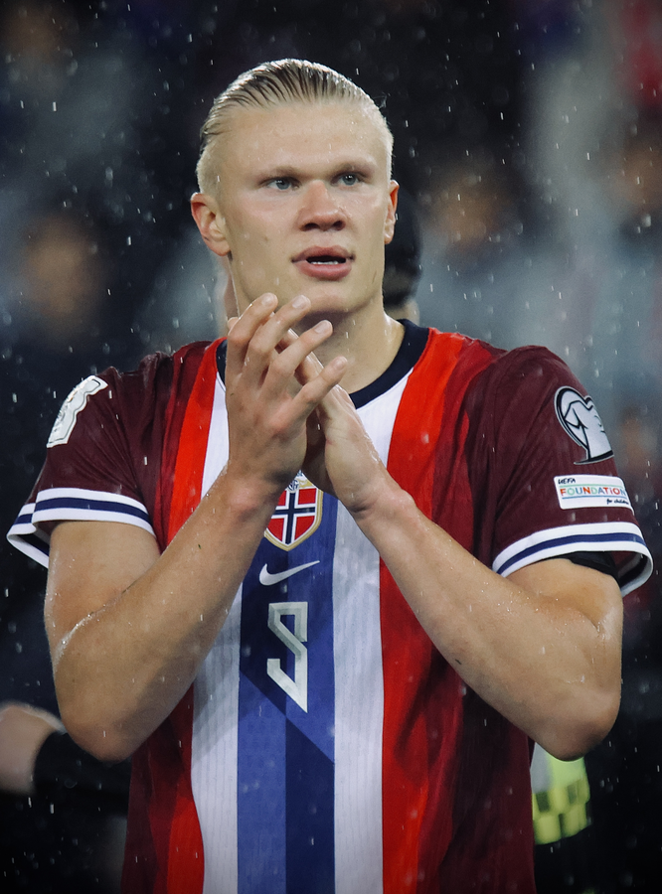
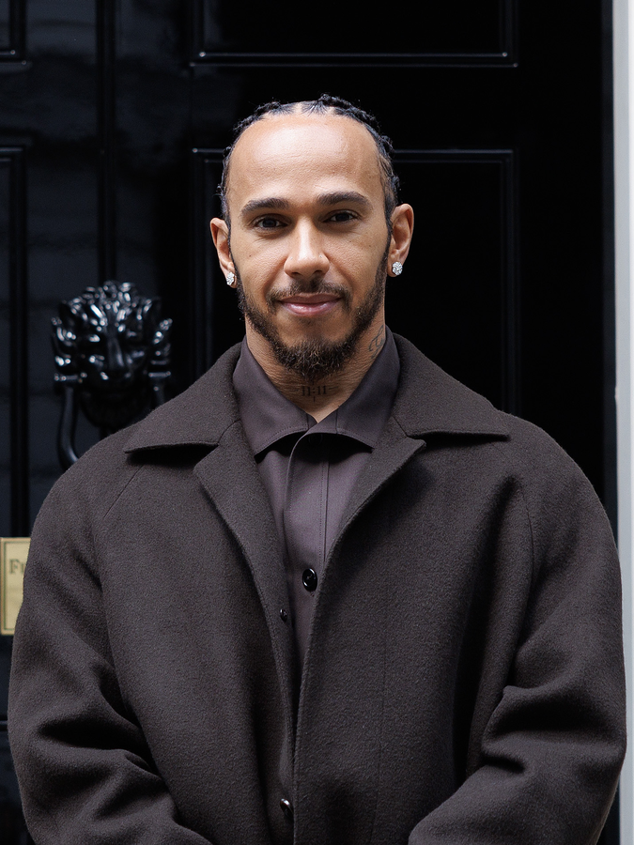
FANTASY PLAYER POOL
Star power makes fantasy feel alive
The deck now shows recognizable cricket, football, and F1 athletes as the kind of cross-sport pool this platform can support.
Rohit Sharma
Virat Kohli
MS Dhoni
Lionel Messi
Cricket | BAT
Cricket | BAT
Cricket | WK
Football | FWD
Cristiano Ronaldo
Erling Haaland
Max Verstappen
Lewis Hamilton
Football | FWD
Football | FWD
Formula 1 | DRV
Formula 1 | DRV
Fantasy value can combine credits, form, popularity, role scarcity, and multiplier potential.
FANTASY PLAYER POOL
14
Notes:
Use this slide to make the fantasy domain concrete: the player pool can span real sports and recognizable athletes.

Slide 15
FANTASY ANALYSIS LAYER
A good fantasy product helps users compare risk and upside
Analysis visuals translate raw player data into fast decisions: captain choice, credits, form, selection share, and role coverage.
Max Verstappen
Form 9.8
Risk vs Upside Matrix
C/VC upside
Credits 10.5
Form
Max
Rohit Sharma
Form 8.9
Messi
Opening impact
Credits 9.5
Rohit
Cristiano Ronaldo
Form 8.7
Haaland
Goal threat
Credits 10
Dhoni
Lionel Messi
Form 9.2
Safer
Higher upside
Assist + goal
Credits 10
Analysis images to include in a future product: ownership heatmaps, captain-risk radar, credits-vs-form scatter, and matchup trend cards.
FANTASY ANALYSIS LAYER
15
Notes:
This slide shows the kind of analysis layer that makes player selection more strategic and presentation-friendly.

Slide 16
TECH STACK
Modern web stack with real-time and media capabilities
The implementation combines frontend polish with backend services that make live interaction possible.
Layer
Technology
Purpose
Frontend
React 19, Vite, React Router, lucide-react
Interactive pages, navigation, icons
Visuals
Three.js, @react-three/fiber, CSS effects
Futuristic animated interface
Backend
Express, Node.js, CORS
API routes and production serving
Data
Prisma, SQLite
Models, persistence, seed data
Realtime
Socket.IO, WebRTC
Presence and browser screen sharing
Streaming
Node Media Server, flv.js
OBS ingest and FLV playback
AI
Google Generative AI
Champak coach responses
The stack is intentionally demo-friendly: local database, local media server, and browser-first flows.
TECH STACK
16
Notes:
Close the technical portion by explaining each layer in language a review panel can follow.

Slide 17
FUTURE SCOPE
The foundation is ready for richer campus-scale play
The next version can focus on reliability, richer scoring, and broader event support.
1
Mobile-first refinement
Responsive drafting and live watch party controls.
2
Advanced scoring rules
IIITN Fantasy Arena turns events into participation.
Sport-specific points, substitutions, penalties, and bonuses.
3
Payments or rewards
Wallet top-ups, badges, certificates, and sponsor prizes.
4
Moderation and roles
Separate admin, streamer, organizer, and user permissions.
Thank you
5
Deployment hardening
Environment secrets, persistent database, logs, and monitoring.
FUTURE SCOPE
17
Notes:
End with future scope and a simple conclusion: the project brings participation to campus events.

