Slide 1

A Time Series Analysis of Labor Hours Worked in the United States
By: Jack Ross

Slide 2
Introduction
This case study examines a time series data set that observes the number of hours worked by the part-time and full-time labor force in the United States. This data set comes from the Federal Reserve Economic Data (FRED) and was uploaded to github for universal access.
We will use the four baseline forecasting methods (Moving Average, Naive, Seasonal Naive, and Drift) on this time series data to test which model generates the most accurate forecast for this data. We will use Mean Absolute Prediction Error, Mean Absolute Deviation, and Mean Square Error in order to gauge which model generates the most accurate forecast.

Slide 3
Exploratory Data Analysis
The data set contains two variables, the date and the number of total hours worked in millions of hours. The observations in the data set are recorded annually and begin in 1948 and stop in 2021
The date variable is omitted in order to make the data useable for the time series function, ts.
The data is split into a testing and a training data set
The testing data is the last ten years of the original data set, the training data is the previous 64 years in the data set

Slide 4
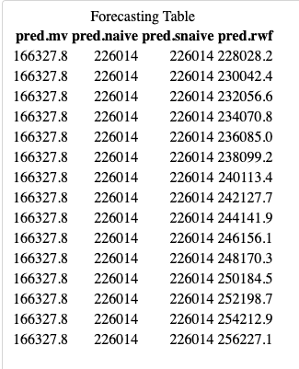
Model Building
We generate a model for the Moving Average, Naïve, Seasonal Naïve, and Drift forecasting methods
This shows forecasts for each year from 2011 to 2026

Slide 5
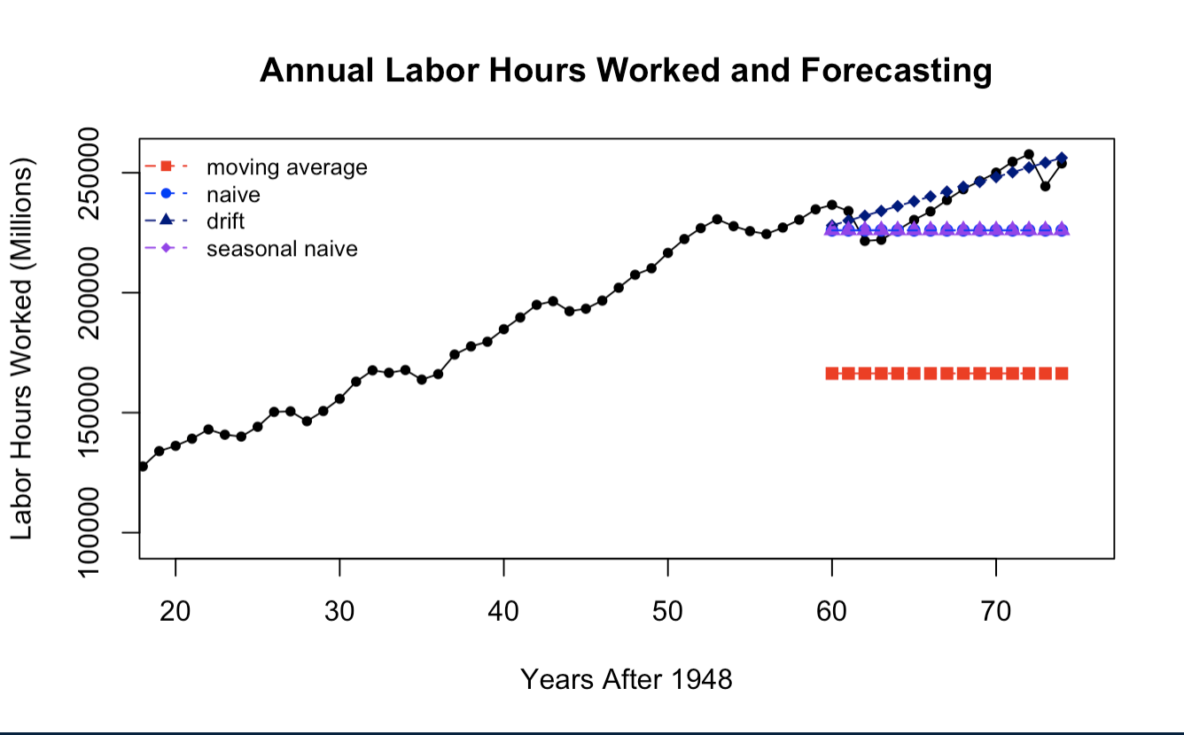
Visualization

Slide 6
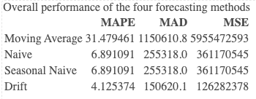
Model Accuracy Results
Based upon the model accuracy metrics, the drift forecasting method appears to be the best fit for time series modeling on this data

Slide 7
Summary of Findings
After performing the model diagnostics, we can conclude that the Drift model was most accurate in forecasting the future labor hours worked in the United States
This model suggests in year 2024 there will be 252,197.7 millions of hours worked in the United States. This forecast continues to increase for the years 2025 and 2026.
The work force in the United States was projected to be 160.89 million people in March of 2023
By dividing the number of labor hours in 2024 by the quantity of active workers and then dividing that number by 50, we can see that the average employee (part-time or full-time) in the US is expected to work a 31-hour work week in 2024 based upon the forecasting methods used.
252,197.7/160.89 = 1567.52 --> 1567.52/50 = 31.35

Slide 8
Conclusion
Using the drift forecasting method generated the best model for this time series
If this analysis were to be conducted differently, a method such as ARIMA or Exponential Smoothing model may generate forecasted values with more accuracy
Data Citation:
U.S. Bureau of Economic Analysis, Hours worked by full-time and part-time employees [B4701C0A222NBEA], retrieved from FRED, Federal Reserve Bank of St. Louis; https://fred.stlouisfed.org/series/B4701C0A222NBEA, May 5, 2023.

