Slide 1

BREAKING THE WALLED GARDEN
IOS SECURITY BEYOND THE SANDBOX
BY
JACK SESSIONS

Slide 2

ROOT://_WHO I AM
  Mobile Security & Counterintel Researcher (and fixed data insurance)
  Bartender IRL, Hacker in VR, and working in AR/AXI
  CyberSec YouTuber @JackSessions
  CyberSec Rapper (retired… for now)
  Pre Seed Money Comp Sci Student
  Wanted for Treason... (Kim did not like my rap)
  2x CVE-2025-50861, CVE-2025-50862

Slide 3
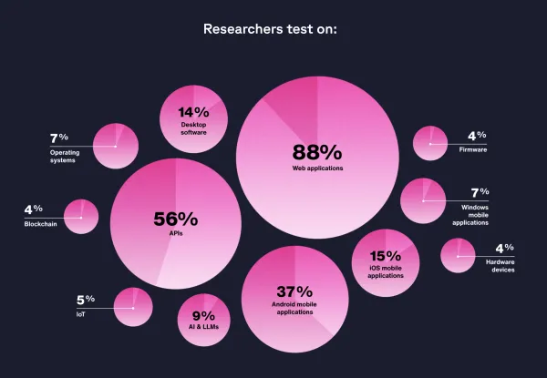
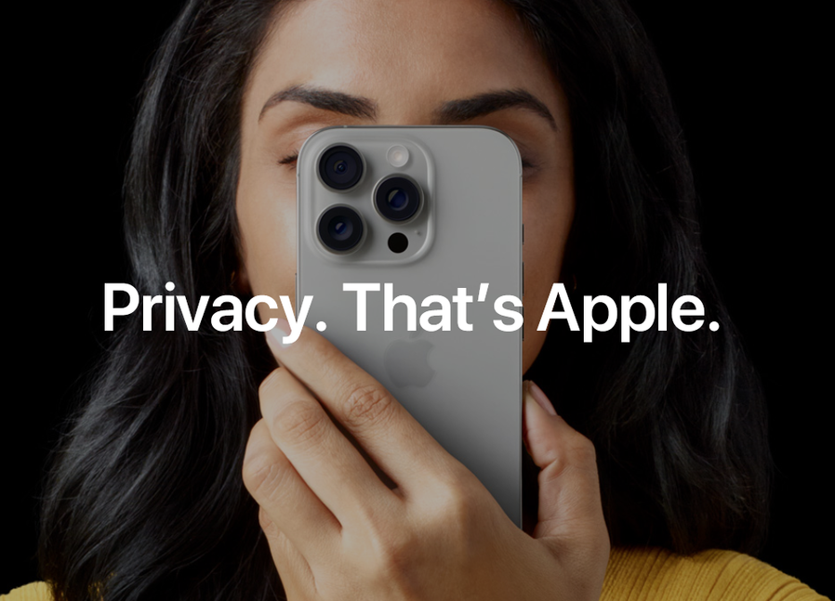
WHY HACK THE APPLE?
iPhones make up ~60%+ of mobile traffic in AU / US.
Where the money and secrets are → the attackers go.
Walled Garden, Encrypted Everything, No Malware.
Even without a jailbreak! analysis, telemetry, and radio surfaces are wide open for study.
Rooting culture = deeper exposure

Slide 4
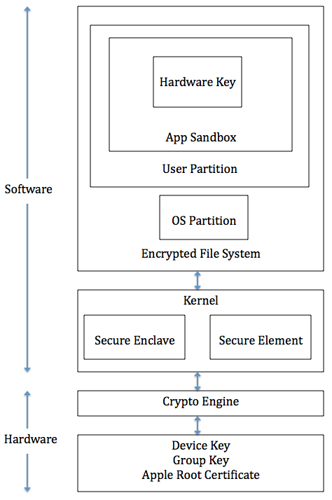
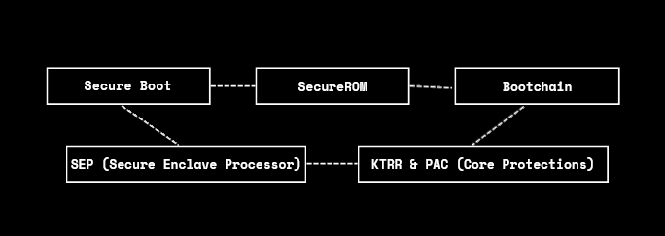
TL;DR LAST TIME AT BSDIES

Slide 5
WHAT THIS TALK IS
A DIVE INTO APPLE’S INVISIBLE SECURITY WALLS — FROM USERLAND TO GPU.
HOW “NO JAILBREAK” DOESN’T MEAN “NO ACCESS”
GPU DRIVERS & RADIO STACKS AS PRIVILEGED SURFACES EVEN WITHOUT JAILBREAKS
REAL DEMOS: SANDBOX DETECTION DEMO + GPU LIVE DEMO
AND YEAH… SOME CHAOS, DEMOS, AND PROBABLY A RAP.

Slide 6
WHAT THIS TALK IS NOT
A polished corporate deck with 180 slides
A full jailbreak walkthough (if need that go to nullcon)
“All exploits revealed” (sorry, not today)
A quiet academic lecture (nah, we’re memeing)

Slide 7
THE WALLED GARDEN CONCEPT
The garden = sandbox + entitlements + code signing + SEP + AMFI
Aim: protect kernel, IPC, and key material (keybags, biometrics)

Slide 8
SECTION 2
THE SANDBOX

Slide 9
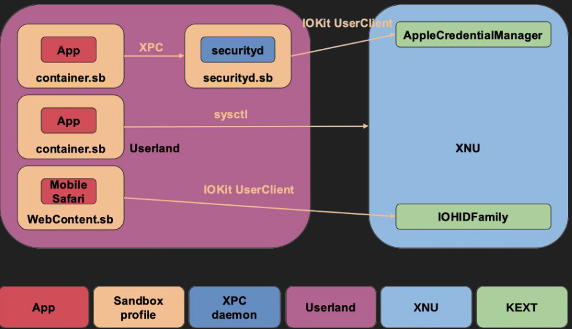
SANDBOX OVERVIEW
A sandbox is a technology that protects an underlying system, by limiting the operations an app that runs on the system can perform
○ White-list, obviously, so sandbox technologies specify
what is allowed (policies or profiles)
On iOS the sandbox protects mainly two resources of the underlying system
○ The kernel and its drivers (kernel extensions)
○ IPC (XPC, NSXPC, etc.) system services
○ Others too (e.g. parts of the filesystem)

Slide 10
SANDBOX VS PRIVILEGE ESCALATION
Apple introduced the sandbox in iOS 2.0 and relies on it a lot
for limiting privilege escalation and post-exploitation
  Every iOS release keeps reducing the surface accessible
from within the sandbox
  Sandbox escape, then kernel interface to LPE
Apps are placed in a container (app sandbox) by default
  They don't need to do anything code-wise (or in anyotherway)
  AMFI (Apple Mobile File Integrity) for code signing and entitlements (not discussed - out of scope)

Slide 11
IOS SANDBOX IMPLEMENTATION
Based on the TrustedBSD (FreeBSD) MACF (Mandatory
Access Control Framework)
  MAC: security policy is centrally controlled by a security policy administrator; Apple in our case
  Users do not have the ability to override the policy and, for example, grant access to files that would otherwise be restricted
  Not even ones they own/created
  Enforced by the kernel

Slide 12
IOS SANDBOX IMPLEMENTATION
Based on the TrustedBSD (FreeBSD) MACF (Mandatory
Access Control Framework)
  MAC: security policy is centrally controlled by a security policy administrator; Apple in our case
  Users do not have the ability to override the policy and, for example, grant access to files that would otherwise be restricted
  Not even ones they own/created
  Enforced by the kernel

Slide 13
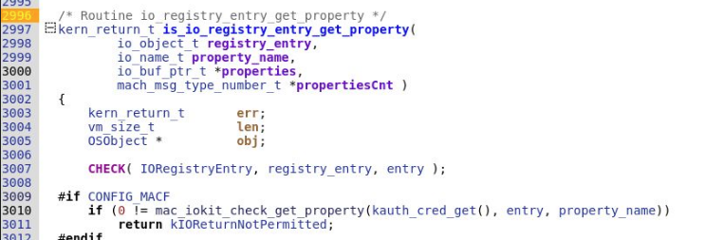
IOKIT PROPERTIES
IOKit drivers allow the getting/setting of their properties from userland
  Userland API leads to kernel function
is_io_registry_entry_get_property
  MACF specific code addition (#ifdef CONFIG_MACF)

Slide 14
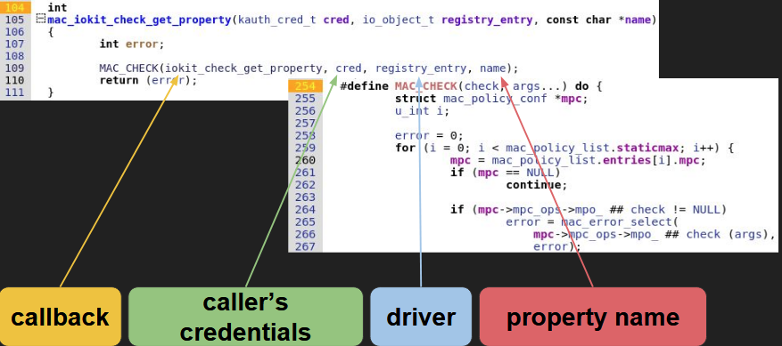
MAC_IOKIT_CHECK_GET_PROPERTY
One example of an entry function to MACF for making an access control decision (IOKit get property here)

Slide 15
SANDBOX PROFILES
Each hook implements a check (implemented in the kernel)
  Specifically called at certain code points as we saw
  These hooks/operations are used in profiles
  Profiles specify allowed operations and conditions on them
During the kernel’s (or a kext’s) initialization
mac_policy_register is called
  Registers hooks (operations) from the mac_policy_ops struct
  Calls hook_policy_init which loads the sandbox profiles

Slide 16
IOS SANDBOX IMPLEMENTATION
Closed source both on iOS and on macOS
  Sandbox Profile Language (SBPL) - (Tiny)Scheme
  No container.sb there
On iOS profiles compiled and packed in the kext itself
  Sandbox.kext binary has no symbols
  Only some strings (that can aid symbolization/RE)

Slide 17
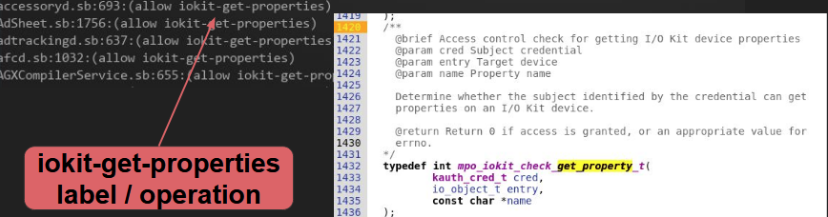
OPERATIONS
An operation is some action that an app wants to perform
that is checked by the sandbox
  Abstract names (labels) corresponding to MACF callbacks
  Callbacks defined in security/mac_policy.h
  Implemented in the sandbox kext

Slide 18
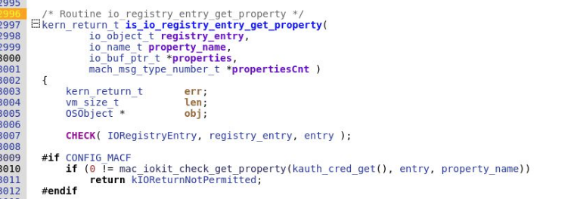
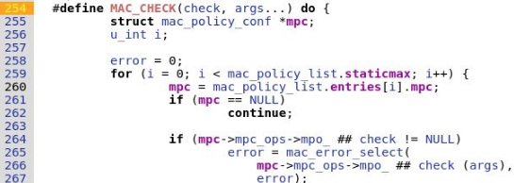

CONFIG_MACF CALLBACKS

Slide 19
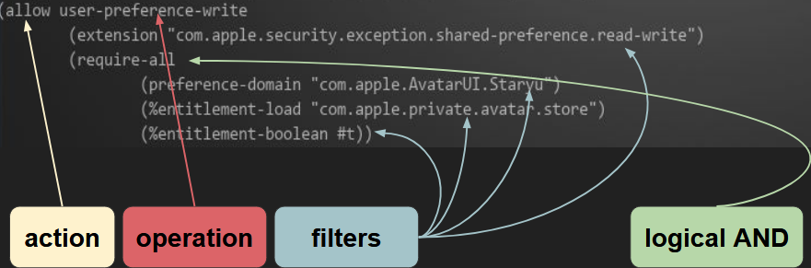
SBPL NOTES
  Action or “decision”
  Logical OR == “require-any”
  All together == rule

Slide 20
FINDINGS
XPC daemons sandboxed on newer devices, unsandboxed on older devices
Sandboxed XPC daemons/IOKit drivers may differ among iOS versions
  And their profile conditions (filters)
Even more surprising results when you dig deeper

Slide 21
ATTACK SURFACE ENUMERATION
Assumption: we start as a regular app
  Dev signed or compromised
  No container.sb there
Goal: LPE and then kernel code execution
  LPE: app (mobile) -> root || app -> sandbox escape
  Direct kernel code execution possible but surface keeps
getting smaller/hardened
Automated; output stored per iOS version and device model
  So diff among them is possible

Slide 22
ATTACK SURFACE ENUMERATION PT.2
Analyze container.sb and gather all reachable XPC services
  And the required entitlements (and other conditions
Analyze each XPC service’s profile and gather all reachable IOKit UserClients
The diff among iOS releases helps you define attack paths :)

Slide 23
SECTION 3
COVERT APPS

Slide 24
COVERT APPS = TL;DR
Signed, stealthy, and living inside policy.

Slide 25
HOW COVERT APPS GET IN
  Enterprise certs / MDM abuse / TestFlight & adhoc provisioning/ social engineering sideloads
  Supply-chain installs and repackaging (trojanized libs)

Slide 26
ENTITLEMENT ABUSE
  Some entitlements are effectively privileged tokens (private entitlements, socket/network entitlements, IOKit access).
  Plist/effective entitlement masquerade, provisioning edge cases.

Slide 27
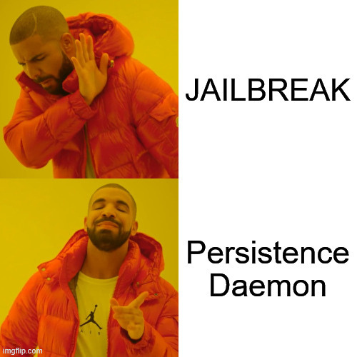
PERSISTENCE WITHOUT JAILBREAK
  Launch daemons via enterprise provisioning / abusing MDM-managed agents / update mechanisms / abusing background fetch & silent pushes
  Minimize visibility by using user facing schedules, that can mimic legitimate app behavior.

Slide 28
DYNAMIC INJECTION & HIDING
  Frida / Objection attach patterns, dylib/symbol hooking, runtime code patching (in-memory)
  Anti-instrumentation can help as it can detect debuggers, obfuscate strings, throttle behaviors to avoid anomaly detection.

Slide 29
DETECTING COVERT APPS
(STATIC & DYNAMIC)
  Static: sign/entitlement checks, inspect provisioning, scan for suspicious libs or exported services.
  Dynamic: baseline telemetry, watch for abnormal background wake counts, unusual IPC/XPC calls.

Slide 30
DEMO #1
SANDBOX PROBE

Slide 31
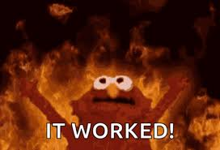
DEMO TAKEAWAY

Slide 32
COVERT APPS TAKEAWAYS & MITIGATIONS
Prioritize exported services, harden provisioning, monitor telemetry baselines, rate limit suspicious userclient/IOCTL activity.
Fix priority = user facing > background > debug

Slide 33
SECTION 4
GPU SPACE/RADIO STACK

Slide 34
THE FORGOTTEN PRIVILEGE SURFACE
GPU drivers are complex, privileged, and accept rich inputs (shaders, buffers) → high risk
Drivers run close to kernel resources (DMA, mapped memory).
Under monitored in many app telemetry pipelines.

Slide 35
GPU ATTACK SURFACE OVERVIEW
App →
Metal/OpenGL →
userclient →
driver →
kernel resources
Key areas:
shader parsing, buffer descriptors, IOCTLs, sync primitives.

Slide 36
WHY DRIVERS ARE LIKELY TO FAIL
Huge code surface + many platform-specific optimizations
Custom parsers and many edge cases (shaders, formats).
Complex memory management: shared buffers, DMA, caches → race & use after free risk.

Slide 37
USERLAND INPUTS THAT MATTER
Shader languages & compilers (vertex/fragment/compute).
Buffer/descriptor formats (vertex buffers, textures, compressed formats)
GPU command streams, sync primitives, and timing/race conditions
Malformed inputs or carefully timed sequences can destabilize the driver.

Slide 38
TELEMETRY & GPU FAILURES
Driver crashes surface as kernel logs, panic traces, and GPU fault registers.
Correlate app activity (shader compiles, heavy renders) with driver faults.
Many telemetry systems ignore intermittent GPU errors even on iOS 17>

Slide 39
WHAT TO WATCH FOR
Detection rules to add: sudden spikes in GPU API errors; repeated shader compile failures from same app.
Watch for abnormal IOCTL frequency or unusual userclient open counts.
Forensics = kernel backtraces, GPU error registers, correlated process timestamps.

Slide 40
DEMO #2
GPU DATA

Slide 41
BASEBAND + RADIO STACK EXPLOIT CHAINS
Baseband runs its own RTOS, often neglected.
Attack surface
SMS, Wi-Fi, LTE, Bluetooth.
Compromise → pivot into kernel space.

Slide 42
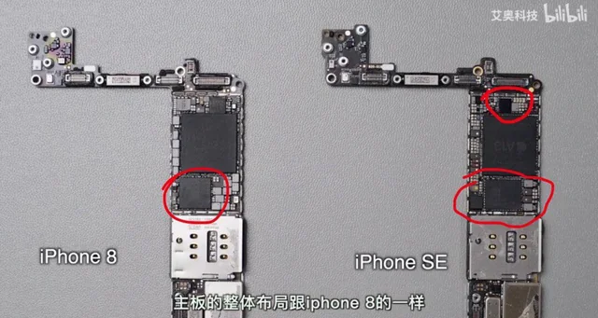
BASEBAND DIAGRAM

Slide 43

SECTION 5
FUTURE OUTLOOK

Slide 44
WHATS NEXT??
Jailbroken iPhone = your first lab.
Corellium / DockerOSX = next step.
iOS Static & Dynamic App Analysis
Reverse entitlements & sandbox profiles.
Learn, share, meme and collab with the community.

Slide 45
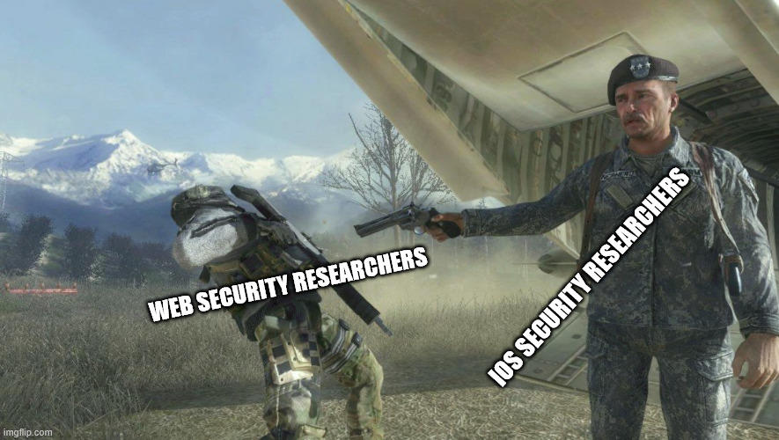
_MY_HOPE:_

Slide 46





THANK YOU
GET IN TOUCH
+7 (499) 244-16-06
WWW.LINKEDIN.COM/IN/JACKSESSIONS
JACKSESSIONS@PROTONMAIL.COM

Slide 47

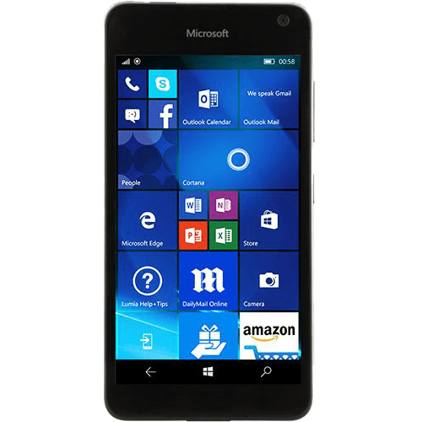

FREESTYLE RAP

