Slide 1

Prove or Delete
10:15
5G
HookSmith
PROVEN
$ whoami --talk
Hardcoded AES key
REFUTED
Key is derived per call
UNREACHABLE
Ending the guesswork in mobile pentesting
Method never fired
Jack Sessions
UNVALIDATED
N/A
Notes:
Walk on, say hi, point at the phone before I even start talking — that picture is the whole talk. Every finding ends up in one of four buckets, nothing else. Mention HookSmith is going open source today, and that there are six demos, all run for real while prepping this (not staged screenshots pretending to be live). I've got about 45 minutes; the content runs closer to 34, so there's real breathing room for questions and for a demo to misbehave without it wrecking the schedule. Colour code holds for the whole deck: green is PROVEN, yellow REFUTED, orange UNREACHABLE, magenta UNVALIDATED — always next to the word, never standing alone.

Slide 2

Jack Sessions
$ whoami
JS
Mobile security researcher, based in Sydney.
Spends most of the working week breaking Android and iOS apps the slow way
Website JackSessions.dev
HookSmith. Open source, as of today.
JACK SESSIONS
02 / 51
Notes:
NEEDS YOUR INPUT before this is final: I only had your actual name, location and the fact that you're releasing HookSmith today to work with — I deliberately didn't invent an employer, certifications, years of experience or social handles, since I have no way to verify any of that and getting it wrong on a SINCON badge slide would be worse than leaving it plain. Tell me what to add — company/role, OSCP-style letters, X/GitHub handle, whatever you actually want on screen — and I'll drop it straight in. Said out loud, keep it to two sentences: who you are, and that HookSmith goes open source today.

Slide 3

You’ve written “potential”
$ grep -ci potential report.md
- Potential hardcoded cryptographic key
- Possible cleartext HTTP traffic
- May use an insecure RNG
JACK SESSIONS
03 / 51
Notes:
T+0:30 (0:40). Make it personal before you make it technical. Ask for a show of hands — who's written 'potential' or 'possible' in a report because there just wasn't time to check? Let the hands stay up a second, let people look around. Then land it: it's a list of guesses, dressed up as evidence.

Slide 4

Same finding. Different report.
$ diff report.before report.after
AFTER · PROVEN
BEFORE
16-byte AES key seen at runtime equals a constant in the app
Potential hardcoded cryptographic key
evidence: none
hook.js · runtime.log · screen.mp4
JACK SESSIONS
04 / 51
Notes:
T+1:30 (0:40). This is the whole talk on one slide. Left is the sentence everyone writes. Right is the same finding, same bug, but now there's a verdict and the evidence to back it — the client can actually replay it themselves. Demo 3 produces exactly this, live, on a real OWASP MASTG app. Everything between here and there is just how we get from left to right without burning a day per app.

Slide 5

One finding. One hook. How long?
$ time ./write-frida-hook.sh
by hand
40 min
HookSmith
<1 min
So under deadline pressure, the step just gets dropped.
JACK SESSIONS
05 / 51
Notes:
T+2:10 (0:40). The bars are drawn to scale — 40 minutes to under a minute is a 40-to-1 ratio, so that sliver isn't me being cheeky, it's just what the math looks like. Thirty to forty minutes for a skilled Frida hook, and under a minute with HookSmith — both numbers are in the abstract and the README. Don't over-explain, just let the bars sit there, then tease: now multiply that by how many findings a real app actually has.

Slide 6
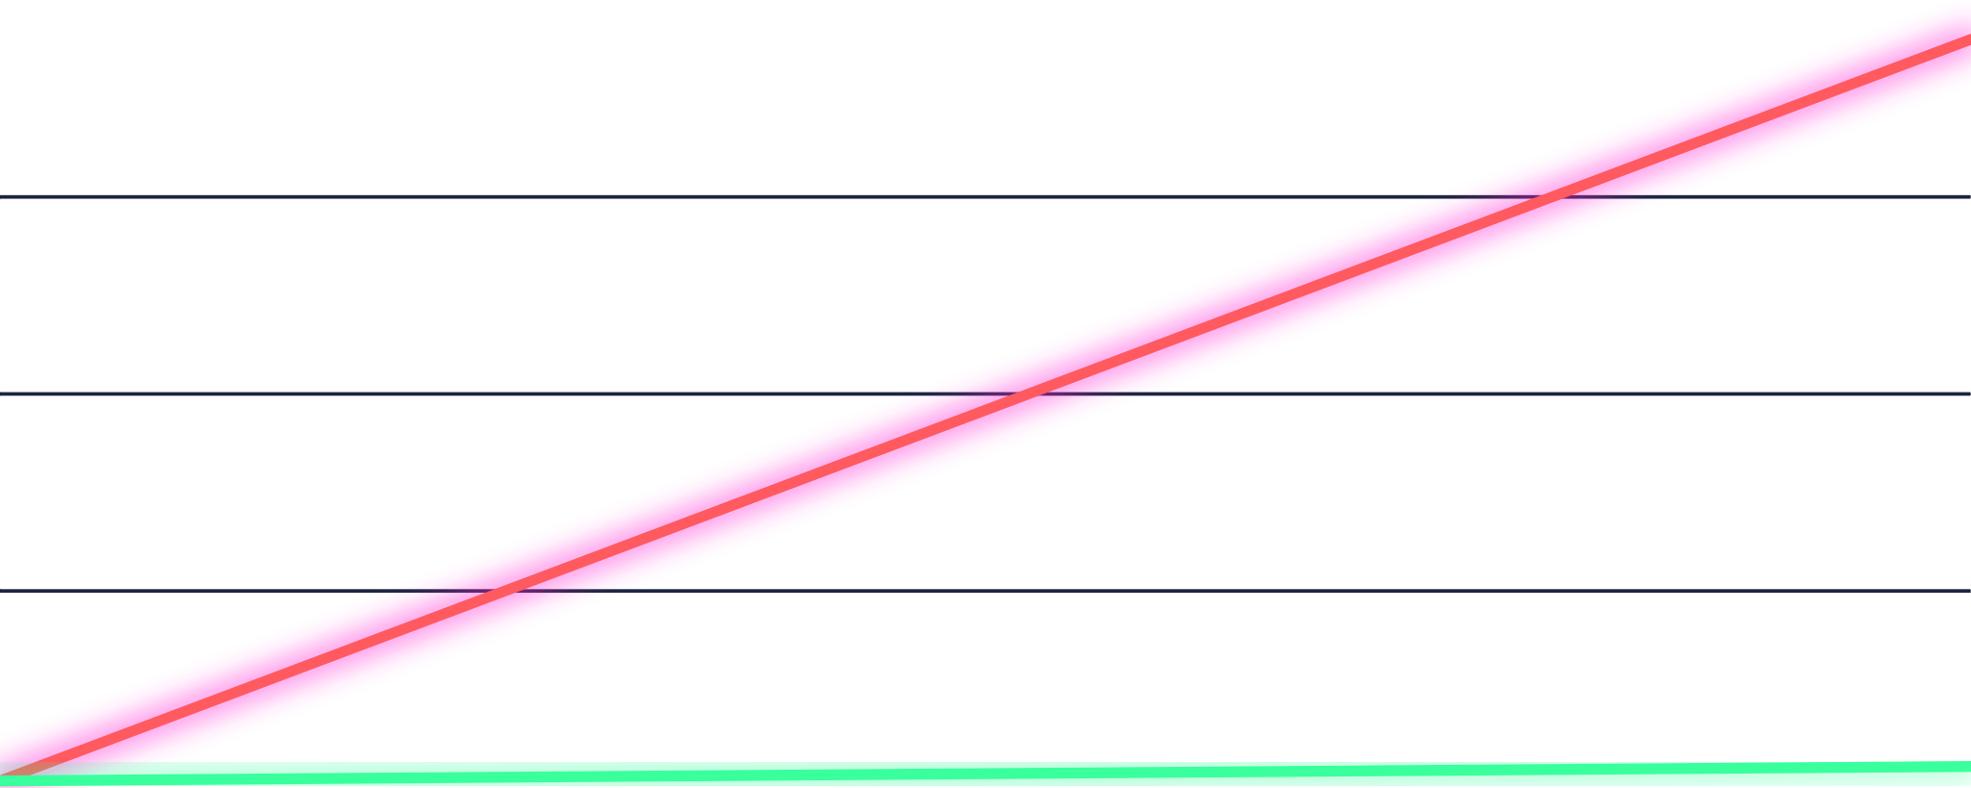
Now multiply by 200 findings
$ plot hours_vs_findings
140
133 h
by hand
105
70
35
3.3 h
0
HookSmith
0
100
200 findings
JACK SESSIONS
06 / 51
Notes:
T+2:50 (0:40). 200 findings at 40 minutes each is 8,000 minutes — 133 hours, basically three and a half working weeks on one app. At a minute each with HookSmith that's 200 minutes, 3.3 hours, and the README says under a minute so that's really the ceiling, not the floor. 200 findings is a made-up round number for the arithmetic — if you've got a real figure from your own assessment work, swap it in here, it'll land harder. The line itself comes from the two stated per-finding costs, not a stopwatch on a full run, and I'll say that if anyone asks.

Slide 7
Cost rewrites the wording
$ git log --oneline report.md
Confirmed
›
Likely
›
Potential
Nobody ever says it out loud.
JACK SESSIONS
07 / 51
Notes:
T+3:30 (0:30). The cost of proof quietly rewrites what the report says. Finding something is cheap, proving it costs forty minutes, so the wording absorbs that gap instead — and the client ends up reading certainty levels nobody actually measured. If you've got a real example from the MSTG apps or your own assessment work, this is the spot to tell it.

Slide 8

Prove it.
Or delete it.
$ hooksmith --rule
Four verdicts. No fifth bucket.
JACK SESSIONS
08 / 51
Notes:
T+4:00 (0:40). This is the pivot of the whole talk — pause here, let it sit for a beat before moving on. Every static finding leaves the assessment with a runtime verdict attached. No fifth bucket, no 'probably fine' hiding in the margins. And it's a methodology before it's a tool — works fine with pen and paper, the tool just makes it cheap enough to actually do every time. This and the cover are the only two slides carrying the tagline on them; everywhere else it's just the name.

Slide 9

One pile becomes four buckets
$ hooksmith explain
PROVEN
REFUTED
BEFORE
Hook ran. Claim held up. Evidence kept.
Hook ran. Claim was wrong. False positive, with proof.
“Potential”
UNREACHABLE
UNVALIDATED
Hook attached. Code never ran on the paths tried.
Couldn't even attach a hook. Here's exactly why.
JACK SESSIONS
09 / 51
Notes:
T+5:05 (1:10). Before: every finding dumped into one grey pile, all labelled 'potential'. After: four buckets, each one telling you what to actually do next. PROVEN — hook attached, method called, behaviour matched the claim, log kept: file it. REFUTED — same path, but the behaviour contradicted the claim: a false positive, and you've got proof, so close it. UNREACHABLE — hook attached but it never fired on the paths we exercised, could be real, could be dead code: try a longer timeout, --agent-plan, or just poke the app by hand. UNVALIDATED — couldn't even attach a hook (obfuscation, native code, a hallucinated hook) and the reason is written down, not guessed at. Worth saying out loud: the last two are legitimate outcomes, not failures of the tool — 'probably fine' is the only answer that isn't allowed. The dot grid is a drawing, not a real distribution, don't let anyone read numbers into it.

Slide 10
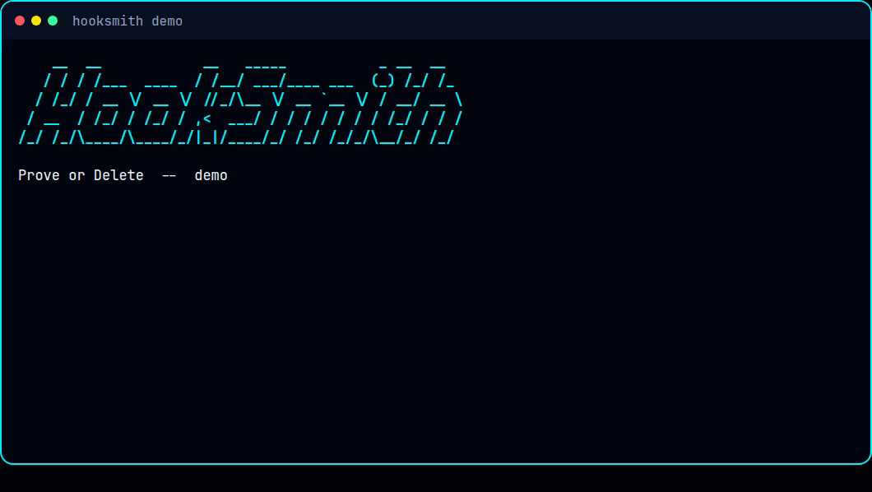
$ uv run hooksmith demo
Every verdict, one command
JACK SESSIONS
10 / 51

Slide 11
Not a scanner replacement. A missing step.
$ where does this sit in the toolchain
STATIC
PROVE OR DELETE
DYNAMIC / MANUAL
MobSF & friends
›
HookSmith
›
A pentester, by hand
Fast, broad, reads the APK. Every finding stays "potential." It never ran.
Takes those findings, writes the hook, runs it, hands back a verdict in minutes. Not a scanner result. Not a full pentest.
Business logic, chained exploits, judgment calls. The parts a verdict can't automate.
It clears the obvious pile automatically so the hours a pentester actually has go to the findings that need a human.
JACK SESSIONS
11 / 51
Notes:
Worth being precise here so nobody mistakes the pitch: HookSmith doesn't compete with MobSF or any static scanner — it consumes their output (`--report mobsf.json` is a real flag) and does the one thing they structurally can't: run the claim and watch what the app actually does. It also isn't trying to be a full dynamic-analysis or pentest replacement — there's no business-logic reasoning, no chaining findings into an exploit chain, no judgment about what's actually exploitable in context, and it won't try to be. The honest positioning is the narrow middle step: turn a pile of "potential" into PROVEN or REFUTED automatically, so the manual hours left in an engagement go to the findings that actually need a human — which is also exactly what the ROI argument from the cost slides earlier was about.

Slide 12
$ cat agenda.txt
Forty minutes, four demos
00:00
The problem and the four verdicts
why "potential" ends up in the report
07:00
Demo 1 · Prove a real app
OWASP UnCrackable L1, hardcoded AES key
13:00
How it's built
LangGraph, the validator, the signal library, real code
23:00
Demo 2 · TLS: trust-all vs strict
MITM-grade findings, and the false positives next to them
28:00
Demo 3 · A scanner PDF becomes a test plan
five read-only agents, planning only
32:00
Demo 4 · Fail the build on a verdict
--expect and --fail-on as a CI gate
36:00
Where it breaks, and Monday
R8, native code, iOS: the honest list
JACK SESSIONS
12 / 51

Slide 13
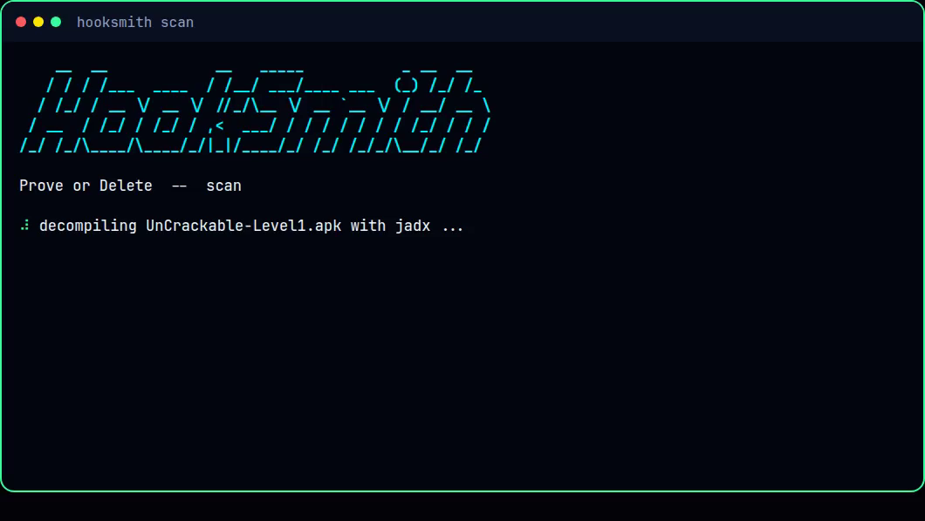
$ hooksmith scan --apk UnCrackable-Level1.apk
Demo 1 · APK in, findings out
JACK SESSIONS
13 / 51

Slide 14

Prove a real app
01
VIDEO · ON DEVICE
$ hooksmith run --report findings.json --apk UnCrackable-Level1.apk --package owasp.mstg.uncrackable1 --executor avd --provider template --record
PROVEN
16-byte key · 8d12…73cc
JACK SESSIONS
14 / 51
Notes:
This is the hero demo, the video should show the phone and the terminal side by side, exactly what --record captured on a real AVD (Android 13, Frida 17.22.2). Freestyle over it as it plays: the app launches, the Secret String field gets tapped, VERIFY, OK, and the result lands PROVEN with the real key 8d127684cbc37c17616d806cf50473cc. Worth a line while it runs: getting this working on a real app surfaced three genuine bugs I fixed rather than papered over, a misparsed constructor, a wrongly declined one-letter method, and a key search that only looked in the hooked class instead of the whole decompiled tree.

Slide 15
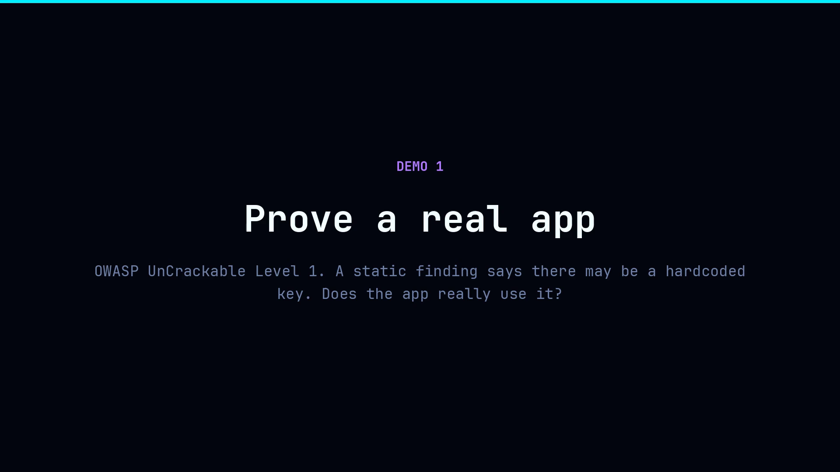
JACK SESSIONS
15 / 51

Slide 16

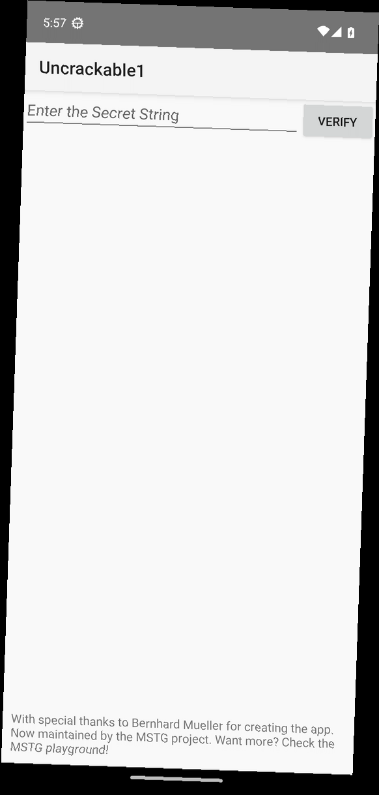
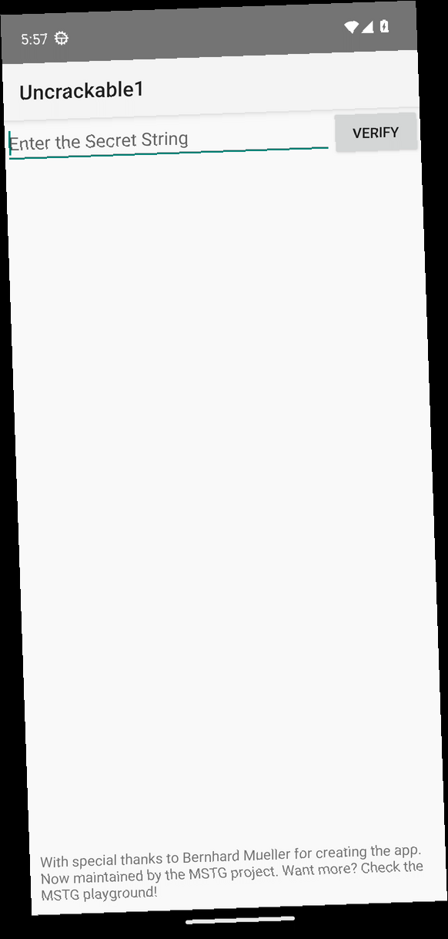
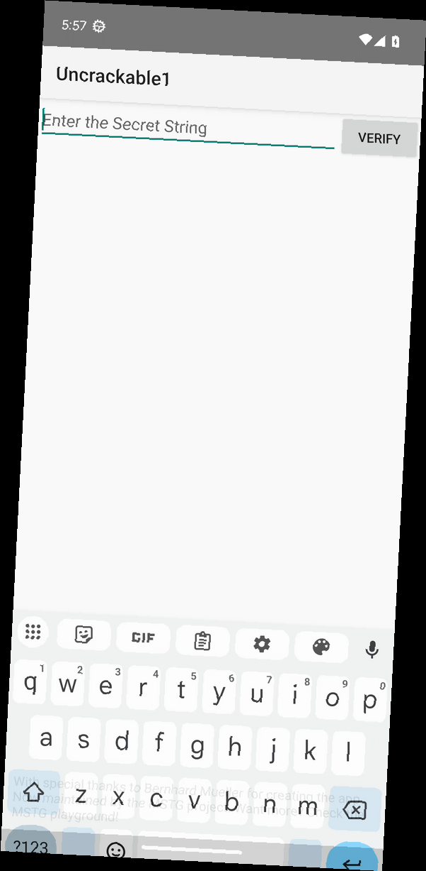
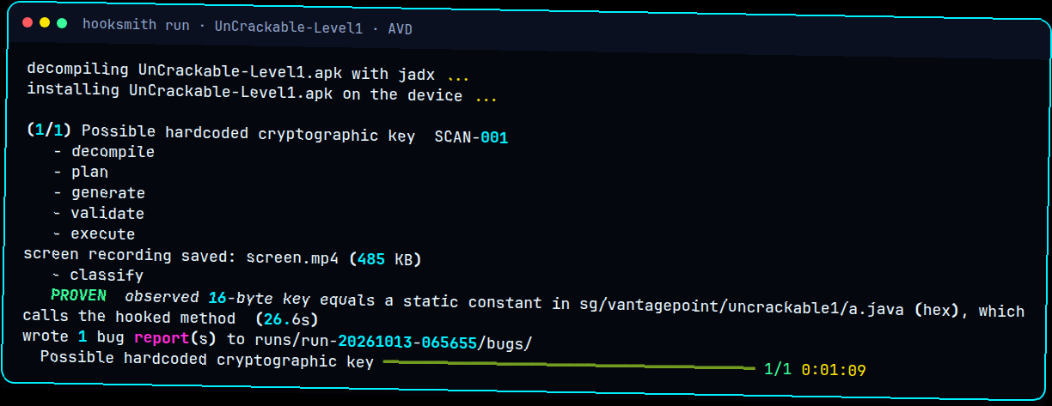
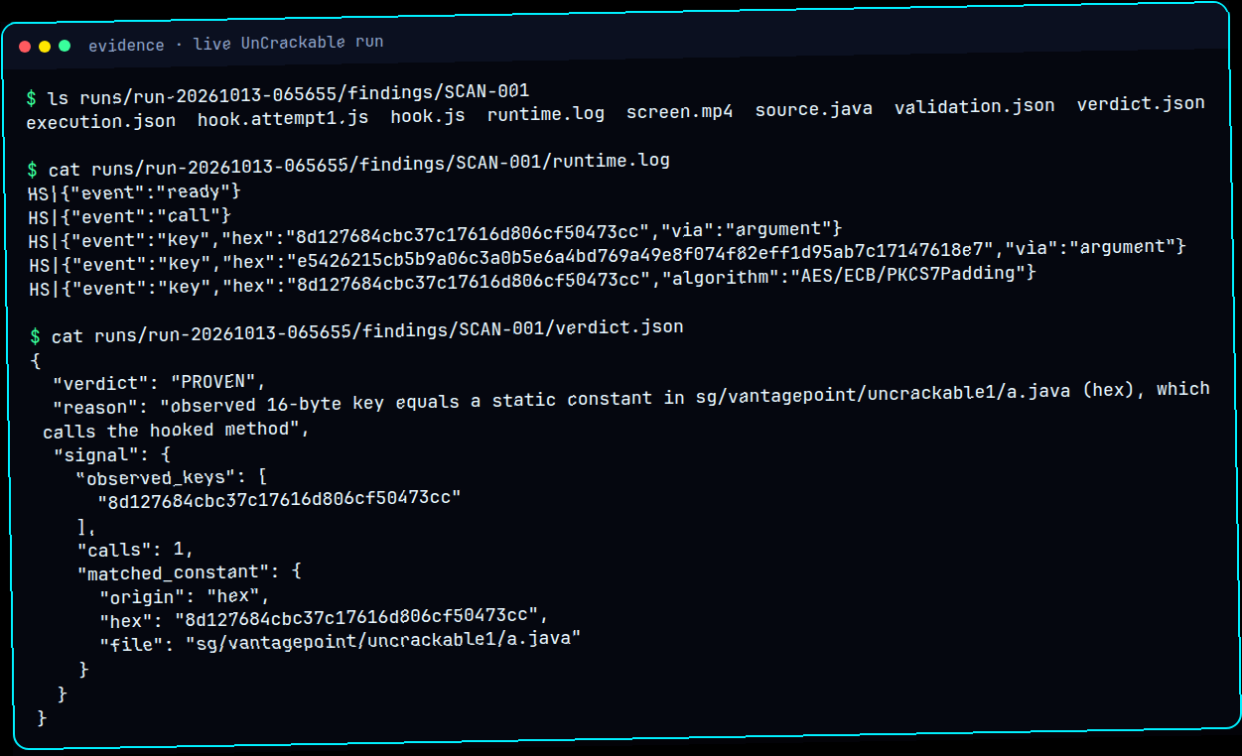
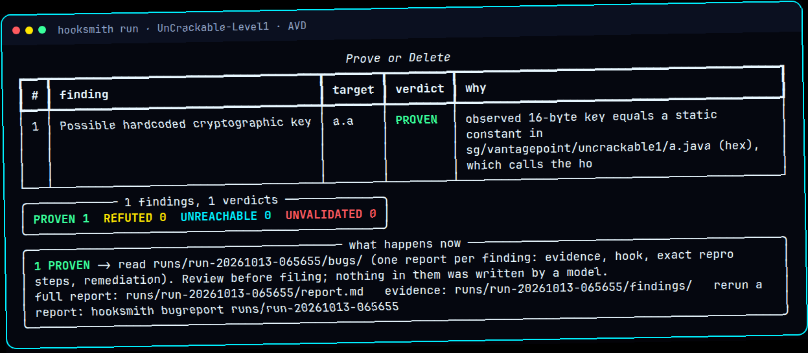
01
LIVE ON THE EMULATOR
16 / 51
Notes:
All real: the four phone frames come straight from the --record screen capture of the live run (splash screen, the app itself, the field focused, keyboard up). Terminal shots are the same run — PROVEN, the raw log with the key, and the final table. One thing worth remembering: on a cold run with --record, I hit 'Invalid cross-device link' because the recording gets moved out of /tmp across filesystems — pointing TMPDIR at the same disk as the output folder fixed it. Set that the same way before the talk.

Slide 17
$ hooksmith run --report findings.json --apk UnCrackable-Level1.apk --executor replay
What the tool prints
(1/1) Possible hardcoded cryptographic key SCAN-001
- decompile - plan - generate - validate - execute - classify
PROVEN observed 16-byte key equals a static constant in
sg/vantagepoint/uncrackable1/a.java (hex), which calls the hooked method
1 findings, 1 verdicts
PROVEN 1 REFUTED 0 UNREACHABLE 0 UNVALIDATED 0
Replayed from the recorded device run. Same pipeline, same verdict, no phone needed.
JACK SESSIONS
17 / 51

Slide 18
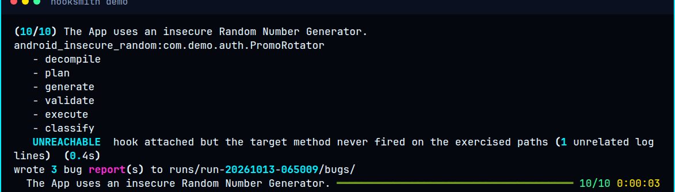
Code reads the log. Code decides.
$ cat signals.py
Finding | PROVEN | REFUTED
Hardcoded key | Matches a constant | Changes per call
Cleartext HTTP | http:// seen | https only
Insecure RNG | Random in key code | SecureRandom
JACK SESSIONS
18 / 51
Notes:
This is the reference signal library for three common finding types — two more cover TLS, next slide. Hardcoded key is PROVEN when a 16, 24 or 32-byte key observed at runtime matches a constant in the decompiled class, REFUTED when the key changes between calls — you saw both in Demo 1. Cleartext HTTP is PROVEN on any http:// URL to a non-loopback host, REFUTED if everything was https or loopback. Insecure RNG is PROVEN when Random or Math.random shows up in a security-relevant method, REFUTED when it's SecureRandom or there's no security context. Every rule reads that same structured log, so the same input always gives the same verdict, and the model never gets a vote.

Slide 19
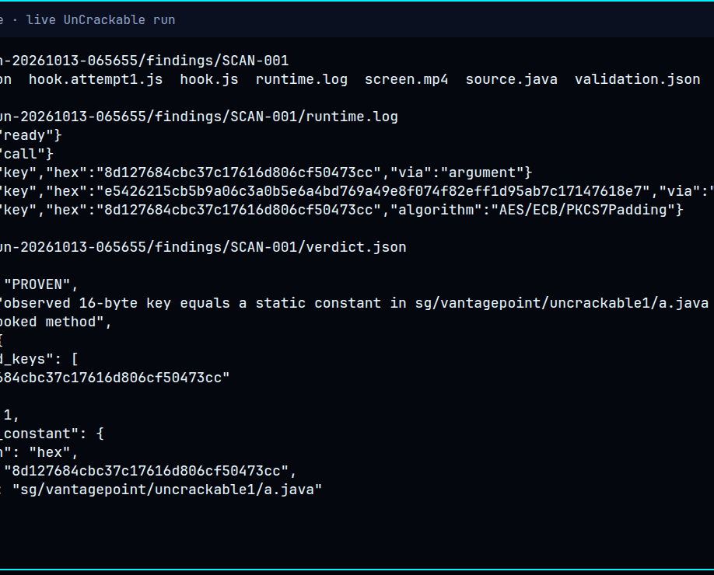
Every verdict is a folder
$ tree runs/run-…
runs/run-…/
run.json
findings/<id>/
Replay it.
Don't just take my word.
hook.js · runtime.log
verdict.json · screen.mp4
bugs/<id>.md
JACK SESSIONS
19 / 51
Notes:
Evidence is really the product, and you've been seeing it all talk without me labelling it — that photo in the middle is a real evidence folder, ls'd, with the real runtime.log and verdict.json for an actual PROVEN finding. Every generated hook gets kept, validated or not, plus the raw log and a verdict that says exactly what the signal library saw. screen.mp4 only shows up if that run used --record. run.json pins the APK hash, model, temperature, prompt hash, Frida version and device, so a verdict can actually be reproduced, not just trusted. `hooksmith evidence <run> <finding>` prints the whole bundle, and `--replay-from` replays logs recorded earlier — exactly how demos 5 and 6 work.

Slide 20
Inside the machine
$ hooksmith run --report findings.json
Triage
›
Decompile
›
Plan
›
Generate
›
Validate
dedupe · order
jadx
how to reach it
LLM
7 checks
Execute
›
Classify
›
Record
›
Report
Frida, on device
signal library
evidence
bug per PROVEN
The model writes. Code decides.
JACK SESSIONS
20 / 51
Notes:
T+6:15 (1:10). The whole architecture in two rows. It's a LangGraph state machine. Top row runs before any device is touched: triage once up front, decompile with jadx, work out how to reach the code — deep links, exported activities, taps — then generate the hook and validate it against seven static checks. Bottom row is the device: run the hook with Frida, let the signal library classify what came back, write the evidence to disk, and once every finding has a verdict, write one bug report per PROVEN finding. The design decision worth remembering: the model writes the hook and nothing past that — every verdict is plain code reading a structured log, never the model's opinion. Up next, Demo 1 runs the whole thing start to finish on a sample app.

Slide 21
$ cat src/hooksmith/graph.py
The pipeline is a state machine
Every edge a failure can take is written down. Nothing falls through.
graph.py
g = StateGraph(State)
g.add_edge("triage", "next_finding")
g.add_conditional_edges("decompile", after_decompile,
{"record": "record", "plan": "plan"})
g.add_edge("plan", "generate")
g.add_conditional_edges("validate", after_validate,
{"record": "record", "execute": "execute",
"generate": "generate"})
g.add_edge("classify", "record")
g.add_edge("record", "next_finding")
the routing function
def after_validate(s):
if s.get("outcome"):
return "record"
ok = s["attempts"][-1].validation.ok
return "execute" if ok else "generate"
# fail twice: UNVALIDATED
# never a third try
A hook that fails validation loops back to generate once, with the errors fed in. Two failures end as UNVALIDATED.
JACK SESSIONS
21 / 51

Slide 22

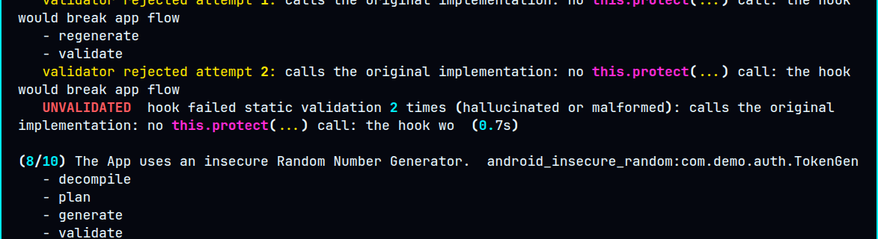
What the model is actually told
$ cat prompts/system.txt prompts/hardcoded_key.txt
1 · HOUSE RULES
Output only JavaScript due to Frida
Edge LLM
2 · THE CLAIM
This method uses a constant key. Log the key bytes.
↓
3 · WORKED EXAMPLE
A correct hook for a different class, to copy from/build upon.
hook.js
4 · YOUR TARGET
Class, method, and the decompiled source.
JACK SESSIONS
22 / 51
Notes:
This replaces the generic 'a model writes the hook' hand-wave with what the model's actually handed, straight out of the prompts folder. Layer 1, system.txt: write hooks that OBSERVE one method, output only JavaScript, wrap it in Java.perform, always call the original, report only through console.log with an HS| prefix, no eval, no Runtime.exec, no sockets. Layer 2 is the finding-type file — the claim to test plus what evidence to log. Layer 3 is one worked example to copy the structure from. Layer 4 is the actual target. Temperature's 0.1. You can point this at the Cloudflare Worker, any OpenAI-compatible endpoint, RunPod, or an offline template with no model at all. Be straight if asked: the Worker's bundled but not yet deployed, and I haven't benchmarked its output quality.

Slide 23
A real Frida hook it wrote
$ cat findings/TokenGen/hook.js
function hex(b){ … }
Java.perform(function () {
var C = Java.use("com.demo.auth.TokenGen");
var inTarget = 0;
var R = Java.use("java.util.Random");
R.nextInt.overloads.forEach(function (ov) {
ov.implementation = function () {
if (inTarget > 0) console.log("HS|" + JSON.stringify(
{event: "random", impl: "java.util.Random"}));
return ov.apply(this, arguments);
}});
C.newSessionToken.overload().implementation = function () {
inTarget++;
try { console.log("HS|" + JSON.stringify({event: "call"}));
return this.newSessionToken.apply(this, arguments);
} finally { inTarget--; }
};
console.log("HS|" + JSON.stringify({event: "ready"}));
});
WHAT IT PROMISES
ready
hook installed
call
target method ran
random
java.util.Random, in target
original
always called, result unchanged
7 gates check this before it ever runs.
JACK SESSIONS
23 / 51

Slide 24
$ cat src/hooksmith/validator.py
Model output is untrusted input
Seven gates run before a single second of device time is spent.
validator.py (trimmed)
uses = [m.group(2) for m in _USE_RE.finditer(js)]
add("Java.use targets the correct class",
class_name in uses,
f"expected Java.use({class_name!r}); found {uses}")
add("calls the original implementation",
bool(calls_orig),
f"no this.{method}(...) call: breaks app flow")
bad = [l for p, l in FORBIDDEN.items() if re.search(p, js)]
add("avoids dangerous APIs", not bad, ...)
FORBIDDEN, in generated hooks
eval(), new Function()
Runtime.getRuntime, ProcessBuilder
System.exit, killProcess
Socket / URL.openConnection
Interceptor.replace
Memory.write / protect
File writers, require(), import()
JACK SESSIONS
24 / 51

Slide 25
Seven gates, then two strikes
$ hooksmith validate hook.js
01
02
03
04
05
06
07
Parses as JS
Java.perform
Right class
Right method
Logs output
Calls original
Safe APIs only
TokenGen · attempt 1 · REJECTED at gate 03
expected Java.use('com.demo.auth.TokenGen')
found ['com.demo.auth.TokenFactory', 'java.util.Random']
attempt 2 · regenerated with that error · PASS
Fail twice and it's UNVALIDATED. No third try.
JACK SESSIONS
25 / 51
Notes:
T+13:50 (1:05). These are the patterns worth taking home. 01: parses as JavaScript, because Frida runs modern JS and node --check is a cheap sanity check. 02: contains Java.perform. 03: Java.use hits exactly the finding's class — models will happily hook a plausible-sounding neighbour instead. 04: hooks the requested method, overload-aware. 05: actually produces observable output. 06: calls the original implementation — skip that and the hook breaks app flow and stops firing after one call. 07: avoids dangerous APIs, eval, Runtime.exec, sockets, file writes, Interceptor.replace, memory writes. The two highlighted here are the two that actually fired in Demo 1: TokenGen failed gate 03 on attempt one (hooked TokenFactory, that's the real validator message on screen), got regenerated, passed. PinStore failed gate 06 on both attempts and ended UNVALIDATED with no recovery. Worth being upfront: these gates catch structural problems, not a well-formed hook pointed at the wrong overload — that's a real gap, not swept under anything.

Slide 26
$ cat src/hooksmith/signals.py
The model writes. Code decides.
The LLM never sees this file, and never picks the verdict.
signals.py: hardcoded_key (trimmed)
if not keys:
return Outcome(UNVALIDATED, "fired, but no key seen")
if len(distinct) > 1:
return Outcome(REFUTED,
"key differs across calls: derived")
for origin, raw in key_constants(source):
if raw == keys[0]:
return Outcome(PROVEN,
"equals a static constant in the class")
return Outcome(UNVALIDATED, "matches no constant")
the only contract
HS|{"event": "ready"}
HS|{"event": "call"}
HS|{"event": "key", "hex": ...}
HS|{"event": "url", ...}
HS|{"event": "tls_chain", ...}
One line protocol. No free-text parsing.
Same input, same verdict, every time. That is what lets a verdict be a regression test later.
JACK SESSIONS
26 / 51

Slide 27
What the hook prints back
$ cat findings/SCAN-001/runtime.log
ready
HS|{"event":"ready"}
Hook's installed.
HS|{"event":"call"}
call
HS|{"event":"key","hex":"8d127684cbc37c17616d806cf50473cc",
Target method actually ran.
"algorithm":"AES/ECB/PKCS7Padding"}
key
The real 16 bytes the app used.
Code checks those bytes against the app’s constants.
Match: PROVEN.
JACK SESSIONS
27 / 51
Notes:
T+12:55 (0:55). This is a real runtime.log, trimmed, from the recorded UnCrackable-Level1 run. The hook talks back through one line format, HS| plus JSON, so nothing downstream ever has to parse free text. 'ready' fires once, the moment the hook's installed. 'call' fires every time the target method runs. 'key' is the actual evidence — bytes in hex plus the algorithm, captured where the key enters SecretKeySpec while that method's on the stack. That hex, 8d127684cbc37c17616d806cf50473cc, is the real 16-byte key from that run. The model never sees this log and gets no vote on what it means — signals.py compares those bytes against constants pulled from the decompiled source and makes the call. Next: how a hook gets checked before it ever touches a device.

Slide 28
$ git log --grep uncrackable
Three bugs a real app found in my tool
javasrc.py
A method named like its class was parsed as a constructor
sg.vantagepoint.a.a declares a static a(). Every hook pointed at the wrong target.
decompile.py
The obfuscation gate refused an unambiguous method
Single letter names scored as obfuscated. Now it only applies when the method had to be guessed.
signals.py
The real key lived in the caller, not the hooked class
The match only searched one class. Now it falls back to the whole decompiled tree.
JACK SESSIONS
28 / 51

Slide 29

Spawn, hook, exercise, collect
$ frida -U -f com.target.app -l hook.js
01 Spawn
›
02 Attach
›
03 Resume
›
04 Exercise
›
05 Collect
Spawn, don't attach: the code that matters runs in onCreate.
THREE THINGS THAT BIT ME
Set a log handler
Bundle the Java bridge
Deoptimize first
console.log isn't a message since Frida 15.
Frida 17 dropped it; run through frida-compile.
ART kept compiling around our hooks.
JACK SESSIONS
29 / 51
Notes:
Spawn the app suspended, attach, load the hook, resume it, exercise, collect the log. The photo is a real frame pulled from a --record capture on a live device, not a mockup — it's the splash screen right as a real run starts. Exercising means walking the manifest's deep links and activities, then poking the UI, then a short monkey burst. Navigation only — uiautomator taps controls in the target package, never types text, hard-blocked from anything labelled delete, log out, purchase or payment. The three bugs are real field notes from the first time I ran this on an actual device: console.log stopped being a message in Frida 15+, register a log handler or everything silently looks UNREACHABLE; Frida 17 pulled the Java bridge, hooks now bundle through frida-compile (cached after the first time); hooks on the app's own classes just wouldn't fire because ART had compiled around them, Java.deoptimizeEverything() fixed it.

Slide 30
02
LIVE · VULNLAB · NEEDS INTERNET
TLS: trust-all against strict
$ hooksmith run --report vulnlab/findings.json \
--apk vulnlab.apk --executor avd \
--provider template --record --expect vulnlab/expected.json
JACK SESSIONS
30 / 51

Slide 31
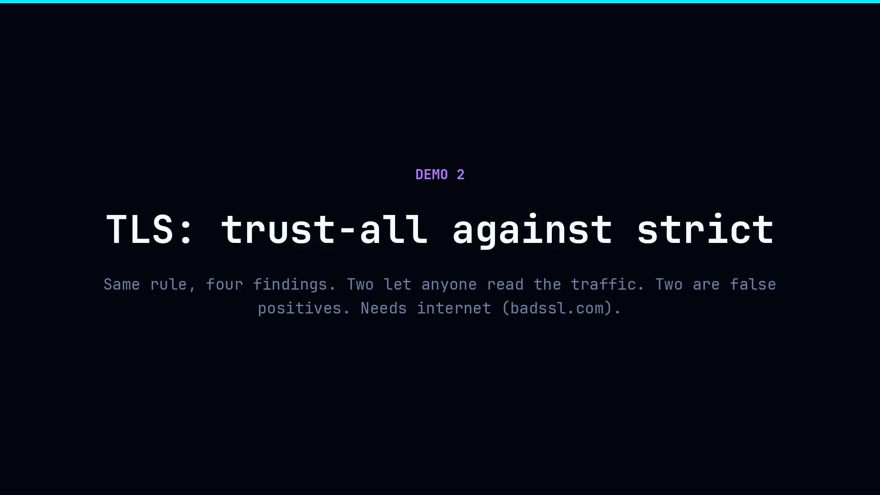
JACK SESSIONS
31 / 51

Slide 32
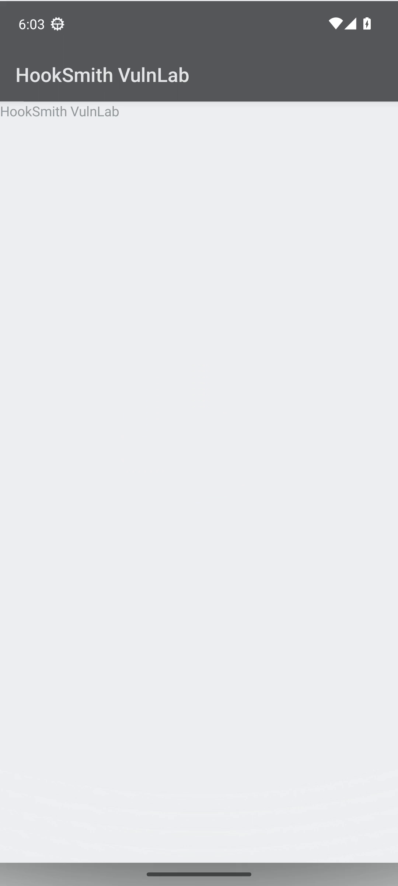
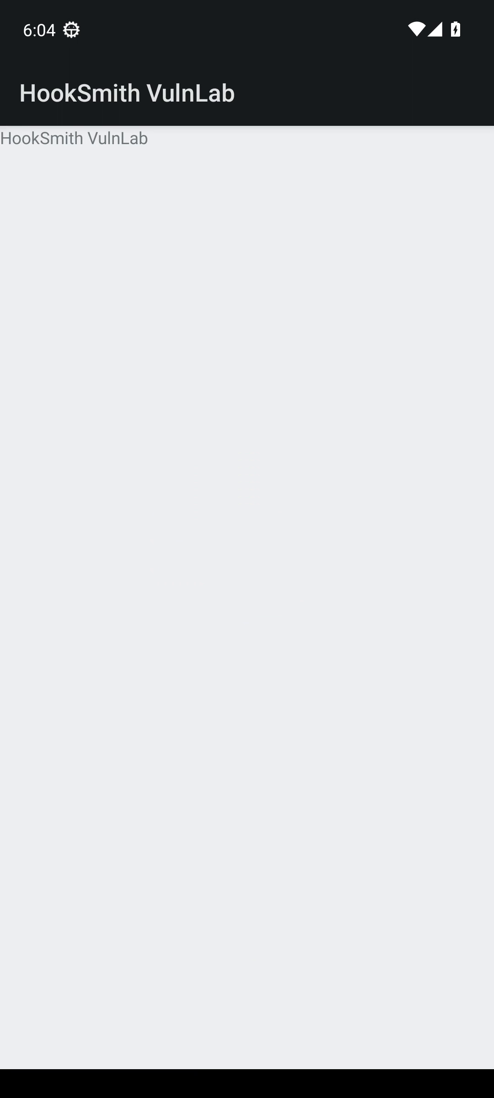
$ hooksmith run --apk vulnlab.apk --record
Same hook, same app, two TrustManagers
PROVEN
REFUTED
TrustAllManager
StrictTrustManager
JACK SESSIONS
32 / 51

Slide 33
$ cat TrustAllManager.java; cat findings/VL-8/runtime.log
What a hook can see about a certificate
TrustAllManager.java
public class TrustAllManager
implements X509TrustManager {
public void checkServerTrusted(
X509Certificate[] chain,
String authType) {
} // accepts everything
}
runtime.log (VL-8)
HS|{"event":"call"}
HS|{"event":"tls_chain",
"accepted": true,
"self_signed": true,
"subject": "CN=*.badssl.com"}
The hook calls the original and logs whether it accepted a bad chain. Accepted a self-signed one: PROVEN.
JACK SESSIONS
33 / 51

Slide 34
$ hooksmith run --report vulnlab/findings.json --apk vulnlab.apk --expect vulnlab/expected.json
TLS, as the terminal shows it
(6/11) TrustManager accepts any certificate VL-8
PROVEN accepted a self-signed certificate chain for CN=*.badssl.com
(7/11) TrustManager (platform delegate) VL-9
REFUTED rejected a certificate chain: validation is in place
(8/11) HostnameVerifier allows any hostname VL-10
PROVEN returned true for wrong.host.badssl.com, which the certificate does not cover
(9/11) HostnameVerifier (platform default) VL-11
REFUTED rejected a hostname the certificate does not cover
11 findings, 11 verdicts PROVEN 5 REFUTED 5 UNREACHABLE 1 UNVALIDATED 0
harness: passed
Per-step lines trimmed. --expect compares every verdict to the pinned file and exits 0.
JACK SESSIONS
34 / 51

Slide 35
$ hooksmith report
Four findings, four verdicts
VL-8
TrustAllManager.checkServerTrusted
PROVEN
accepted a self-signed chain for *.badssl.com
VL-9
StrictTrustManager.checkServerTrusted
REFUTED
rejected a chain: validation is in place
VL-10
AllowAllVerifier.verify
PROVEN
returned true for wrong.host.badssl.com
VL-11
StrictVerifier.verify
REFUTED
rejected a host the certificate does not cover
Two are real MITM bugs with a certificate in the log. Two are closed as false positives, with the same evidence.
JACK SESSIONS
35 / 51

Slide 36
When a hook can’t tell
$ hooksmith explain tls
Trust all
=
Correct
...if every server it talked to was configured right.
UNVALIDATED
No bad cert shown, no verdict given.
JACK SESSIONS
36 / 51
Notes:
T+20:10 (0:40). This is the slide that earns trust, so don't rush past it. The trust-manager and hostname-verifier signals only mean something if the app actually got exercised against a bad certificate. PROVEN means the original call accepted a self-signed or expired chain, or returned true for a host the cert doesn't cover. REFUTED means it rejected one. If the app only ever talked to properly configured servers, a trust-all manager and a correct one look identical from inside a hook — so the verdict is UNVALIDATED, with that exact reason, not a guess dressed up as one. To actually get a decision, you exercise the app against an endpoint with a deliberately bad cert. Demos 4 and 5 both include TLS findings decided this way, against badssl.com hosts.

Slide 37
03
PLANNING ONLY · NO DEVICE
A scanner PDF becomes a test plan
A real 16-page scanner report, 45 claims, 32 read only model calls. It produces a plan..
JACK SESSIONS
37 / 51

Slide 38
$ cat master-plan.md
One plan entry, from a real 45-item report
Planning only. PDF assertions are not runtime vulnerability verdicts.
Counts: confirmed_items 45 · plans 45 · inference_calls 32 · pages_read 16 · rejected 0
## Google Tag Manager
PDF claim: The report lists Google Tag Manager as an analytics tracker.
Behavior to test: check tracker detection for this named tracker.
Confirmation: PDF=True; source=False; runtime=False
Evidence: PDF page 12, extracted lines 21-23
JACK SESSIONS
38 / 51

Slide 39
Five agents, one planner
$ ls examples/run-57ea…/
01
report-reader
reads the scanner PDF
pages → 45 claims
5 calls
02
source-reader
reads decompiled source
finds the method
1 call
03
target-validator
is the target real?
class · method · overload
7 calls
04
master-planner
builds the plan
one plan per item
12 calls
05
evidence-reviewer
independent second look
reviews, never writes
7 calls
32 inference calls · 16 pages read · 45 items confirmed · 0 rejected
Each agent is a read-only codex exec with a JSON output schema. It can read. It cannot run anything.
JACK SESSIONS
39 / 51

Slide 40
The master plan
$ cat master-plan.md
PDF
scanner report
16 pages
45 items
claims, quoted with page + lines
confirmed_in_pdf
master-plan.json
setup · exercise steps · future Frida observation
one plan each
review
evidence-reviewer
independent
›
›
›
"planning_only": true
"execution_authorized": false
The plan is a claim to test, not a verdict. PDF confirmed ≠ source confirmed ≠ runtime confirmed.
EVERY ITEM CARRIES
behavior_to_test
exercise_steps
future_frida_observation
future_hook_generator_prompt
remaining_unknown_details
JACK SESSIONS
40 / 51

Slide 41
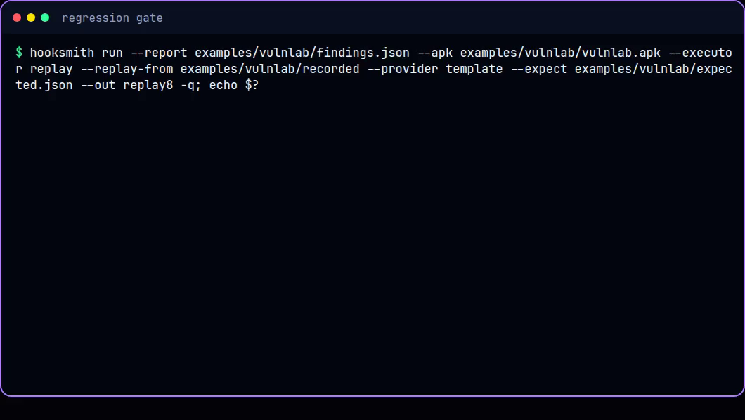
Fail the build on a verdict
04
exit 0
exit 1
$ hooksmith run ... --expect expected.json; echo $?
JACK SESSIONS
41 / 51
Notes:
Real terminal, both runs for real: the clean pass first, exit 0, all 11 verdicts matched, replayed deterministically. Then the flipped-pin pass — VL-2 changed from REFUTED to PROVEN in a copy of expected.json, run again, 'harness: FAILED', exit 1, naming exactly what differed. Mention --fail-on and --max-unvalidated in passing. This is the slide that turns the whole talk practical.

Slide 42
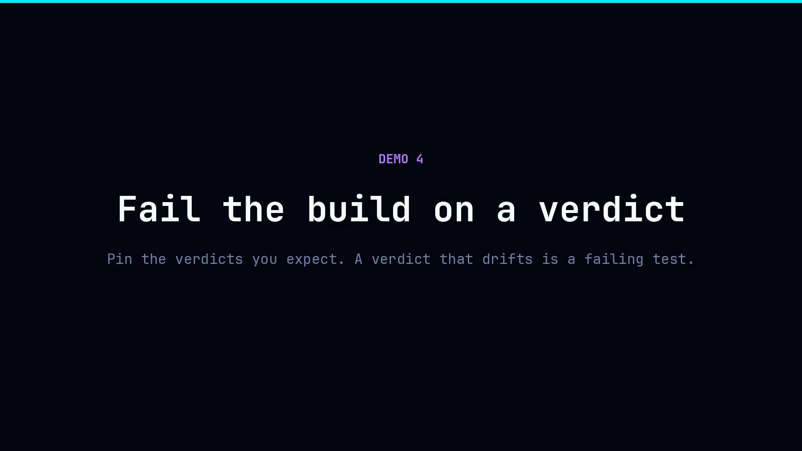
JACK SESSIONS
42 / 51

Slide 43
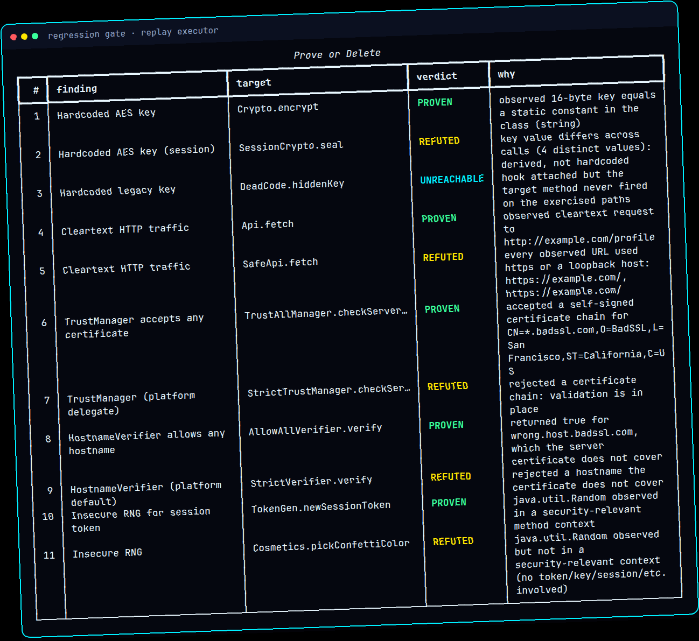
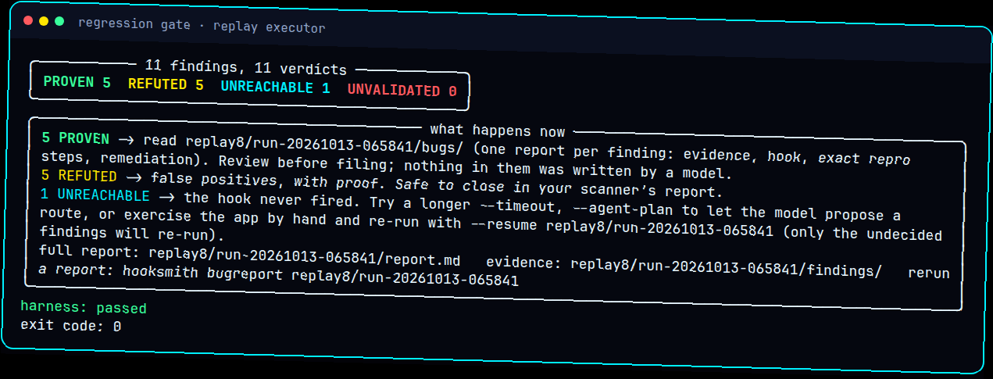
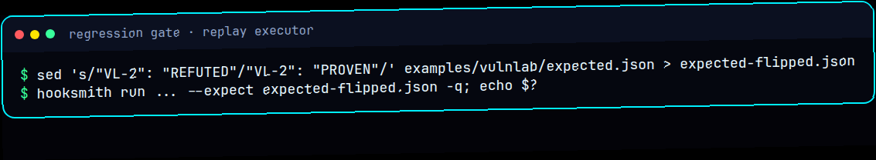
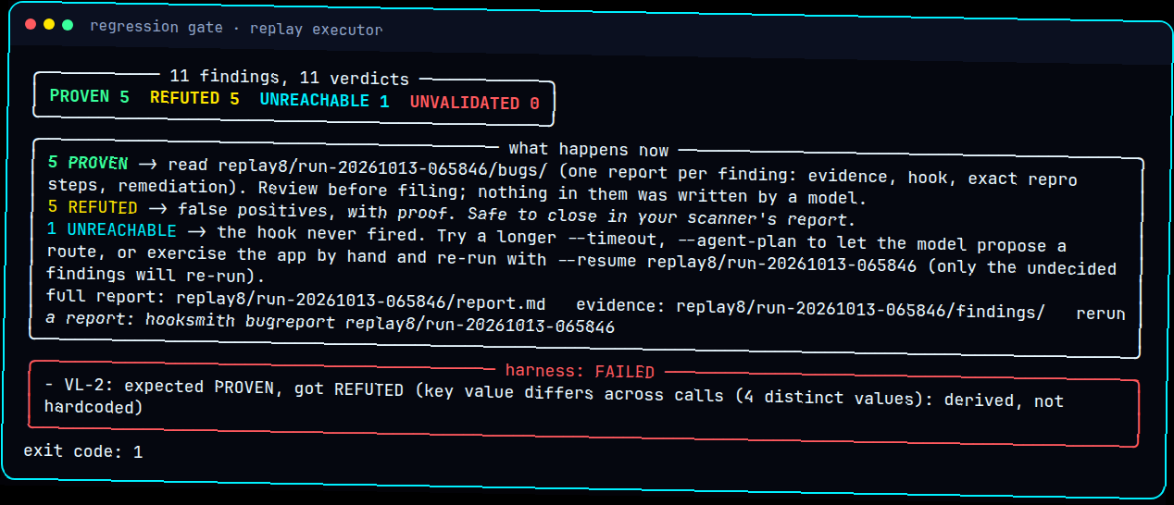
04
WHAT IT REALLY PRINTED
43 / 51
Notes:
Real output of the pin-and-gate flow — the clean pass, then the flipped pin breaking exactly as expected, naming VL-2 by hand.

Slide 44
$ cat .github/workflows/hooksmith.yml
A verdict is a build gate
Every release build re-proves its own findings.
hooksmith.yml
- name: Prove or Delete
run: |
uv run hooksmith run \
--report mobsf.json --apk app-release.apk \
--executor avd --provider worker \
--fail-on PROVEN:high --max-unvalidated 5
- uses: actions/upload-artifact@v4
if: always()
with: { name: hooksmith-evidence, path: runs/ }
two ways to fail
--fail-on PROVEN:high
a proven high-severity bug
fails the build
--expect expected.json
any verdict that drifts
from the pinned file: exit 1
Pin the verdicts you expect. A code change that flips one is a regression test failing
JACK SESSIONS
44 / 51

Slide 45
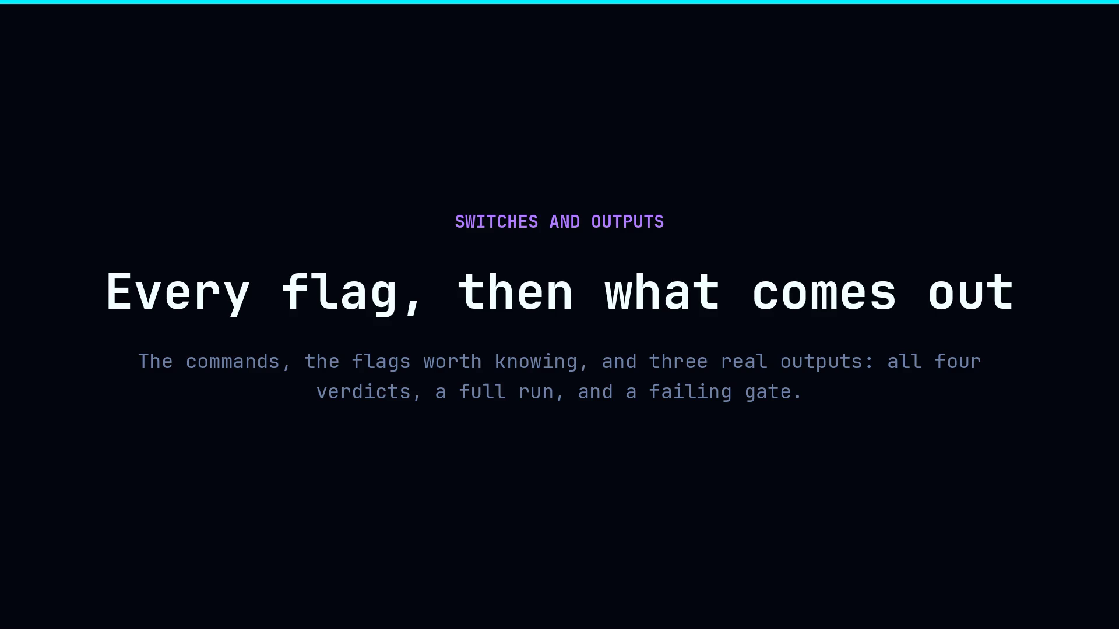
JACK SESSIONS
45 / 51

Slide 46




Where it breaks
$ hooksmith --where-it-breaks
Native code
Obfuscation
UNVALIDATED
next up
Wrong overload
UI gaps
valid but wrong
UNREACHABLE
JACK SESSIONS
46 / 51
Notes:
T+24:30 (0:40). This is the honest account I promised in the abstract. Native JNI methods are always UNVALIDATED in v1 — Interceptor.attach needs offsets a model just can't reliably produce, and Demo 1 showed NativeCrypto landing there. Obfuscation's next, and Demo 5. Hallucination slipping past the validator is real — those checks catch structural problems, not a well-formed hook pointed at the wrong overload. Say plainly that a validated-but-wrong hook is the failure mode worth losing sleep over. UI gaps mean methods buried behind complex flows can genuinely never fire, so that's UNREACHABLE, not a guessed verdict. Also worth a mention: method lookup is a regex reader, not a full Java parser. Each of these maps cleanly onto one of the four buckets — that's the whole point, failure gets labelled, not hidden. Good moment to remind the room: only ever use this on apps and devices you're actually authorised to test.

Slide 47
What has actually run
$ hooksmith doctor
[ ok ] Android AVD · Frida 17
[ ok ] Corellium · Android 16
[ -- ] Edge LLM · user defined (upon selecting a modal)
[ -- ] iOS · tests only for now, due to $$$
JACK SESSIONS
49 / 51
Notes:
T+30:05 (0:40). Straight from the README, keep it honest on the day. AVD row: Android 13, x86_64, Google APIs, Frida 17.22, run for real on VulnLab (R8 build included) and on UnCrackable-Level1. Corellium row: a real Android 16 arm64 device over the Corellium VPN, all seven original VulnLab findings landed right; the REST lifecycle client itself is only tested against a mock. TWO ROWS NEED MY ATTENTION BEFORE I'M ON STAGE: Edge LLM — the Worker's bundled but not deployed, and I haven't measured output quality, so if I deploy it and run the benchmark before the talk, this row goes green with real numbers. iOS — the parser, templates and validator are hermetic-tested against a fake executor, never a real device, and that code's still uncommitted; either say 'in progress' or just drop the row, don't imply it works on hardware. OpenAI-compatible and RunPod providers are request-shape tested only, mention that if asked.

Slide 48
Do this on Monday
$ ./monday.sh
01
02
03
04
Scan
›
Prove
›
Sort
›
Gate
hooksmith scan
hooksmith test
hooksmith report
--expect
Step 3 alone WILL changes your reports.
^-^
JACK SESSIONS
50 / 51
Notes:
T+30:45 (1:00). This is the workflow I actually want people to walk out with — each step maps straight back to a demo: scan to Demo 2, prove to Demos 3 and 4, sort to the evidence slide, gate to Demo 6. Scan with your own MobSF or Semgrep report, or hooksmith scan if you don't have one. Prove with hooksmith test — one command, a verdict table, --provider template needs no API key at all. Sort — file the PROVEN, close the REFUTED, triage the rest by the reason given. Gate — pin verdicts with --expect, break CI when they drift. Even if someone never installs this tool, step 3 alone changes what their report says, because every finding leaves with one of four labels instead of a hedge.

Slide 49
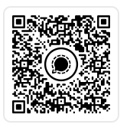
Prove it.
Or delete it.
$ echo "released today · MIT"
$ git clone [github.com/jacksessions/hooksmith]
Questions?
JACK SESSIONS
Notes:
This slide is yours, not mine — no timing note, no script, just stay here and take the room. Swap in the real repo URL before the day, and a QR code once that link's final. Remind people: only run this against apps and devices you're actually authorised to test. If the questions dry up before the room does, these are the ones worth having a real answer ready for: how good is the edge model (honestly, not benchmarked yet), what about iOS (slide covered it — template-only, never run on a real device), how does it handle anti-Frida and root detection (it doesn't try to beat those, it just reports what it can't reach), can it run in CI (just showed that), what does it cost per app to run, and why not just have an LLM write the whole report instead of a verdict (because then nobody's checking the LLM's work).

