Slide 1
Checking System Rules
Using System-Specific, Programmer-Written Compiler Extensions
Dawson Engler, Benjamin Chelf, Andy Chow, Seth Hallem
Computer Systems Laboratory
Stanford University

Slide 2
What are system rules?
“variable A must be guarded by lock B”
“system calls must check user pointers before using them”
“message handlers must free their buffer before completing”
……
Rules in systems software must be obeyed for correctness and performance

Slide 3
How to check rules?
Verification 
  rigorous but hard to construct specifications
Testing 
  dynamic but misses many cases and makes diagnosis difficult
Manual inspection 
  semantic level powerful but unreliable and tedious
Static compiler analysis 
  can perform automatic check with source code, but needs semantic help!

Slide 4
Approach in this paper
Using extensions written by implementers to help compiler checking system rules
  System implementors uses meta-level compilation (MC) to write simple system-specific compiler extensions
  checks are automatically made on code for rule violations

Slide 5
Benefits:
take into account semantics
  comparing to pure static compile analysis
automatic
  comparing to manual inspections
general, extensible
  comparing to related work focusing on specific errors
rules usually are easy to express
  comparing to formal verification

Slide 6
How it works?
rules as compiler extensions written in a high-level, state-machine language--metal
extensions dynamically linked into extensible compiler, xg++
extensions are applied down every possible execution path by xg++ on internal representation form
Using patterns to match key source code, causing transitions between states

Slide 7
A simple rule example
//This example checks disabled interrupt to the end and
//duplicate enable/disable calls
//define patterns
pat enable = { sti(); }|{ restore_flags(flags); };
pat disable = { cli(); };
//States, the first state is the initial state
is_enabled: disable ==> is_disabled
| enable ==> { err(“double enable”); };
is_disabled: enable==>is_enabled
| disable ==> { err(“double disable”); }
| $end_of_path$ ==>
{ err(“exiting with intr disabled!”; };

Slide 8
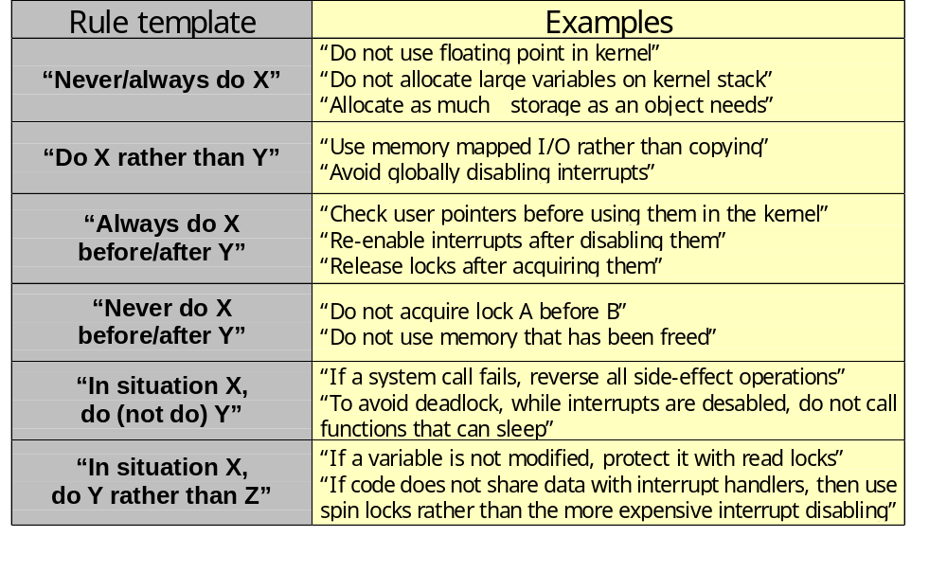
Rule template and more examples

Slide 9
Applying this approach
Check illegal actions in assert
Apply check on Linux and OpenBSD
  copyin/copyout
  memory management
Enforce rules globally across functions
Check Linux mutual exclusion
Optimize FLASH

Slide 10
Conclusion
A general approach with easy to write rules, easy to implement extensions
Succeeded in checking real systems --- found more than 500 bugs
Use of meta-level compilation can significantly aid system construction

Slide 11
Discussion
When propagating the rules through the code, should it be:
Flow-sensitive?
  Apply down all path
Flow-insensitive?
  Apply linearly through the code

