Slide 1
Intern Project: Treadmill Scheduler Simulator
Nan Shao 8/21/2018

Slide 2
Agenda
Background Introduction
Our problems
What I have done
Future work
Q&A

Slide 3
Background Introduction
Treadmill | Cloud computing platform Container based Open sourced
Scheduler | Core Treadmill component to schedule container on hosts in treadmill cell Different state of Container Zookeeper based distributed storage

Slide 4
Our Problems
Difficult to run scheduler separately
No tool to launch a test scenario easily
Hard to observe the behavior of scheduler

Slide 5
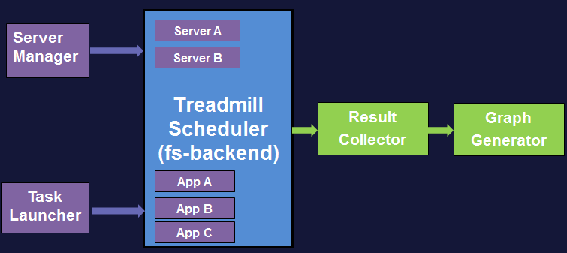
What I have done
Treadmill scheduler 2. Server manager 3. Task launcher
4. Result collector 5. Graph generator

Slide 6
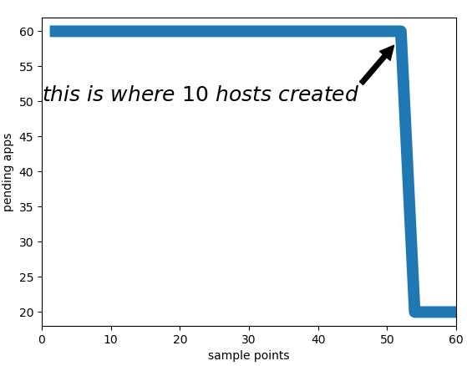
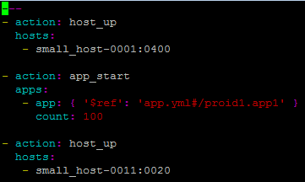
Example: Large Scale Footprint
Sample Task :
---
action: app_start
apps:
- app: {}
- count: 1000
- action: host_down

Slide 7
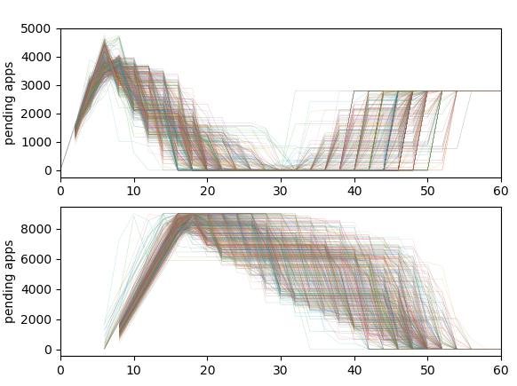
Example: Capacity with Private Allocation
Sample Task:
---
action: allocation_configure
alllocation: {}
delta:
assignment:
- pattern: proid2.app2*
priority: 1
action: app_start
apps:
- app: { ‘$ref’: ‘app.yml#/proid1.app1’ }
count: 5000
action: sleep
interval: xxxxx
action: app_start
apps:
- app: { ‘$ref’: ‘app.yml#/proid2.app2’ }
count: 9000
App 1
App 2

Slide 8
Future work
Batch-launch Monte Carlo simulations in treadmill container
Support new capacity dimension for simulation

Slide 9
Q&A

Slide 10


What I have done
Use case:
Large Scale Footprint | Customer’s Private Use Case
?

Slide 11
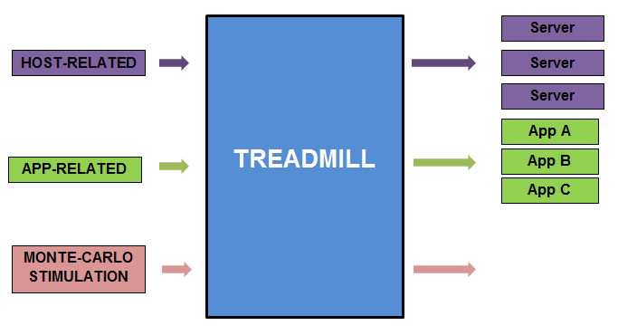
What I have done

Slide 12
What I have done
Add new dimension for capacity of TM | Scale up servers | Private test for third party
…
?
CPU
DISK
MEMORY
Source: Source text same as footnote; no hanging indent
Footnotes are Arial 8 pt.

Slide 13
What I have done
Execute treadmill scheduler completely without master dependency(zookeeper --> file system)
Server manager(add/remove server in the scheduler)
Task launcher(submit tasks/apps in the scheduler)
Result collector(collect information about status of app and show app placement by scheduler)
Graph generator(visualize the result)

Slide 14
What I have done
Treadmill Scheduler (fs-backend)
Server Manager
Server A
Server B
Result Collector
Graph Generator
App A
Task Launcher
App B
App C

