Slide 1
Intern Project: Treadmill Scheduler Simulator
Nan Shao 8/21/2018

Slide 2
Table of Contents
Background Introduction
Our problems
What I have done
Future work
Q&A

Slide 3
What is Treadmill
Treadmill | Cloud computing platform Container based Open sourced
Scheduler | Core Treadmill component to schedule container on hosts in treadmill cell Container in different state Zookeeper based distributed storage

Slide 4
Our Problems
Difficult to run scheduler separately
No tool to launch a test scenario easily
Hard to observe the behavior of scheduler

Slide 5
What I have done
Execute treadmill scheduler completely without master dependency(zookeeper --> file system)
Server manager(add/remove server in the scheduler)
Task launcher(submit tasks/apps in the scheduler)
Result collector(collect information about status of app and show app placement by scheduler)
Graph generator(visualize the result)

Slide 6
What I have done
Treadmill Scheduler (fs-backend)
Server Manager
Server A
Server B
Result Collector
Graph Generator
Task Launcher
App A
App B
App C

Slide 7
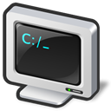

Why we want to do stimulation
Add new dimension for capacity of TM | Scale up servers | Private test for third party
…
?
CPU
DISK
MEMORY
Source: Source text same as footnote; no hanging indent
Footnotes are Arial 8 pt.

Slide 8
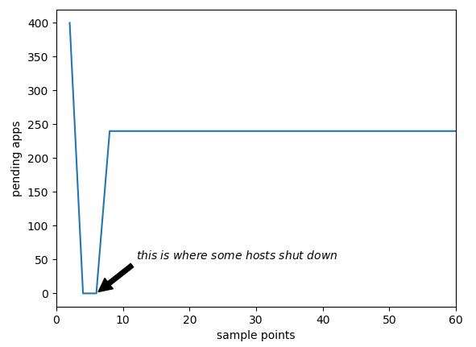
What I have done
Example 1:
When hosts are shut down, applications’ states will become pending

Slide 9
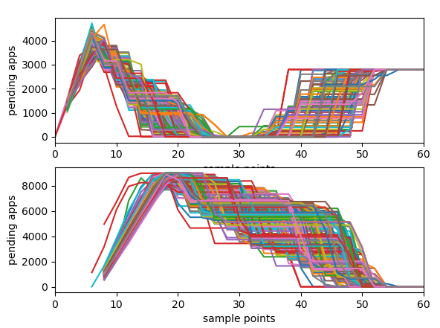
What I have done
Example 2:
Monte Carlo Stimulation

Slide 10
Future work

Slide 11
Q&A

Slide 12
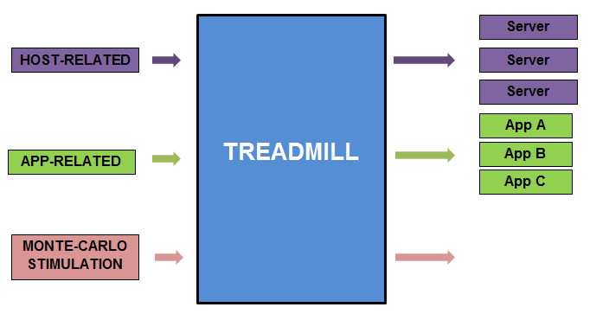
What I have done

