Slide 1
File | Folder權限管理

Slide 3
Powershell file Permissions

Slide 4
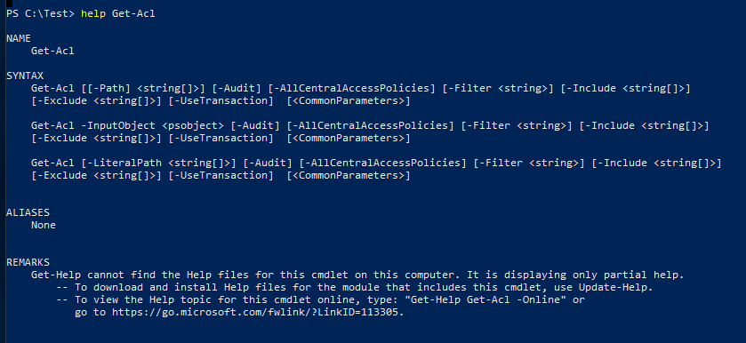

Slide 5


Slide 6


Slide 7
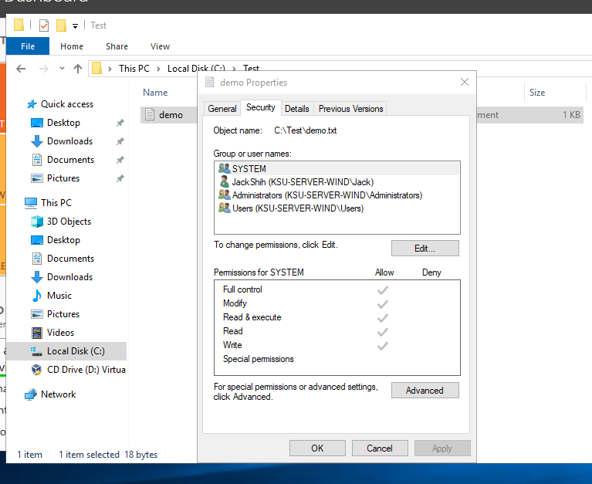

Slide 8
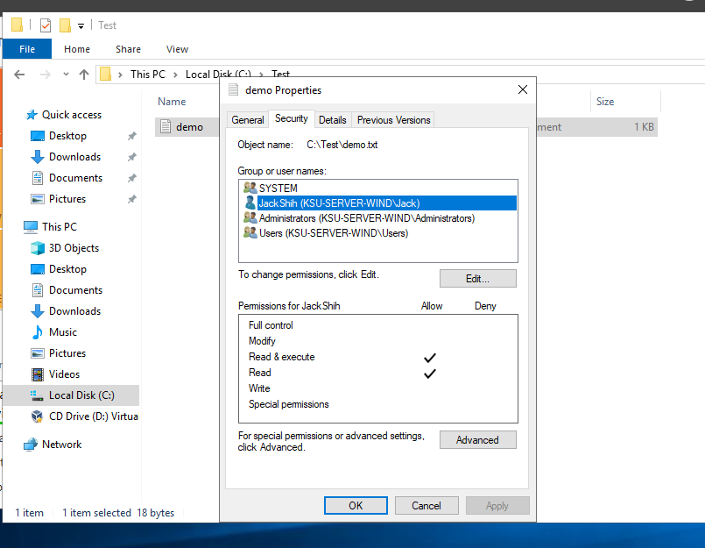

Slide 9
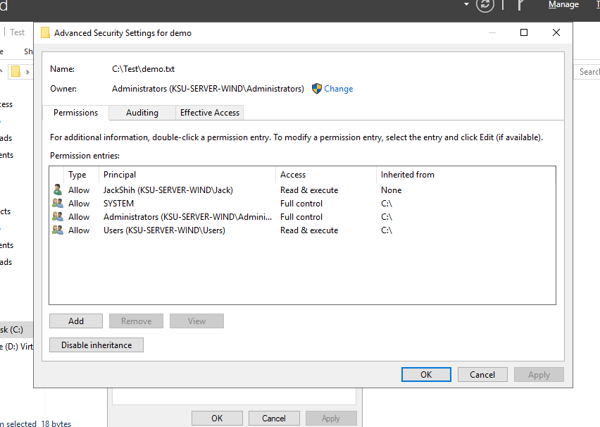

Slide 10
