Slide 2
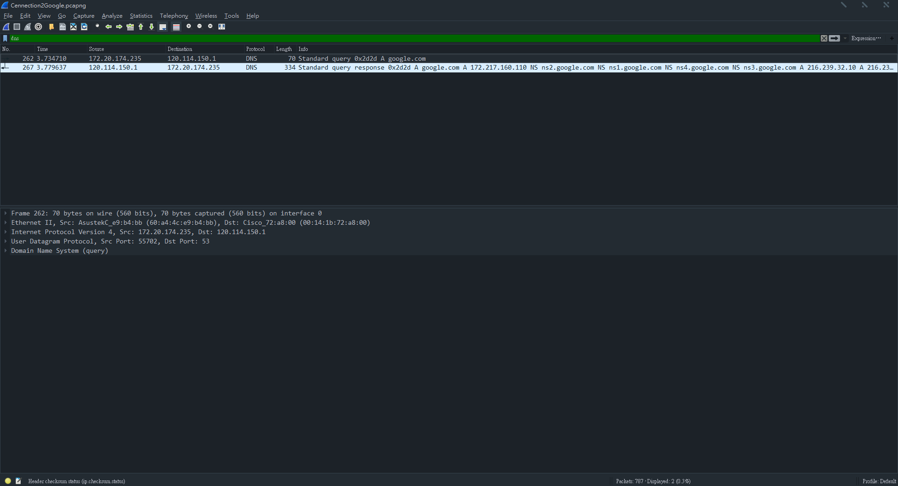
Google IP
Google IP:128.114.150.1

Slide 3
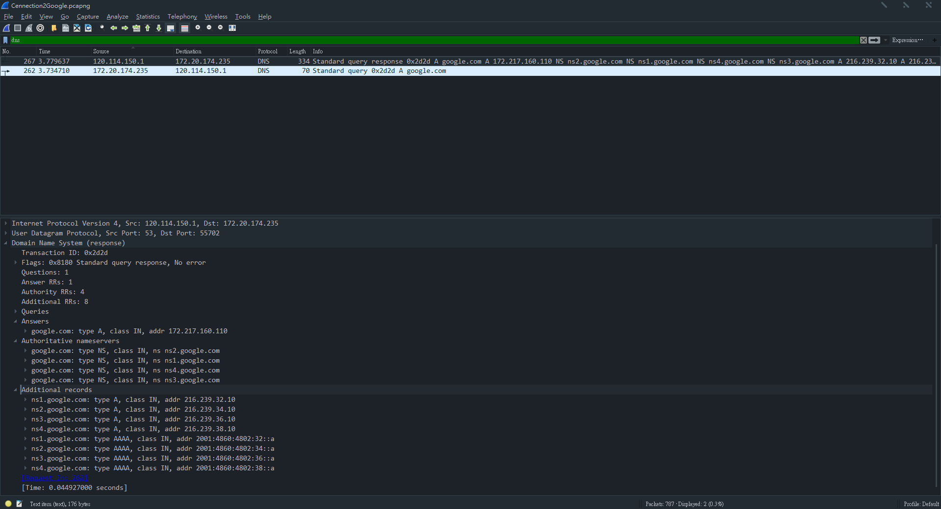
DNS server IP

Slide 4


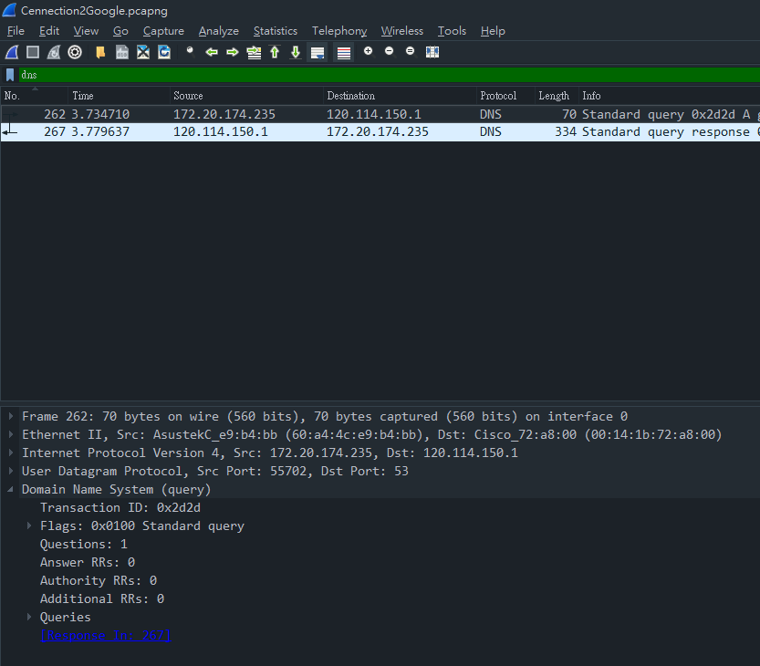
DNS Server
DNS Query

Slide 5
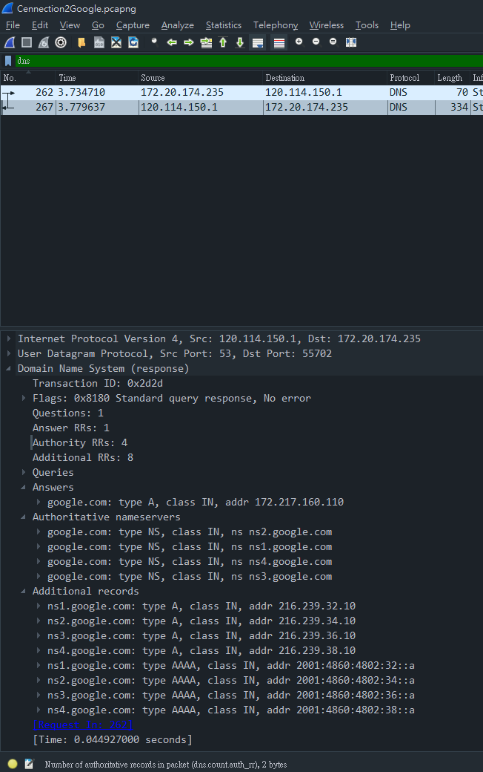
DNS Server
DNS Response

Slide 6
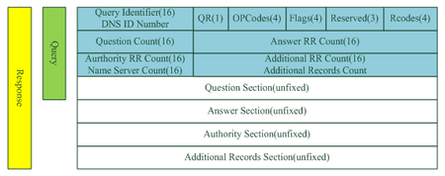
DNS Format

Slide 7
UDP Format
32 bits
Source Port(來源埠) | Destination Port(目的埠)
Length(長度) | Checksum(檢查碼)

Slide 8
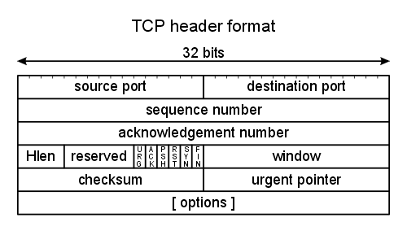
TCP Format
來源埠
目的埠
序列號
確認號

Slide 9
Three way handshake
A
SYN
B
SYN,ACK
A
ACK
B

