Slide 2
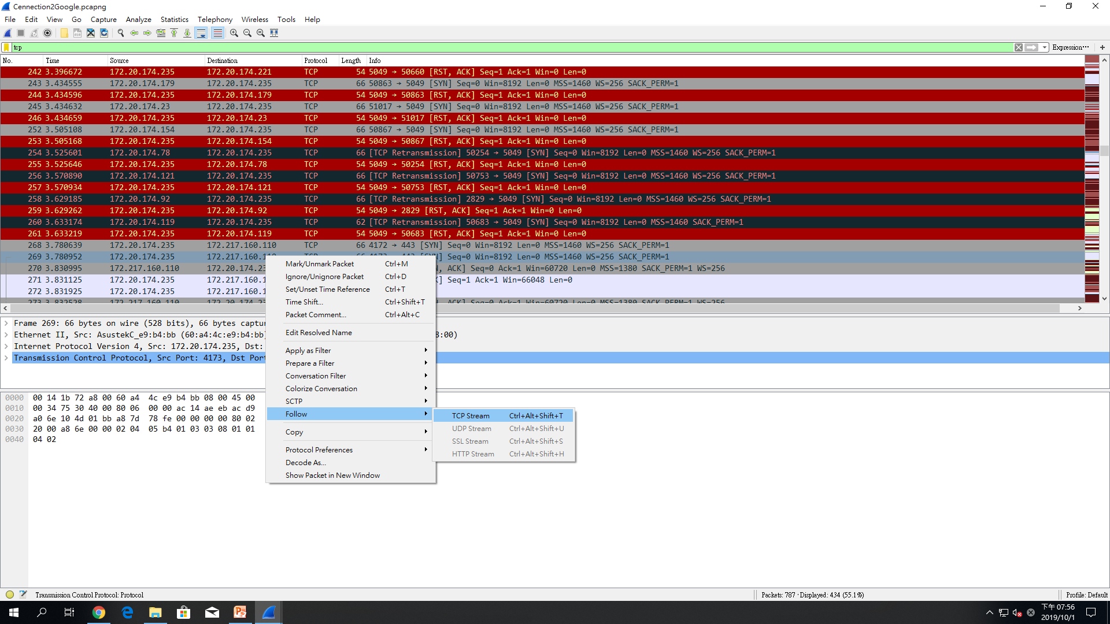
TCP Steam

Slide 3
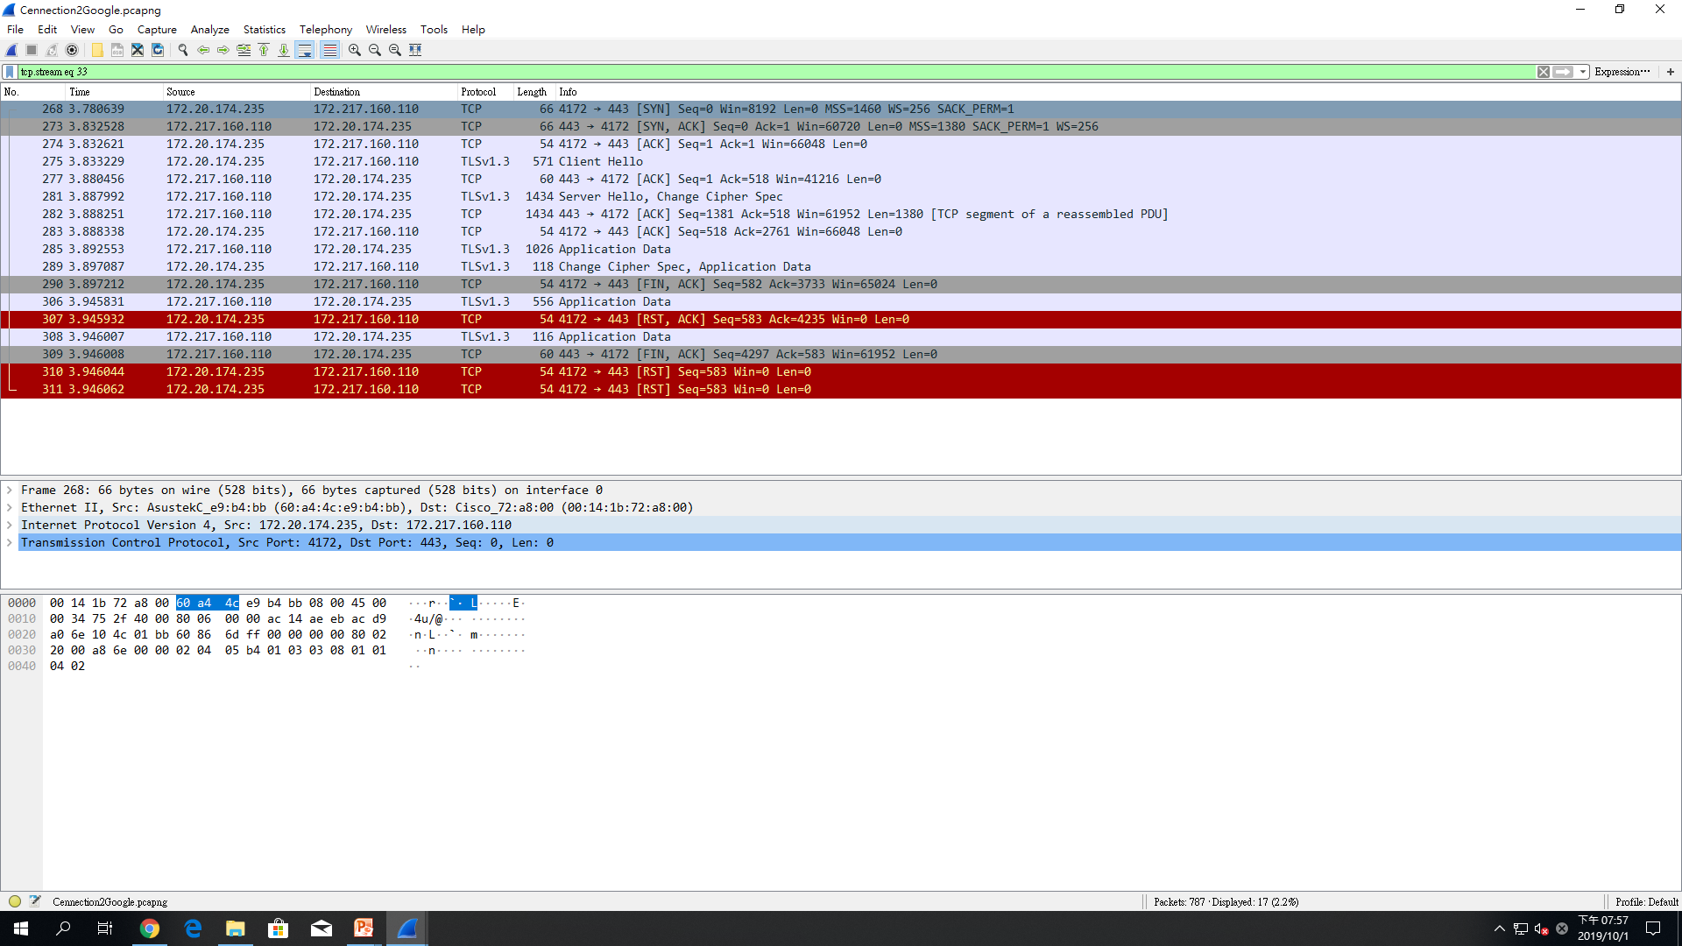

Slide 4
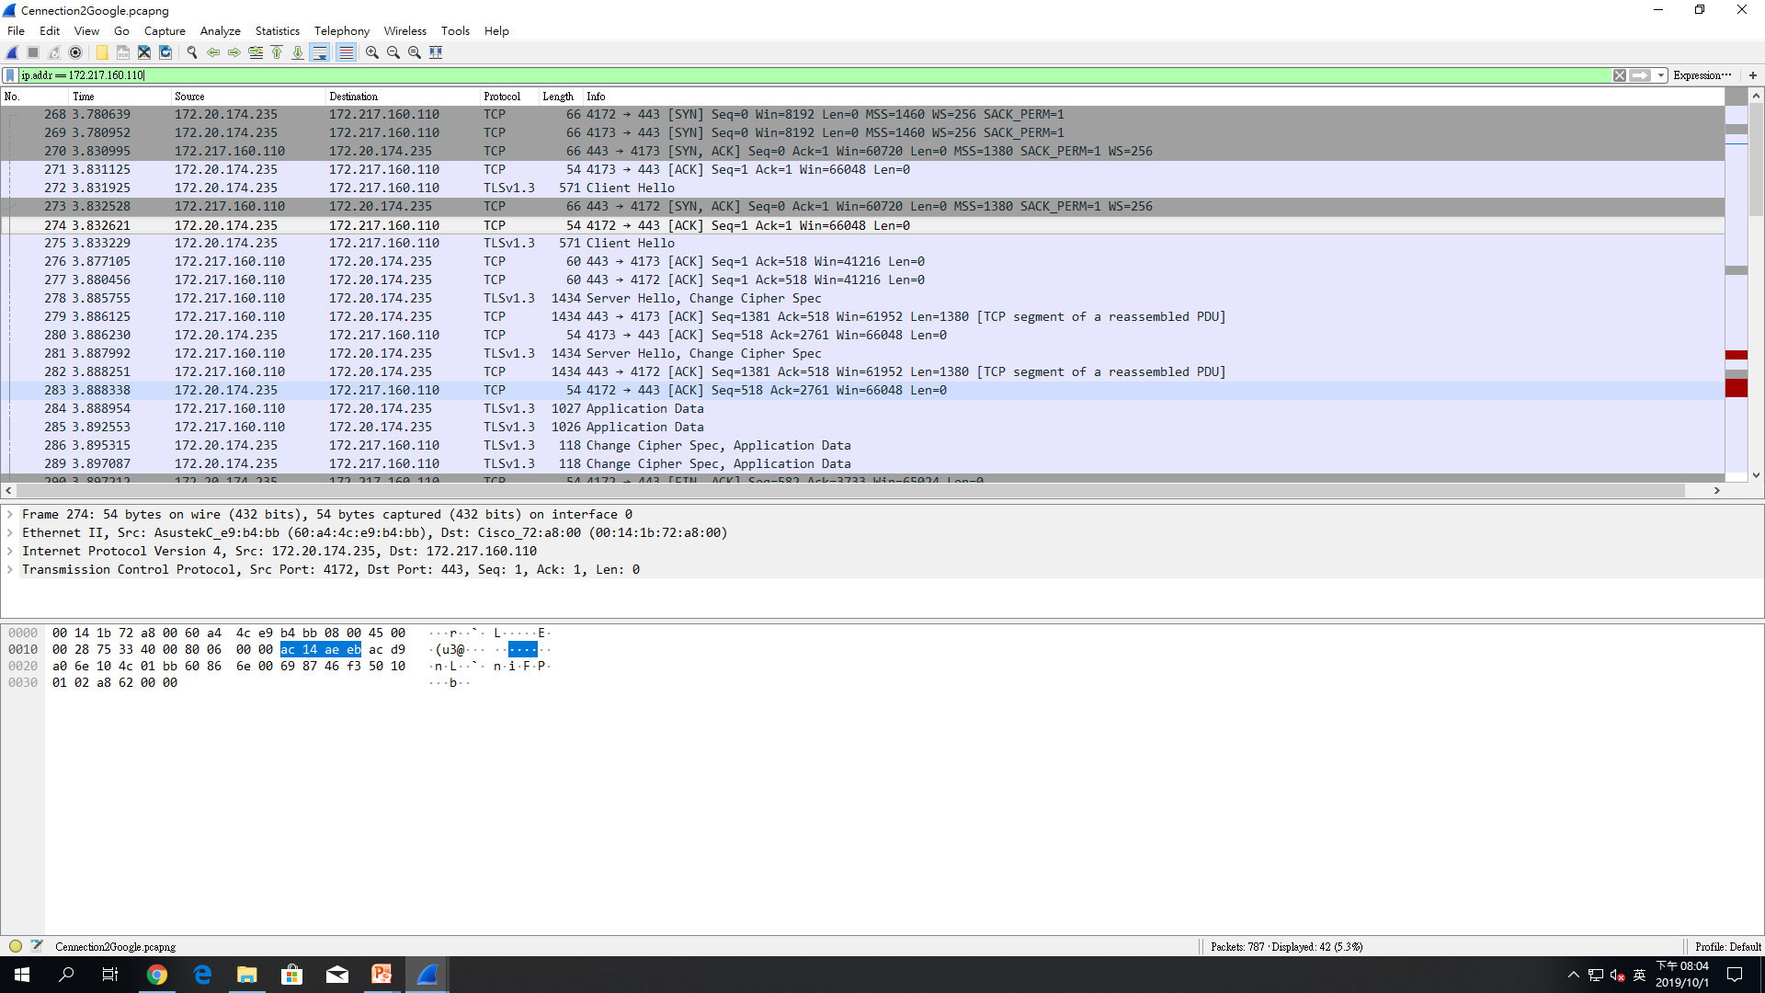
Display filter

Slide 5
Ip.addr

Slide 6
Ip.src

Slide 7
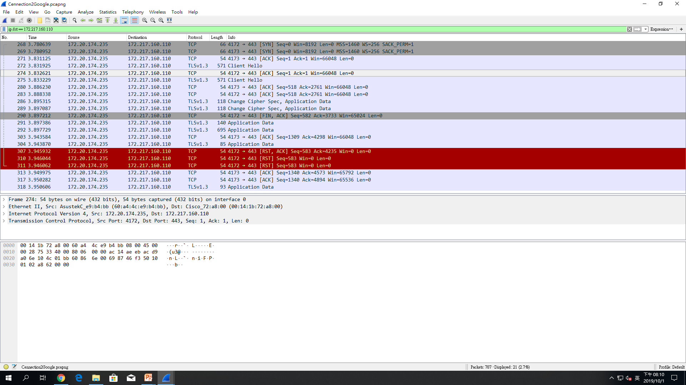
Ip.dct

Slide 8
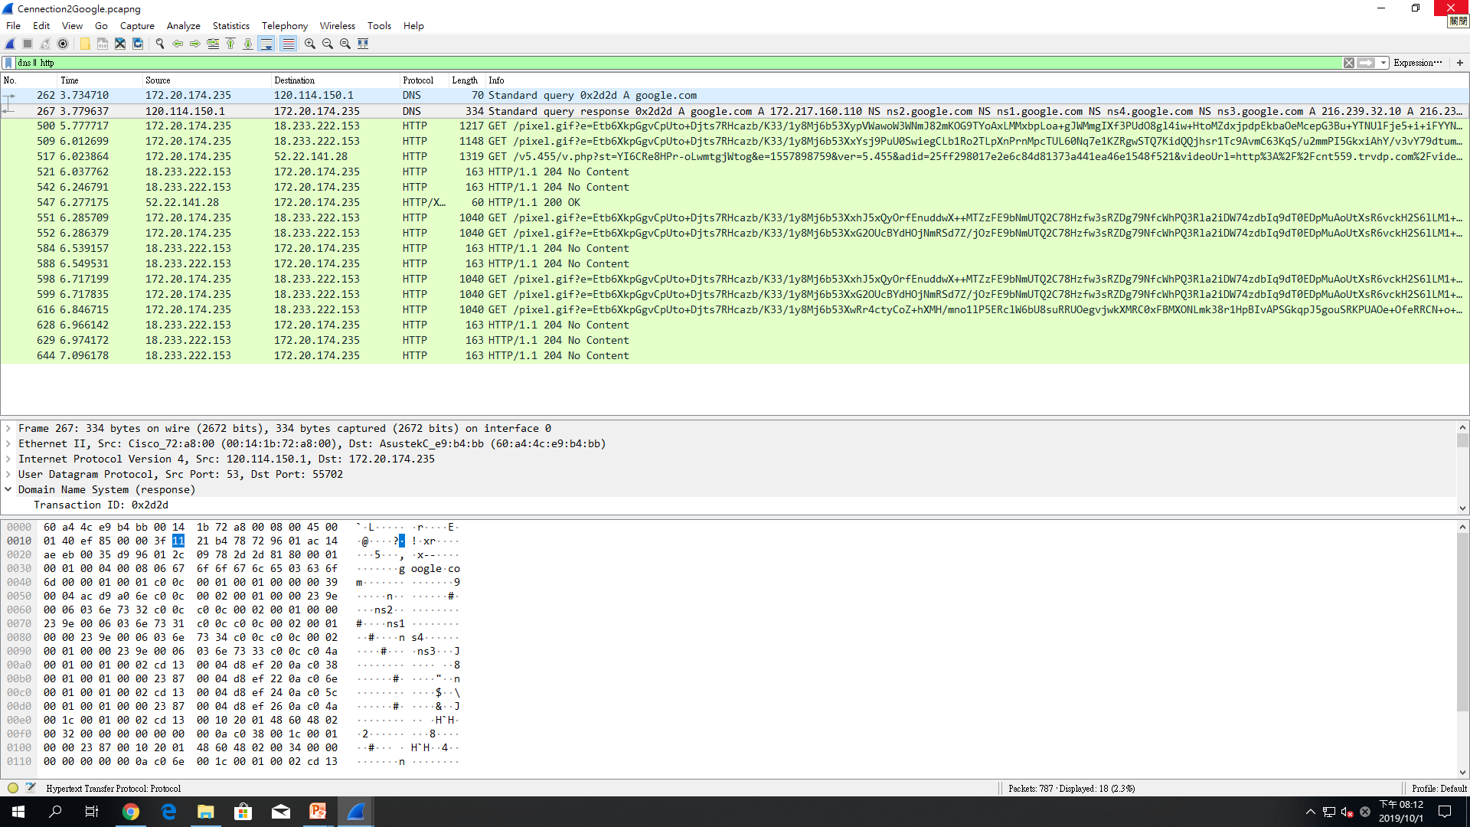
Dns || http

