Slide 1
WireShark

Slide 2
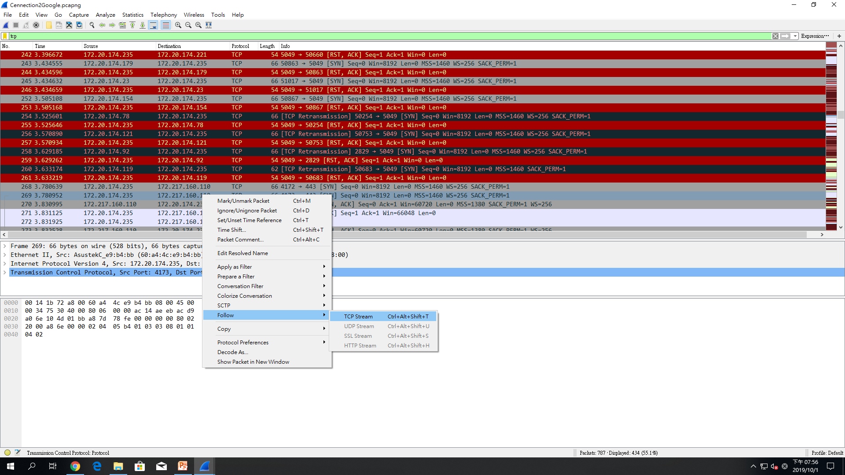
TCP Steam

Slide 3
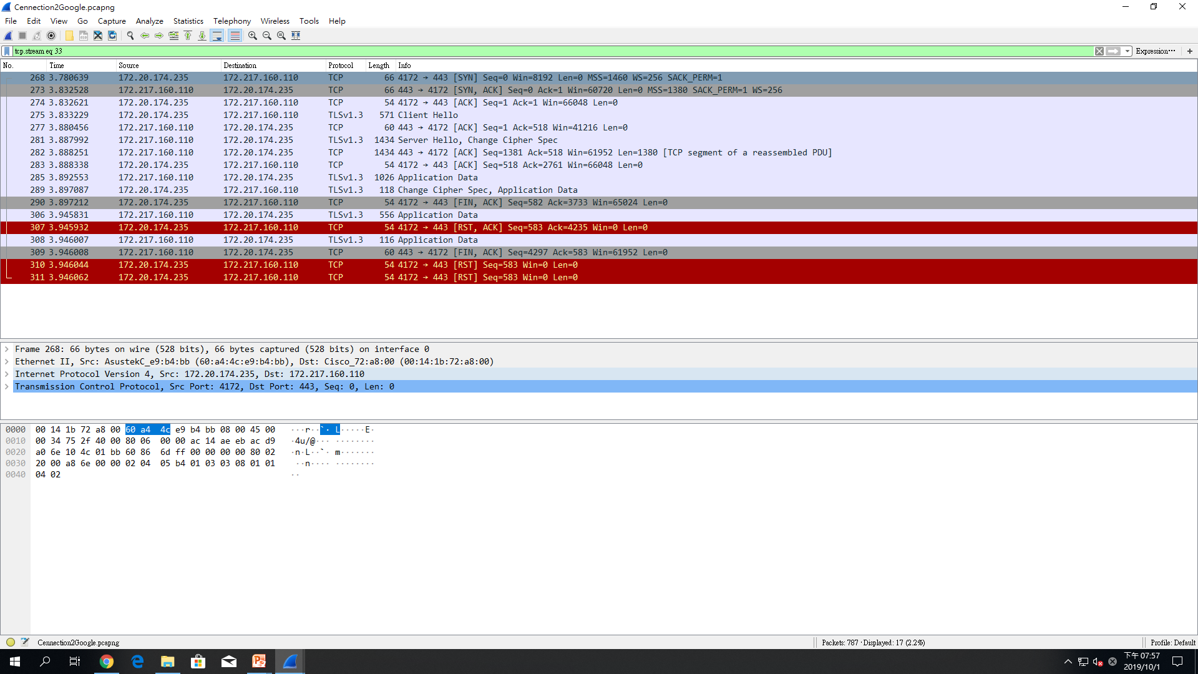
Tcp.steam eq33

Slide 4
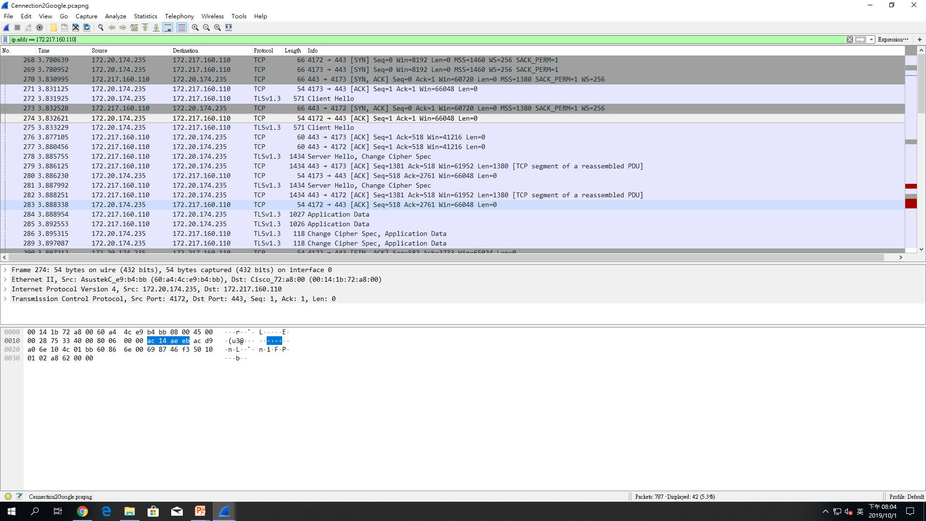
Display filter

Slide 5
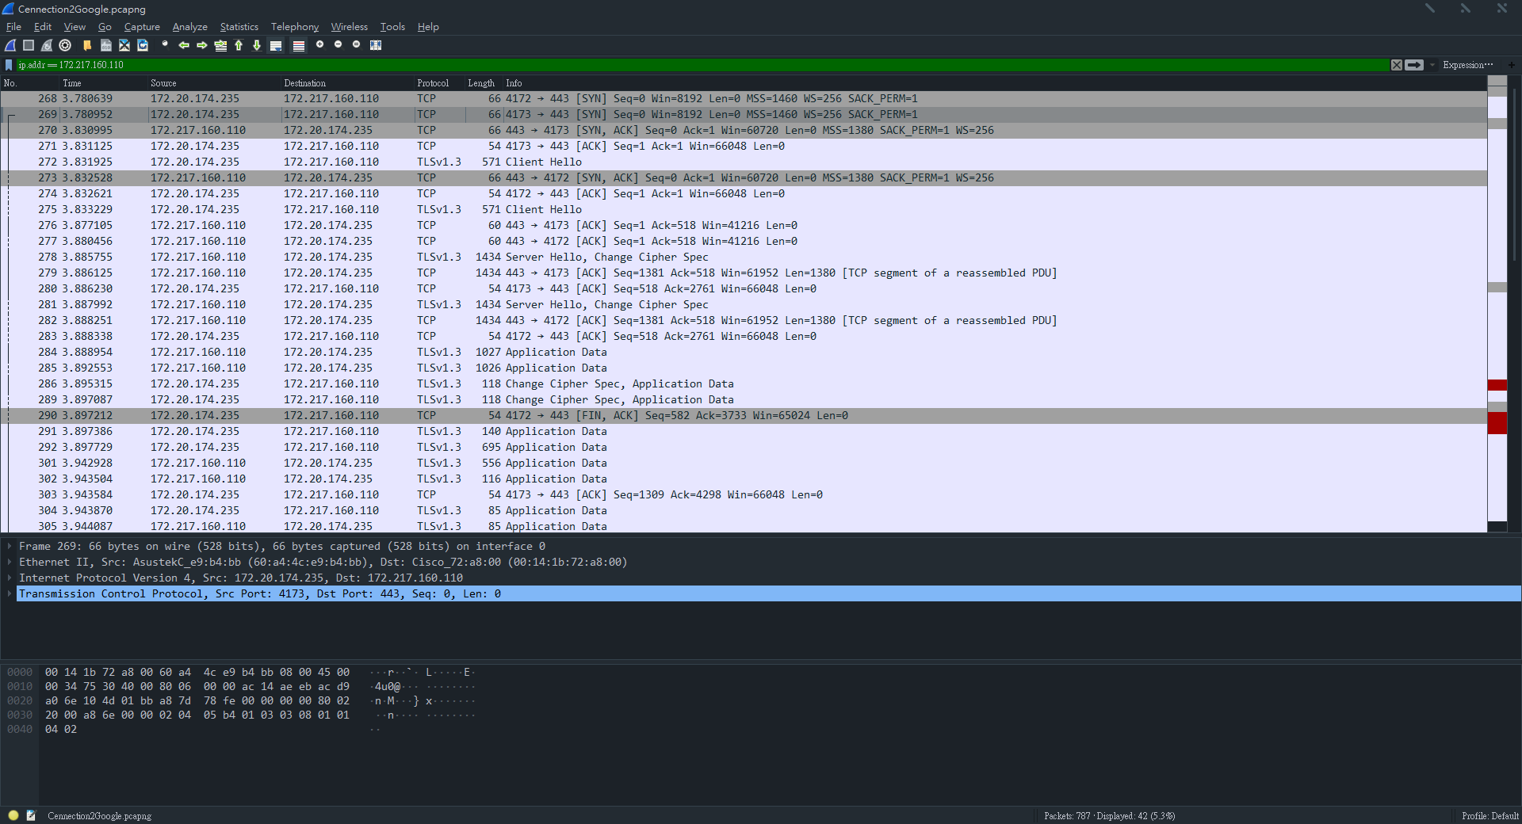
Ip.addr

Slide 6
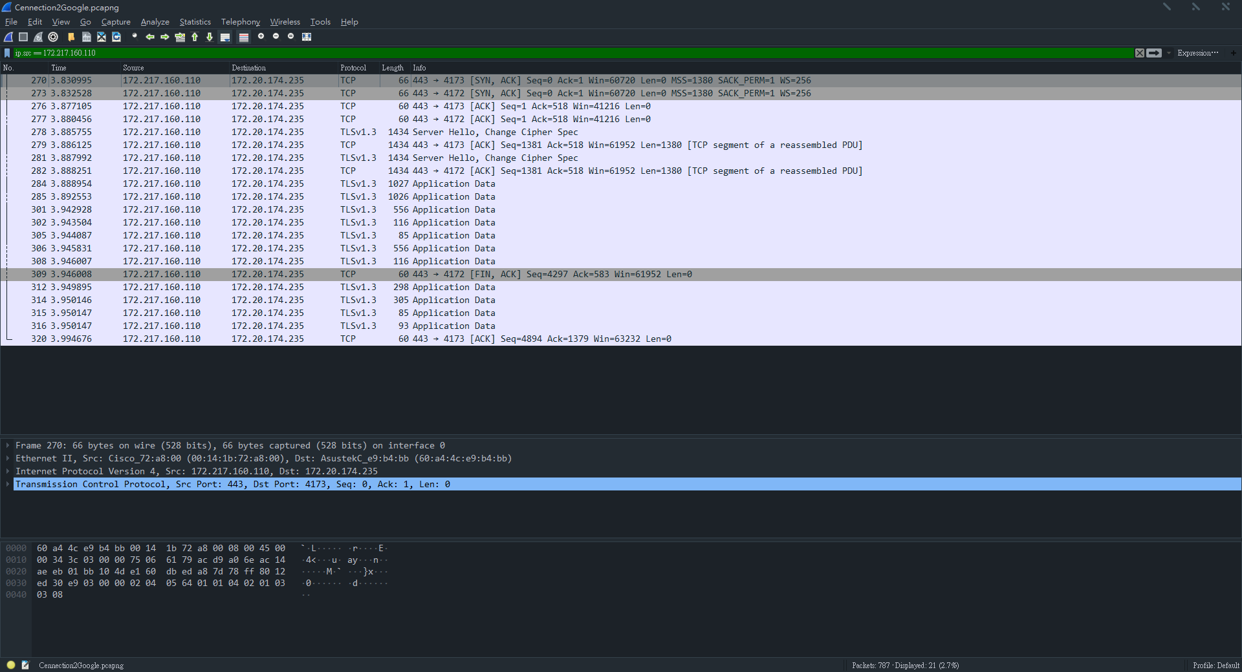
Ip.src

Slide 7
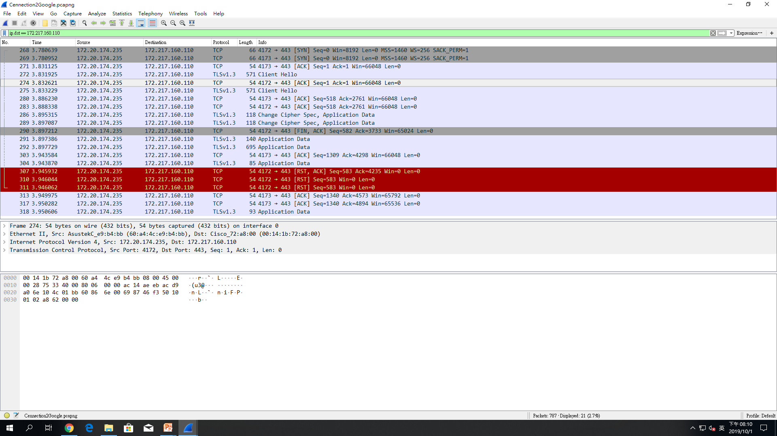
Ip.dct

Slide 8
Tcp.port == 443

Slide 9
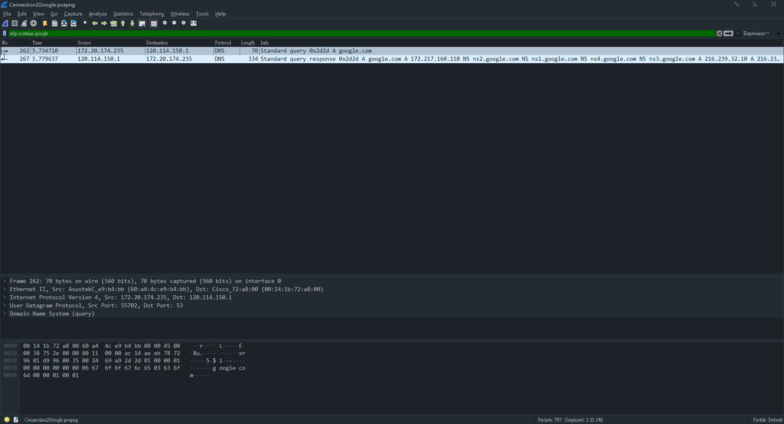
udp contains google

Slide 10
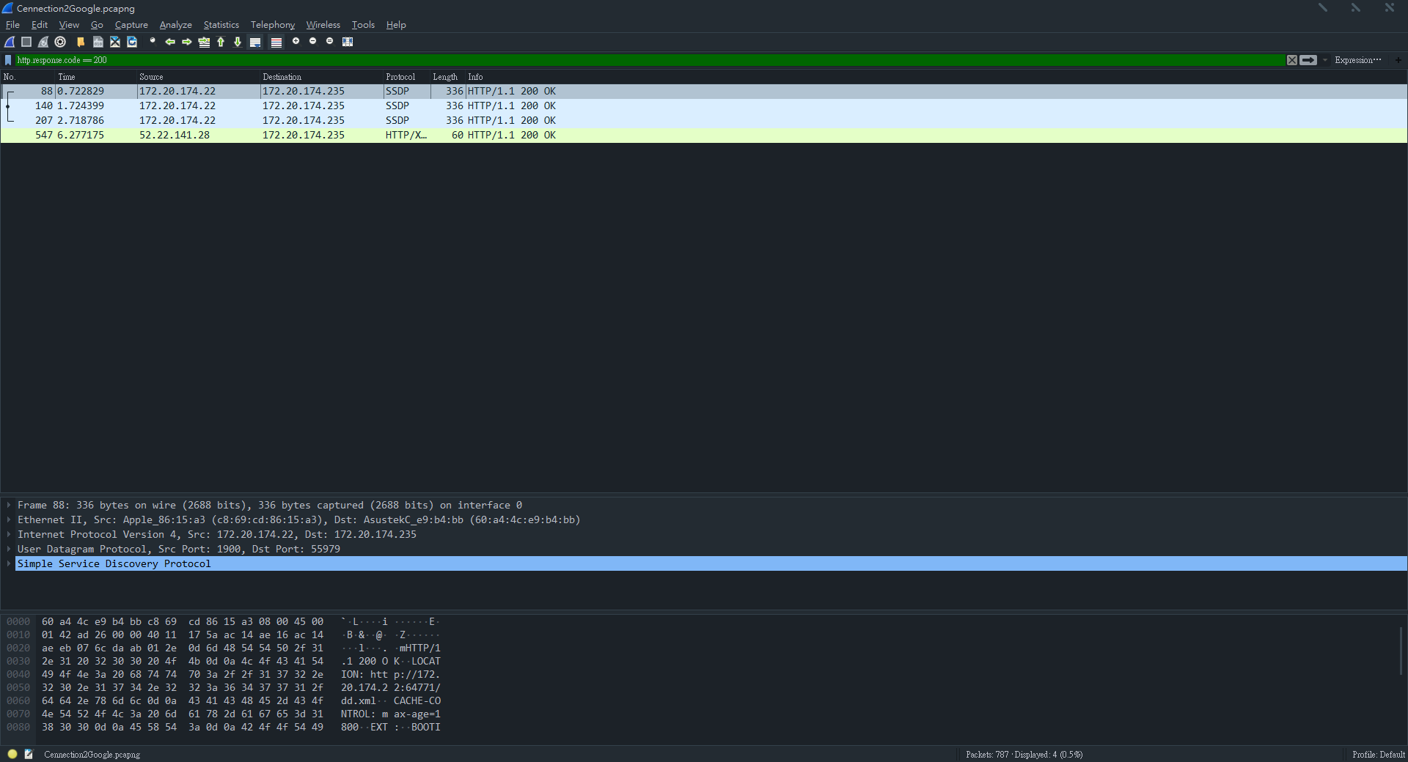
http.response.code == 200

Slide 11
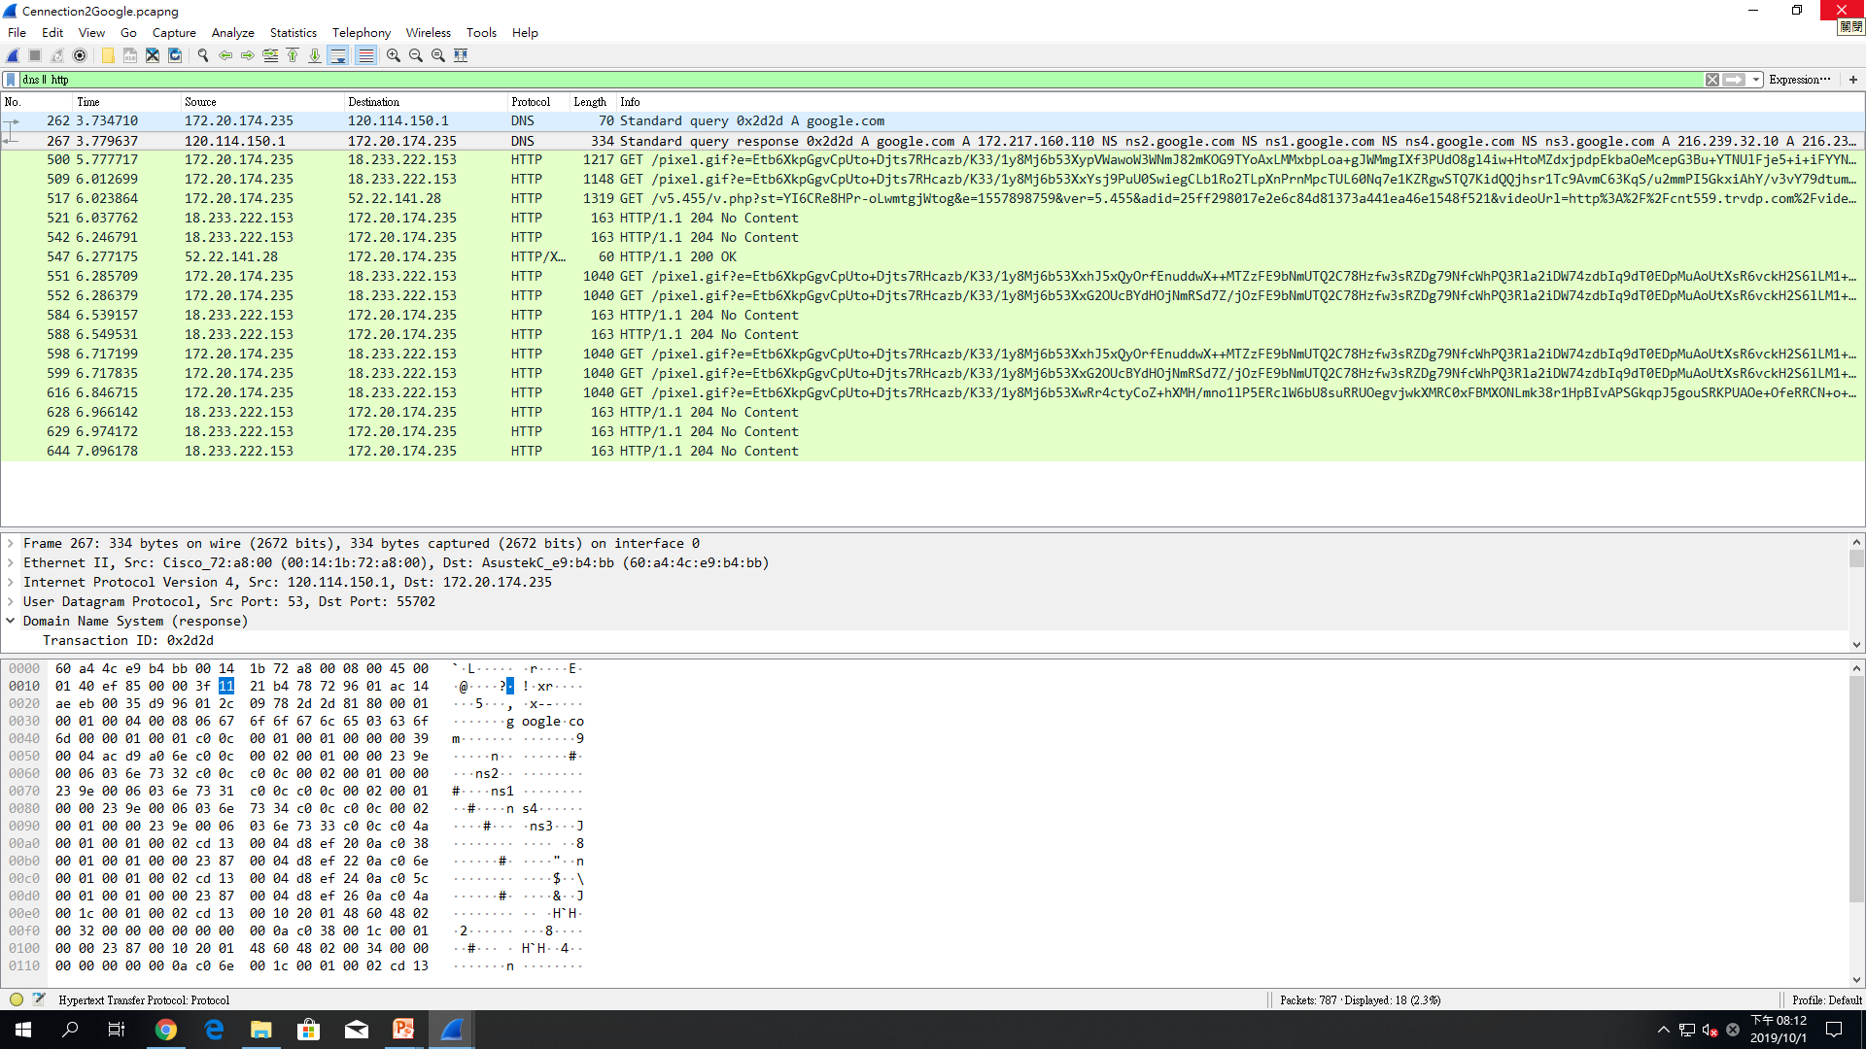
Dns || http

