Slide 1
Project Definition
Software Engineering: CSCE 3513

Slide 2
Background
A company would like you to develop a laser tag game interface
Two screens, one for player entry, one for game progress
You will be reverse engineering/updating the software that is currently in use.
Originally written the 1980’s then updated in the early 2000’s
Original software written in languages that most people under the age of 30 have never dealt with (c, tcl/tk, wish)

Slide 3
Customer Definition
Initial screen will be set up to prompt for player input
Will need to interface with a PostgreSql database for player information
Should be able to use the tab key to move from field to field
After all players are entered, pressing the <f3> key will move to the play action screen for the rest of the game
When the game ends, stay on the play action screen until <f1> is pressed which will then clear out all player data and return to the player input screen

Slide 4
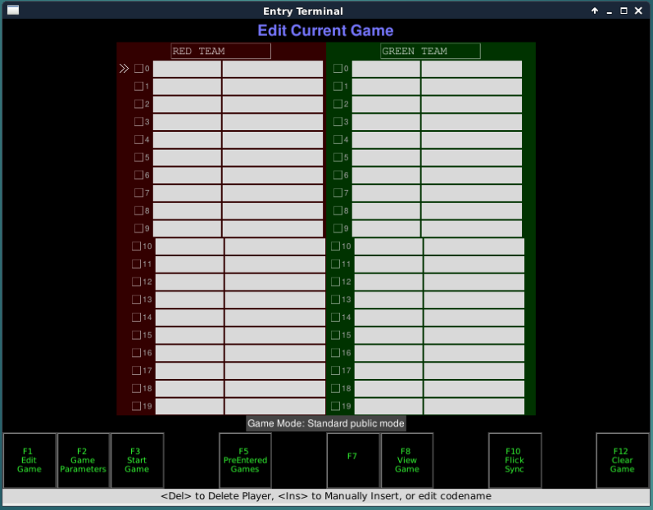
Initial/1st Screen

Slide 5
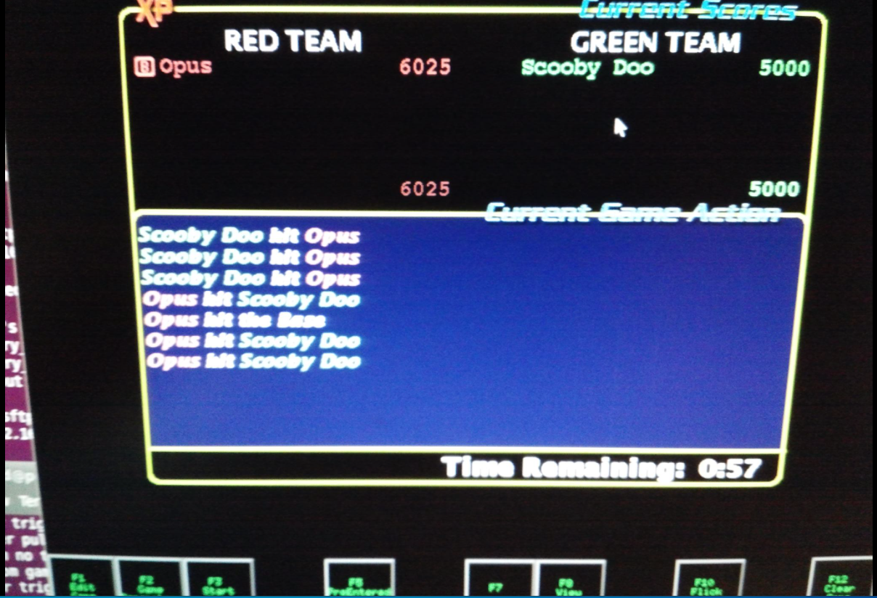
Game Action Screen

Slide 6
Behind the Scenes
There will be two udp sockets
One to broadcast data (udp port 7500)
Format will be int (id of player who got tagged)
One to receive data (udp port 7501)
Format will be int:int (id of player transmitting:id of player tagged)

Slide 7
Assumptions
No security is required
All network communication will be performed on a non routeable address (192.168.1.100)
No need to consider performance in the prototype

Slide 8
Approach
Databasewill be deployed on Heroku
Heroku is an easy to use wrapper around Amazon AWS
Minimal database (PostgreSQL) interaction to persist player information
The database class is not a prerequisite for this course
I have done a lot of this work and can help as needed with anything that is remaining

Slide 9
Preparation – Each Team Member
Create an account on Github
[https://github.com/]
This will serve as the version control system for the project
Create a Trello account
[https://trello.com/]
Simple task management

Slide 10
Preparation – Team
Create a private channel in Slack titled “#team-{your-team-name}”
Make sure that all your team members are included in the channel
Invite me and the graders to your team’s channel
Consolidate each team member’s name, Github username, and Trello username
Post these three items for each team member all together in a single post to your team’s private channel in Slack
Tag me and the graders in the post
Pin the post to your channel

Slide 11
Helper Code
I will be putting out some code in git to help you with the udp part of the project

Slide 12
Code – Other
Your team does have to solve this problem
Your team does not have to use the helper code
Each member of the team must agree to use the same approach
The TA’s are a great source of help, take advantage of their office hours

Slide 13
Development Environment
You may need to install some or all of the following on your computer
Git client
[https://git-scm.com/]
PostgreSQL client
[https://www.enterprisedb.com/downloads/postgres-postgresql-downloads]
Heroku command line interface (CLI)
[https://devcenter.heroku.com/articles/heroku-cli]
I will not have time to help you with installs, so you are on your own
You may want to take a snapshot of your system before installing all these programs in case something messes up
You may want to backup all your data and continue to do this over the course of the semester so that you don’t lose anything

Slide 14
Questions
Always feel free to ask me or the TA(s) questions
Try to provide as much detail as you believe to be necessary
But also try to be concise
Just please remember – there are many of you and 1 of me

