Slide 1
Hybrid Centralized Voting System
M. Fawad
Supervised by: Mr. Syed Aizaz Ul Haqq

Slide 2

Agenda
Introduction
Literature Review
Problem Statement
Research Question(s)
Research Objective(s)
Proposed Methodology
References

Slide 3

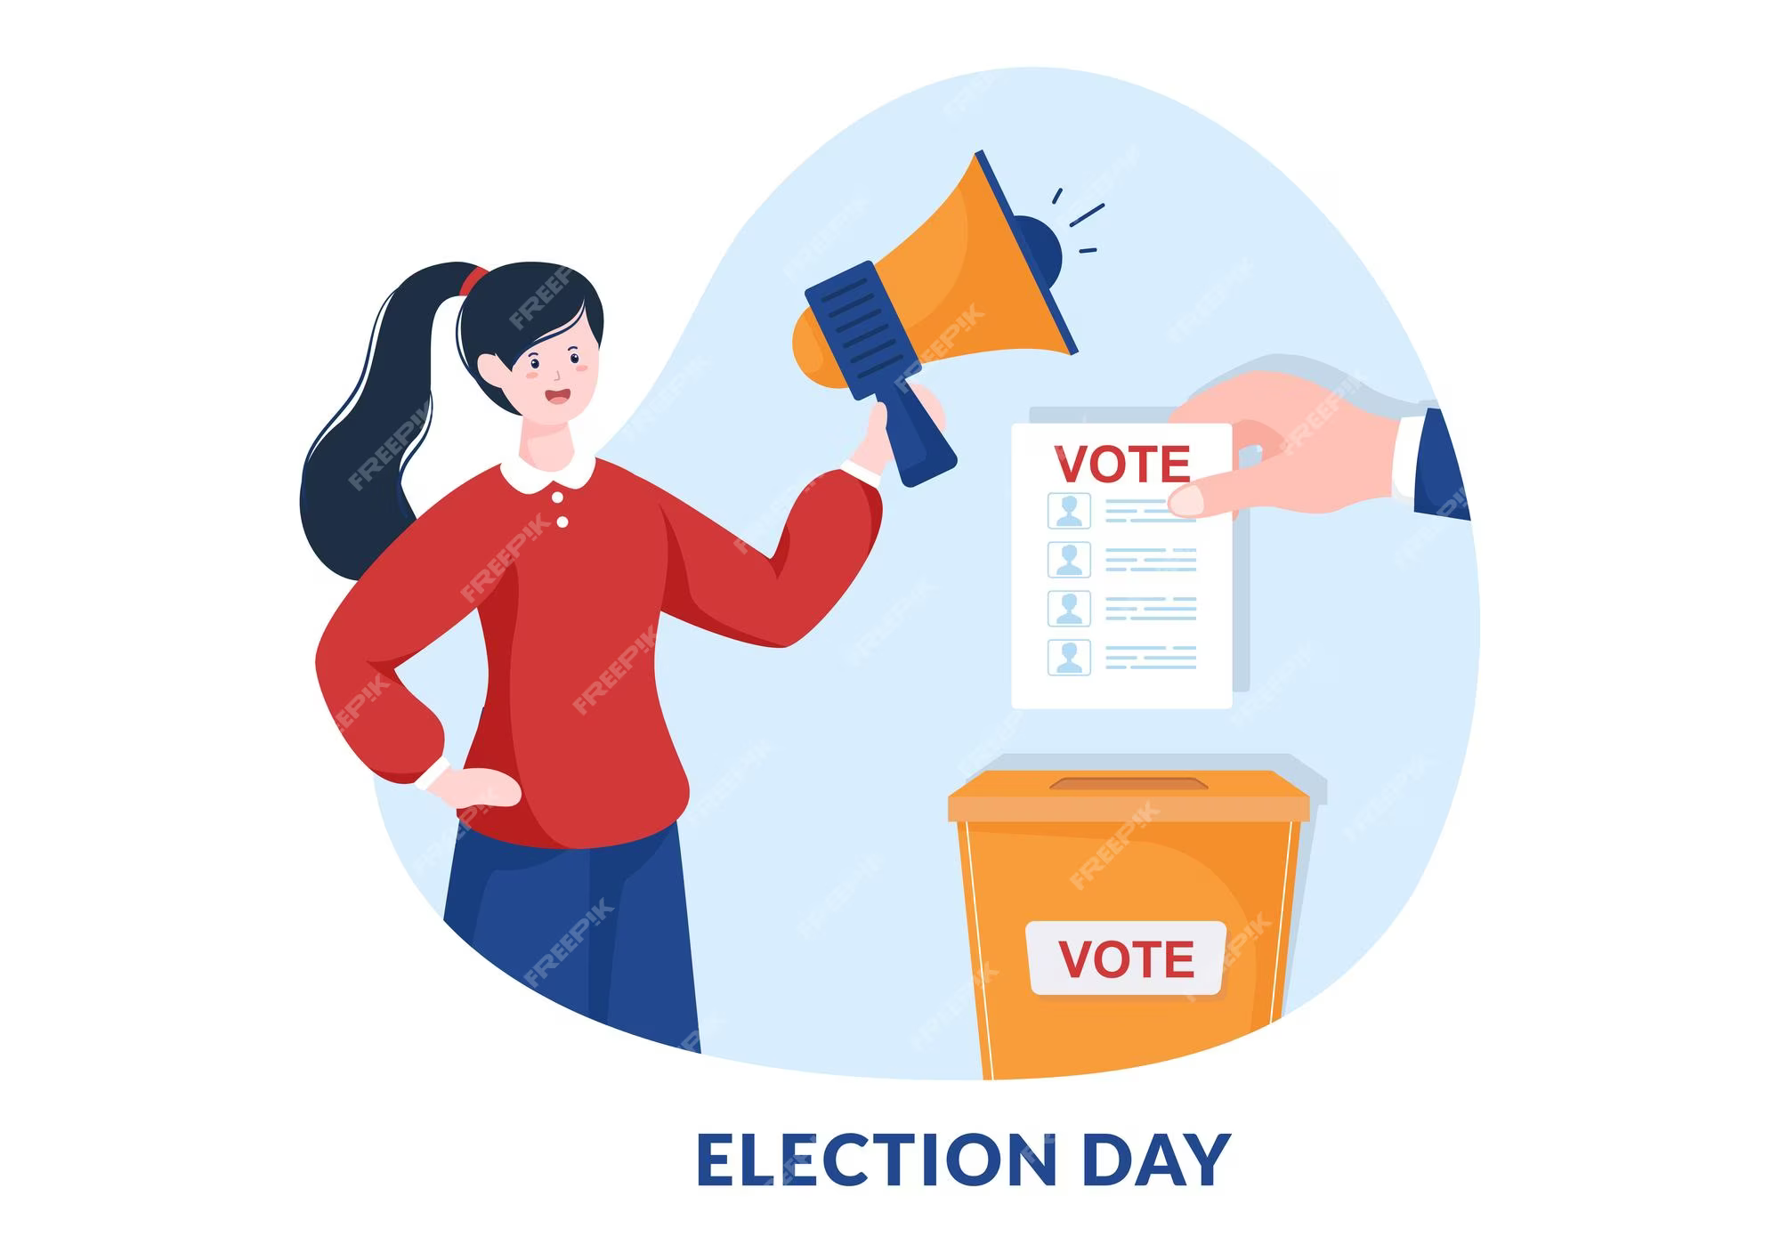

Introduction
Online voting
Corporate/Firm/Organization elections and voting cultures
Corporate/Firm/Organization policy making & decisions

Slide 4
Literature Review
Blockchain based voting for elections on electronic gadgets^{[1]}.
Critical analysis of each blockchain for elections purpose^{[1]}.
Draw back of the research:
Not firm oriented analysis of the election.
Not limiting elections to targeted masses.
Drawback of already existing solution: POLYAS
There’s no direct organizational level monitoring over the election organizer on this platform.
No organization level auth of voters and candidates.
No concrete vetting process of candidates

Slide 5
Literature Review (Summary)
S. No. | Title of Research paper | Year | Problem Identified | Methodology Used | Results Achieved | Future Work
1 | Blockchain for Electronic Voting System—Review and Open Research Challenges | 2021 | Centralized electronic/non-electronic elections | Current blockchain technologies and electronic voting solutions | Critical analysis of popular blockchain(s) for voting purpose | -

Slide 6
Problem Statement
There are organizations/institutes who still follows the manual or paper-stamp method; inevitably to be having an inaccurate, faulty or at worst rigged elections.
The problem not only encourages dishonesty, but also keeps the rightful candidates at bay from fulfilling what they deserve and where they deserve to be.
The reason being the lack of a system which ensures the competent people contest the election and thus preventing competent of them all to be elected for the concerned role.
The system should also ensure the right and integrity of choice of the masses who got to be under the authority of the person who comes as the elected one.

Slide 7
Project Question(s)
How the election organized will be limited to the organization/firm only?
How the solution will be secure?
How the candidates will be acquired?

Slide 8
Project Objectives
Integrity
Transparency
Security

Slide 9
Proposed Methodology
Organization level auth i.e., the authentication of the person using this system will be based on the person’s existence in the database.
Role-based apps (Voter, Candidate, Election Data Admin, System Admin) for separation of concerns.
The employees as candidates or voters will be added from the organization’s DB by the system, based on a certain criteria.
Once vote casted, the voter’s voting is done, preventing from re-voting for someone again or undoing the casted vote.
If a voter/candidate left the organization then he/she won’t be the part of the system.
The voting will be done using blockchain to prevent the tampering or cyber-attack on the voters’ casted votes, and on the candidates acquired votes.

Slide 10
Tools and Technology
Front end + Backend:
Flutter and Dart
Firebase
Ethereum interaction + Smart contract:
Solidity v0.8.19
Smart contract testing & deployment:
Truffle(NPM Package)
Truffle Ganache(Blockchain simulator)
Remix IDE(for solidity smart contract deployment on production level blockchain).
Sepolia blockchain for smart contract’s production level deployment.
Metamask for contract’s deployment gas fee on production blockchain.
Development IDE:
VSCode
SDLC model:
Waterfall
Reason of usage:
Versality
Domain requirement

Slide 11
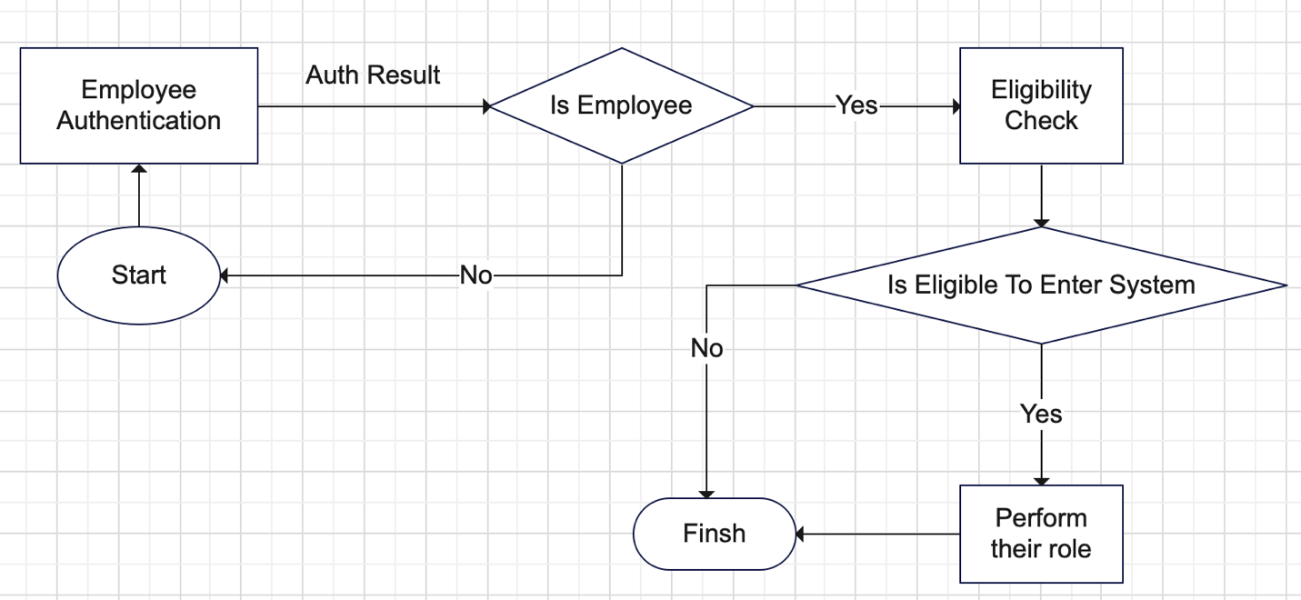
Designs | Flowcharts
Voters and Candidates apps workflow:
In the above screenshot, you’re able to see the following features which are very basic requirements of system:
Employee Auth & validation
Eligibility check & validation
Performing their role
Finish
(Continue)

Slide 12
Contn.
Here the “eligibility check” refers to the bool checks of being eligible to enter the system as per the required role of Voter or Candidate.
The process “Perform their role” refers to the roles of the both Voter and Candidate, the prior’s role is to cast vote and wait for result and post one’s role is to wait for result until election is done.

Slide 13
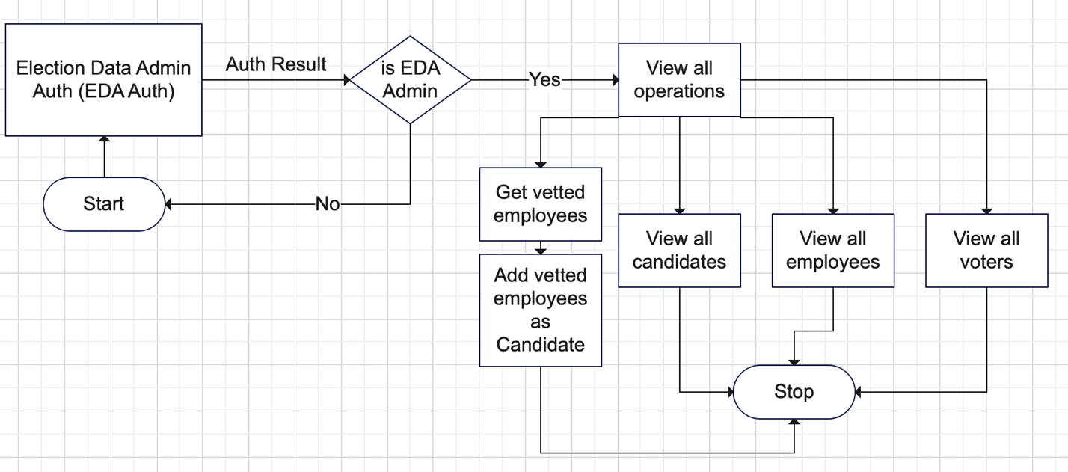
Designs | Flowchart
Election Data Admin(EDA) app workflow:
The requirements, and based on it the workflow of the Election Data Admin is as under:
The main task here is to do the vetting of the employees to be considered fit as candidates. The peripheral tasks are:
View all Candidates
View all employees
View all Voters
The significance of the periphery tasks is to make sure everything is going all right.

Slide 14
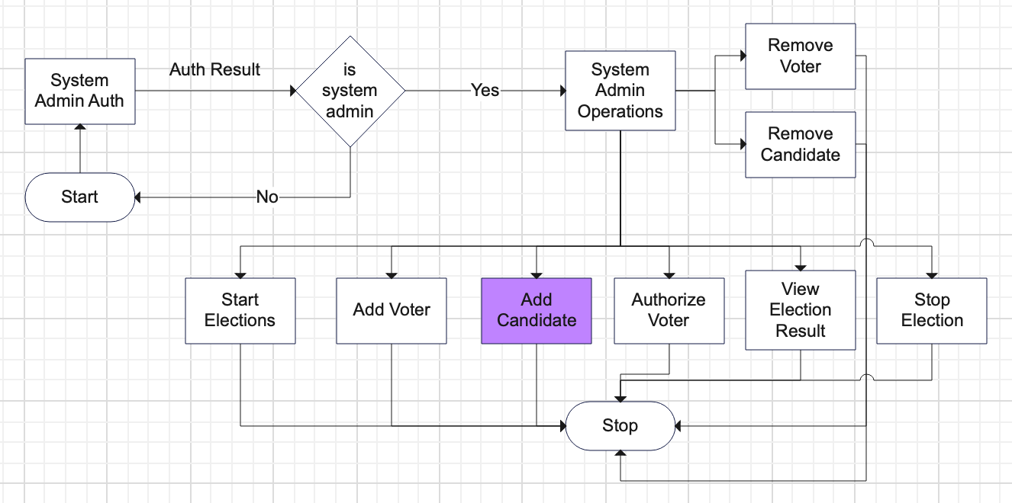
Designs | Flowchart
System Admin app workflow :
The workflow based on the requirements of System Admin app is as under:

Slide 15
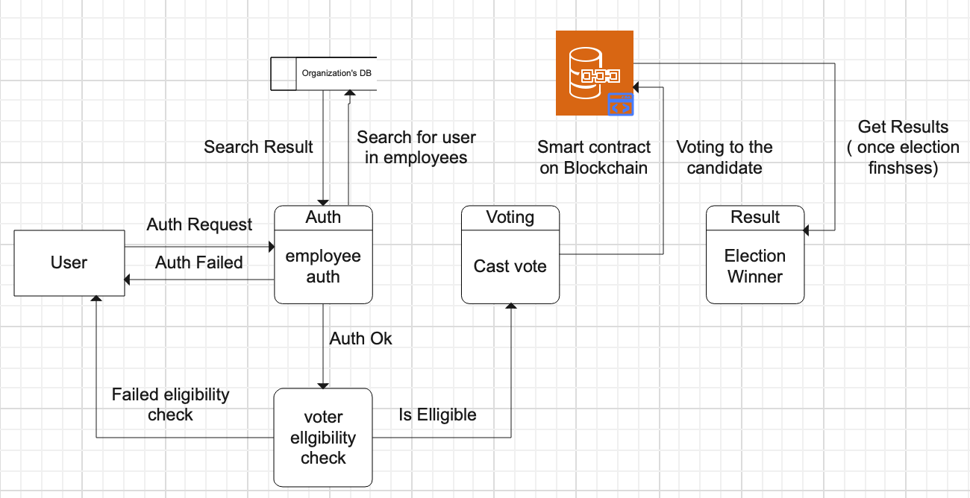
Designs | DFD
Voter app:

Slide 16
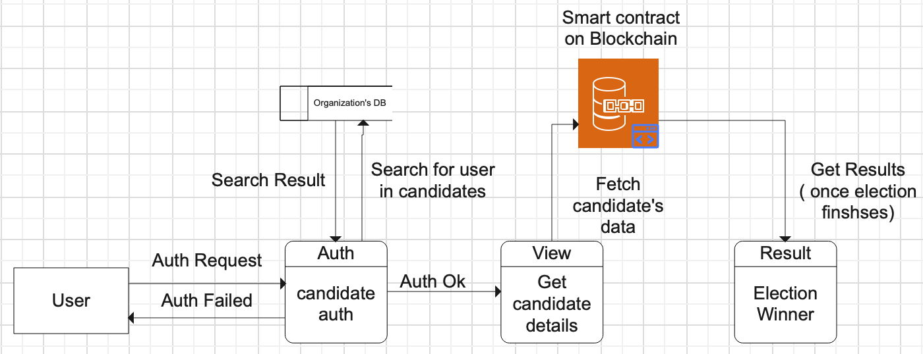
Designs | DFD
Candidate app:

Slide 17
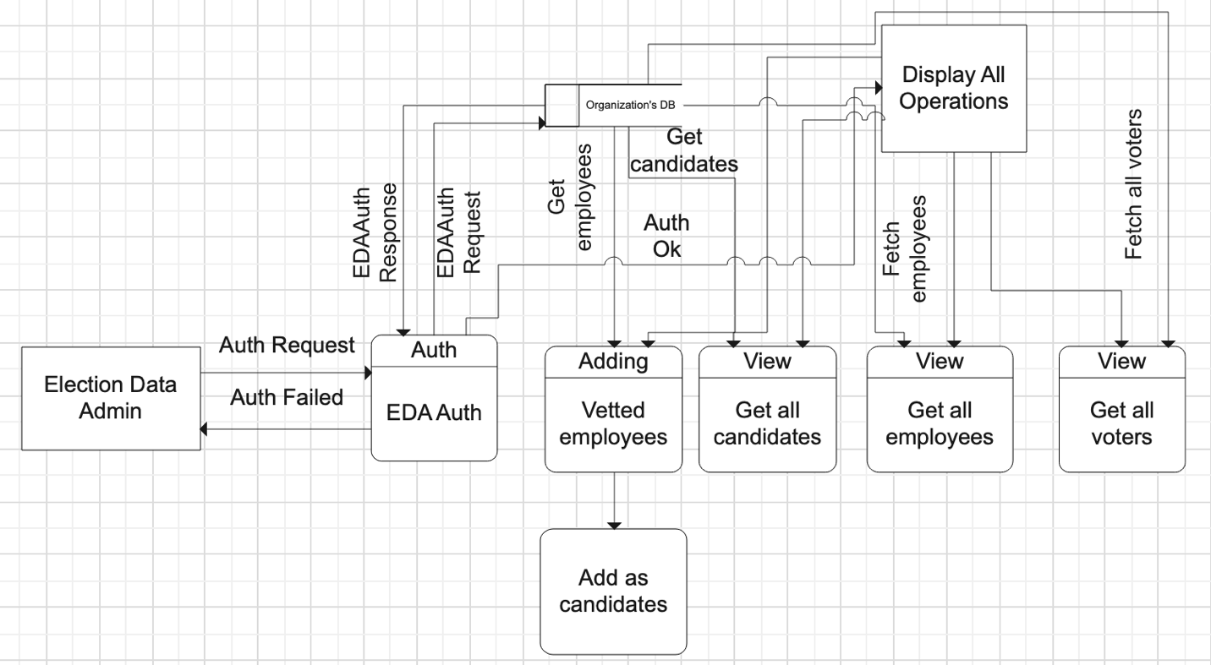
Designs | DFD
EDA app:

Slide 18
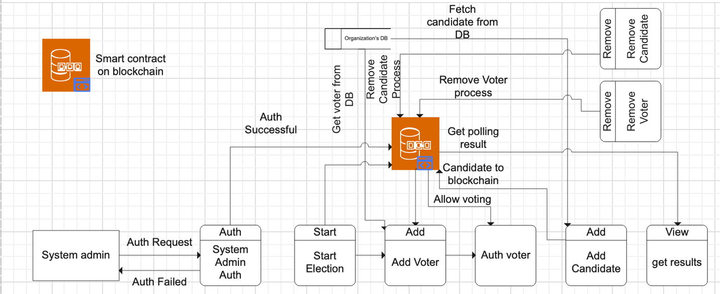
Designs | DFD
System Admin app:

Slide 19
References
^{[1]} M. J. A. A. a. Z. S. Uzma Jafar, "National Center of Medicine," 31 August 2021. [Online]. Available: https://www.ncbi.nlm.nih.gov/pmc/articles/PMC8434614/.

Slide 20
Thank You
Q&A

