Slide 1
Hybrid Centralized Voting System
By
M. Fawad Awan
Registration: 20584
Supervised by
Mr. Syed Aizaz ul Haq

Slide 2
Contents:
Problem statement
Background & motivation
Aims & Benefits
Required features of the solution
Benefits
Project’s execution mechanism
Requirements Analysis
Voter and Candidate apps
EDA(Election Data Admin) app requirements
System Admin app requirements
No employee auth for EDA and system admin
Tech stack
Q/A

Slide 3
Problem Statement:
There are organizations/institutes who still follows the manual or paper-stamp method; inevitably to be having an inaccurate, faulty or at worst rigged elections.
The problem not only encourages dishonesty, but also keeps the rightful candidates at bay from fulfilling what they deserve and where they deserve to be.
The reason being the lack of a system which ensures the rights of the masses who got to live under the authority of the person who comes as the elected one.
That system should make sure that the competent persons contest the election and the competent of them all is elected for the concerned role.

Slide 4
Background & motivation:
Keeping in view the problem statement as described previously, the following proved as motivation for development of the current project:
Rigged election at educational institute for students’ societies presidential election.
Lack of transparency at most of the corporate/organizational environments, e.g. flattery over competence, nepotism etc.
Already existing system’s(POLYAS) drawback.

Slide 5
Aims & Benefits:
Integrity
Transparency
Security
Authenticity of the system
Trust of the people in the system developed
Real time results production as soon as polling ends

Slide 6
Required features of the solution
Organization level auth i.e., the authentication of the person using this system will be based on the person’s existence in the database.
Role-based apps (Voting, Candidates stats, Election Data Admin, System Admin).
The employees as candidates or voters will be added from the organization’s DB by the system, based on a certain criteria.
Once vote casted, the voter’s voting is done, preventing from re-voting for someone again or undoing the casted vote.
If a voter/candidate left the organization then he/she won’t be the part of the system.
The voting will be done using blockchain to prevent the tampering or cyber-attack on the voters, their casted votes or on the candidates and their all data including but not limited to their acquired votes
(Continue)

Slide 7
Cont.
The organization’s database should be able to interact with the blockchain to determine only the candidate who is within the organization.
He/she should be able to remain a candidate, whenever there is election.
Voter should only be the employee who is within the organization.
If he/she left, then they’ll be removed as the voter from the organization’s DB.
After that, from the blockchain as the voter as well.

Slide 8
Project’s execution mechanism:
Voter and candidate will be able to enter the system, only if they’re authorized as the employee and fulfil the condition of entering and using the system.
The voter after voting will not be able to re-vote; preventing from any rigging scenario.
The system admin will perform the critical tasks related to system.
The EDA (Election Data Admin) will be responsible for performing the vetting process of employees to be considered as candidates, and some other peripheral tasks.
The candidate will be able to see their results only.

Slide 9
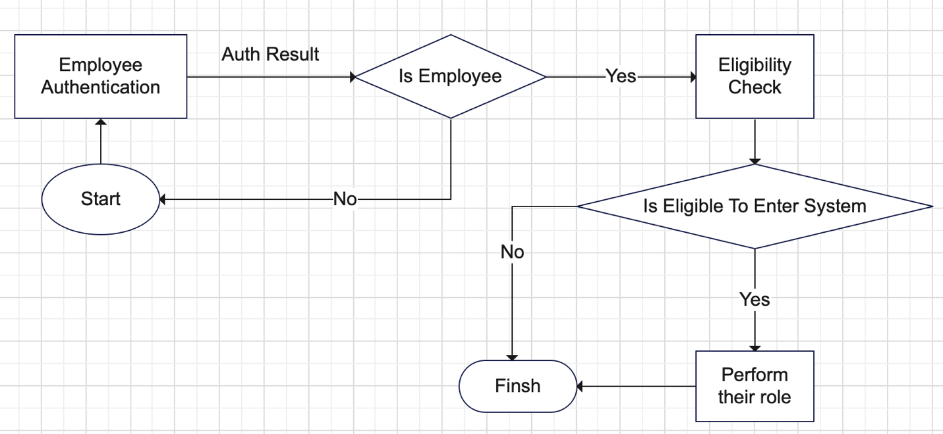
Requirements Analysis
Voters and Candidates apps requirements:
In the above screenshot, you’re able to see the following features which are very basic requirements of system:
Employee Auth & validation
Eligibility check & validation
Performing their role
Finish
(Continue)

Slide 10
Contn.
Here the “eligibility check” refers to the bool checks of being eligible to enter the system as per the required role of Voter or Candidate.
The process “Perform their role” refers to the roles of the both Voter and Candidate, the prior’s role is to cast vote and wait for result and post one’s role is to wait for result until election is done.

Slide 11
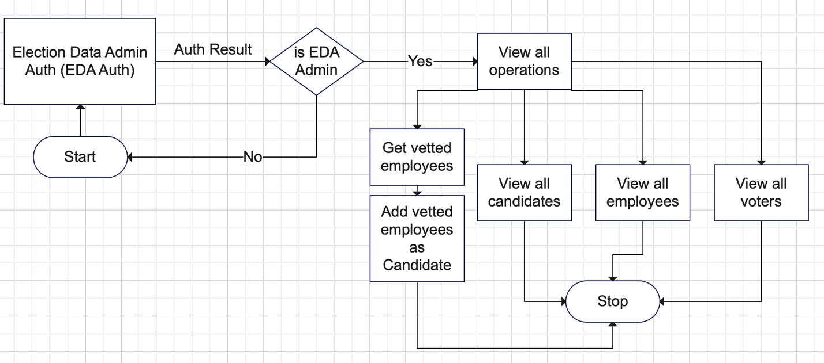
EDA(Election Data Admin) requirements:
The requirements, and based on it the workflow of the Election Data Admin is as under:
The main task here is to do the vetting of the employees to be considered fit as candidates. The peripheral tasks are:
View all Candidates
View all employees
View all Voters
The significance of the periphery tasks is to make sure everything is going all right.

Slide 12
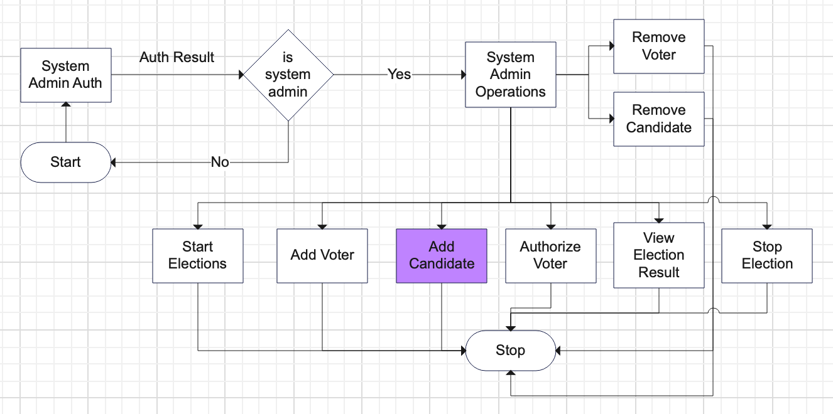
System Admin app requirements
The workflow based on the requirements of System Admin app is as under:

Slide 13
No employee auth for EDA and System Admin?
In both EDA and System Admin apps, there’s no employee checking authentication because:
The EDA and system admin are part of the organization but not employees.
They’re both registered in the organization’s DB as EDA and System Admin respectively.
They’re both are two different roles respectively.

Slide 14
Tech stack
Front end + Backend:
Flutter and Dart
Firebase
Ethereum interaction + Smart contract:
Solidity v0.8.19
Smart contract testing & deployement:
Truffle(NPM Package)
Truffle Ganache(Blockchain simulator)
Remix IDE(for solidity smart contract deployement on production level blockchain).
Sepolia blockchain for smart contract’s production level deployement.
Metamask for contract’s deployement gas fee on production blockchain.
Development IDE:
VSCode
SDLC model:
Waterfall

Slide 15
Q/A

