Slide 1

—— Baseline FNC Implementation
Stance Detection based on GradientBoostClassifier
Hongjie Wang
Shanghai University

Slide 2
Content
FNC-1 Task
Related files
Flow chart
Main codes
Results

Slide 3
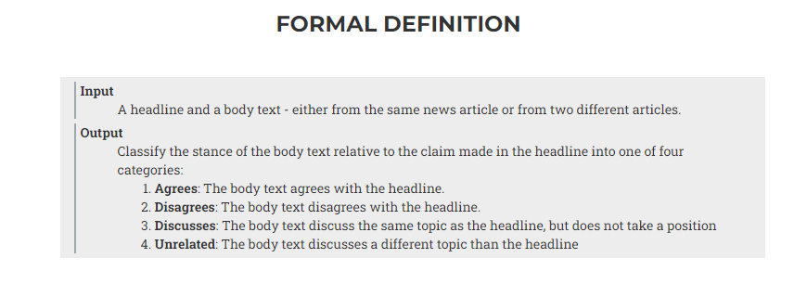
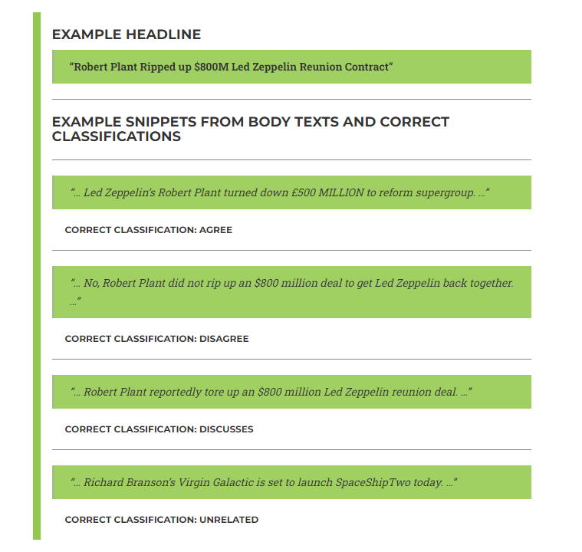
FNC-1 Task

Slide 4
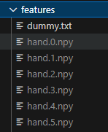
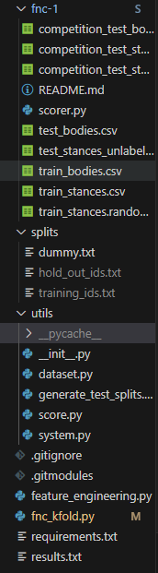
Related files

Slide 5
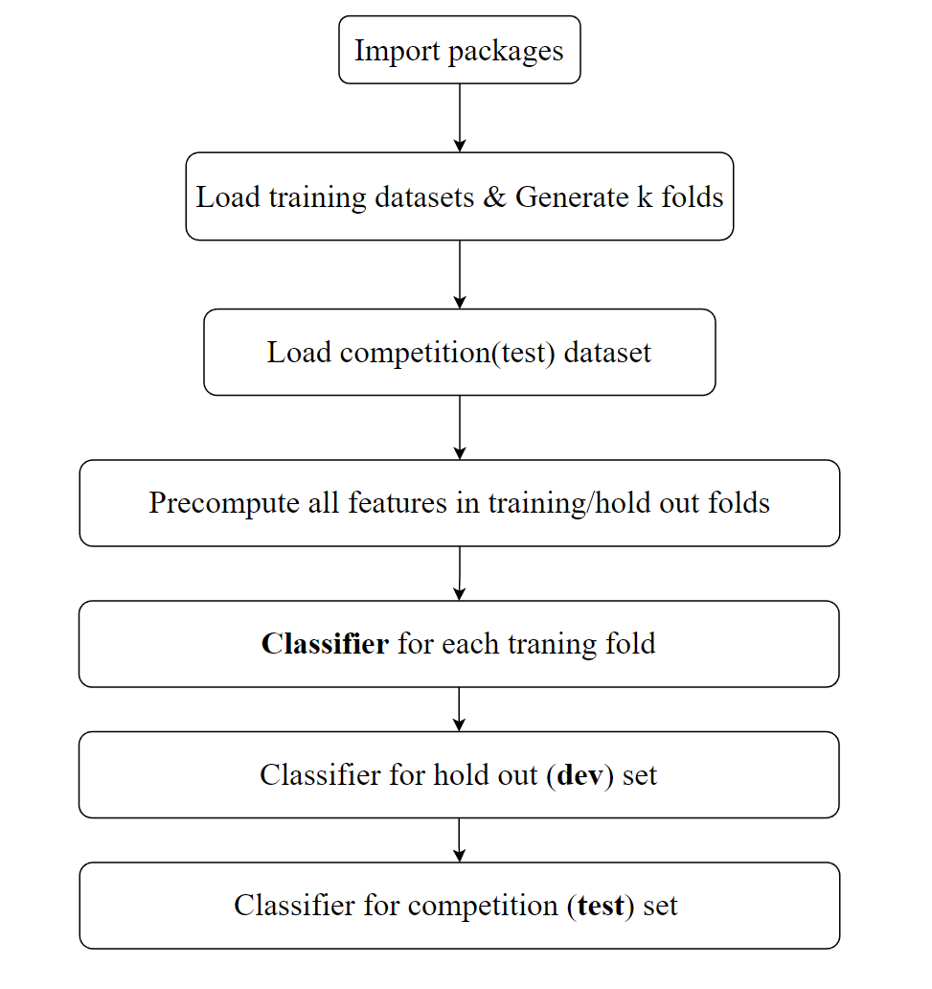
Flow chart

Slide 6
Main codes

Slide 7
Results
Scores on the test set
-------------------------------------------------------------
| | agree | disagree | discuss | unrelated |
-------------------------------------------------------------
| agree | 167 | 11 | 1439 | 286 |
-------------------------------------------------------------
| disagree | 36 | 7 | 416 | 238 |
-------------------------------------------------------------
| discuss | 228 | 14 | 3546 | 676 |
-------------------------------------------------------------
| unrelated | 9 | 5 | 364 | 17971 |
-------------------------------------------------------------
Score: 8748.75 out of 11651.25 (75.0885098165433%)
Scores on the dev set
-------------------------------------------------------------
| | agree | disagree | discuss | unrelated |
-------------------------------------------------------------
| agree | 115 | 8 | 557 | 82 |
-------------------------------------------------------------
| disagree | 16 | 3 | 128 | 15 |
-------------------------------------------------------------
| discuss | 61 | 3 | 1529 | 207 |
-------------------------------------------------------------
| unrelated | 5 | 1 | 96 | 6796 |
-------------------------------------------------------------
Score: 3539.25 out of 4448.5 (79.56052602000675%)

Slide 8
Thanks for listening!
Acknowledgement:
http://www.fakenewschallenge.org/
https://github.com/FakeNewsChallenge/fnc-1-baseline

