Slide 1

Student Dropout Prediction
Jack Xin

Slide 2
Mission & initial dataset
Build Machine Learning Model for dropout classification
Initial dataset – from Kaggle
Pre-processed
2,476 rows
x
36 columns

Slide 3
Step 1: Data cleaning
Duplicates
Remove remaining duplicates (if any)
Missing & “Not a number” values
Categorical data
All in numerical values
Features selection
Only ID is not selected
Features with strong correlation
Remove features too strongly correlated with each other (inter-collinearity) (PCA)

Slide 4
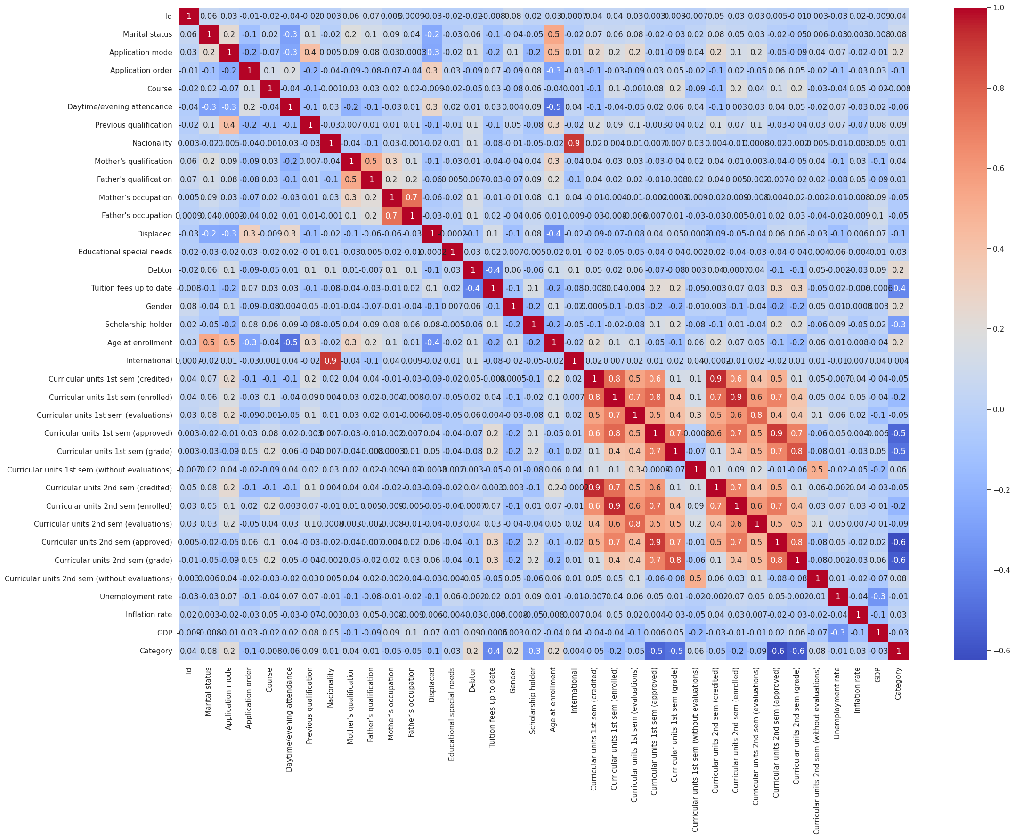

Slide 5
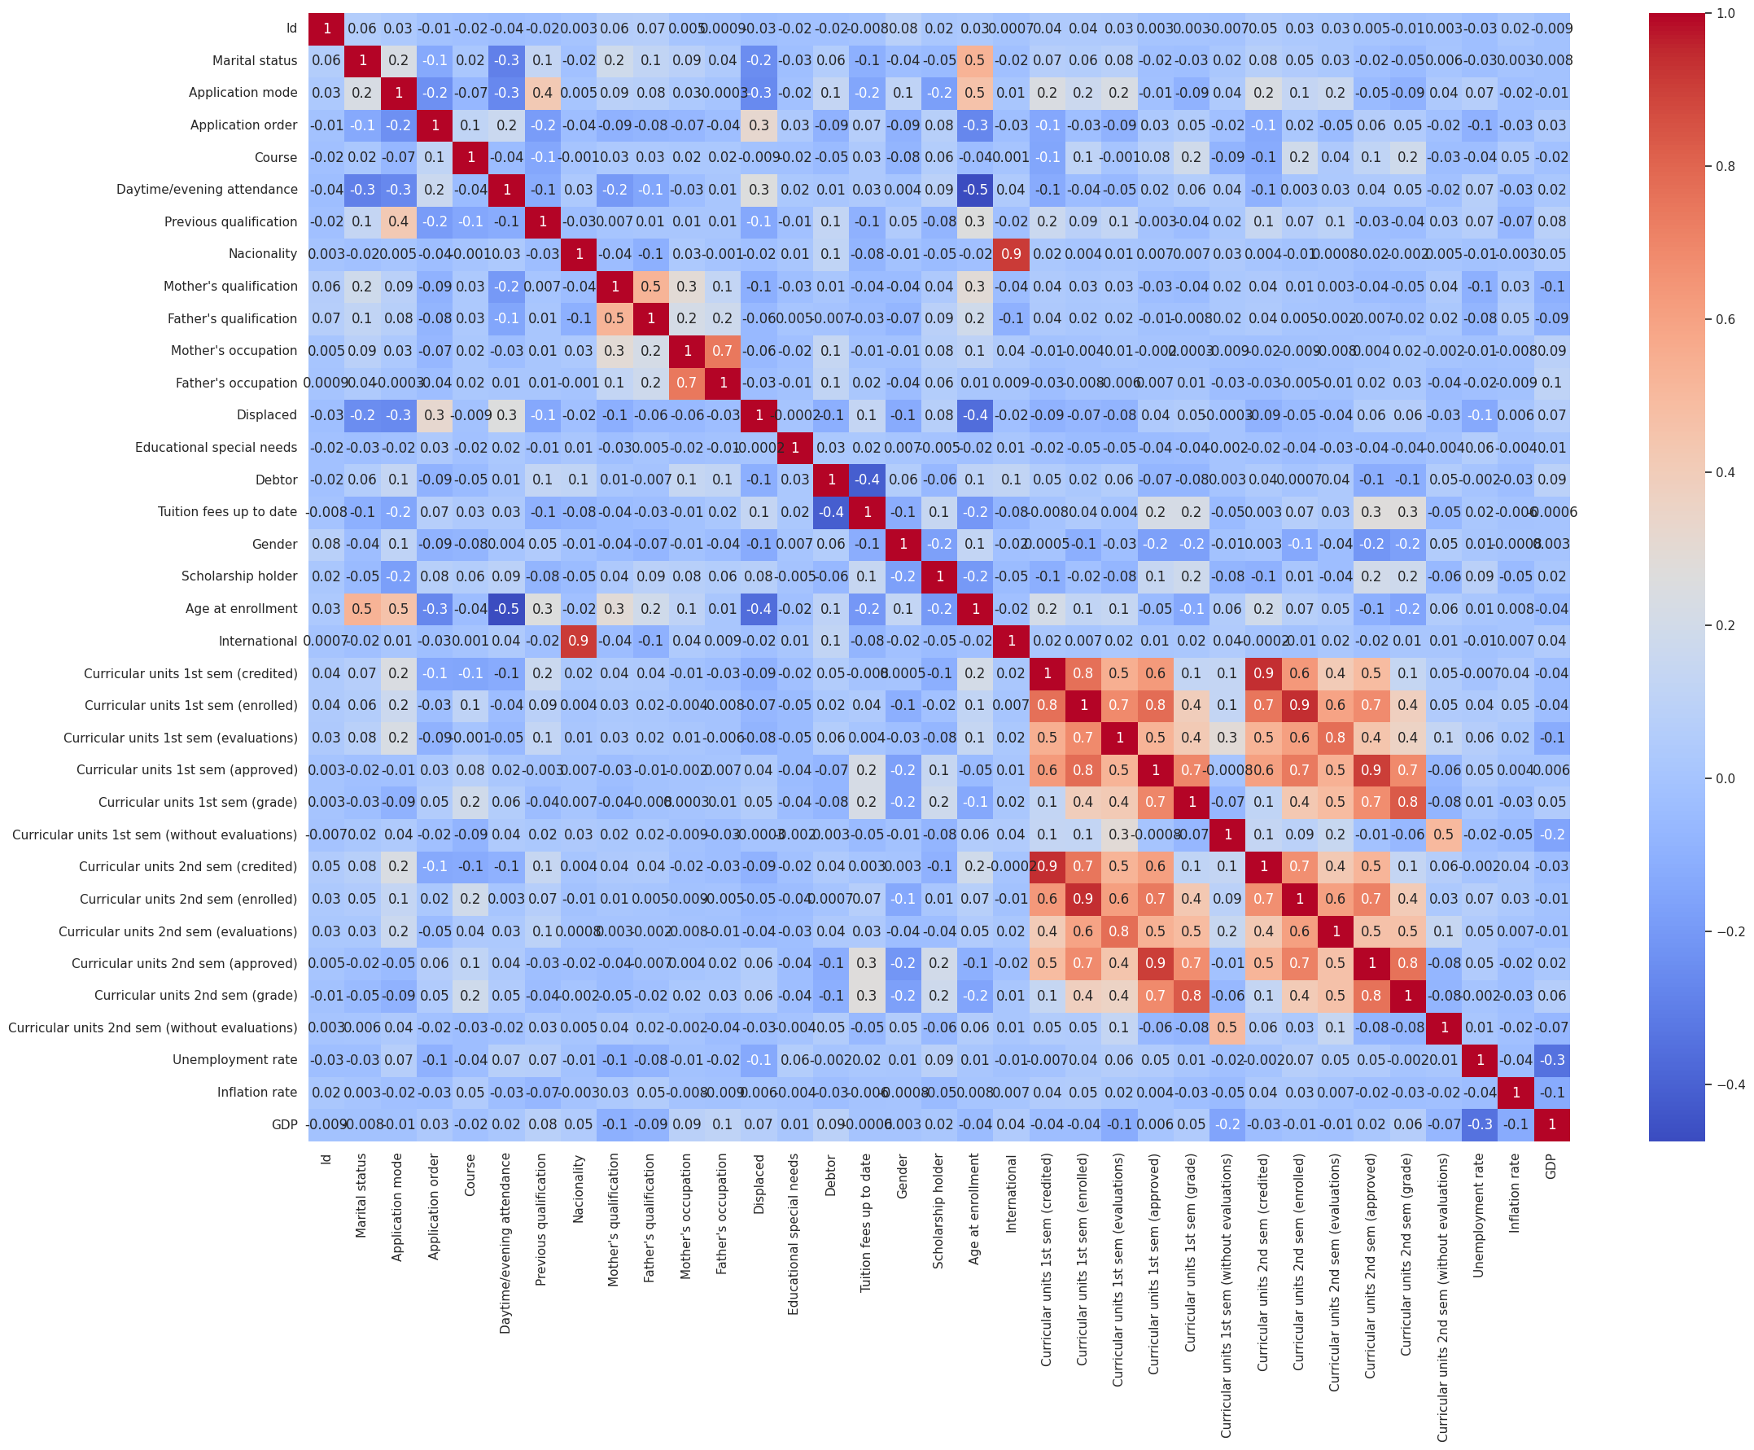

Slide 6
Feature1 | Feature2 | Corr
International | Nacionality | 0.9, Delete International
Curricular units 1st sem (enrolled) | Curricular units 1st sem (credited) | 0.8
Curricular units 2st sem (credited) | Curricular units 1st sem (credited) | 0.9
Curricular units 1st sem (approved) | Curricular units 1st sem (enrolled) | 0.8
Curricular units 2st sem (enrolled) | Curricular units 1st sem (enrolled) | 0.9
Curricular units 2st sem (evaluations) | Curricular units 1st sem (evaluations) | 0.8
Curricular units 2st sem (approved) | Curricular units 1st sem (approved) | 0.9
Curricular units 2st sem (grade) | Curricular units 1st sem (grade) | 0.8
Curricular units 2st sem (grade) | Curricular units 2st sem (approved) | 0.8

Slide 7
Feature selection
habitable surface (0.5)
number of bedrooms (0.4)
swimming pool (0.3)
building condition (0.2)

Slide 8
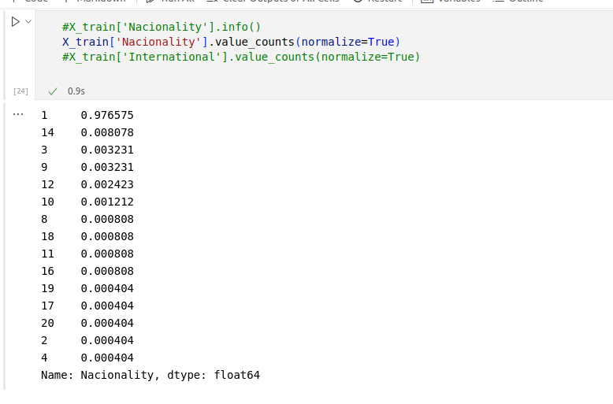

Slide 9
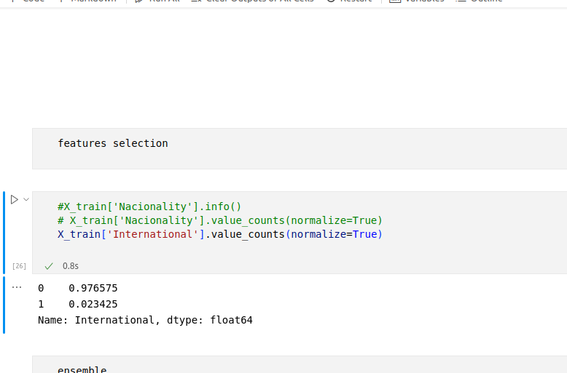

Slide 10
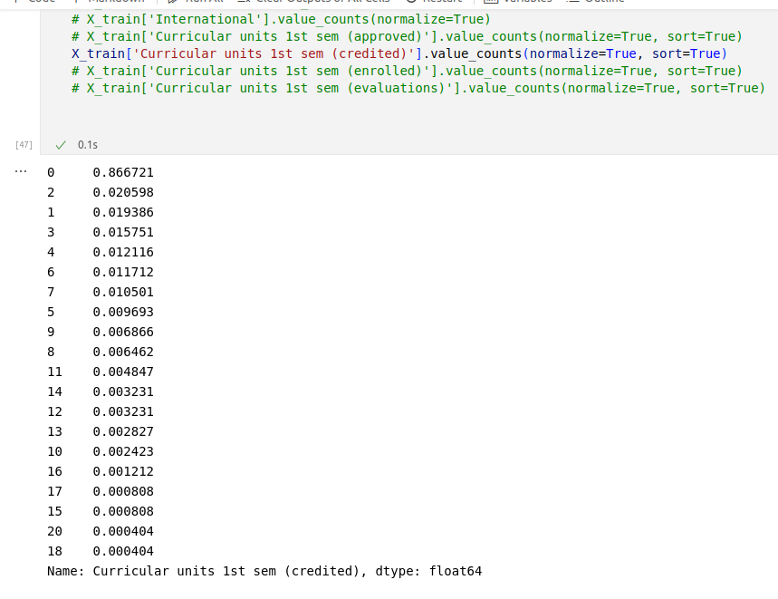

Slide 11
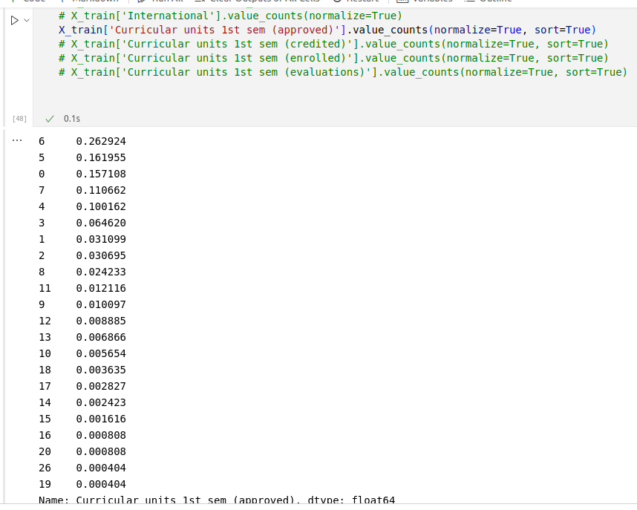

Slide 12
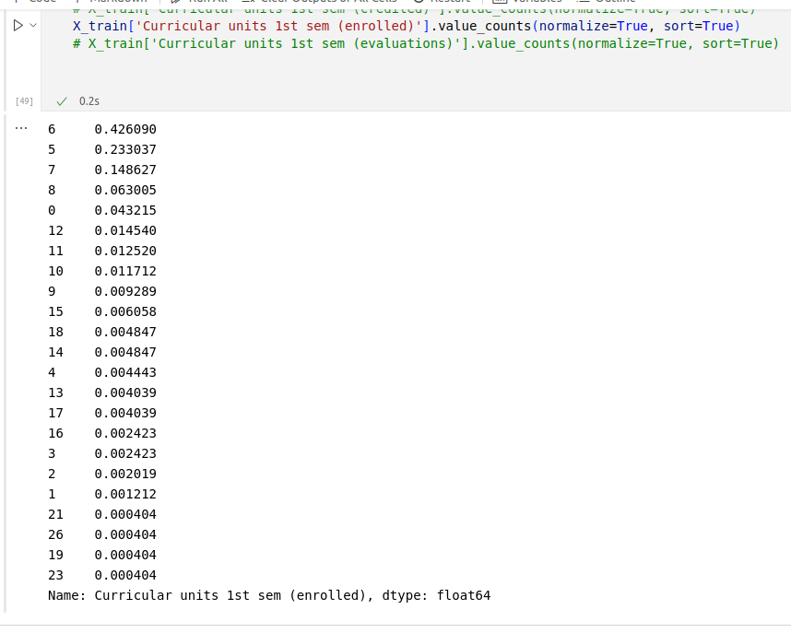

Slide 13
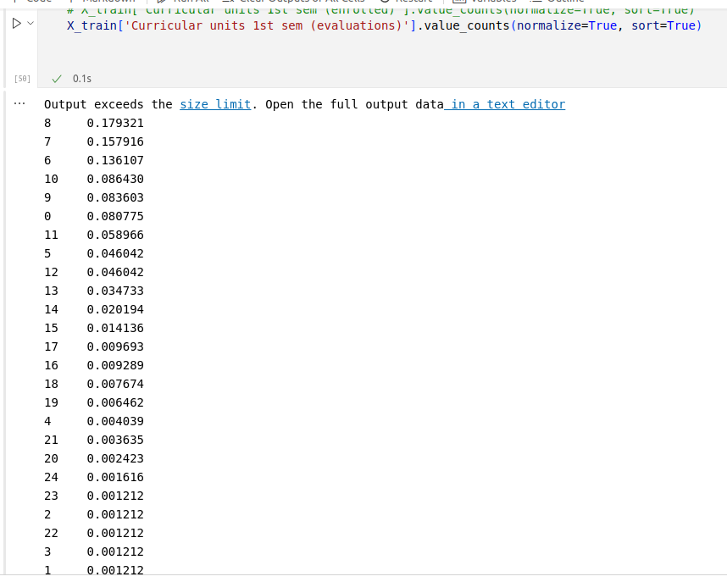

Slide 14
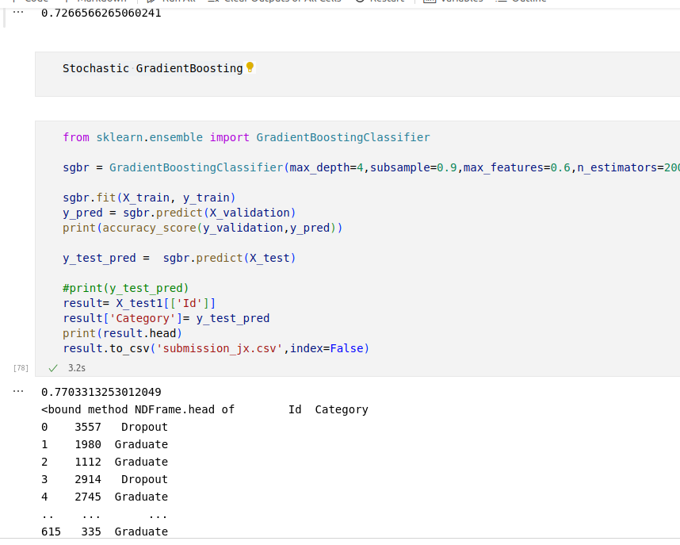
j2

Slide 15
Step 2: Data formatting
Training set
(X_train, y_train)
Dataset
Validation set
(X_validation, y_validation)
Testing set
(X_test)

Slide 16
Step 3: Model selection
Ensemble (Logistic Regression, K Nearest Neighbours, Classification Tree)
Random forests
AdaBoosting
Stochastic GradientBoosting
Multi-layer Perception

Slide 17
Step 4: Apply your model
Model | Accuracy Score
Ensemble | 0.7356
Random Forest | 0.6957
AdaBoosting | 0.7304
Stochastic GradientBoosting | 0.7750
Multi-layer Perception | 0.4819

Slide 18
Step 5: HyperParameters Tuning
Max_depth: 4
Max_features: 0.6
N_estimators: 200
Subsample: 0.9

