Slide 1
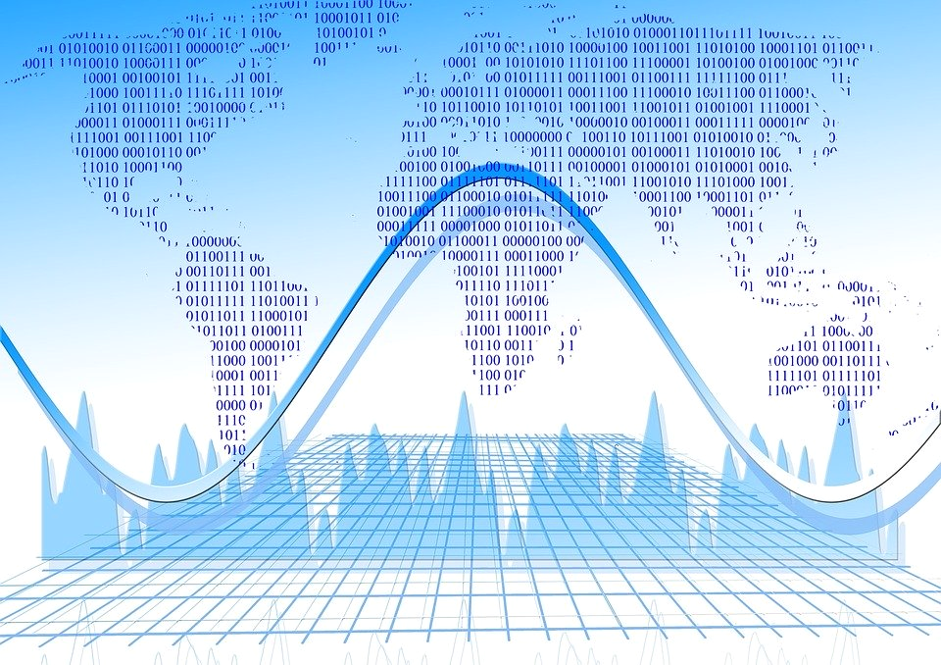
Data in the Humanities:
Interpreting the Humanities in a Digital World
By: Mariana Zuniga, John Schulz, Matthew Mason, Jack Xie

Slide 2
Readings
“We Are All Social Scientists Now: How Big Data, Machine Learning, and Causal Inference Work Together” Grimmer
“Defining Data for Humanists: Text, Artifact, Information or Evidence” Owens
“The state of the digital humanities A report and a critique”
Liu
“CRITICAL QUESTIONS FOR BIG DATA Provocations for a cultural, technological, and scholarly phenomenon” Boyde & Crawford

Slide 3
What are the Digital Humanities?
“combines ‘humanities computing’ or ‘text-based’ digital humanities and new media studies” (Liu, 10)
What’s the challenge?
Maintaining the same critical, cultural, and disciplinary awareness that characterizes the humanities while putting to use openly available mass data and accepted DH practices.

Slide 4


Data for Humanists
Data as Constructed Artifacts
Data as Interpretable Text
Data as Processable Information
Data Can Hold Evidentiary Value
“I contend that data is not a kind of evidence; it is a potential source of information that can hold evidentiary value.” (3)

Slide 5
Inability to take into account New Forms of Media
Liu’s Critique
Lack of Data Visualization
Macro Analysis over Micro Analysis

Slide 6
Critiquing Big Data in the Humanities
Boyde & Crawford:
Big Data Changes The Definitions Of Knowledge
Claims To Objectivity And Accuracy Are Misleading
Bigger Data Are Not Always Better Data
Taken Out Of Context, Big Data Loses Its Meaning
Just Because It Is Accessible Does Not Make It Ethical
Notes:
Big Data Changes The Definitions Of Knowledge
Claims To Objectivity And Accuracy Are Misleading
Bigger Data Are Not Always Better Data
Taken Out Of Context, Big Data Loses Its Meaning
Just Because It Is Accessible Does Not Make It Ethical
Limited Access to Big Data Creates New Digital Divides
“numbers don’t speak for themself”

Slide 7

Interpreting Big Data
“Context is hard to interpret at scale and even harder to maintain when data are reduced to fit into a mode”

Slide 8

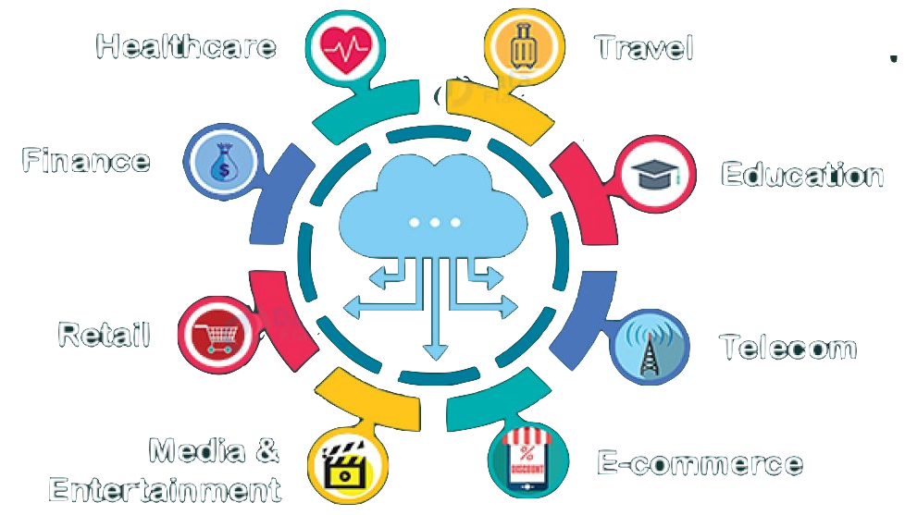
Possibilities for Data in the Humanities
Big data presents many research opportunities
Wide range of applications for the humanities
Using data as a supplemental tool for research

Slide 9
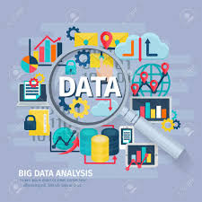
Beneficial Interpretations of Big Data Grimmer
“BIG DATA alone is insufficient for solving society’s most pressing problems — but it certainly can help”
Justin Grimmer

Slide 10



Slide 11
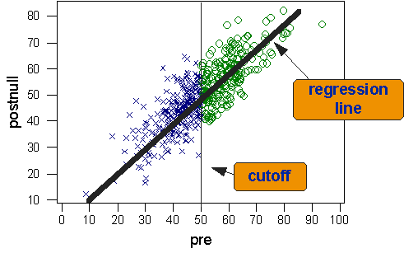
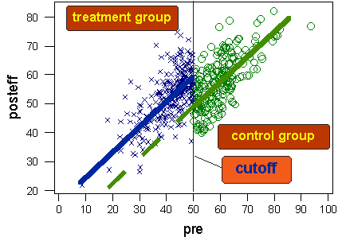
Regression-Discontinuity Design

Slide 12
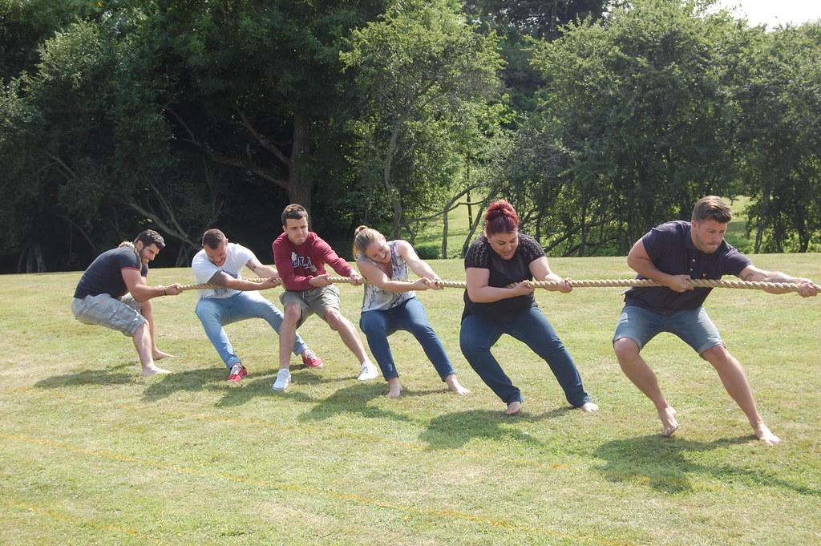
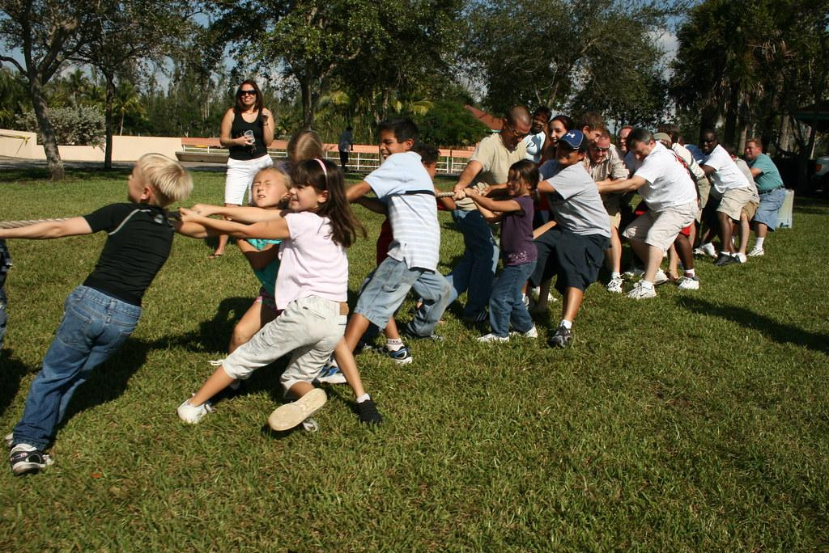

Slide 13
The Hopefuls
The Skeptics
Dr. Nan Z Da
Data as supplemental
Unprecedented Scale
New forms of interpretation
Lack of microanalysis
Unprecedented Scale
Needs more Editorial scrutnity
Losing cultural awareness and critique
Little Visualization
Lack of Microanalysis
Needs more scrutiny

Slide 14

While it’s important to have a positive outlook for the future, we must also keep these critiques in mind so as not to forget the humanities aspect.
Notes:
While it’s important to have a positive outlook for the future, we must also keep these critiques in mind so as not to forget the humanities aspect

Slide 15
Thank You!

