Slide 1
Water Quality Management with LLM Semantic Kernel Plugins
Jack Xue
2024-09-20

Slide 2
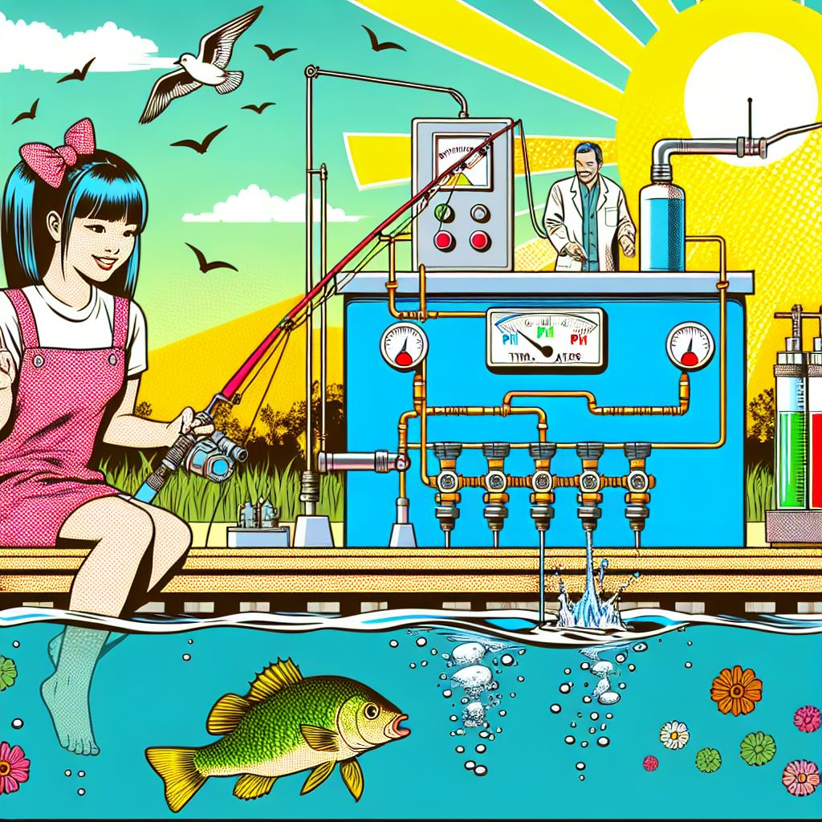
What is Water Quality Management?
Generated by GPT-4 with prompt: A pop art image of a girl fishing by a big water tank. In the tank, there are a pH meter and a thermometer. On the other side of the tank, a chemist is adjusting three valves for water treatment. The sun is shining, and birds are singing.

Slide 3
Math Model
We have five time series datasets for
pH value (dependent variable)
Temperature
Treatment 1 to 3.
pH = f(Temp, Tr1, Tr2, Tr3)
When “pH low” alerted by a sensor, what is the best way to adjust (increase or reduce) the value of Tr1, Tr2, or Tr3?
Fundamentally, this is time series correlation analysis problem. Among Tr1 to Tr3, we select the treatment that has the highest positive correlation coefficient to increase or the one highest negative correlation coefficient to decrease.

Slide 4
Math tools
Pearson Correlation: Measures the linear relationship between two time series. It’s simple but assumes the relationship is linear and both series are stationary.
Spearman’s Rank Correlation: A non-parametric measure that assesses how well the relationship between two variables can be described using a monotonic function. It’s useful when the data isn’t normally distributed.
Cross-Correlation Function (CCF): Used to find the lag at which two time series are most correlated. This is particularly useful in identifying lead-lag relationships.
Granger Causality Test: Determines whether one time series can predict another. It’s based on the idea that if a time series (X) Granger-causes (Y), then past values of (X) should contain information that helps predict (Y).
Dynamic Time Warping (DTW): Measures similarity between two time series that may vary in speed. It’s useful for time series that are not aligned in time.
Vector Autoregression (VAR): A statistical model that captures the linear interdependencies among multiple time series. It’s used for multivariate time series analysis.
Cointegration Tests: Used to determine if two or more time series are cointegrated, meaning they have a long-term equilibrium relationship despite being non-stationary individually.
Mutual Information: Measures the amount of information obtained about one time series through another. It’s a more general measure that can capture non-linear relationships.

Slide 5
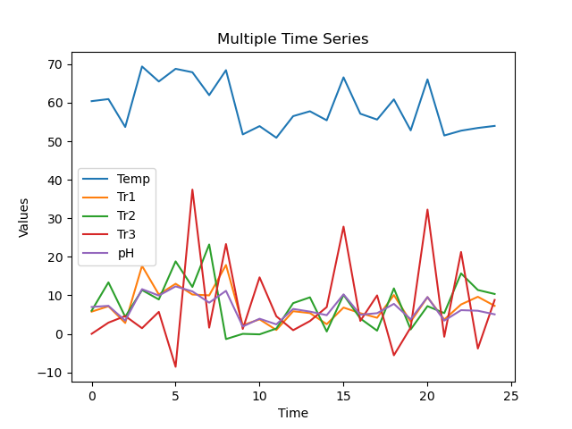
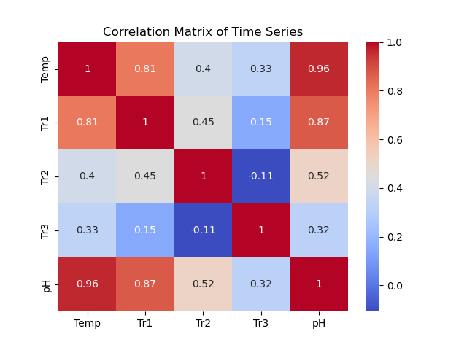
Data Model

Slide 6
Programming Model
sk-plugin model:
plugin 1: Configuration info
plugin 2: Calibration info
plugin 3: Time series data and correlation analysis
AzureChatCompletion calls the plugins and generates the report.
API
Flask app takes HTTP/GET
Testing WUI
Calls the API for ROA

Slide 7
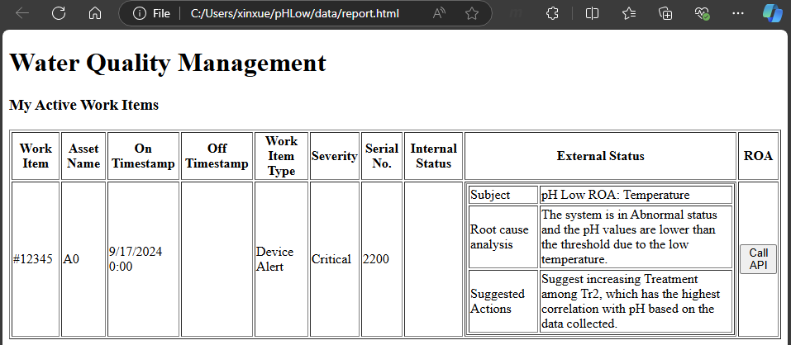
Testing WUI
Click the button “Call API” to retrieve ROA and suggested action, which backfill the cell of External Status.

Slide 8
Reference
pH of Drinking Water: Acceptable Levels and More (healthline.com)
3 Simple Ways to Raise the pH of Water - wikiHow
Plugins in Semantic Kernel | Microsoft Learn

