Slide 1

Microservice on Kubernetes & Coding Copilot
An introduction to Microsoft offerings on microservice, containerization & coding copilot
Jack Xue, PhD & MBA
Principal Cloud Solution Architect
2024-03-07

Slide 2
Agenda
Part 1: Microservice on Kubernetes
What is microservice / containerization?
Container hosting environments
Microservice app in Azure Kubernetes Service – Developers’ perspective
R&D in Kubernetes ecosystem
Part 2: Coding with AI assistance
What is coding AI assistant
Codeium & GitHub Copilot
Part 3: Demo
Dev, test & deploy locally
Code repo & CI/CD pipeline
Monitoring with Azure Monitoring solution and Prometheus & Grafana

Slide 3
What is microservice?
In software engineering, a microservice architecture is a variant of the service-oriented architecture structural style. It is an architectural pattern that arranges an application as a collection of loosely coupled, fine-grained services, communicating through lightweight protocols.
Software architecture evolution timeline:
Monolithic application: Gang of Four, 1994
Service-Oriented Architecture: Roy Fielding, 2000
Microservice: Peter Rodgers 2005

Slide 4
What is containerization?
The containers are basically a fully functional and portable cloud or non-cloud computing environment surrounding the application and keeping it independent of other environments running in parallel. Individually, each container simulates a different software application and runs isolated processes by bundling related configuration files, libraries and dependencies. Collectively, multiple containers share a common Operation System.
In 2001, container technology made it to the Linux side of the house @ Red Hat. Jacques Gélinas created the VServer project, allowed “running several general-purpose Linux server on a single box with a high degree of Independence and security.”

Slide 5
What is the relationship between Microservice & Containerization?
They are two complementary concepts in application development that enable more agile, scalable, and portable software.
Microservices are about designing software as smaller, single-function modules that work together.
Containerization is about packaging software for deployment in isolated and standardized environments.
By using containers to host microservices, developers can benefit from reduced overhead, increased flexibility, faster development, and easier adoption of a microservices architecture.

Slide 6
Landscape of cloud container hosting environment
A container hosting environment is a platform or infrastructure that allows users to deploy, manage, and scale containers
Docker (2010) a platform for Linux containers
Cloud Native Computing Foundation (CNCF): Kubernetes (Google 2015) is now the de-facto container hosting environment.
Amazon Elastic Container Service (Amazon ECS), a highly elastic/scalable container service
Microsoft Azure offers Azure Kubernetes Service (AKS), advanced identity and access management
Google Kubernetes Engine (GKE), GitOps-based configuration and deployment
Red Hat OpenShift Container Platform

Slide 7
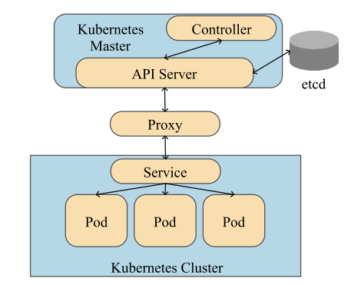
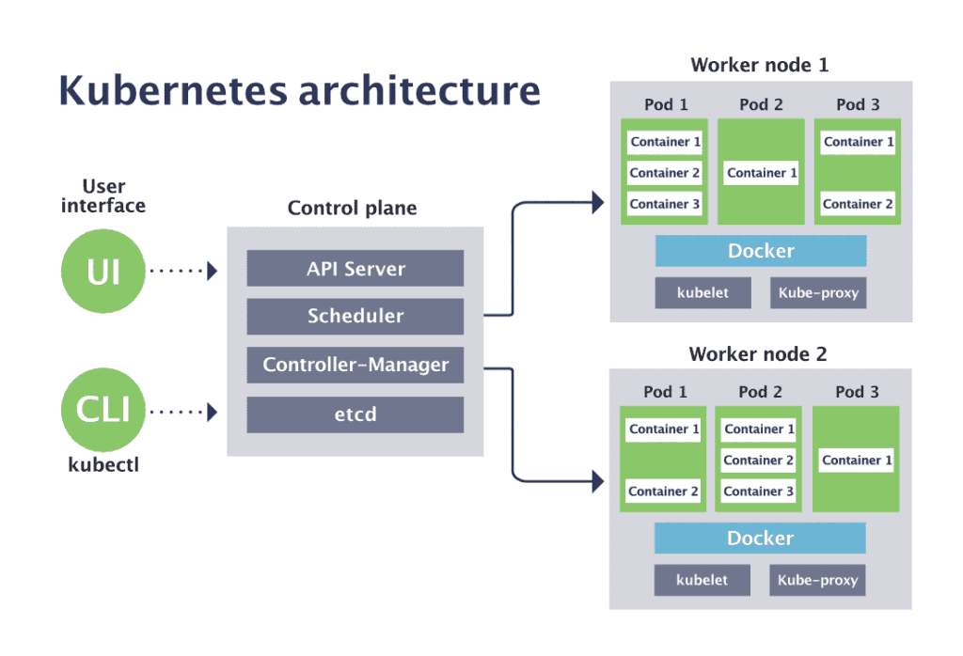
What is the architecture of Kubernetes?
https://www.cncf.io/blog/2019/08/19/how-kubernetes-works/

Slide 8
What are Microsoft cloud container hosting offerings?
Azure Container Registry (ACR): Create Docker images and store them in a repository in Azure Container Registry.
Azure App Service: Use Azure App Service to run web apps that are based on Docker images held in Container Registry.
Azure Container Instances (ACI): a service that makes it simple and quick to deploy containers without having to deal with virtual machines.
Azure Kubernetes Service (AKS): an open-source container orchestration platform, is a managed Kubernetes service that makes it easier to deploy, manage, and scale containerized applications.
Azure Container Apps (ACA): run microservices and containerized applications on a serverless platform.

Slide 9
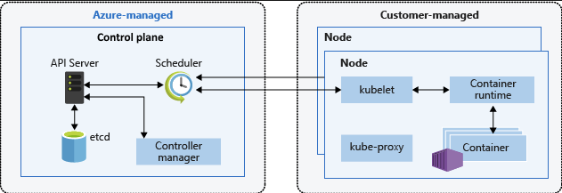
What is Azure Kubernetes Service?
Managed Kubernetes Cluster:
Automatically sets up the control plane and the master nodes are free.
Offloads operational tasks, such as health monitoring and maintenance, to Azure
Deployment Options: Create an AKS cluster using various methods:
Azure CLI, PowerShell, and scripting for IaC
Advanced Features:
Networking (VNet, Subnet, ILB, Private Links)
Microsoft Azure Active Directory (Entry AD) integration for RBAC
Monitoring (Azure Monitor, Container Insights, Log Analytic Workspace, Prometheus & Grafana)
Optional Adds-in: Keda, Extensions: Dapr, Flux, Backup & integration with other popular CNCF projects, such as Helm
Integration with IDE & CI/CD
After install Azure SDK, all IDEs can interact with AKS
Using Azure tasks, major CI/CD tools can communicate with AKS
Monitoring and Insights:
Azure Monitor, Container Insights. Log Analytic Workspace.
Prometheus & Grafana

Slide 10
How does microservice app deploy in AKS?
Microservices architecture on Azure Kubernetes Service

Slide 11
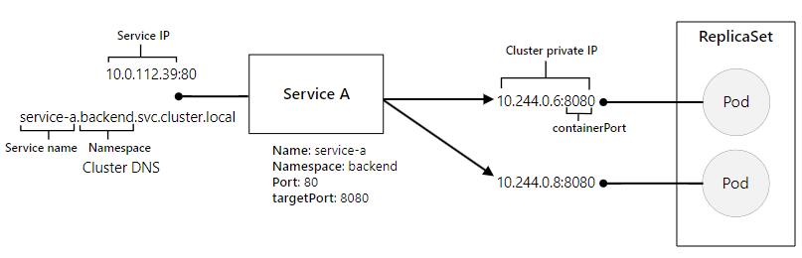
How does AKS expose my app?
Visual Studio Code extension update for Azure Kubernetes Service (AKS). Published date: January 31, 2024

Slide 12
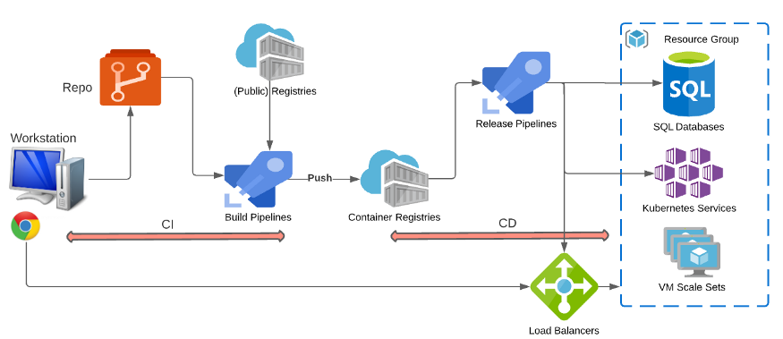
What is a dev toolbox for AKS?
Visual Studio Code extension update for Azure Kubernetes Service (AKS). Published date: January 31, 2024

Slide 13
How to monitoring AKS with Azure Monitor Logs?
Set up logging:
From Azure portal, select Diagnostic settings, and then select Add diagnostic setting.
Under Destination details, choose Send to Log Analytics and then select your Log Analytics workspace.
In your Python code:
logging.info('My app logs here.’)
From the AKS->Monitoring->Logs.
Kusto query:
ContainerLogV2 | where LogMessage contains "Xue"

Slide 14


What is Azure Kubernetes Service Monitoring Solution?
Basic solution:
Azure Monitor, Container Insights and Log Analytics Workspace
Enhanced solution:
CNCF components: Prometheus and Grafana

Slide 15
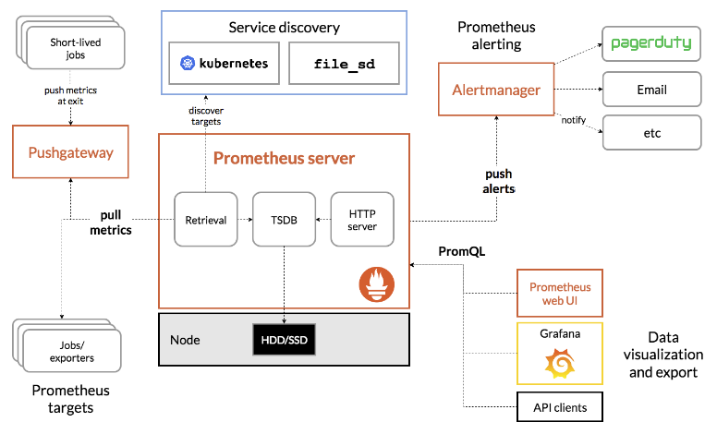
How Prometheus & Grafana work with Kubernetes?

Slide 16
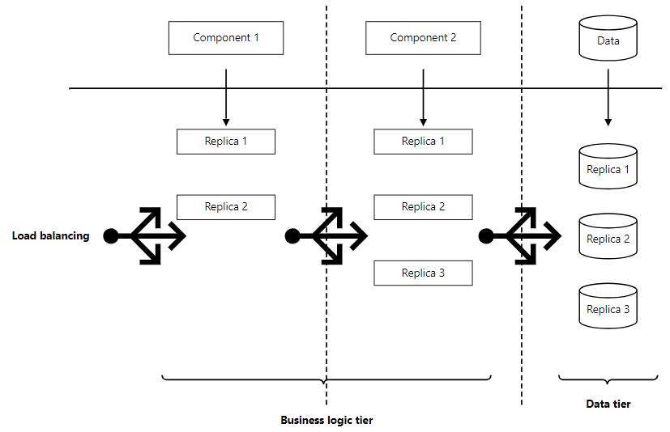
How about AKS’ HA/DR?
Four HA pillars appear in every highly available system:
Redundancy
Monitoring
Recovery
Checkpointing
Consider a multitiered AKS application, where traffic arrives to the business logic tier, the data tier preserves state, and the application returns responses to users.

Slide 17
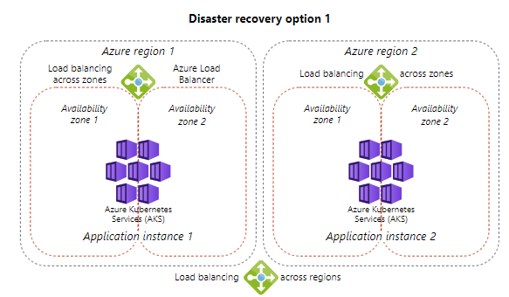
How about AKS’ HA/DR?
DR requires multiregion service deployment at the entire service level, with load balancing solutions between Azure regions.
The application is either spread across multiple regions, or an entire application instance is deployed in each region.
The choice depends on application type, application architecture, and latency tolerance between components.

Slide 18
How about R&D in Kubernetes ecosystem?
Challenges Related to Infrastructure Domain
New Types of Physical Devices
Enhance Resource Virtualization Techniques
Challenges Related to Cluster Domain
Distributed Control Plane
Collaboration Among Clusters
Challenges Related to Scheduling Domain
Dynamic scalability
Advance Context-Aware Scheduling Algorithm
Challenges Related to Application Domain
Workflows and Microservices
Model Workloads
Challenges Related to Performance Domain
Usability and security

Slide 19
How to code with coding assistant?
AI coding assistants are powerful tools that can help developers write code more efficiently. They use artificial intelligence to generate code snippets, provide suggestions, and assist with debugging.
Codeium: A new AI-powered coding assistant that can write you code, answer your questions, and level up your productivity. Available for free today in our VSCode, JetBrains, and Eclipse extensions.
GitHub Copilot
'Bing Code Search’ a Microsoft Research project released in February 2014
On June 29, 2021, GitHub announced GitHub Copilot for technical preview.
This tool integrates with popular code editors like Visual Studio Code. It offers intelligent
Code suggestions
Chat
Documentation
Efficient debugging assistance,
Security issue spotting

Slide 20
Useful links
CNCF Landscape
Add-ons, extensions, and other integrations with Azure Kubernetes Service (AKS) - Azure Kubernetes Service | Microsoft Learn
Working with Kubernetes in Visual Studio Code
Deploy to Azure Kubernetes Service with Azure Pipelines - Azure Kubernetes Service | Microsoft Learn
Enable monitoring for Azure Kubernetes Service (AKS) cluster - Azure Monitor | Microsoft Learn
Codeium · Free AI Code Completion & Chat

Slide 21
Demos
Develop a python app
Write Azure Function in Python in VS Code
Test the function locally
Locally deploy the function to Azure App Service
CI/CD pipeline deploy the function to Azure App Service
Containerize the python app
Build the image with Dockerfile
Test the image locally
Push the image to ACR
Deploy the image from ACR to AKS
CI/CD pipeline deploy the image form ACR to AKS
AKS monitoring:
KQL
Prometheus & Grafana

