Slide 1






端
午
中
国
传
统
节
日
端
午
HAPPY DRAGON BOAT FESTIVAL
物联网1班 2411

Slide 2

background
The Dragon Boat Festival is the fifth day of the fifth lunar month, also known as the Dragon Boat Festival, noon day festival, May Festival, five day festival, AI Festival, Duanwu Festival, Chongwu Festival, Chongwu Festival, noon day, summer festival and Pu Festival. It is an important traditional festival in the East Asian cultural circle in Greater China, Japan, North Korea, South Korea and Vietnam.

Slide 3


农历五月初五，端午节划龙舟吃粽子
插艾蒿等都是我国的传统习俗
习俗
May 5th lunar,racing the dragon boat and eating Zongzi is our traditions.

Slide 4
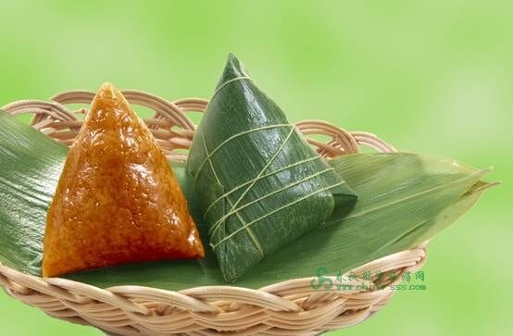
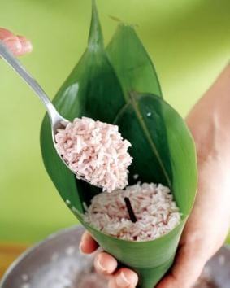
为什么称之为粽子
历史上关于粽子的记载，最早见于汉代许慎的《说文解字》。“粽”字本作“糉”，《说文新附•米部》谓“糉，芦叶裹米也。从米，葼声。”《说文•夂》：“葼，敛足也。”义为鸟飞时收敛腿爪。《集韵•送韵》：“糉，角黍也。或作粽。”
粽子又名“角黍”，最早记载见西晋周处的《风土记》：“仲夏端五，方伯协极。享用角黍，龟鳞顺德。注云：端，始也，谓五月初五也。四仲为方伯。俗重五月五日，与夏至同。●（同
“鸭”），春孚雏，到夏至月，皆任啖也。先此二节一日，又以菰叶裹黏米，杂以粟，以淳浓灰汁煮之令熟，二节日所尚啖也。……裹黏米一名‘糉’，一名‘角黍’，盖取阴阳尚相苞裹未分散之象也。”
明代李时珍《本草纲目》中，清楚说明用菰叶裹黍米，煮成尖角或棕榈叶形状食物，所以称“角黍”或“粽”。
明清以后，粽子多用糯米包裹，这时就不叫角黍，而称粽子了。

Slide 5
包粽子
包粽子，首先要准备好粽子叶，老北京包粽子的粽子叶一般是苇叶，用在包粽子上就被称为粽叶。过去，粽子叶都是老人们去自己摘的，现在北京城周边没有芦苇荡了，这粽子叶也只有去超市买了。很多人认为粽子叶越绿越艳越好，其实不然，越绿越艳的粽叶有可能是用颜料染成的，正常的粽叶应该是黄绿色略显陈旧；正常的粽叶包出的粽子有一种粽叶的香味而不是其他的怪味；如果煮完粽子之后，水是淡黄色，那说明这粽叶没问题。
First,to start some leaves.People make Zongzi by the reed leaves in traditional Beijing.The past,the olds picked Zongzi leaves by their hands,there is rarely reeds around Beijing nowadays,people could only get the leaves from supermarket.
.

Slide 6

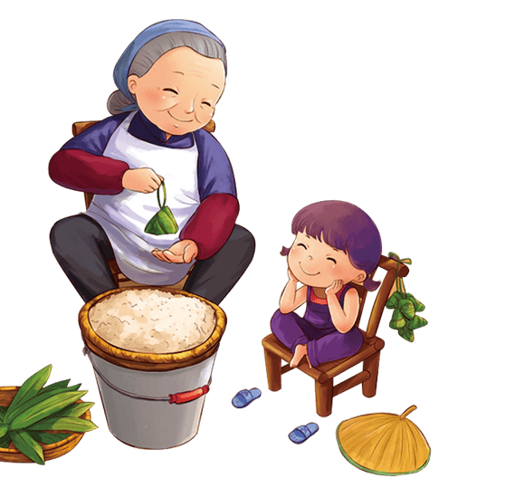
Methods of making zongzi

Slide 7
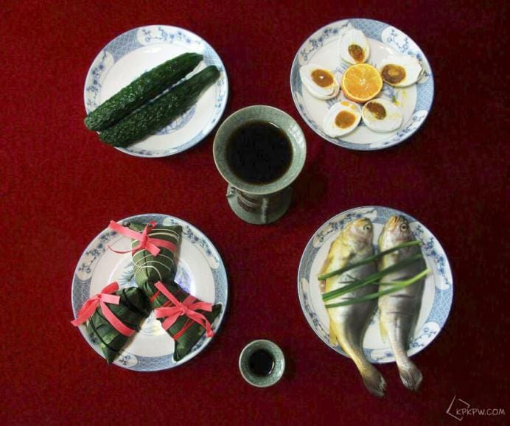
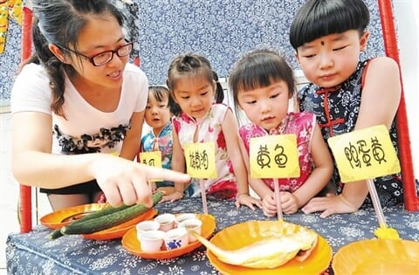
Glutinous rice filled with meat, nuts or bean paste and wrapped in bamboo leaves. It is associated with Dragon Boat Festival with historical meaning.The custom of eating zongzi is now popular in North and South Korea, Japan and Southeast Asian nation。
糯米一般先用肉、坚果或者豆沙馅填充起来，然后再用竹叶包裹起来。这是和端午节的历史意义紧密结合在一起的。吃粽子的习俗，现在已经在朝鲜、韩国、日本和东南亚国家流行开来。

Slide 8






Put in a small amount of glutinous rice
subsidiary material
Fold the two leaves into a funnel
Wrap the glutinous rice tightly
Wrap the leaves tightly with a rope
Add another layer of glutinous rice

Slide 9
THANKS
中
国
传
统
节
日
端
午
HAPPY DRAGON BOAT FESTIVAL
DESIGN BY 1PPT

