Slide 1
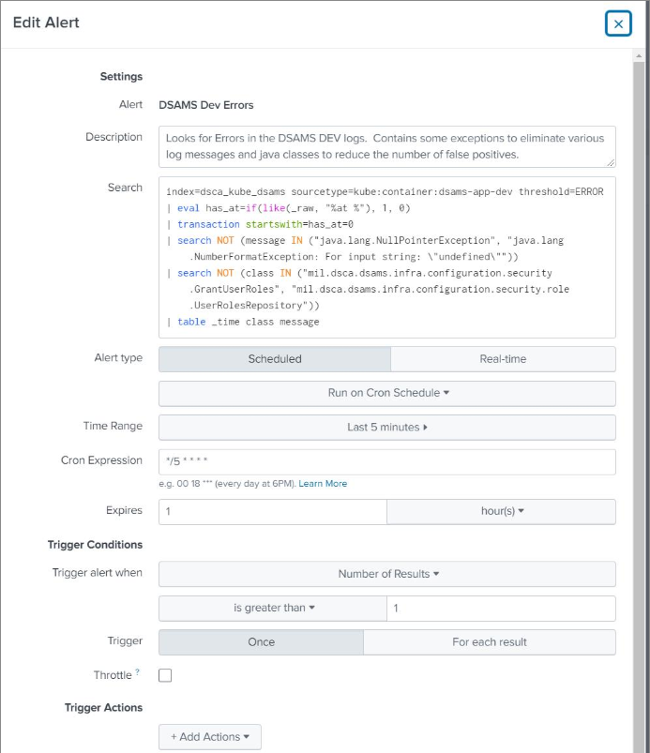

Slide 2
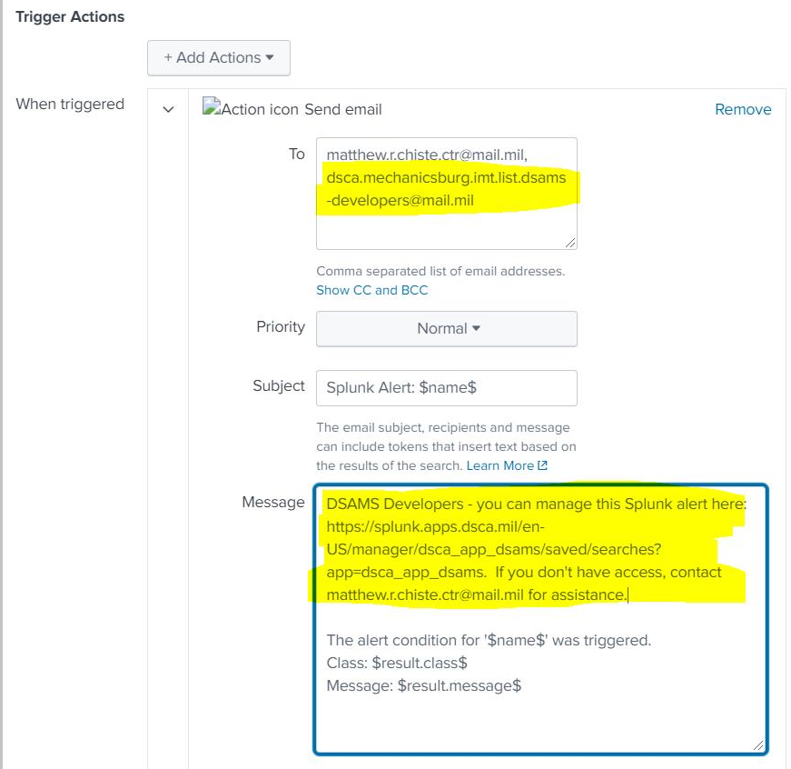

Slide 3
[6/24 11:46 AM] Chiste, Matthew R CTR DSCA OBO IMT TS (USA)so I can add that alias to the alert, but if you'd rather use individual names or self-manage, it can be done with a comma-separated list here: https://splunk.apps.dsca.mil/en-US/manager/dsca_app_dsams/saved/searches?app=dsca_app_dsams&count=10&offset=0&itemType=&owner=matthew.r.chiste.ctr%40mail.mil
​
[6/24 11:50 AM] Chiste, Matthew R CTR DSCA OBO IMT TS (USA)OK I've updated the alert notification, and I also updated the text that will show up in the email so that users have a link to self-manage or email to request access. I think with this I'll close out the ticket, but of course don't hesitate to reach out if you need other assistance!

Slide 4
source="*dsams-web-proxy*" status=40* OR status=50*
source="*dsams-web-dev-proxy*" NOT (error OR fail)
sourcetype="kube:container:dsams-app" xiaoming
sourcetype="kube:container:dsams-app-dev" exceeded simultaneous
sourcetype="kube:container:dsams-app-dev" 32458 ERROR
kube:container:dsams-web
kube:container:dsams-web-dev 370 0.051%
sourcetype="kube:container:dsams-app-dev" PIV Login:CHERYL
sourcetype="kube:container:dsams-app-dev" "ERROR mil.dsca.dsams" getFundingParameterSet(11281) | stats count by error | head 10
sourcetype="kube:container:dsams-app-dev" "This data is already locked" OR "by user Cheryl Cote" "This data is already locked" | append [search "by user Cheryl Cote"]
sourcetype="kube:container:dsams-app-dev" ### ### PIV Login:XIAOMING
View results in Splunk/Click on the Exception/View Events/Expend the Exception/Event Actions/Show Souce

Slide 5
Children Component
Parent (Edit Slider)
onToggleEdit(event: any) {
if (event.checked) { <-- #0. more condition if (this.closeIn == "1") {
this.isEditable = true;
this.setLock(); <-- #1. setLock() no need from legacy/but for non legacy
} else {
checkValuesChanged() <-- #2. check changes() reactive form new/del rows
if (result == 0) { // canceled
this.isEditable = false;
this.setLock();
}
if (result == 1) { // save <-- #3. call Save()
if (this.saveData) {
this.saveData().subscribe(data => {
this.intSetViewMode();
});
} else {
this.intSetViewMode()
}
if (result == 2) { //Continue <-- #4. reload the data
this.isEditable = true;
}
}
onToggleEdit ()
getEditableAccess()
onToggleEdit ()
getEditableAccess()
Other methods()

Slide 6




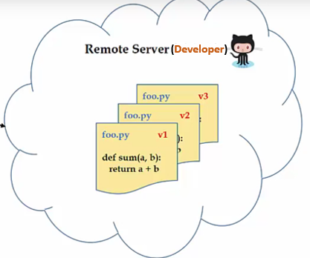

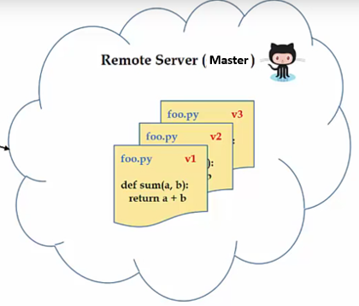

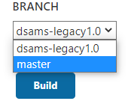

Bug Fix Branch
Scenario-1
Scenario-2
Source code v1.0
DSAMS-0.1
DSAMS-0.1
DSAMS-0.1
1
2
4
3
DEV
UAT
PROD
Issues
Suggest solustion
Source code v1.0
Source code v2.0
Master Branch
Solution
Code Release
Code Release
Develop Branch

Slide 7
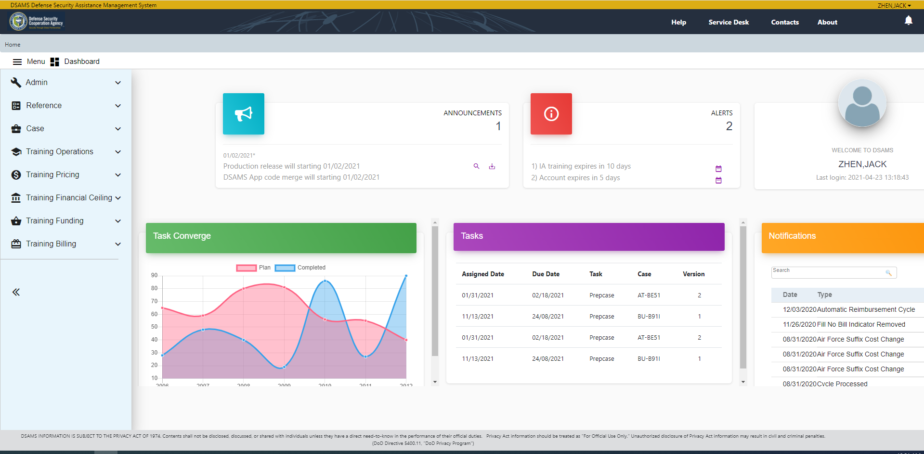
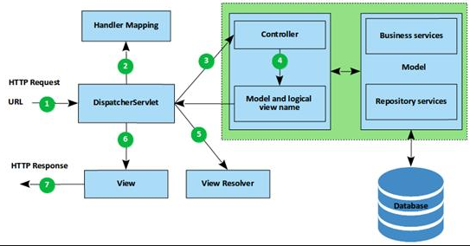
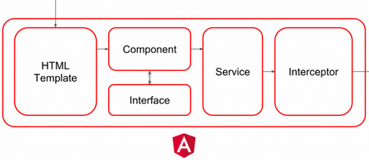
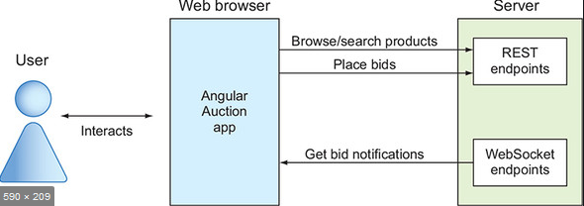



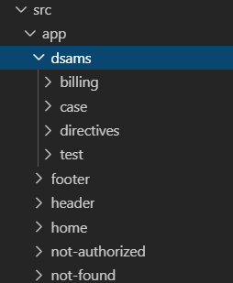
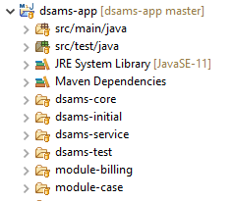
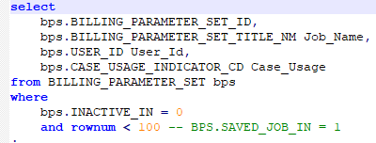
DSAMS Application Architecture
Browser
Middle Tire (Spring Boot: Java)
User Interface (HTML5, CSS, Bootstrap, Angular 6)
Handler Mapping
JSON
JSON
Angular 6
RESFul Web Service in Java
Oracle (12c)
Angular 6 Framework
Query
Spring Boot Framework

Slide 8
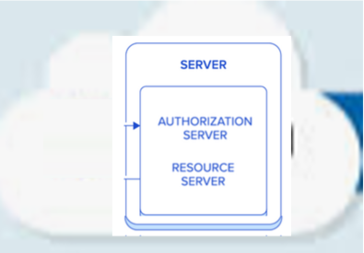



DSAMS Spring OAuth2 Authorization
PIV Card
DSAMS-Web
JWT Token
userId:1453845@mil
sub: xiaoming.zhen.ctr@mail,mil
given_name: jack
family_name: zhen
JWT Token
DSAMS-App
#1. User Identity:
SELECT DISTINCT usp.LOGIN_ID, usp.USER_ID, usp.LAST_LOGIN_DT, prs.PERSON_FIRST_NM, prs.PERSON_LAST_NM
FROM PERSON prs, USER_SECURITY_PROFILE usp
WHERE prs.USER_ID = usp.USER_ID
AND usp.ACCOUNT_STATUS_CD = 'AC'
AND upper(prs.EMAIL_ADDRESS_TX) = ${JWT.SUB}
AND prs.user_id =(SELECT MAX (user_id)FROM PERSON prs2 WHERE prs2.EMAIL_ADDRESS_TX = prs.EMAIL_ADDRESS_TX)
User Roles
#2 a) User Authorization (Roles):
SELECT SECURITY_ROLE_CD …
DSAMSONE
#2 b) User Authorization (Data Service):
SELECT SERVICE_DB_ID ….

