Slide 1

Digital forensics in corporate simulations: a study of tool efficacy and analysis techniques
Candidate: Zunino Giacomo
Supervisor: prof. Atzeni Andrea
07/04/2025

Slide 2
Introduction to digital forensic
Definition & purpose:
digital forensics is a branch of forensic science focused on identifying, acquiring, processing, analyzing, and reporting of electronic data;
it is used in cybercrime investigations, corporate security, and legal proceedings.
Key phases of investigation:
identification, preservation, analysis, documentation, and presentation.
Candidate: Zunino Giacomo
07/04/2025

Slide 3
Motivations and goals of the thesis
Motivations
Goals
the ongoing evolution of cyber threats
analyze digital forensic investigation methods
the increasing frequency of attacks against SMBs
identify improvements in digital forensic investigations techniques for SMBs
the impact of these attacks on small medium businesses
simulation of attacks to examine their investigation and prevention strategies
Candidate: Zunino Giacomo
07/04/2025

Slide 4
Cyber attacks and the importance of digital forensics
The impact of cyber attacks:
48% of SMBs experienced cyber incidents in the past year;
a 150% increase in cyber attacks from 2020 to 2022, with 31,000 daily attacks worldwide;
cybercrime costs are projected to reach $10.5 trillion annually by 2025.
Repercussions of cybercrime
financial loss
reputational damage
legal consequences
Candidate: Zunino Giacomo
07/04/2025

Slide 5
Tools used in digital forensics
Industry-standard tools
Role of automation
Autopsy (file system analysis, deleted file recovery)
scripts for network monitoring
Volatility (memory forensics)
automated analysis of logs
SIEM systems (security event monitoring)
timestamp manipulation detection
Wireshark (network traffic analysis)
Candidate: Zunino Giacomo
07/04/2025

Slide 6
Virtualized environment setup with docker
Why docker?
provides isolation
flexibility
rapid deployment of attack simulations
Infrastructure overview:
demilitarized zone (DMZ) – contains servers (database, email);
internal network – workstations and employee systems;
external attacker node – simulating real-world cyber attacks.
Technical Setup:
configured using dockerfiles and bash scripts
Candidate: Zunino Giacomo
07/04/2025

Slide 7
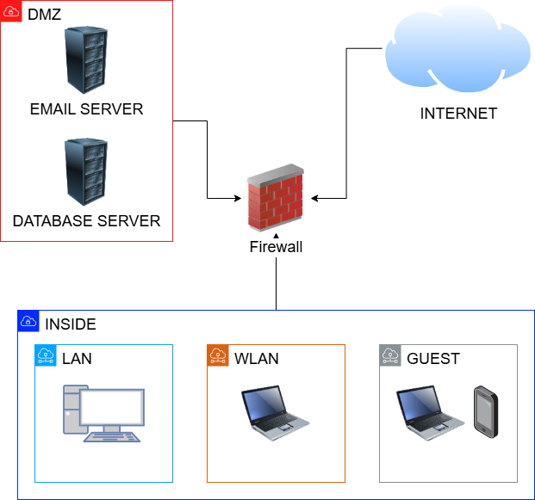
Infrastructure
Candidate: Zunino Giacomo
07/04/2025

Slide 8
Real case scenarios
Ransomware
what is it?
example: in October 2023, a library in Toronto was attacked and refused to pay the ransom but it had no backup
Intellectual property theft
what is it?
example: in May 2022, two former employees were accused by Apple for stealing confidential information about SoC
Spear phishing
what is it?
example: a CEO fraud, where attackers impersonated a CEO in a fake email targeted at specific employees
APT
what is it?
example: in India, attackers used COVID-related themes to trick victims into opening malicious documents and execute some code
Candidate: Zunino Giacomo
07/04/2025

Slide 9
Simulated cyber attacks
Attack 1:
data breach
methods used: social engineering, unauthorized database access, data exfiltration;
detection: email and database logs monitoring.
Attack 2:
phishing
methods used: GoPhish, credential theft, unauthorized database access;
detection: email and database logs monitoring, network activity.
Attack 3: ransomware
methods used: email spoofing, malicious attachment;
detection: file integrity monitoring.
Attack 4: malware
methods used: email spoofing, malicious attachment, scheduled execution via crontab, data exfiltration via SSH;
detection: network traffic analysis, forensic memory analysis.
Candidate: Zunino Giacomo
07/04/2025

Slide 10
Investigating the attacks: process & methodology
data collection (disk images and logs)
forensic analysis
reconstructing the attack timeline
assessing damage & preventive measures
Candidate: Zunino Giacomo
07/04/2025

Slide 11
Key findings from the simulated attacks
Malware attack
malicious script that runs periodically and exfiltrates files via SSH;
fake update attached via email.
Phishing attack
suspicious accesses to the db from multiple users originating from an unknown IP;
phishing email, posing as IT maintenance.
Ransomware attack
disk images were heavily encrypted, making traditional forensic analysis difficult;
email logs showed an email with a fake update attached before encryption.
Data breach
unauthorized database queries extracting sensitive company data;
identified an insider accomplice who had escalated privileges.
Candidate: Zunino Giacomo
07/04/2025

Slide 12
Lessons learned & key takeaways
Challenges in digital investigations:
detecting and analyzing attacks requires correlation of multiple sources (logs, disk images, network captures)
forensic tools must be complemented with behavioral analysis
attackers use sophisticated evasion techniques, requiring continuous updates in detection strategies
Key takeaways:
early detection is key: a rapid response minimizes damage and facilitates forensic investigations.
comprehensive logging matters: detailed logs across all systems (network, email, databases) improve attack reconstruction.
user awareness is a weak link: social engineering remains a top attack vector, so ongoing training is essential.
Candidate: Zunino Giacomo
07/04/2025

Slide 13
Future improvements and research directions
Expand Attack Simulations
Different environments and platforms
Enhanced infrastructure:
certificate-based authentication with public and private CA
Candidate: Zunino Giacomo
07/04/2025

Slide 14
Thank you for your attention

