Slide 1
Math 1: Linear Algebra
Eric@Udacity

Slide 2
Content
Linear Algebra
(1) Vector and Matrix
(2) Solve Linear equations
(3) Eigenvalues and Eigenvectors
(4) Singular Value Decomposition (LSA)

Slide 3
1.1 Vector and Matrix
Scalar, vector, matrix, tensor
Operator: +, -, ×, T, ·, inverse (A-1), determinant (|A|), adjoint matrix (A*)
(1) dot
(2) inverse
(3) determinant
(4) adjoint matrix

Slide 4
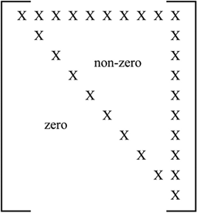
Terms related to matrix
(1) Order of matrix (m×n)
(2) Square matrix
(3) Diagonal matrix
(4) Upper triangular matrix
(5) Lower triangular matrix
(6) Scalar matrix: Square matrix with all the diagonal elements equal to some constant k.
(7) Identity matrix
A*I = A

Slide 5




(8) Trace: the sum of all the diagonal elements of a square matrix
(9) Symmetrical matrix A = A.T
(10) Orthogonal matrix A.inv = A.T, A dot A.T = I
(11) Rank of matrix
(12) Nonsingular matrix Note: A is |A|!=0 (A is a square matrix)
(13) p-norm
(14) Frobenius norm
(15) Condition number (nonsingular)
Stability

Slide 6
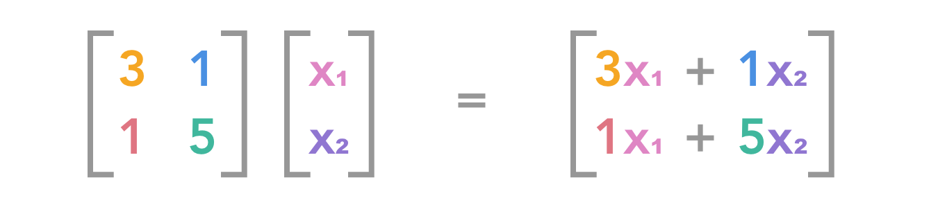
Dot
2×3 dot 3 ×n = 2 ×n
(2) Inverse (elementary transformation)
Row switching: A row within the matrix can be switched with another row.
Row multiplication: Each element in a row can be multiplied by a non-zero constant.
Row addition: A row can be replaced by the sum of that row and a multiple of another row.

Slide 7

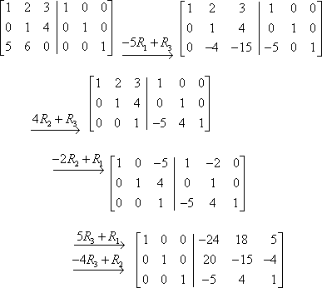


Slide 8


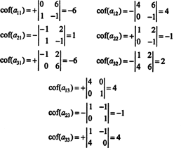


(3) Determinant
|A| = ad − bc
sum(-1**(i+j) *a_ij *det(sub_matrix))
(4) adjoint matrix A*

Slide 9
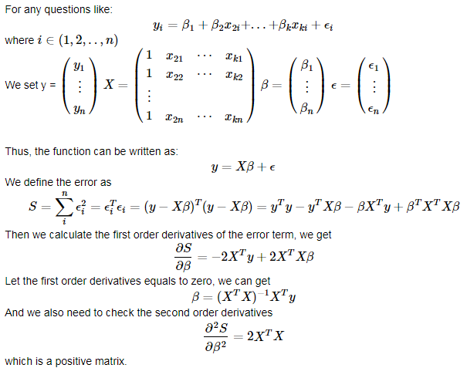
1.2 Solve Linear equations
OLS

Slide 10
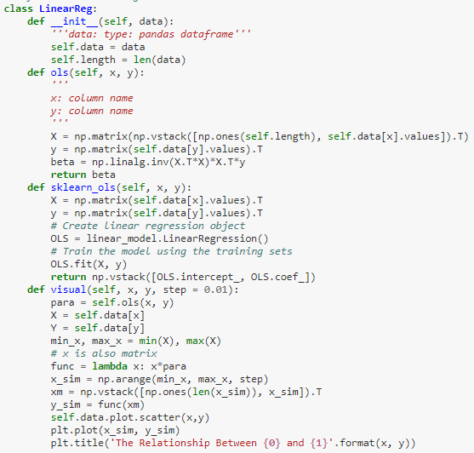

Slide 11
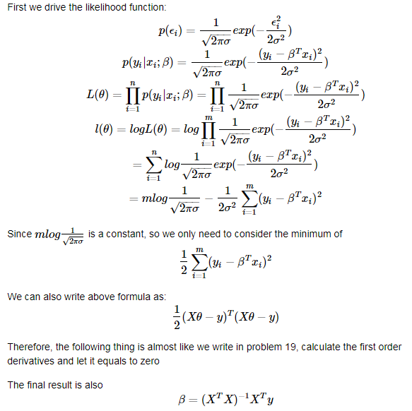
Maximum Likelihood

Slide 12
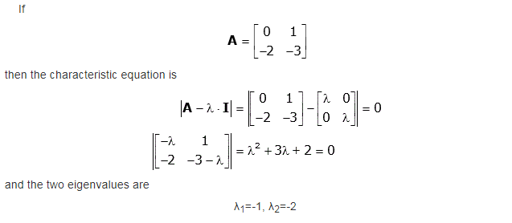
1.3 Eigenvalues and Eigenvectors

Slide 13
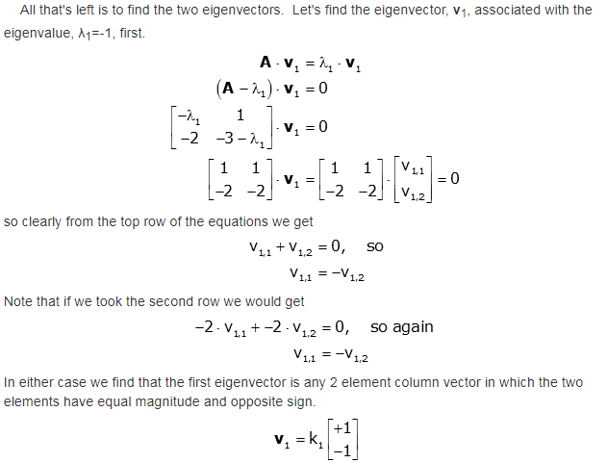

Slide 14
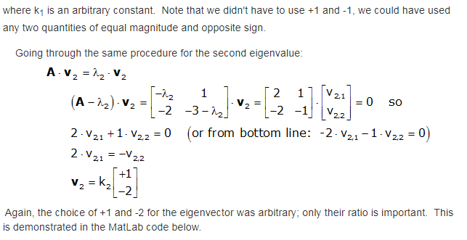

Slide 15
1.4 Singular Value Decomposition

