Slide 1
Introduction to Game Programming
Course introduction
Instructor: Dung, Dinh Nguyen Anh
Email: dungdna@uit.edu.vn

Slide 2
Course overview
DirectX 10 , simple drawing and movement
Frame-based animation
Keyboard handling
Collision handling & camera
Scene Manager
Sample source:
https://github.com/dungdna2000/gamedev-intro-tutorials

Slide 3
Project
NES Super Mario Bros 3
Solo
2 main check points
(1) First half of world 1-1 : week 6-8
(2) Full world 1-1 and world map : week 12
This is going to be a real product, not a student demo: (almost) perfection is a requirement.
Progress mark = Final mark

Slide 4
How to pass?
Try to build your first best game, don’t care about passing or not
Start from the sample code. It has everything you need to finish your project.
Do NOT “reference” other’s code
Do not rush to Internet or “training club”
Attend class and understand what I want first !
Invest at least 160 hours of your life
code … debug … code
code .. debug .. code

Slide 5
A SUPER quick Git tutorial
Using Git correctly is now a MUST

Slide 6
About Git
Git is a source code management system
To make sure a team of developers do not step on each other’s code
Track and handle changes
Git was created by Linus Torvalds in 2005 for development of the Linux kernel
SVN (Subversion), CVS
Github & Bitbucket are the most popular Git hosting services for free
Gitlab : self-hosted, open-source

Slide 7
Git basic
Repository (repo): is where the source code is stored
remote repo: central repository, usually stored on cloud (like in Github or Bitbucket)
local repo: the repositories on each developer machines
Git has a “magic” way to keep all repos in sync via many mechanism like pull, push, merge, etc
Luckily, we don’t have to learn all these advanced features to use in our project

Slide 8
Git basic
Remote repository
Github / Bitbucket
Local repository
Local repository
Local repository

Slide 9
Git basic
Remote repository
Push commit(s)
Change:
Modify a file
Add a file
Delete a file
Local repository
Commit : write changes to repo
Source files
Stage changes
- Manually select changes to commit instead of committing ALL changes

Slide 10
Demos
Create a repository for a project on Github using VS 2022
Making changes, staging changes, commit changes, push
See changes and diff

Slide 11
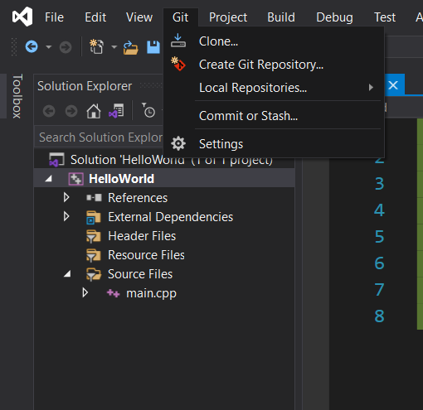
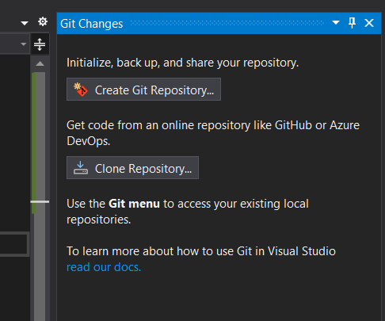
Create a repo from VS
Git > Commit or Stash…
Create Git Repository

Slide 12
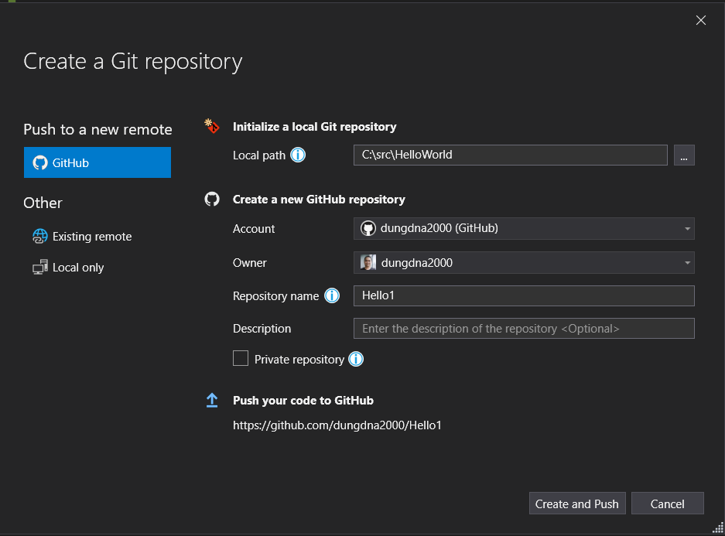
Create a repo from VS
Unchecked to make your repo public (i.e. accessible by your instructor)

Slide 13
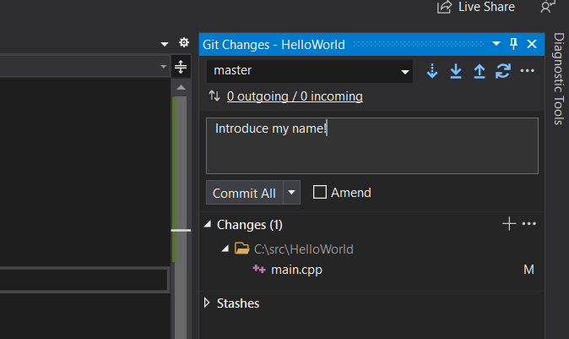
Commit and push
Comment : what did you change? Must have
Push: send commit to remote repo
Commit: Write change(s) to your local repo

Slide 14
Warning
DO:
Create repo using VS Studio.
DO NOT
Create repo using other tools
Your repo will include tons of intermediate files generated by VS Studio

Slide 15
Start from sample code
Start clean
Create and init empty repo using VS Studio
Download & add files from sample 05

Slide 16
Use Git properly
A small commit is much better than a large commit
Small commit = few changes & small change
Commit = something meaningful done, not necessary a large completed feature
Commit MUST have a meaningful comment
Because commit = something meaningful done
Hint:
when you build successfully and test something passed, it’s time for a commit
Notes:
Some large companies even implement tools to detect invalid commit’s comments

Slide 17
Use Git properly
Lots of commits and frequent
Meaningful and small commits
A lot modifications (bug fixing)
Red flags
Project created too close to deadline
Few commits
Large commits
Binaries

Slide 18
Use Git properly
I take ZERO tolerance on bad Git repos
No matter what you did, if you do not have a proper Git repo, you will fail.

