Slide 1
AngularJS
Jackey Li

Slide 2
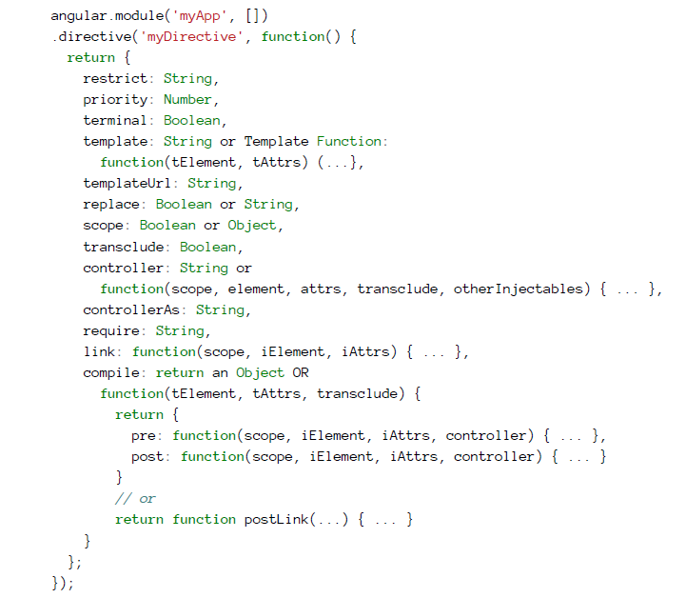
directive

Slide 3
Service factory provider constant value
Service
Factory
Provider
Constant
value

Slide 4
filter
{{ expression | filter }}
{{ expression | filter1 | filter2 | ... }}
{{ expression | filter:argument1:argument2:... }}

