Slide 1
Event Camera Simulator
From high-frame-rate video to asynchronous events
Group 13
EE5110/EE6110
Event Camera Simulator
1
Notes:
Hello everyone. Our project is an event camera simulator that converts ordinary video into an asynchronous event stream.

Slide 2
Contents
01
Background
Event cameras and the simulation objective
02
Model + Algorithm
Contrast thresholds, interpolation and sensor noise
03
Architecture + Implementation
System modules, data flow and video I/O
04
Visualization
Event accumulation and illustrative output
05
Verification + Results Discussion
Tests, benchmark and result discussion
EE5110/EE6110
Event Camera Simulator
2
Notes:
Here's the outline.

Slide 3
EE5110 / EE6110
01
SECTION 01
Background
Frame cameras, event cameras and the simulation objective
EVENT CAMERA SIMULATOR
Group 13
EE5110/EE6110
Event Camera Simulator
3
Notes:
First, the background.

Slide 4
Background: Event Cameras
Frame-based sensing vs. event-based sensing
Aspect | Frame camera | Event camera
Output | Complete image at each exposure | Pixel-level brightness changes
Timing | Synchronous sampling at fixed FPS | Asynchronous timestamp per event
Redundancy | Records unchanged regions again | Reports threshold crossings only
Fast motion | Limited by exposure and frame rate | Records rapid changes without waiting for the next frame
Event representation
$$e_{k}$$ = ($$t_{k}$$, $$x_{k}$$, $$y_{k}$$, $$p_{k}$$), $$p_{k}$$ ∈ {−1, +1}
Project goal: convert conventional video into a reproducible event stream
Next: model the contrast threshold at each pixel
Group 13
EE5110/EE6110
Event Camera Simulator
4
Notes:
A conventional camera records complete frames at fixed intervals, even when most pixels do not change. An event camera operates differently: each pixel responds independently and reports only a significant brightness change. Each event contains a timestamp, pixel coordinates, and polarity. This produces sparse data with high temporal resolution. Our simulator recreates this behavior from standard video, so later modules can process and visualize events without physical event-camera hardware.

Slide 5
EE5110 / EE6110
02
SECTION 02
Model + Algorithm
Contrast thresholds, timestamp interpolation and sensor noise
EVENT CAMERA SIMULATOR
Group 13
EE5110/EE6110
Event Camera Simulator
5
Notes:
Now I will explain the model and algorithm.

Slide 6
Event Generation Model
Why does one pixel fire an event?
Asynchronous threshold crossings
log intensity
Convert intensity to log space:
L(x,y,t) = log(I(x,y,t) + ε)
ON: L(t) − Lref ≥ Con
OFF: L(t) − Lref ≤ −Coff
After each event, update Lref by exactly one applicable threshold.
Reference update
ON Lref ← Lref + Con
OFF Lref ← Lref − Coff
time
ON
OFF
OFF
ON
ON
OFF
OFF
Each threshold crossing produces one event (t, x, y, p)
Group 13
EE5110/EE6110
Event Camera Simulator
6
Notes:
For each pixel, we first convert intensity into log space because event cameras respond to relative contrast. The pixel stores the log intensity at its most recent event as a reference. If the change reaches the positive threshold, it generates an ON event. If it reaches the negative threshold, it generates an OFF event. After every event, the reference moves by exactly one threshold step. Therefore, a large intensity change may cross several thresholds and generate multiple events within one frame interval.

Slide 7
From Video Frames to Events
Vectorized array pipeline
High-FPS
BGR frames
Grayscale
Normalize + log
Threshold crossings
+ analytical timing
Vectorized
H × W array
Sorted
(t,x,y,p)
Configuration
Con, Coff • timestamp unit • random seed
Analytical timestamp interpolation
te = t0 + (Ltarget − L0) / (L1 − L0) × (t1 − t0)
Sensor-noise model
Fixed per-pixel threshold mismatch
Leak ON events
Hot pixels
Seeded and reproducible
No microsecond-by-microsecond scan is required.
Group 13
EE5110/EE6110
Event Camera Simulator
7
Notes:
The complete pipeline starts with high-frame-rate BGR frames. We convert them to normalized grayscale and log intensity. For each pair of frames, vectorized NumPy operations find threshold crossings over the full pixel array. We calculate each timestamp by linear interpolation in log-intensity space, estimating when the signal reached its target threshold between two frame times. This avoids a costly microsecond-by-microsecond scan. The simulator supports separate ON and OFF thresholds and outputs integer microsecond timestamps. To imitate sensor imperfections, I added reproducible per-pixel threshold variation, leak events, and hot pixels using a fixed random seed. Finally, all events are combined and sorted by time, row, column, and polarity.

Slide 8
Algorithm Verification
Test coverage
21 algorithm tests passed
Scenario | Expected behavior | Result
Constant intensity | Zero ideal events | Passed
Bright / dark ramps | Exact count, polarity and time | Passed
Multiple crossings | One event per threshold | Passed
Seeded noise | Repeated output is identical | Passed
Scalar vs array | Events and reference match | Passed
30 random intervals
128 × 128 frame interval
Exact scalar–array match
44,283 events in ~8 ms*
Canonical output: int64 μs timestamps, (x,y), p ∈ {−1,+1}, sorted by (t,y,x,p)
* Development-machine benchmark; runtime depends on hardware and event density.
Group 13
EE5110/EE6110
Event Camera Simulator
8
Notes:
We verified ideal events, multiple crossings, asymmetric thresholds, interpolation, and seeded noise. All twenty-one algorithm tests passed. The vectorized output also matched the scalar reference across thirty random intervals. In one 128-by-128 benchmark, 44,283 events were generated in about eight milliseconds. The resulting event array is ready for video I/O, visualization, and system integration.

Slide 9
EE5110 / EE6110
03
SECTION 03
Architecture + Implementation
System modules, data flow and video I/O
EVENT CAMERA SIMULATOR
Group 13
EE5110/EE6110
Event Camera Simulator
9
Notes:
Next, I will explain the software architecture and how the modules are integrated into a complete video-to-events workflow.

Slide 10
System Architecture
Modules keep media handling, event mathematics and presentation concerns separate
Video I/O
Preprocessing
Simulator
Event I/O
Visualization
Decode BGR frames
and timestamps
›
Grayscale, normalize
and log intensity
›
Own reference state
and process intervals
›
Validate and save
NPZ or CSV
›
Accumulate, render
and overlay events
Inside EventCameraSimulator
Noise Model
Crossing Kernel
Merge + Sort
Initialize fixed threshold maps
from sensor and noise config
›
Generate all ideal events
for one frame interval
›
Combine background events
and sort by (t, y, x, p)
The mathematical kernel never reads video files or writes output files
Group 13
EE5110/EE6110
Event Camera Simulator
10
Notes:
This section explains how the code is organized. Video I/O decodes the source into BGR frames and timestamps. Preprocessing converts the frames to normalized log intensity. EventCameraSimulator then owns the reference image and processes each adjacent frame interval. During reset, ConfiguredNoiseModel initializes fixed ON and OFF threshold maps. For every interval, the simulator calls the vectorized array-crossing kernel, adds optional background events, and sorts the canonical event array. Event I/O saves NPZ or CSV data, while visualization consumes the same event stream independently. This separation keeps the mathematical kernel free from OpenCV and file-system dependencies.

Slide 11
End-to-End Implementation
One command composes validated configuration, simulation and output
1
Load and validate YAML
Stable data contracts
Reject unknown keys and invalid thresholds before processing starts.
Frame time
float64 seconds
2
Read timestamped video
Return frames (T,H,W,3), dimensions and strictly increasing seconds.
Event time
int64 microseconds
3
Simulate adjacent intervals
Coordinates
arrays [y,x], events (x,y)
Reset from frame zero, then generate events for each frame pair.
Polarity
int8, exactly +1 or -1
4
Serialize canonical events
Ordering
deterministic (t,y,x,p)
Write compressed NPZ and optional CSV without changing dtype or order.
Persistence
validated NPZ and CSV
5
Create illustrative output
Load the saved stream and render synchronized event and overlay video.
event-sim simulate --input VIDEO --config YAML --events EVENTS.npz
Group 13
EE5110/EE6110
Event Camera Simulator
11
Notes:
The integration layer provides a complete execution path without duplicating algorithm logic. The command-line interface first loads and strictly validates the YAML configuration. It then reads the video, constructs timestamps in seconds, and applies grayscale conversion, normalization, and log transformation. EventCameraSimulator resets its state from the first frame and processes every adjacent interval. The result follows one canonical structured dtype: integer microsecond time, x and y coordinates, and polarity plus or minus one. Event I/O validates this contract before writing NPZ or CSV. The visualization stage can then reload the same events to create the final illustrative video.

Slide 12
EE5110 / EE6110
04
SECTION 04
Visualization
Event accumulation and illustrative output
EVENT CAMERA SIMULATOR
Group 13
EE5110/EE6110
Event Camera Simulator
12

Slide 13
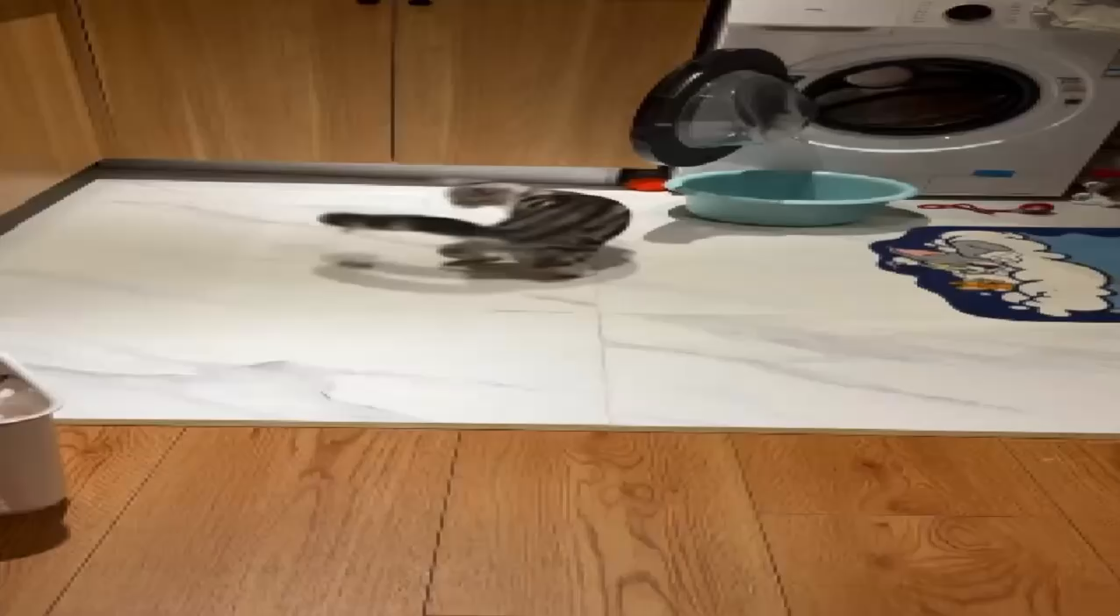
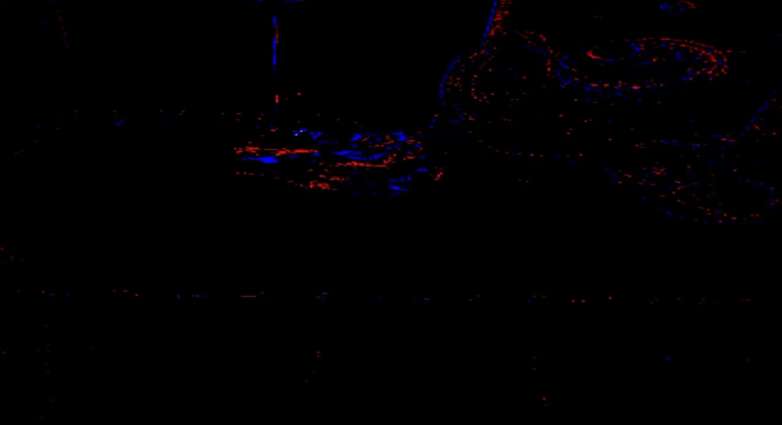
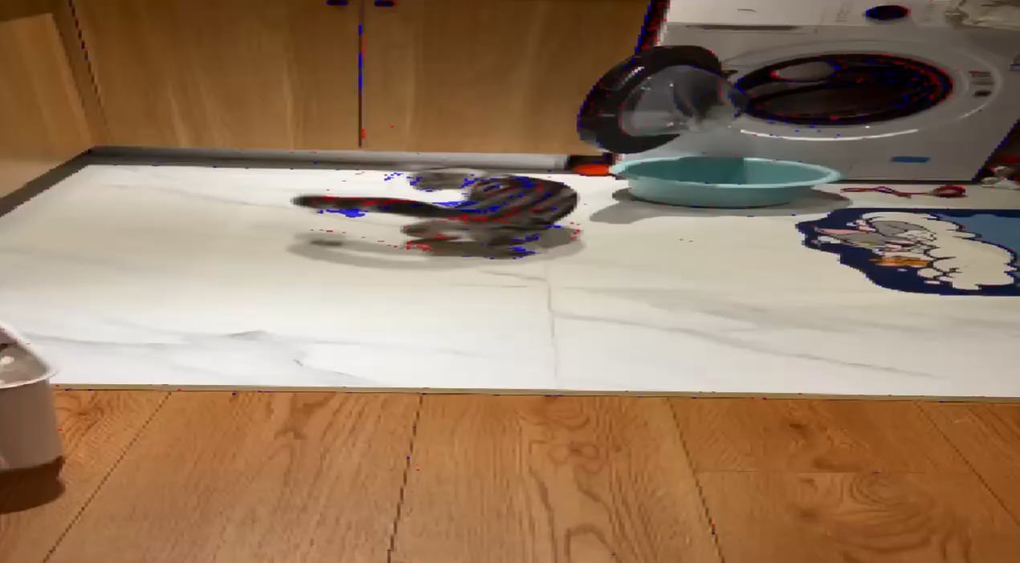
Event Visualization
Input Frame
Event Frame
Overlay
Red = ON event Blue = OFF event
Group 13
EE5110/EE6110
Event Camera Simulator
13
Notes:
This slide shows how we visualize the simulated events.
On the left is the original input frame from the video, and in the middle is the corresponding event frame generated by our simulator.
Red pixels represent ON events, which are triggered by an increase in brightness, while blue pixels represent OFF events, which are triggered by a decrease in brightness.
On the right, we overlay the events on the original frame, so it is easier to see where the events are generated.
We can observe that most events appear around the moving object and along image edges, where the brightness changes more significantly.
During playback, these three views are synchronized, so we can directly compare the input, event frame, and overlay result frame by frame.

Slide 14
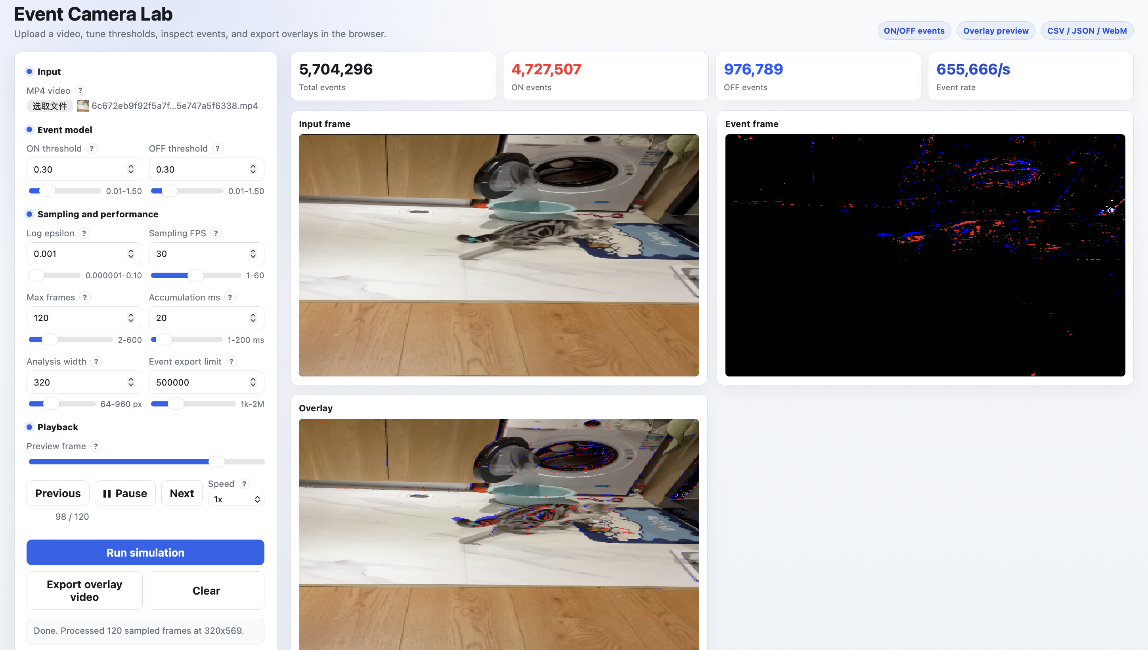
4.2 Interactive Web Interface
Upload an MP4, tune the event model, review synchronized outputs, and export the overlay video | jackeysz.github.io/EE5110
Group 13
EE5110/EE6110
Event Camera Simulator
14
Notes:
The browser interface brings the complete workflow into one page. Users upload an MP4 video, tune ON and OFF thresholds and processing parameters, and run the simulation without a local setup. The summary cards report total events, ON and OFF event counts, and event rate. The page synchronizes the input frame, red and blue event frame, and overlay during playback. It also provides previous, pause, next, speed, clear, and overlay-video export controls. The deployed interface is available at https://jackeysz.github.io/EE5110.

Slide 15
EE5110 / EE6110
05
SECTION 05
Verification
Experiment Results & Analysis
EVENT CAMERA SIMULATOR
Group 13
EE5110/EE6110
Event Camera Simulator
15

Slide 16
5.1 Test Setup
Core Test Objectives
Functionality Check
Verify I/O interfaces, real-time visualization, and event generation logic for software simulator validation.
End-to-End Pipeline
Validate the complete workflow from raw video input to NPZ file output with zero data loss.
5 Standardized Synthetic Scenarios
1. Constant Brightness
4. Fast Motion
2. Brightness Ramp
5. Low Contrast
3. Moving Bar
Group 13
EE5110/EE6110
Event Camera Simulator
16
Notes:
Now we move to Section 5, Verification. First is our test setup. We have two core test objectives. One is functionality check, the other is validating the end‑to‑end pipeline of our software simulator. We use five standardized synthetic test scenarios for our experiments.

Slide 17
5.2 Parameter-sweep Setup
Swept Parameters
Group 1: Threshold Sensitivity
Three core variables are systematically varied to isolate their impact on system performance:
• Threshold: Sensitivity for event activation
• Input FPS: Frame rate of the source video stream
• Noise Level: Controlled injection of sensor noise
Test values from 0.1 to 0.5 (0.1 increments). This sweep analyzes how activation sensitivity impacts event density, detection latency, and false positive rates in dynamic visual scenes.
Group 2: FPS & Noise Robustness
Automated Metrics Pipeline
Compare performance across 30, 60, and 120 FPS inputs under both clean and noisy conditions. Evaluates the system's stability against temporal aliasing and real-world sensor imperfections.
A dedicated `metrics.py` script computes event count and runtime statistics across all test cases. This ensures unbiased, repeatable results and streamlines data aggregation for large-scale analysis.
Group 13
EE5110/EE6110
Event Camera Simulator
17
Notes:
Next is our parameter‑sweep setup. We systematically change three core variables: threshold, input FPS and noise level. We divide our tests into two groups. Group one tests threshold sensitivity. Group two evaluates FPS and noise robustness. We also use a dedicated metrics.py script to calculate event count and runtime statistics, to make our test results repeatable.

Slide 18
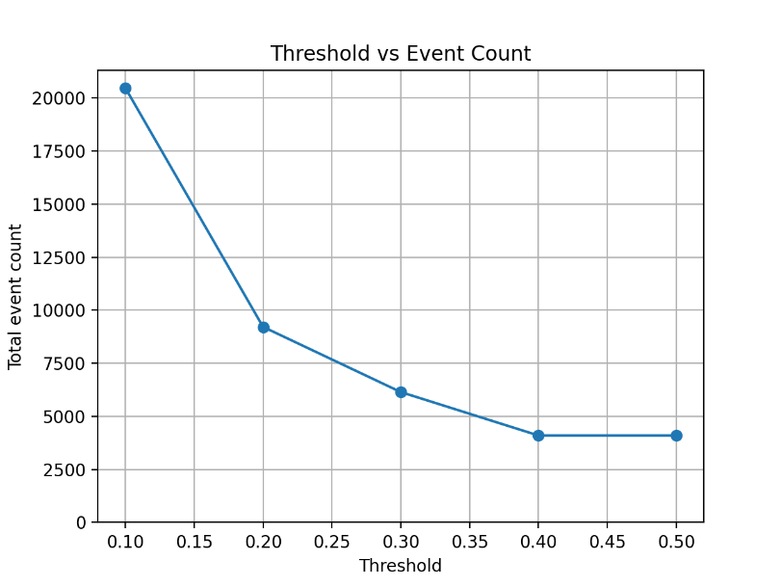
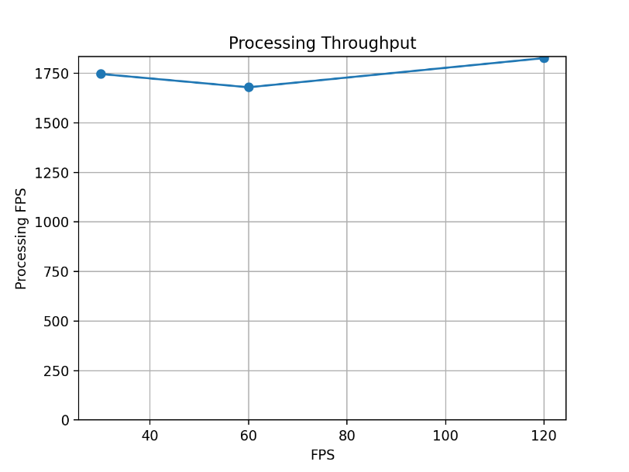
5.3-1 Results: Threshold Analysis
Key Finding: Event Count
Inverse Relationship: As the threshold increases from 0.1 to 0.5, the total number of generated events decreases significantly from approximately 20,000 to 4,000.
Key Finding: Processing Throughput
High Performance: The simulator maintains high processing FPS (over 1600) across different input FPS values, demonstrating real-time capability.
Group 13
EE5110/EE6110
Event Camera Simulator
18
Notes:
Now let’s look at the first group of results for threshold analysis. From the graph at the top, we can see an inverse relationship. As threshold increases from 0.1 to 0.5, total event count drops significantly. When the threshold goes above 0.4, the decline slows down and results tend to saturate. The plot at the bottom shows processing throughput. Here, processing FPS means input frames processed per second by our simulator. It maintains a high value above 1600, which proves real‑time simulation capability. Besides, our constant‑brightness test outputs zero events, which matches our expectation.

Slide 19
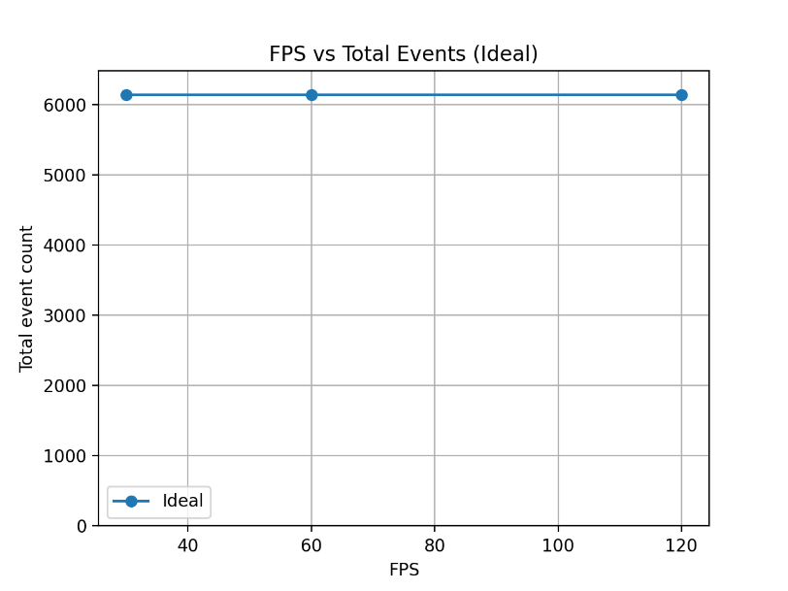
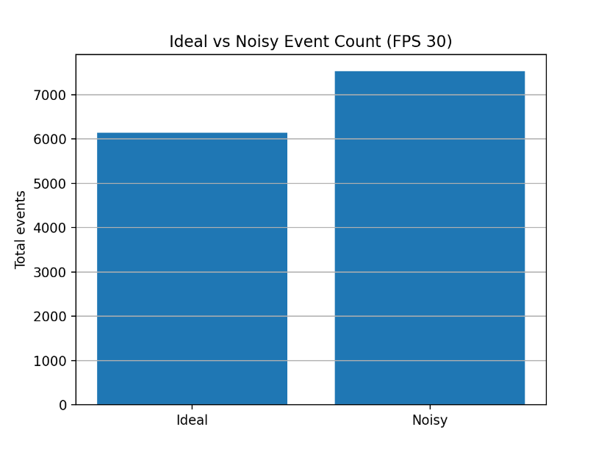
5.3-2 Results: FPS & Noise Analysis
Key Finding: FPS Impact
Minimal Effect: Under ideal conditions, varying input FPS (30, 60, 120) has a negligible effect on the total event count, which remains stable around 6,000.
Key Finding: Noise Impact
Event Increase: Adding noise significantly increases the total event count by approximately 22.5% (from ~6,144 to ~7,528 at 30 FPS).
Group 13
EE5110/EE6110
Event Camera Simulator
19
Notes:
Next we analyse the influence of FPS and noise. On the top graph, under ideal noise‑free conditions, changing input frame rate hardly affects total event count. The number stays stable around 6000. From the bar chart on the bottom, we compare ideal and noisy inputs at 30 FPS. After adding sensor noise, total event count rises by about 22.5 percent. Please note this percentage result is only valid under the 30‑FPS test condition.

Slide 20
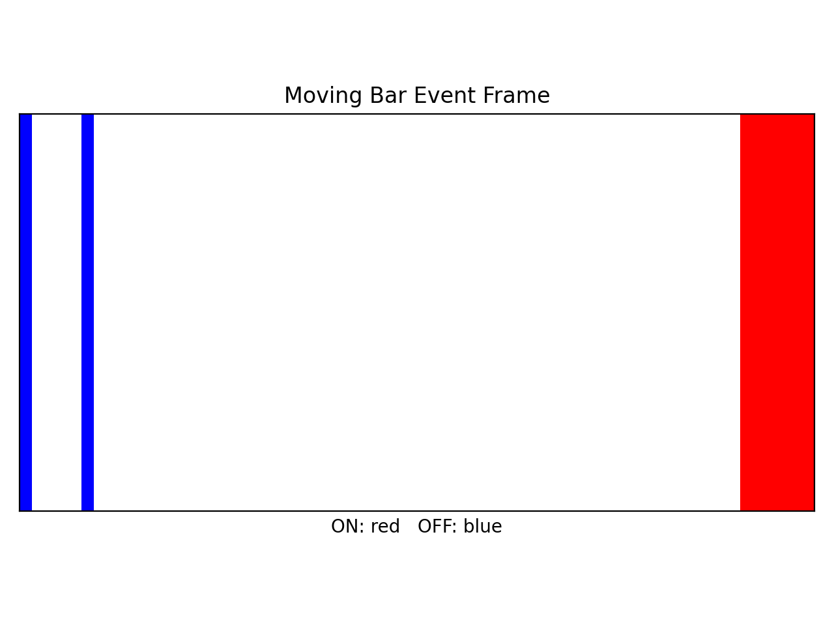
5.4 Visualization Result
Polarity Accuracy: The visualization correctly shows ON events (red) for the leading edge and OFF events (blue) for the trailing edge of the moving bar, confirming correct event generation logic.
Group 13
EE5110/EE6110
Event Camera Simulator
20
Notes:
Then we check our visualization output. Red represents ON events and blue represents OFF events. For the moving‑bar test case, the output colour matches expected event polarity. This confirms our event generation logic is correct.

Slide 21
References
[1]
G. Gallego et al., "Event-Based Vision: A Survey," IEEE Transactions on Pattern Analysis and Machine Intelligence, vol. 44, no. 1, pp. 154-180, 2022.
doi: 10.1109/TPAMI.2020.3008413
[2]
P. Lichtsteiner, C. Posch, and T. Delbruck, "A 128 x 128 120 dB 15 us Latency Asynchronous Temporal Contrast Vision Sensor," IEEE Journal of Solid-State Circuits, vol. 43, no. 2, pp. 566-576, 2008.
doi: 10.1109/JSSC.2007.914337
[3]
E. Mueggler, H. Rebecq, G. Gallego, T. Delbruck, and D. Scaramuzza, "The Event-Camera Dataset and Simulator," The International Journal of Robotics Research, vol. 36, no. 2, pp. 142-149, 2017.
doi: 10.1177/0278364917691115
[4]
H. Rebecq, D. Gehrig, and D. Scaramuzza, "ESIM: An Open Event Camera Simulator," Proceedings of the 2nd Conference on Robot Learning, PMLR 87, pp. 969-982, 2018.
Proceedings of Machine Learning Research, vol. 87
[5]
Y. Hu, S.-C. Liu, and T. Delbruck, "v2e: From Video Frames to Realistic DVS Events," IEEE/CVF Conference on Computer Vision and Pattern Recognition Workshops, pp. 1312-1321, 2021.
doi: 10.1109/CVPRW53098.2021.00144
Group 13
EE5110/EE6110
Event Camera Simulator
21
Notes:
References used for the event-camera model, simulation design, and noise assumptions:
[1] https://doi.org/10.1109/TPAMI.2020.3008413
[2] https://doi.org/10.1109/JSSC.2007.914337
[3] https://doi.org/10.1177/0278364917691115
[4] https://proceedings.mlr.press/v87/rebecq18a.html
[5] https://doi.org/10.1109/CVPRW53098.2021.00144

