Slide 1


Slide 2
{Fiona:} A Smart Assistant
A window to the future

Slide 3






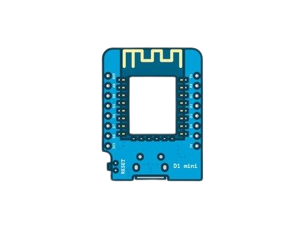
Jumper Wires
Telegram Bot API
2 pcs LEDs
1 pcs Piezo
16x2 LCD
Arduino IDE
ESP8266 Wi-Fi Module

Slide 4
Telegram Bot API
2 pcs LEDs
16x2 LCD
Jumper Wires
ESP8266 Wi-Fi Module
1 pcs Piezo
Arduino IDE

Slide 5
2 pcs LEDs
16x2 LCD
ESP8266 Wi-Fi Module
Telegram Bot API
Arduino IDE
Jumper Wires
1 pcs Piezo

Slide 6
16x2 LCD
ESP8266 Wi-Fi Module
2 pcs LEDs
Arduino IDE
1 pcs Piezo
Telegram Bot API
Jumper Wires

Slide 7
ESP8266 Wi-Fi Module
Arduino IDE
1 pcs Piezo
16x2 LCD
Jumper Wires
2 pcs LEDs
Telegram Bot API

Slide 8
Arduino IDE
1 pcs Piezo
ESP8266 Wi-Fi Module
Jumper Wires
Telegram Bot API
16x2 LCD
2 pcs LEDs

Slide 9
1 pcs Piezo
Jumper Wires
Telegram Bot API
Arduino IDE
2 pcs LEDs
ESP8266 Wi-Fi Module
16x2 LCD

Slide 10

2 pcs LEDs
1 pcs Piezo
{Fiona:}
Telegram Bot API
ESP8266 Wi-Fi Module
16x2 LCD

Slide 11
Why {FIONA:} ?

Slide 12


Why {FIONA:} ?
EMERGENCY
MOMENTUM
ALERT
SYSTEM
SCHEDULE
MANAGEMENT
SMART
COMPANION

Slide 13
Future work
BOT TRAINING
NOTICE QUEUE

Slide 14
Thanks!
Does anyone have any questions?

