Slide 1
A Practical Verification Framework for Preemptive OS Kernels

Slide 2
Introduction
In this paper we propose a verification framework for preemptive OS kernels, and show its application in verifying key modules of µC/OS-II, a commercial preemptive real-time multitasking kernel for microprocessors and microcontrollers. The verification is fully mechanized in Coq.
To our knowledge, it is the first verification of (key modules of) a preemptive OS kernel with machine-checkable proofs.
Notes:
Verifying OS kernels has long been recognized as an important but also extremely challenging task. There have been exciting efforts for OS kernel verification in recent years, but most of them have no or limited support of kernel level preemption, which allows tasks to be preempted even in kernel mode.
This limitation restricts their applicability to real-time systems, where preemptive multitasking is indispensable to achieve real-time guarantees.

Slide 3
Introduction
The key contribution of the work is :
we formulate and verify the correctness of the APIs of OS kernels as contextual refinement between their implementations and specifications.
Our modeling language provides an abstract sched command, allowing us to specify explicitly when the scheduler is invoked in synchronization primitives or interrupt handlers.
we propose a program logic for refinement verification of concurrent kernel programs.
our framework is developed for a practical subset of C, unlike existing works that are focused on kernels newly developed with verification in mind.(generality and applicability)
we also specify and verify priority inversion freedom (PIF) of µC/OS-II.
Notes:
The key contribution of the work is to adapt existing theories on interrupt verification and contextual refinement of concurrent programs , and integrate them into a framework for real-world preemptive OS kernel verification.

Slide 4
Background
Preemptive OS Kernels and Interrupts
In a preemptive OS, execution of a task can be interrupted at any program point (unless interrupts have been disabled) and the control flow can be switched to a different task. To allow preemption, we need these two conditions:
(1) enabling interrupts at the kernel level; and
(2) invoking the scheduler and context switching inside the interrupt handler.

Slide 5
Background
Overview of µC/OS-II.
µC/OS-II is a commercial preemptive real-time multitasking OS kernel developed by Micrium. The kernel has 6000+ lines of C code and 300+ lines of assembly.
It allows a fixed number of tasks, multi-level interrupts, and preemptive priority-based scheduling. The system APIs include semaphores; event flags; mutual-exclusion semaphores that eliminate unbounded priority inversions; mailboxes; message queues; task, time and timer management; and fixed sized memory block management.
µC/OS-II is developed for microprocessors and microcontrollers, and it does not support virtual memory. It has been deployed in many real-world safety critical applications, including avionics (e.g., the Mars Curiosity Rover) and medical equipments .

Slide 6

Overview of the Verification Framework
Contextual refinement as correctness
the correctness of OS kernels requires O refines O’ under all contexts A:
where [[_]] maps a program P to the set of its observable behaviors. It says that, for all applications, executing the concrete code O’ does not have more observable behaviors than executing the abstract version O.
In this paper, observable behaviors are defined as finite prefixes of execution traces consisting of observable events.
Notes:
We consider three entities, the application A, the abstract specifications of the system APIs and interrupt handlers O’, and their concrete implementations O. When system calls are made or interrupts are handled, routines in O are invoked in the real execution, while in the programmers’ mind those in O’ are invoked instead at the abstract level.

Slide 7
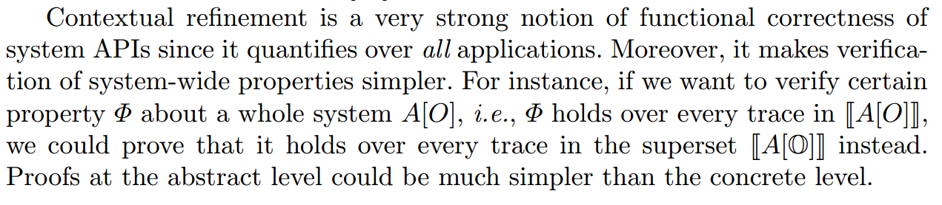

Slide 8
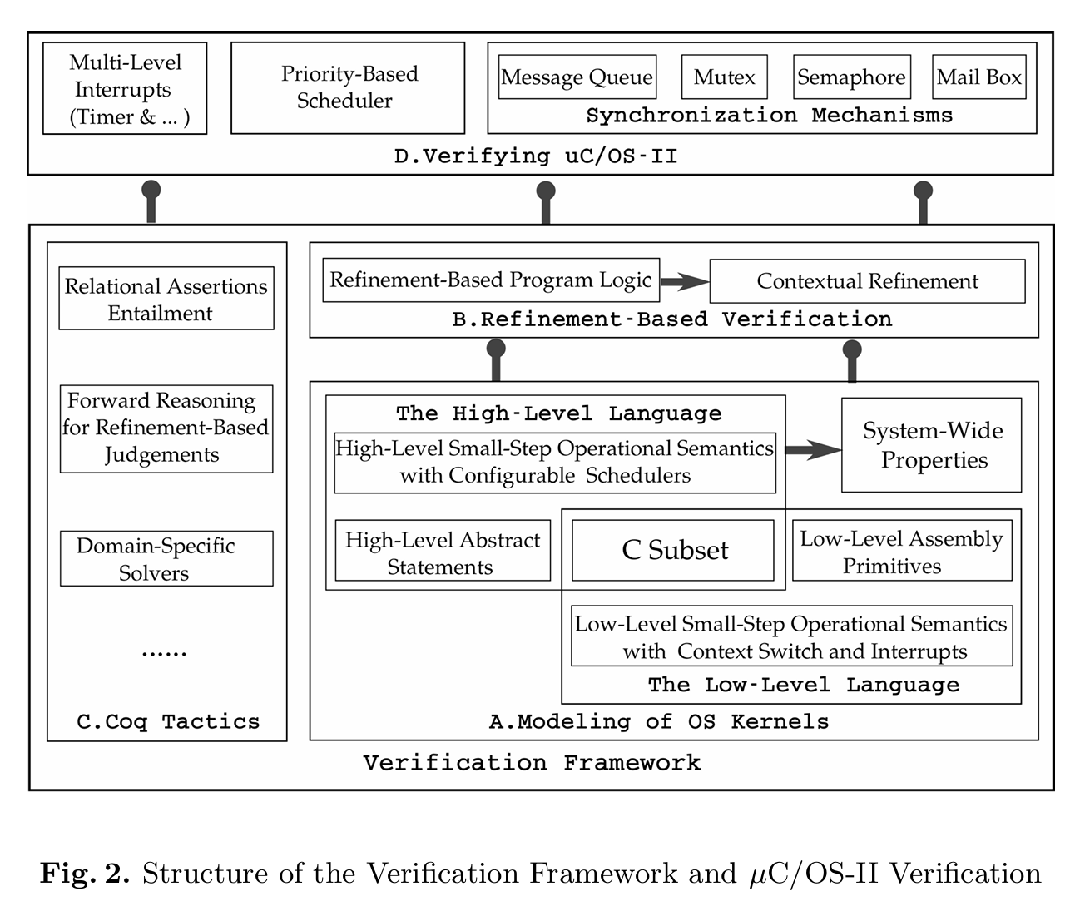
Overview of the Verification Framework
The whole verification framework.

Slide 9
Modeling of the Kernel
The correctness of OS kernels is formalized based on three entities
user applications A
the concrete implementation O
and the abstract specification O’
In this section we introduce the programming (model) languages for the three entities.

Slide 10
Modeling of the Kernel
The Low-Level Language
The low-level language consists of two parts for implementations of user applications and OS kernels, respectively.

Slide 11
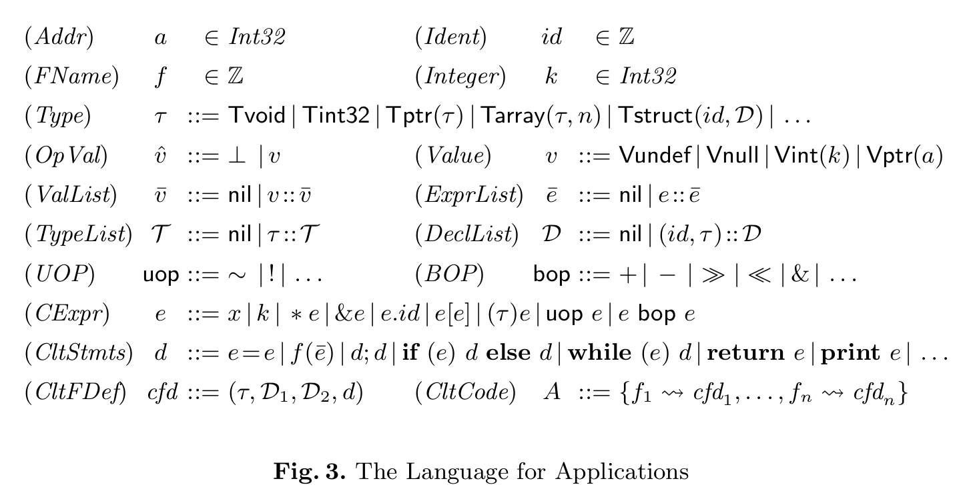
Modeling of the Kernel
The Low-Level Language
Application language
Notes:
The output command print e generates observable event, which is used to define observable event traces needed in our definition of refinement.

Slide 12
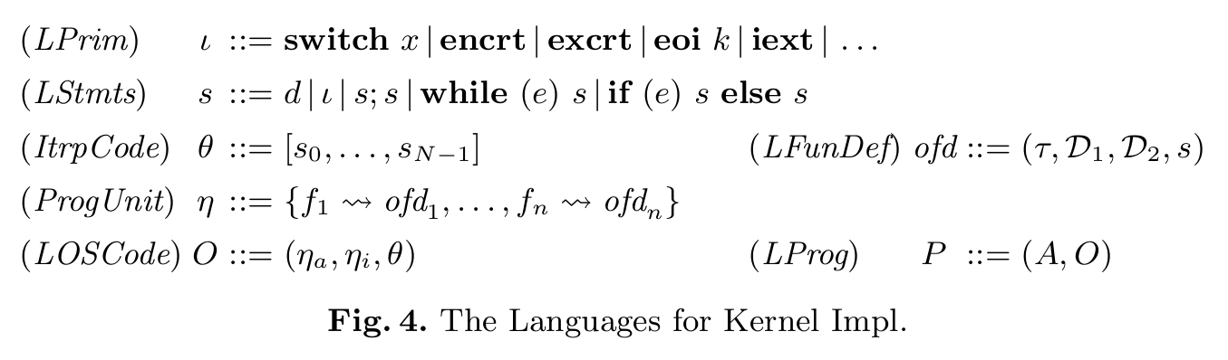
Modeling of the Kernel
The Low-Level Language
Low-level language for OS kernels
Usually the kernels are implemented in C with inline assembly. However, giving semantics directly to C with inline assembly requires us to expose stacks and registers, which makes the semantics overly complex. To avoid this problem, we extend the C statements with assembly primitives ι to encapsulate the assembly code.
Notes:
switch x switches to the target task x.
encrt enters a critical region by disabling interrupts. It also saves the old IF onto the stack to allow nestedcritical regions. Note we use ie to model the IF flag and abstract away other bits in the hardware EFLAGS register.
excrt exits the current critical region by popping the stack to recover ie. Since we hide stacks in our state model, we use an abstract stack cs to save the historical ie bits (see Fig. 6, which is explained below).
eoi k clears the k-th bit in isr, indicating that the k-th interrupt is no longer in service.
iext enables interrupts and returns to the interrupted program.
The kernel implementation O consists of the system API implementation ηa, the internal functions ηi and the interrupt handlers θ. The internal functions are called only by code in ηa or θ.
θ is a sequence of N interrupt handlers, where N is the maximum number of interrupts we support. The handler with the lower identifier has the higher priority.
Then a complete low-level program P is defined as a pair of the application code A and the kernel code O.

Slide 13
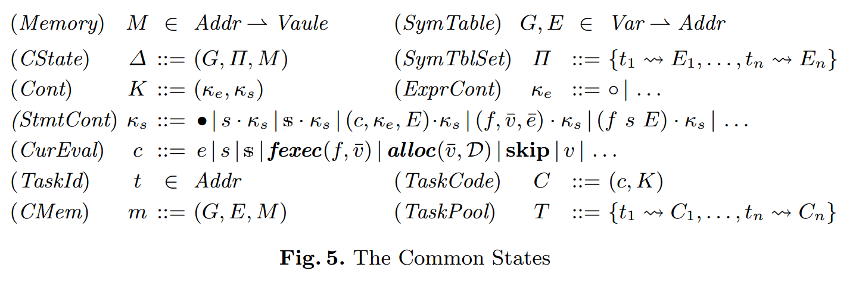
Modeling of the Kernel
The Low-Level Language
Common machine states
Notes:
we present the common machine states for the two levels.
The memory M is modeled as a partial function from addresses to values.
The global symbol table G and the local symbol table E map program variables to addresses.
Note that we use a flat memory model to simplify the presentation. The basic memory operations follow the block-based memory model in CompCert [17].
Π maps the task identifiers to their local symbol tables.
∆ consists of the global symbol table G, the set of local symbol tables Π and the memory M.
For the expression continuations κe, they can be ◦ which means that there is nothing left to be evaluated, or some other standard cases.
For the statement continuations κs, • means that there is nothing left to be done.
When the currently running task is interrupted, we use (c; κe; E)·κs to save the execution context for the current task. Since the interrupt may happen when evaluating an expression, we need to record the current evaluation c, the expression continuation κe and the current local symbol table E for resuming the execution context in the future.
We use (f; v; ¯ e¯) · κs to save intermediate results of calculating function arguments.
(f; s; E)· κs is used to save the context when doing function calls.
We also introduce some runtime statements for defining the small-step operational semantics.
For instance, fexec(f; v¯) is an intermediate statement for calling a function.
alloc(¯v; D) is used to do memory allocations for local variables and parameters in a function.

Slide 14
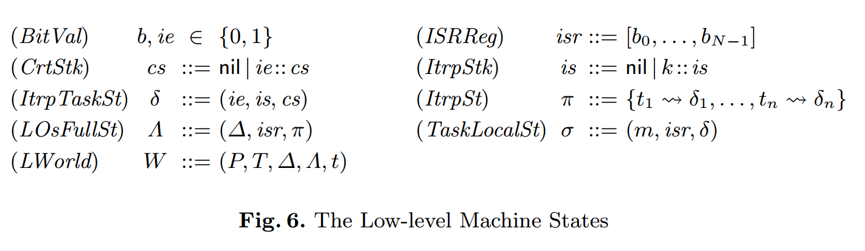
Modeling of the Kernel
The Low-Level Language
Low-level machine states
Notes:
ie is a boolean flag used to turn on/off interrupts.
isr is a sequence of boolean flags, one for each interrupt.
The stack cs records the historical values of ie, which are pushed whenever the execution enters a critical region. It is used to support nested critical regions.
The task-local stack is records the sequence of interrupts that interrupt the execution of this task. It is auxiliary data introduced for verification purpose.
Then the task-local interrupt status δ is defined as a triple (ie; is; cs).
π records the δ of each task.
The kernel level state Λ consists of the general C state ∆, the global isr register and the set π of task-local interrupt status.
The whole program configuration W now consists of the task pool T, the client state ∆, the kernel state Λ, and the identifier t of the current task.
Note that W contains two pieces of ∆, one for user applications (clients), the other inside Λ for the kernel. Separating the data into two parts prevents user applications from accessing kernel data. Applications trying to access data unavailable in the client ∆ will trigger a runtime error in our operational semantics.

Slide 15
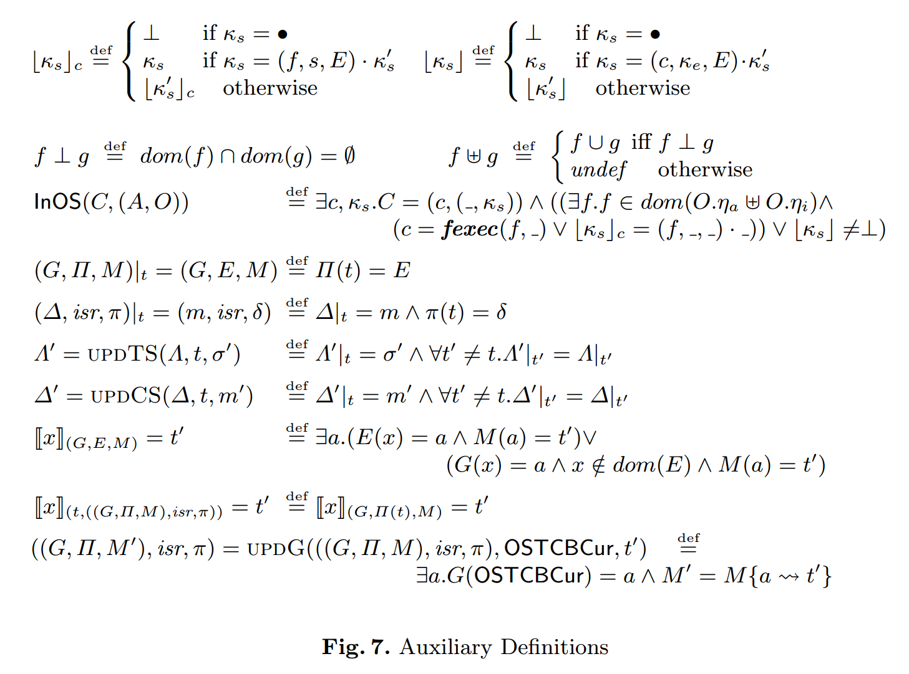
Modeling of the Kernel
Auxiliary Definitions

Slide 16

Modeling of the Kernel
Low-level operational semantics
The low-level program steps denoted as
may execute a regular command in a task (the Ptask rule),
or execute switch x to do context switch (the Psw rule),
or be interrupted and transfer the control to the corresponding interrupt handler (the Pitrp rule).
When executing a regular command in a task, it may either belong to the kernel (the TKernel rule) or the client (the TClt rule).

Slide 17
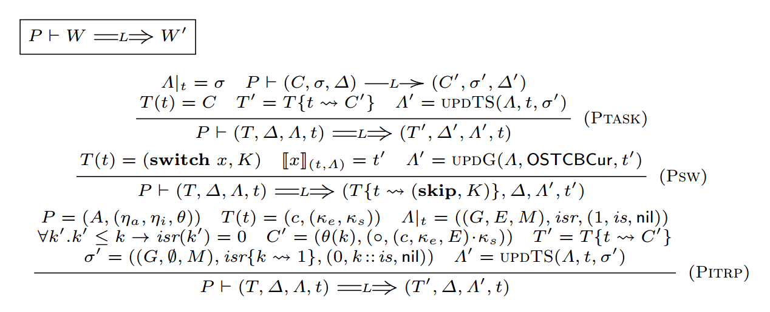
Modeling of the Kernel
Low-level operational semantics
The low-level program steps

Slide 18
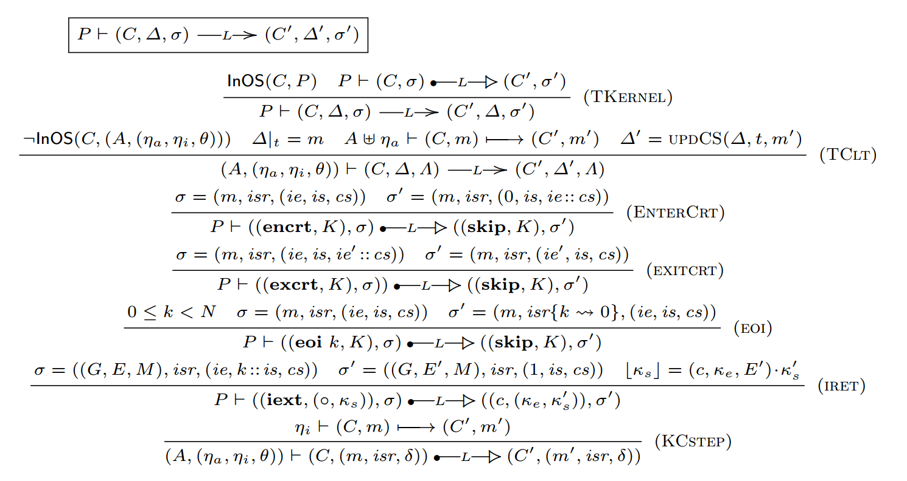
Modeling of the Kernel
Low-level operational semantics
task-local semantics of the assembly primitives for interrupt management.
Notes:
The TClt rule executes the client code. Here updCS(∆; t; m0) updates the local data of t in ∆ with the new m0.

Slide 19
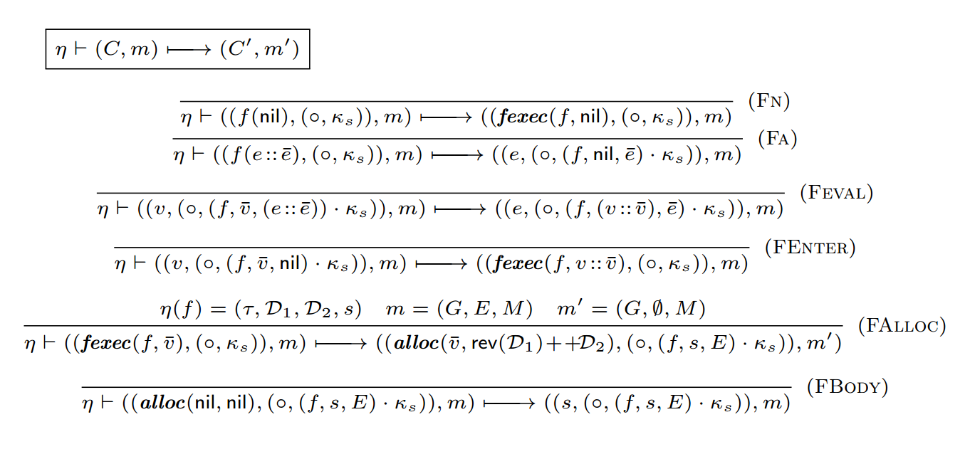
Modeling of the Kernel
Low-level operational semantics
Operational semantics for common C steps
Notes:
Here we only give the Fn ,Fa, Feval, FEnter, FAlloc and FBody rules for executing a function call, other rules for standard C semantics are in our Coq code and omitted here.
When invoking a function,it firsts uses the Fa rule to evaluate the expressions of function arguments.
Then the Feval rule is applied for evaluating the next expression.
After all the arguments are evaluated to a value list, we use FAlloc to allocate memory blocks for local variables and arguments.
Finally, we apply the FBody rule to execute the function body after finishing local allocations.
Note that the dynamical statement fexec(f; v¯) is the execution boundary between client-steps and and kernel-steps when client code invokes a kernel API.

Slide 20
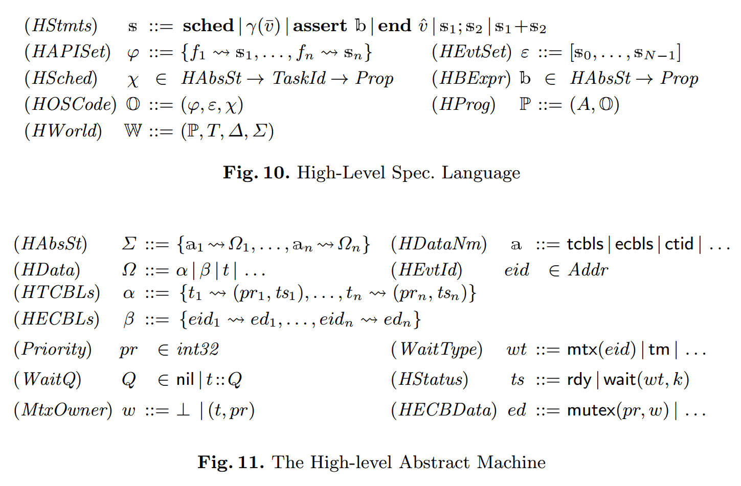
Modeling of the Kernel
The High-Level Specification Language ＆ Abstract states
Notes:
The system APIs and interrupt handlers are specified as an abstract statement s, which forms a simple but expressive specification language.
sched does scheduling. Its semantics is determined by the abstract scheduler specification χ.
χ is a binary relation between abstract states and task identifiers. That is, given an abstract state Σ, χ finds a related task identifier as the next task to execute. Note that χ is a relation instead of a function, therefore the abstract scheduler does not have to be deterministic. Since χ is provided as part of the kernel specification, the semantics of sched in our language is configurable. Specifying details of the scheduling policies (instead of using a more abstract non-deterministic scheduler that may pick any task) allows us to specify and verify scheduling properties such as PIF at the high level.
γ(¯v) is a meta-level relation (defined in Coq) that takes ¯v as arguments and maps an abstract state to another. Users can instantiate it to specify any atomic transitions over abstract states. assert b asserts that the predicate b holds over the current abstract state.
end v^ represents the end of abstract APIs with optional return values or interrupt handlers.
s1; s2 and s1+s2 are statements for sequential composition and non-deterministic choices respectively.
The kernel state is represented as the abstract state Σ at the high level. Σ is a mapping from names a to the abstract data Ω.
Here tcbls is the name for the high-level abstract TCB list α, which maps task identifiers to abstract tasks, including the priority pr (a natural number), the task status (ready, waiting, etc.) and so on, depending on the low-levelimplementations.
ctid is the name for the current task identifier t.
wt represents the type of waiting, including waiting for a mutex mtx(eid) and waiting for a duration tm etc..
ecbls is the name for the high-level abstract event control block (ECB) list β, which maps the event identifiers to abstract events, including abstract mutexes, abstract message queues and so on.
The abstract mutex can be formalized as mutex(pr; w), in which pr is the priority of the mutex and w is a pair of task identifiers and priorities.
ecbls is used to implement mutexes. Note that the definition of the abstract state for ECB list is not tied to our framework, which means different kernel implementations may instantiate these abstract states with different settings.

Slide 21
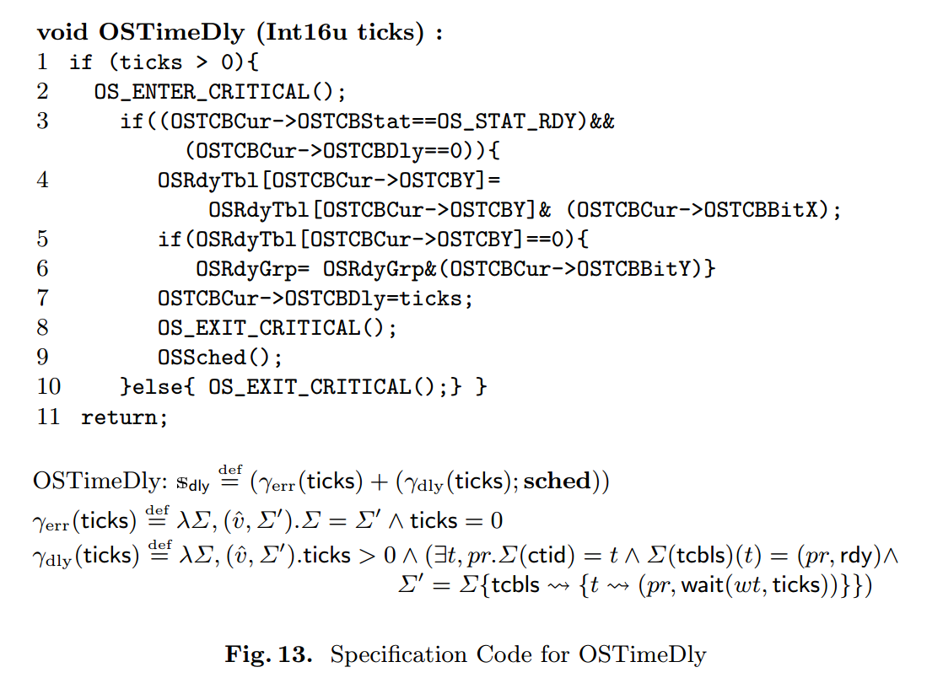
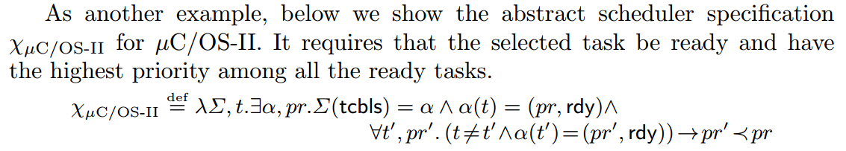
Modeling of the Kernel
Example of high-level specifications

Slide 22
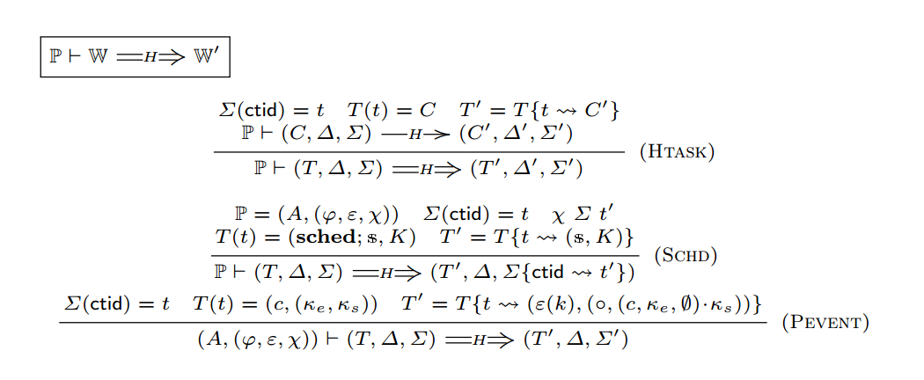
Modeling of the Kernel
The High-level Operational Semantics
high-level program steps
Notes:
The operational semantics rules for programsteps correspond to an execution step of the abstract kernel specification, a step of the sched command, a step to handle events (abstractions for interrupts) and a step of client execution.

Slide 23
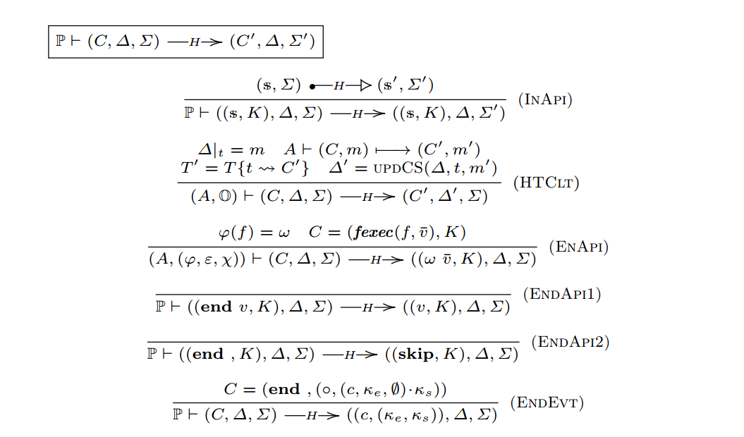
Modeling of the Kernel
The High-level Operational Semantics
high-level task-steps

Slide 24
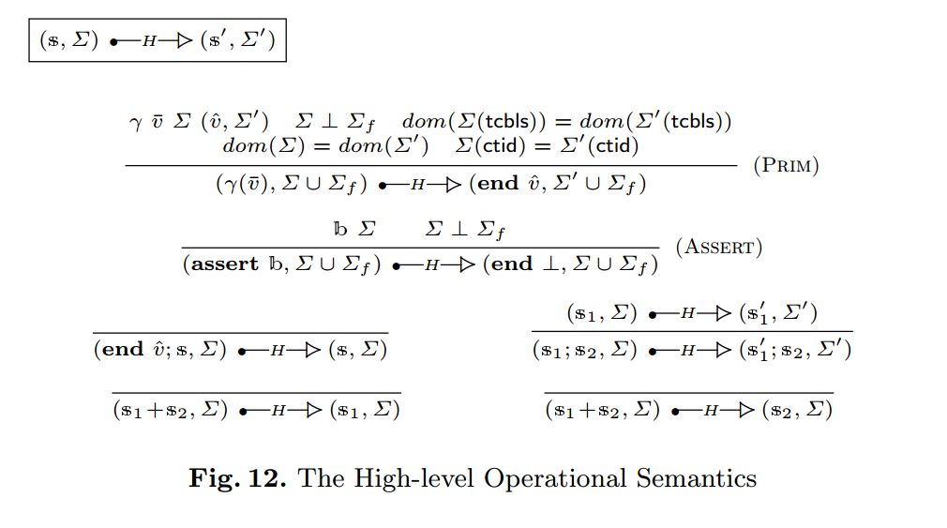
Modeling of the Kernel
The High-level Operational Semantics
high-level kernel-steps

Slide 25
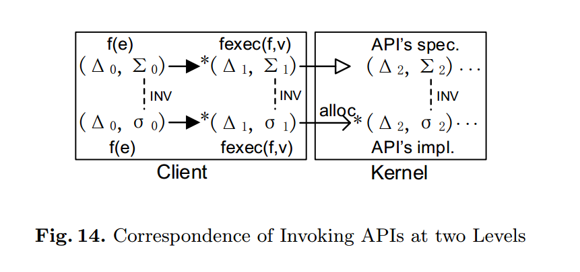
Modeling of the Kernel
Correspondence of Invoking APIs at two Levels

Slide 26
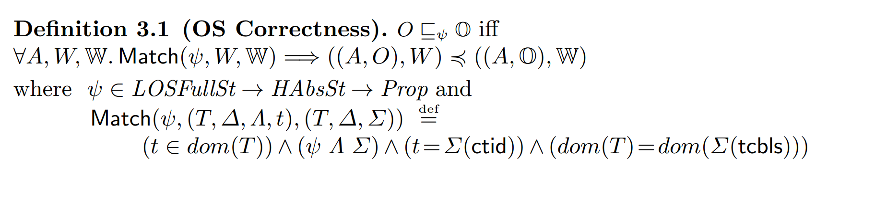
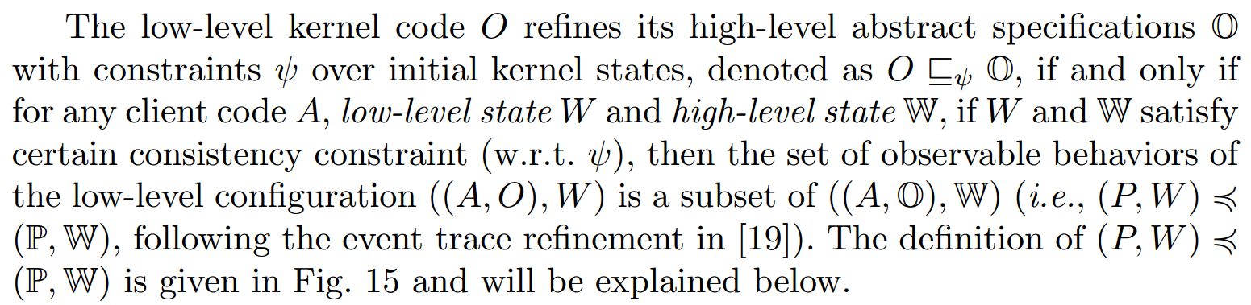
Modeling of the Kernel
OS Correctness

Slide 27
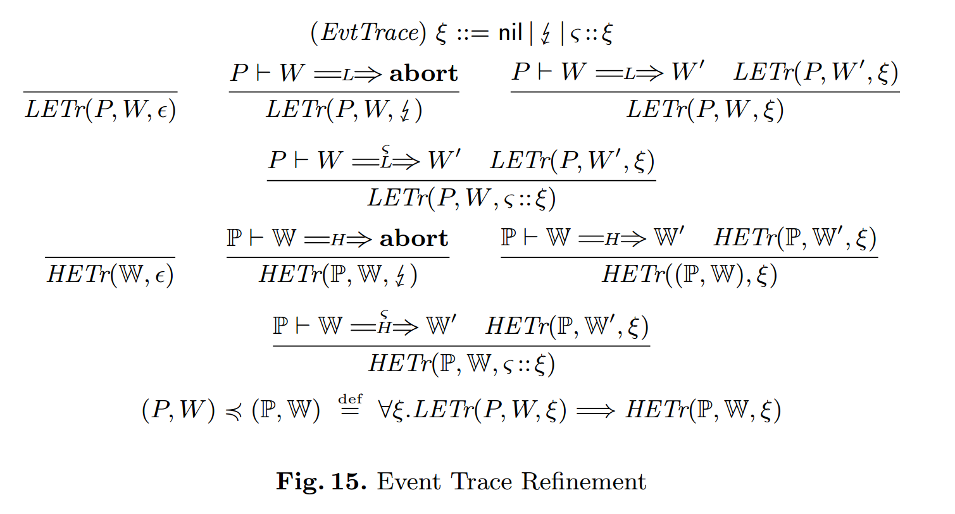
Modeling of the Kernel
Event trace refinement for OS correctness

Slide 28
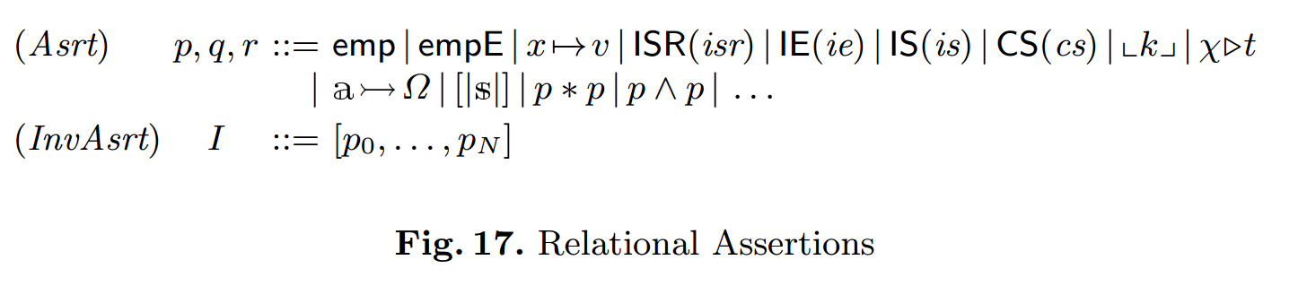
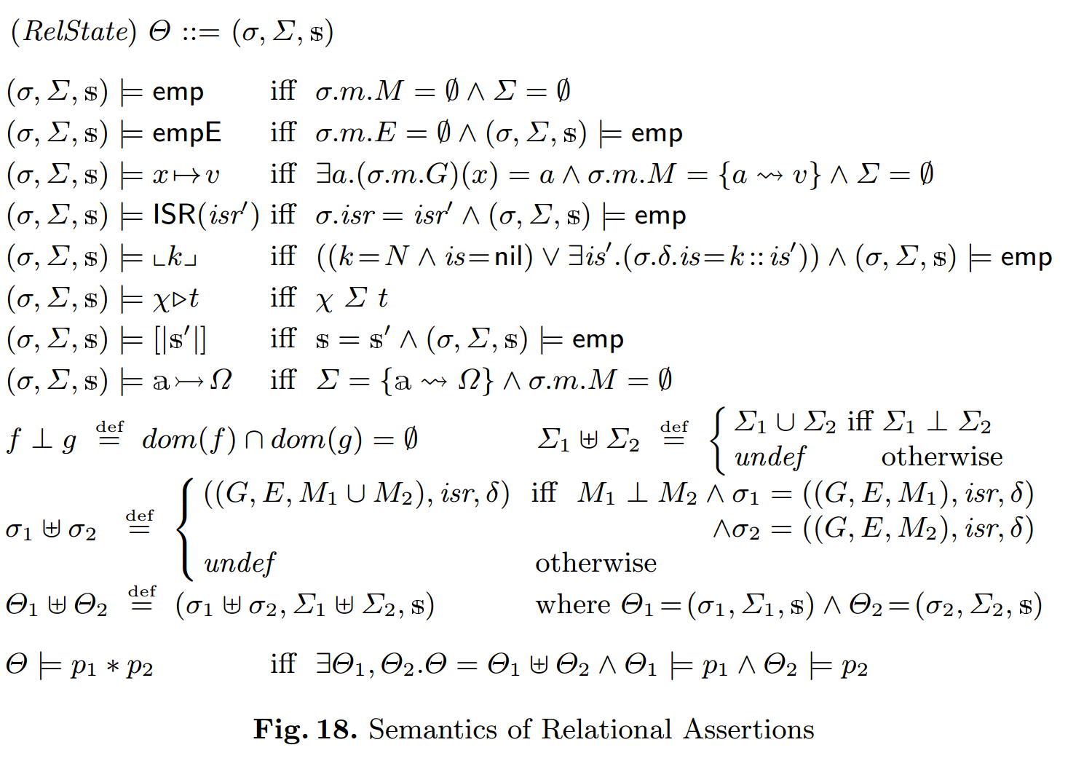
Relational Program Logic for Refinement Verification
Relational Assertion Language
Notes:
As explained above, the assertions are interpreted over relational states Θ, which consist of the low-level task-local states σ, the high-level abstract states Σ, and the abstract statements s that the low-level code needs to refine. Σ and s are defined in Fig. 10. σ, as shown in Fig. 18, consists of a task-local view m of program variables and memory, and also the global isr register and the task-local interrupt states δ (see Fig. 4). Here m contains the global and local variables (G and E respectively) and the memory M, whose definitions are omitted.

Slide 29
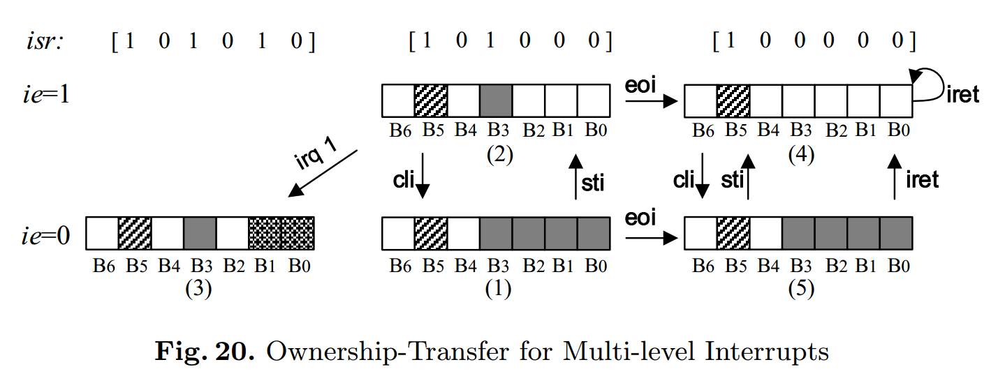
Relational Program Logic for Refinement Verification
Ownership-transfer semantics for multi-level interrupts

Slide 30
Relational Program Logic for Refinement Verification
Inference Rules

