Slide 1
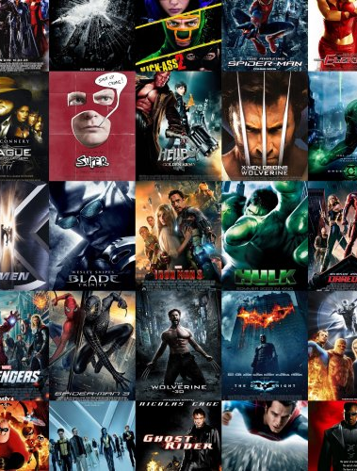
The Movies Dataset
Ji Liang
YunLong Li
Metadata on over 45,000 movies. 26 million ratings from over 270,000 users.

Slide 2
Architecture
Spark
Plotly
Kafka
Spark Streaming
Raw data
Spark SQL
Hive
Hdfs

Slide 3
Coretta Scott King’s childhood
Where was Coretta Scott King born?
What did her parents do?
Did she experience prejudice or injustice because of her race when she was a child?
What kind of a student was she?
What were her interests?
Did she go to college? If so, where?

Slide 4
Traveling to celebrate freedom
Make a timeline of the dates and places that Martin Luther and Coretta Scott King visited together to celebrate a country’s freedom, to honor the memory of an inspirational leader, and to accept a prestigious award.
Name of Event 1 | Name of Event 2 | Name of Event 3 | Name of Event 4 | Name of Event 5 | Name of Event 6 | Name of Event 7 | Name of Event 8
1st Date | 2nd Date | 3rd Date | 4th Date | 5th Date | 6th Date | 7th Date | 8th Date
Description of Event | Description of Event | Description of Event | Description of Event | Description of Event | Description of Event | Description of Event | Description of Event

Slide 5
Coretta Scott King’s childhood
Where was Coretta Scott King born?
What did her parents do?
Did she experience prejudice or injustice because of her race when she was a child?
What kind of a student was she?
What were her interests?
Did she go to college? If so, where?

