Slide 1
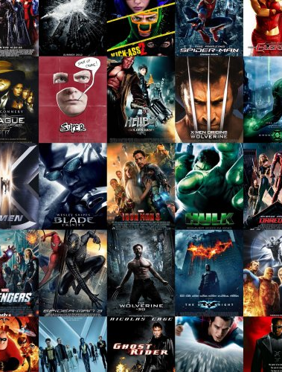
The Movies Dataset
Ji Liang
YunLong Li
Metadata on over 45,000 movies.

Slide 2
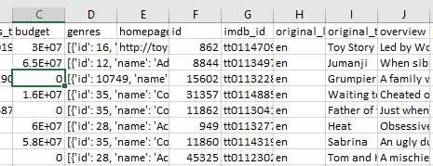
Architecture
Spark Streaming
Raw data
Kafka
Spark
Plotly
Spark SQL
Hive
Hdfs

Slide 3

Kafka

Slide 4
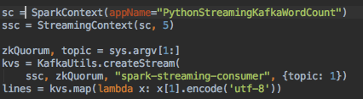
Spark Streaming

Slide 5
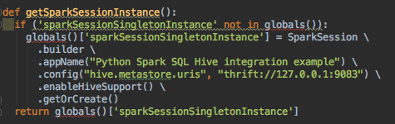
Hive

Slide 6
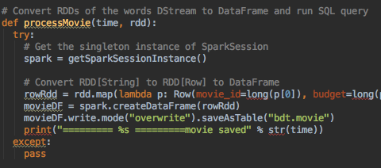
Spark SQL

Slide 7
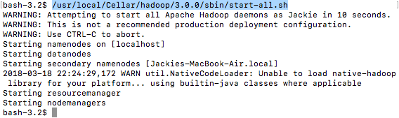
Demo - Start Hadoop

Slide 8


Demo - Start Hadoop, ZooKeeper, Hive metastore

Slide 9
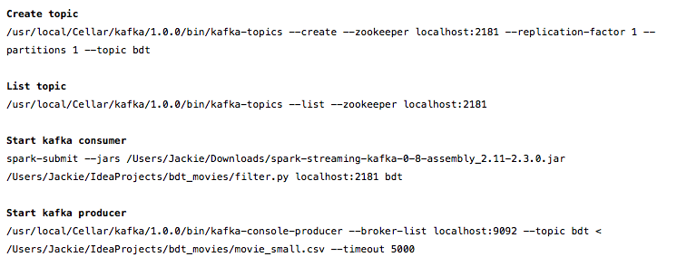
Demo - Communicate with Kafka

Slide 10
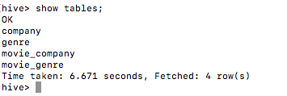
Demo - store data in hive

Slide 11
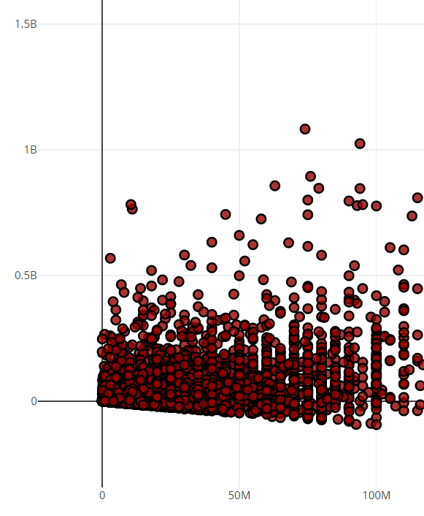
Net profit
X - budget
Y- net profit (revenue-budget)
Link

Slide 12
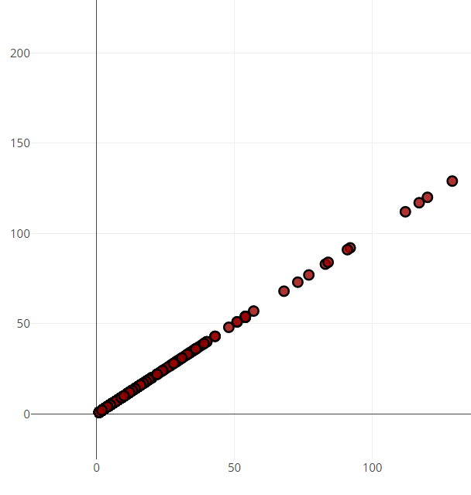
Number of movies released by Distributors
X – number
Y – number
Link

Slide 13
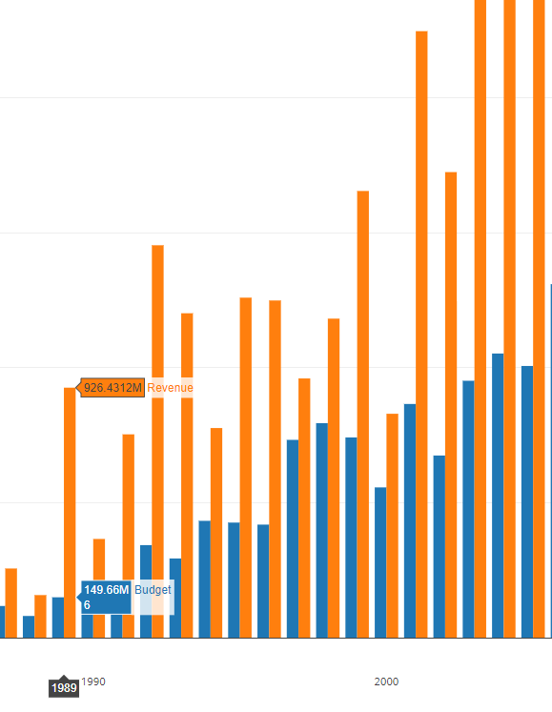
Warner Bros budget/revenue
X – year
Y – money
blue – budget
orange – revenue
Link

Slide 14
Traveling to celebrate freedom
Make a timeline of the dates and places that Martin Luther and Coretta Scott King visited together to celebrate a country’s freedom, to honor the memory of an inspirational leader, and to accept a prestigious award.
Name of Event 1 | Name of Event 2 | Name of Event 3 | Name of Event 4 | Name of Event 5 | Name of Event 6 | Name of Event 7 | Name of Event 8
1st Date | 2nd Date | 3rd Date | 4th Date | 5th Date | 6th Date | 7th Date | 8th Date
Description of Event | Description of Event | Description of Event | Description of Event | Description of Event | Description of Event | Description of Event | Description of Event

