Slide 1

The Movies Dataset
Ji Liang
YunLong Li
Metadata on over 45,000 movies.

Slide 2
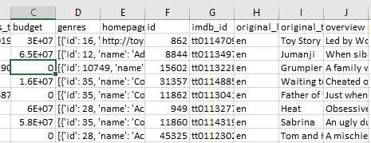
Architecture
Spark Streaming
Raw data
Kafka
Spark
Plotly
Spark SQL
Hive
Hdfs

Slide 3

Kafka

Slide 4
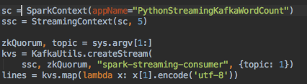
Spark Streaming

Slide 5
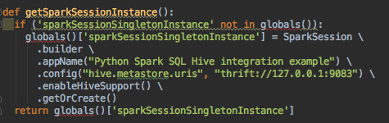
Hive

Slide 6
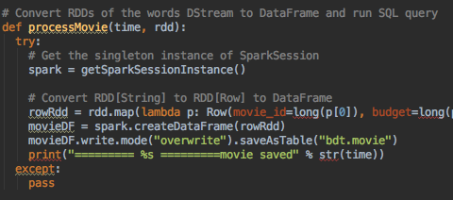
Spark SQL

Slide 7
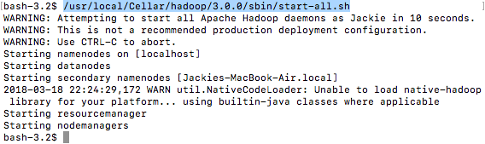


Demo - Start Hadoop, ZooKeeper, Hive metastore

Slide 8
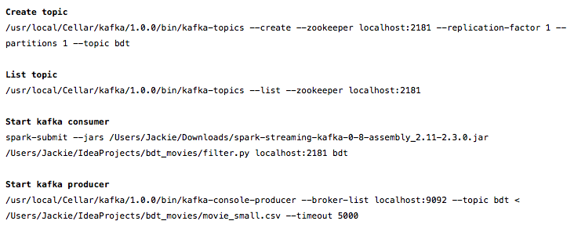
Demo - Communicate with Kafka

Slide 9
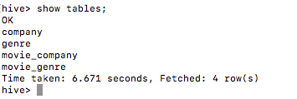
Demo - store data in hive

Slide 10
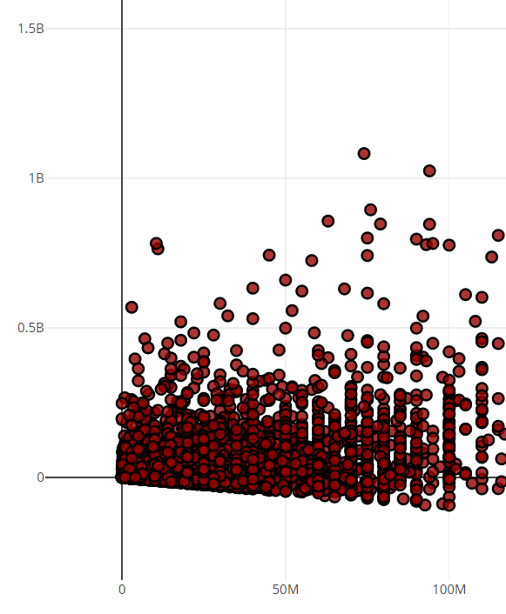
Net profit
X - budget
Y- net profit (revenue-budget)
Link

Slide 11
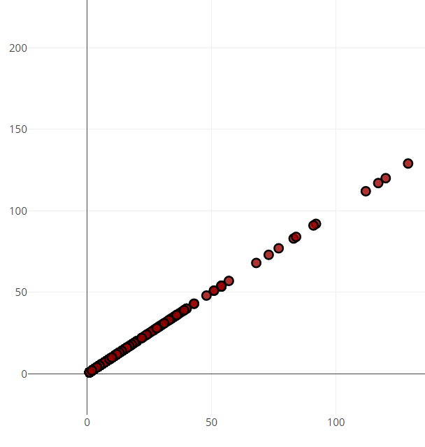
Number of movies released by Distributors
X – number
Y – number
Link

Slide 12
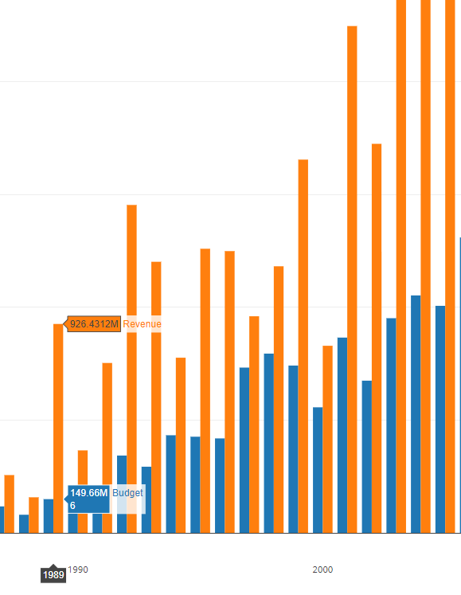
Warner Bros budget/revenue
X – year
Y – money
blue – budget
orange – revenue
Link

Slide 13
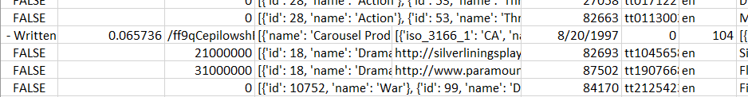
Data problems
First test with small data and it works, then with full data and it doesn’t work.
There are invalid data in the file, these have to be eliminated

Slide 14
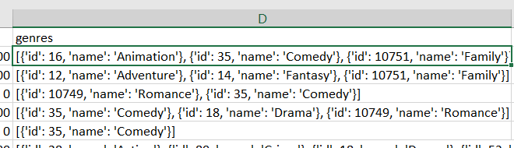
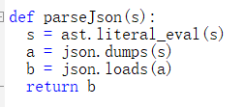
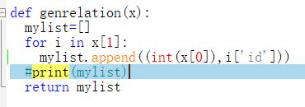
Data problems
Companies and genre are in json format, how to parse/convert json to RDD is a problem
First parse json into dict
Then convert dict into list
Flat map last

Slide 15
Plotly Problems
How to install Plotly?
Pip is needed for install Plotly
But pip is not there, have to install pip first, and some other software needed.
Plotly uses Python 3.6, but Cloudera VM provide Python 2.6, have to upgrade Python on VM.
How to connect Spark SQL result to Plotly?
Read python api document on Plotly, start from demo, then step by step merge our SQL result to Plotly

