Slide 1

The Movies Dataset
Ji Liang
YunLong Li
Metadata on over 45,000 movies.

Slide 2
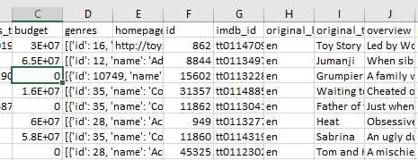
Architecture
Spark
Plotly
Kafka
Spark Streaming
Raw data
Spark SQL
Hive
Hdfs

Slide 3
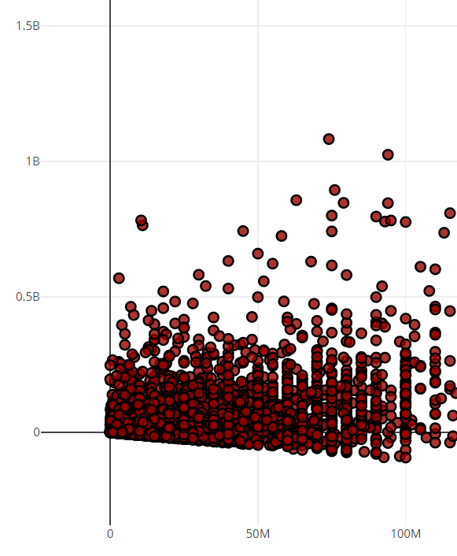
Net profit
X - budget
Y- net profit (revenue-budget)
Link

Slide 4
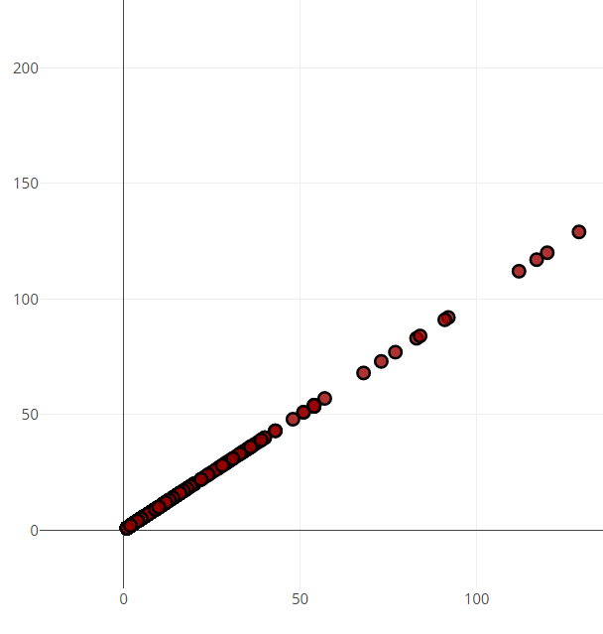
Number of movies released by Distributors
X – number
Y – number
Link

Slide 5
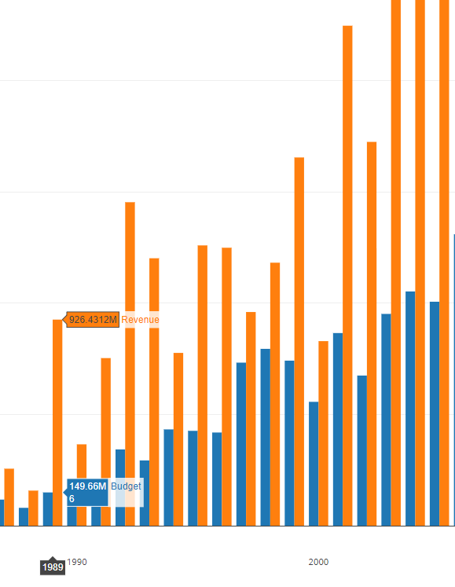
Warner Bros budget/revenue
X – year
Y – money
blue – budget
orange – revenue
Link

Slide 6
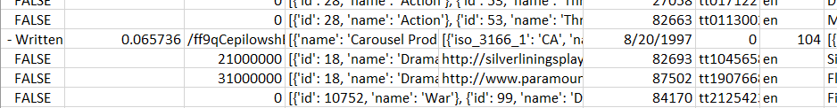
Data problems
First test with small data and it works, then with full data and it doesn’t work.
There are invalid data in the file, these have to be eliminated

Slide 7
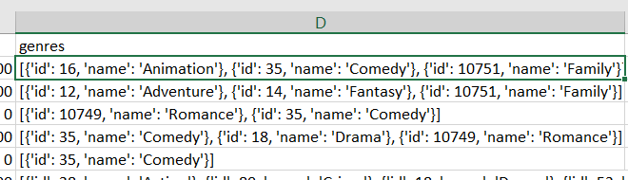
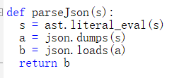
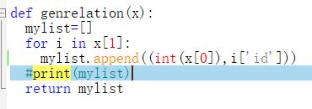
Data problems
Companies and genre are in json format, how to parse/convert json to RDD is a problem
First parse json into dict
Then convert dict into list
Flat map last

Slide 8
Plotly Problems
How to install Plotly?
Pip is needed for install Plotly
But pip is not there, have to install pip first, and some other software needed.
Plotly uses Python 3.6, but Cloudera VM provide Python 2.6, have to upgrade Python on VM.
How to connect Spark SQL result to Plotly?
Read python api document on Plotly, start from demo, then step by step merge our SQL result to Plotly

