Slide 1

The Movies Dataset
Ji Liang
Chenglong Li
Metadata on over 45,000 movies.

Slide 2
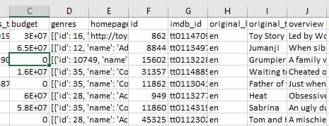
Architecture
Spark Streaming
Raw data
Kafka
Spark
Plotly
Spark SQL
Hive
Hdfs

Slide 3

Kafka

Slide 4
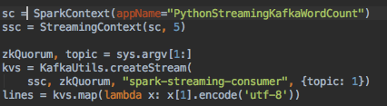
Spark Streaming

Slide 5
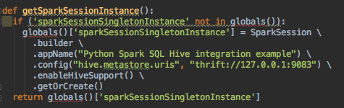
Hive

Slide 6
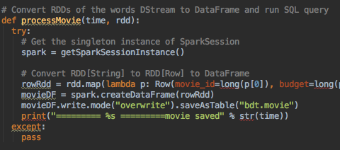
Spark SQL

Slide 7
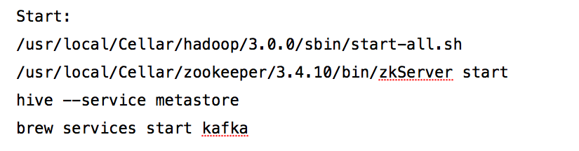
Demo - Start Hadoop, ZooKeeper, Hive metastore

Slide 8
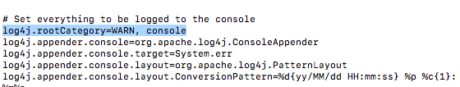
Set log4j level

Slide 9
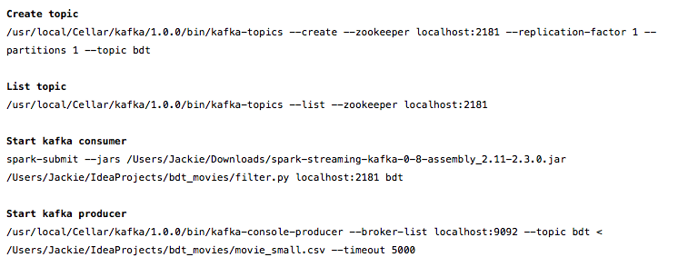
Demo - Communicate with Kafka

Slide 10
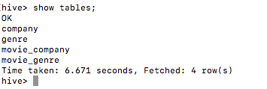
Demo - store data in hive

Slide 11
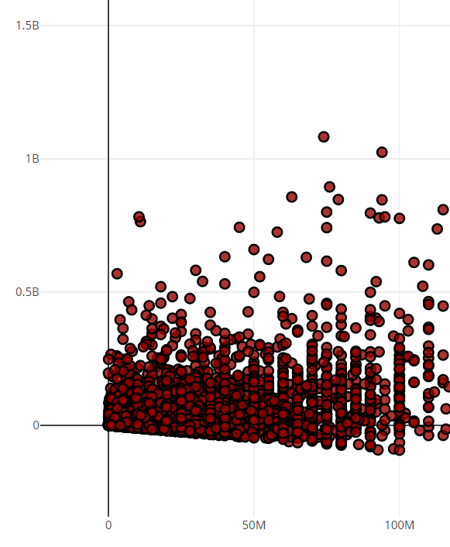
Net profit
X - budget
Y- net profit (revenue-budget)
Link

Slide 12
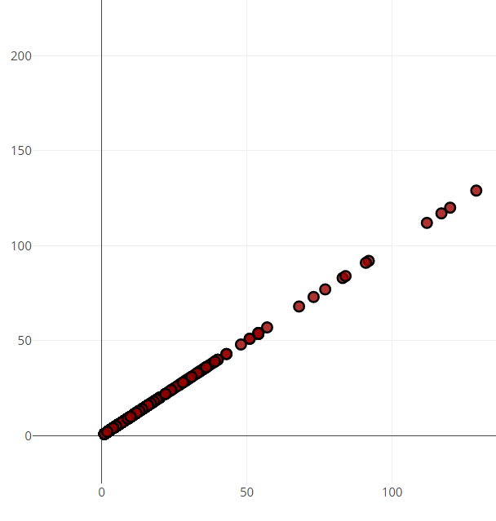
Number of movies released by Distributors
X – number
Y – number
Link

Slide 13
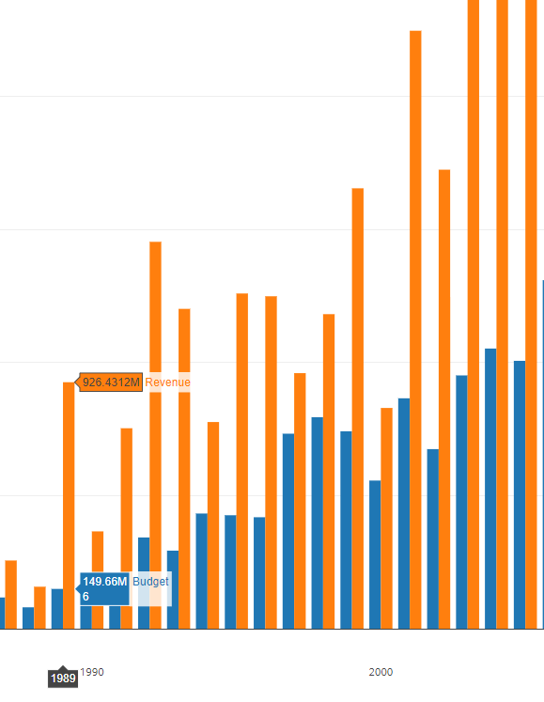
Warner Bros budget/revenue
X – year
Y – money
blue – budget
orange – revenue
Link

Slide 14
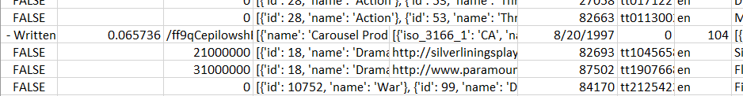
Data problems
First test with small data and it works, then with full data and it doesn’t work.
There are invalid data in the file, these have to be eliminated

Slide 15
Kafka Problem
In the beginning, we want to use the NetCat as a server to send the streaming data to Kafka, but we find it is difficult to transfer the socket stream into the spark stream by Kafka.
Then we choose read the csv.file to Kafka.

Slide 16
Spark SQL Problem
Using schema of for the streaming data will cause error when create table.
Then we use Spark Session to create data frame with Row, then store into hive.

Slide 17
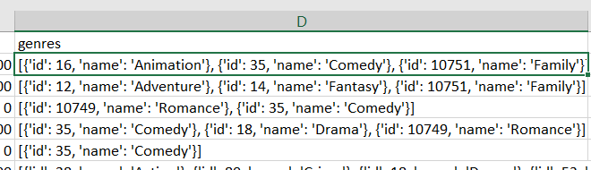
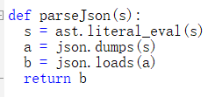
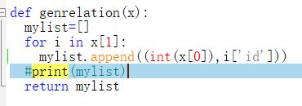
Data problems
Companies and genre are in json format, how to parse/convert json to RDD is a problem
First parse json into dict
Then convert dict into list
Flat map last

Slide 18
Plotly Problems
How to install Plotly?
Pip is needed for install Plotly
But pip is not there, have to install pip first, and some other software needed.
Plotly uses Python 3.6, but Cloudera VM provide Python 2.6, have to upgrade Python on VM.
How to connect Spark SQL result to Plotly?
Read python api document on Plotly, start from demo, then step by step merge our SQL result to Plotly

