Slide 1

A Data-Driven Approach to Telemarketing
Analysis by: Jackie Zuker
Dataset Source: UCI Machine Learning

Slide 2
Introduction
I reviewed the efficacy of a massive telemarketing campaign conducted by a Portuguese bank
Campaign sold bank term deposits (CD’s) from May 2008 to November 2010
Roughly 12.6% of customers bought a bank term deposit during the campaign
Can we use this data to target the most likely buyers and optimize our marketing efforts in the future?

Slide 3
The Data
41,188 samples
21 Variables
10 Categorical (Occupation, Education, Communication type (cell/telephone), Whether previous campaign was successful, etc)
10 Numeric (Age, Number of Calls Conducted, Euribor 3-month rate, Number of days since previous call, etc)
Output Variable
y = Has the client signed up for a term deposit? (yes/no)

Slide 4
Exploring the Data

Slide 5
Prepping the Data
Data Cleaning
Impute any missing values.
Balance the classes via mixed-sampling
Used a combination of over-sampling and under-sampling to balance the classes of the outcome variable.
Why balance the classes?
We want the model to put more importance on the ’rare’ outcome.
Notes:
In the original dataset, there was a class imbalance issue, with the outcome of interest comprising 12.6% of the dataset. This would lead to models preferring the more common class because it is statistically ‘safer’.

Slide 6
Class Imbalance Methodology Advantages and Disadvantages
Over-Sampling increases the number of samples in the more rare class.
Advantages: Do not have to throw away data from the more common class.
Disadvantages: There become many copies of the rare class present in the dataset, so some models may over-fit to this data even when using cross-validation. The model may also become very large and harder to efficiently model.
Under-sampling pulls just a subset of the more common class and includes all of the rare class.
Advantages: Smaller dataset is quicker to model. Safer against over-fitting.
Disadvantages: Smaller dataset means less data. May lose valuable information from the more common class.

Slide 7
Class Imbalance Methodology Advantages and Disadvantages
Mixed sampling mitigates the disadvantages of each class imbalance methodology while capitalizing on the advantages.
Advantages: Quicker to model, does not include too many copies of the rare class (2x or 3 copies instead of 10X copies). This limits over-fitting to a particular instance of the rare class.
Disadvantages: Not all the data is kept, but less is thrown out than with under-sampling. Some potential for over-fitting but this is limited compared to over-sampling.
(Add actual data about the accuracy of each model here or in appendix)

Slide 8
Feature Engineering
Converted outcome variable to 0’s and 1’s for statistical modelling
Removed “Duration” variable
Removed “Day of the Week” variable
Used one-hot encoding to generate dummy variables for all categorical features for modelling
Notes:
In the original dataset, there was a class imbalance issue, with the outcome of interest comprising 12.6% of the dataset. This would lead to models preferring the more common class because it is statistically ‘safer’.

Slide 9
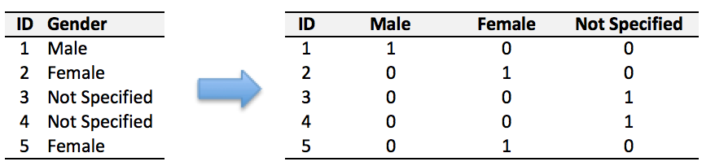
What is one-hot encoding?
One-hot encoding converts categorical variables (and in some instances, numerical variables) into a format that is more amenable to classification and regression modelling.
In effect, one-hot encoding creates a new variables for each outcome of a categorical variable present in the dataset.

Slide 10
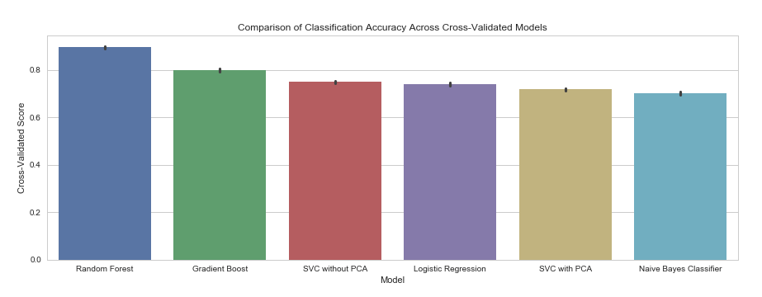
Comparing the Model Outcomes
Random Gradient SVC Logistic SVC Naive
Forest Descent Regression with PCA Bayes

Slide 11
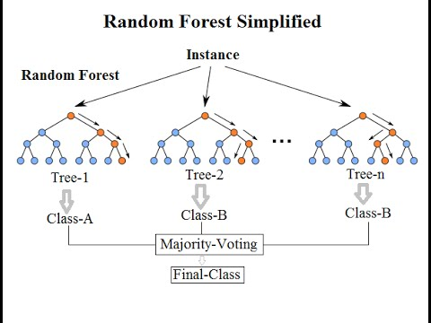
What is Random Forest?
The Random Forest Algorithm works by building many “Decision Trees”. Each decision tree ”votes” for the final outcome.
A decision tree works to classify each sample by imposing a series of decisions on the group which limits entropy.
Each decision tree is built on a subset of the data. A single decision tree is a weak learner, and only slightly better than average at predicting the final outcome of each customer. However, when they are combined in the Random Forest Algorithm, they create a powerful tool for prediction.

Slide 12
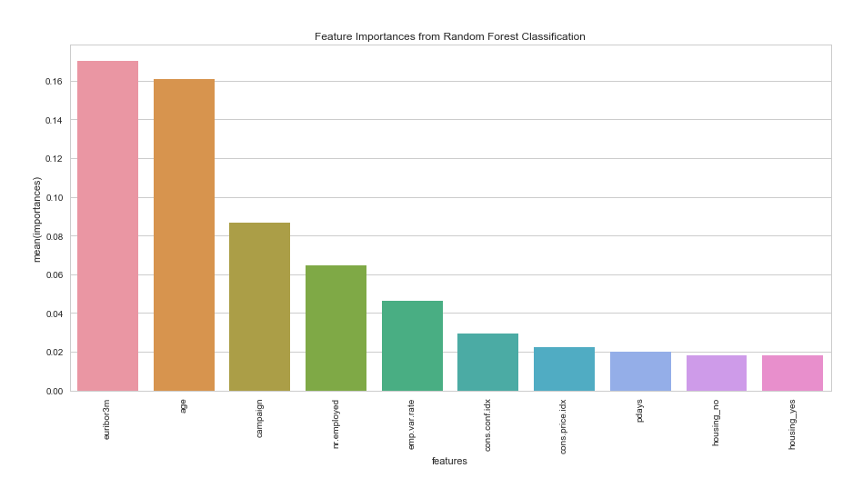
Top 10 Feature Importances from the Fit Model

Slide 13
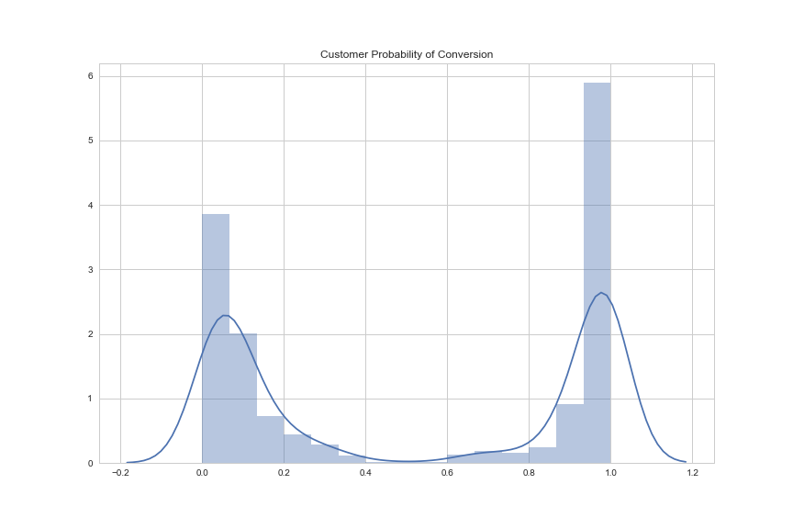
What can we do with this information?
Within our dataset, there are populations that can be specifically targeted in an efficient way.
For example, marketing calls may be more effective on groups which are more likely to convert.

Slide 14
Works Cited
This dataset comes from the UCI Machine Learning Repository; it can be accessed here: https://archive.ics.uci.edu/ml/datasets/bank+marketing
More information about hyper-parameter tuning of each model, especially
Make a confusion matrix for some categorical variable of value of that you think is important.
Feature Importance -> can’t read
Dive deeper into top feature importances
Is the model equally good everywhere? Are there subgroups where the model is not as accurate?
Is there overfitting present?
Residuals -> Class Identification errors
Residuals -> subtract for Probability Scores.

