Slide 1


Replace Type Code with Subclasses
TEAM 18
2153085 马立欣
2252551 徐俊逸
2154284 杨骏昊
2253744 林觉凯
2151422 武芷朵

Slide 2
CONTENTS
1
Problem
2
Solution
3
Detail steps
4
Limitations
5
Pros & cons

Slide 3
01. Problem—Type Code
class Employee {
public :
static const int ENGINEER = 1;
static const int MANAGER = 2;
static const int INTERN = 3;
private:
int type; // type of employee
public:
explicit Employee(int type) : type(type) {}
void setrype(int type) {
this->type = type;
}
double calculatePay(double basesalary) const{
switch (type)
{
Case ENGINEER :
return basesalary * 1.2;
Case MANAGER :
return basesalary * 1.5;
Case INTERN :
return basesalary * 0.8;
default:
throw invalid_argument("Invalid employee type");
}
}
};
Type Code refers to a value or identifier
(such as a number, string, or enum) that represents
the type or state of an object or entity
Type Code is used to determine behavior
of a program, often using ‘if ’ or ‘switch’
Employee type is a type code and the value of it
(which could be ENGINEER, MANAGER, or INTERN)
affects what the program does in the switch statement

Slide 4
01. Problem
class Employee {
public :
static const int ENGINEER = 1;
static const int MANAGER = 2;
static const int INTERN = 3;
private:
int type; // type of employee
public:
explicit Employee(int type) : type(type) {}
void setrype(int type) {
this->type = type;
}
double calculatePay(double basesalary) const{
switch (type)
{
Case ENGINEER :
return basesalary * 1.2;
Case MANAGER :
return basesalary * 1.5;
Case INTERN :
return basesalary * 0.8;
default:
throw invalid_argument("Invalid employee type");
}
}
};
Poor Maintainability
If values of employee type increases, we need to constantly extend
the switch statement. It violates the Open/Closed Principle
a system should be open for extension but closed for modification.
Difficult to Extend
Each time a new state is added, we need to modify the existing
code by adding new case statements, which makes the original
more prone to errors.
Non-intuitive Type Code
Value of employee type is represented by numbers (1, 2, 3)
It is not intuitive and difficult to remember the meaning of the numbers

Slide 5
02. Solutions
Simplify the code by replacing the type code with the subclasses.
Use Self Encapsulate Field to create a getter for the field that contains type code.
Create a unique subclass for each value of the coded type.
Start to move the fields and methods from the superclass to corresponding subclasses, using Push Down Field/
Method.
Make the superclass constructor private.
Delete the field with type code from the superclass.
Use Replace Conditional with Polymorphism in order to get rid of conditions that use the type code once and for all.
Step1
Step2
Step3
Step4
Step5
Step6

Slide 6
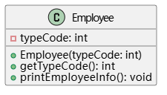
03. Steps and Examples - Initial and Step1
class Employee {
private:
int typeCode;
public:
Employee(inttypeCode) : typeCode(typeCode) {}
int getTypeCode() const {
return typeCode;
}
void printEmployeeInfo() const {
if (typeCode ==1) {
cout <<"This is a Manager"<< endl;
} elseif (typeCode ==2) {
cout <<"This is a Technical Employee"<< endl;
} elseif (typeCode ==3) {
cout <<"This is a Sales Employee"<< endl;
}
}
};
int main() {
Employee emp1(1);
Employee emp2(2);
Employee emp3(3);
emp1.printEmployeeInfo();
emp2.printEmployeeInfo();
emp3.printEmployeeInfo();
return0;
}
TypeCode-to represent the employee type
Operation-to print info
private
1. Self Encapsulate Field
to encapsulate the typeCode field and provide a getter method that ensures that access to the field is made by method rather than direct access.
class Employee {
private:
int typeCode;
public:
Employee(inttypeCode) : typeCode(typeCode) {}
int getTypeCode() const {
return typeCode;
}
virtualvoid printEmployeeInfo() const {
if (getTypeCode() ==1) {
cout <<"This is a Manager"<< endl;
} elseif (getTypeCode() ==2) {
cout <<"This is a Technical Employee"<< endl;
} elseif (getTypeCode() ==3) {
cout <<"This is a Sales Employee"<< endl;
}
}
};
getTypeCode
method
- Manager
- Technical staff
- Salesperson

Slide 7
03. Steps and Examples - Step2
class Employee {
private:
int typeCode;
Employee(int typeCode) : typeCode(typeCode) {}
public:
static Employee*createEmployee(int typeCode) {
if (typeCode ==1) {
return new Manager();
} elseif (typeCode ==2) {
return new TechnicalEmployee();
} elseif (typeCode ==3) {
return new SalesEmployee();
}
return nullptr;
}
int getTypeCode() const {
return typeCode;
}
virtual void printEmployeeInfo() const=0;
};
Private constructor
2. Private constructor with factory method
Make sure that an instance of each Employee subclass can only be created under a specific condition or manner.
Focusing the instantiated logic in the factory method makes it easier to extend new subclasses in the future.
Static factory method
Getter Method

Slide 8
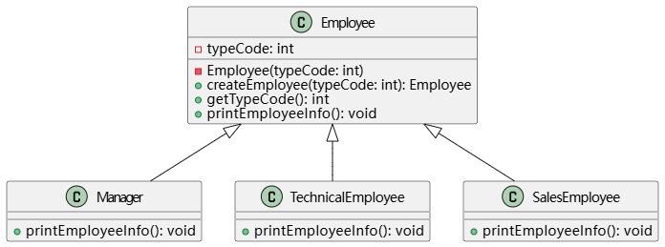
03. Steps and Examples - Step3
class Manager : public Employee {
public:
Manager() : Employee(1) {}
void printEmployeeInfo() const override {
cout<<"This is a Manager"<<endl;
}
};
3. Create unique subclasses
Each subclass implements the printEmployeeInfo method according to its own employee type.
If new employee types are added in the future, the method improves flexibility and scalability.
Manager
class TechnicalEmployee : public Employee {
public:
TechnicalEmployee() : Employee(2) {}
void printEmployeeInfo() const override {
cout<<"This is a TechnicalEmployee"<<endl;
}
};
Technical
Employee
class SalesEmployee : public Employee {
public:
SalesEmployee() : Employee(3) {}
void printEmployeeInfo() const override {
cout <<"This is a Sales Employee"<< endl;
}
};
Sales
Employee

Slide 9
03. Steps and Examples - Step4
4.Delete code field
Remove the typeCode field from the Employee superclass
Make the printEmployeeInfo method a pure virtual method.
This means that each subclass must implement its own printEmployeeInfo method.
This makes the Employee class an abstract class, which cannot be directly instantiated.
Original code：
Refactored code：
remove the type code field
class Employee{
private:
int typeCode;
public:
...// Other functions
void printEmployeeInfo() const{
if(typecode ==1){
cout<<"This is a Manager"<< endl;
}
else if(typecode ==2){
cout<<"This is a Technical Employee"<<endl;
}
else if(typecode ==3){
cout<<"This is a Sales Employee"<<endl;
}
}
}
class Employee{
public:
...// Other functions
// A pure virtual method.
virtual void printEmployeeInfo() const=0;
}
Rewrite as a purely virtual function

Slide 10
03. Steps and Examples - Step5、6
Move the fields and methods to the subclasses
5
Move the fields and methods related to `typeCode` from the superclass to the subclasses.
Ensure that each subclass is fully independent, handling its own logic without relying on the implementation of the parent class.
int main() {
Employee* emp1=Employee::createEmployee(1); // manager
Employee* emp2=Employee::createEmployee(2); // technical staff
Employee* emp3=Employee::createEmployee(3); // salesman
emp1->printEmployeeInfo();
emp2->printEmployeeInfo();
emp3->printEmployeeInfo();
delete emp1;
delete emp2;
delete emp3;
return 0;
}
Replace Conditional with Polymorphism
6
Replace the code that originally required conditional statements with polymorphism.

Slide 11
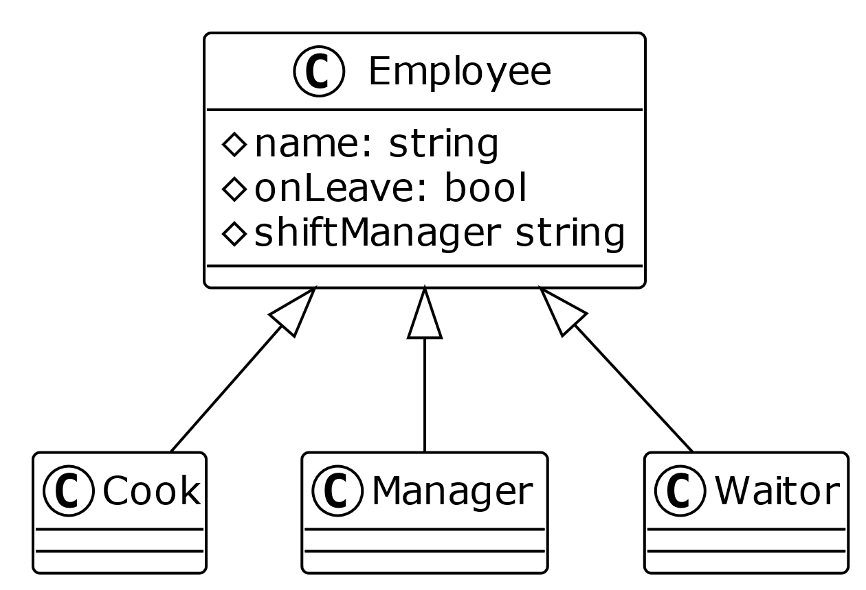
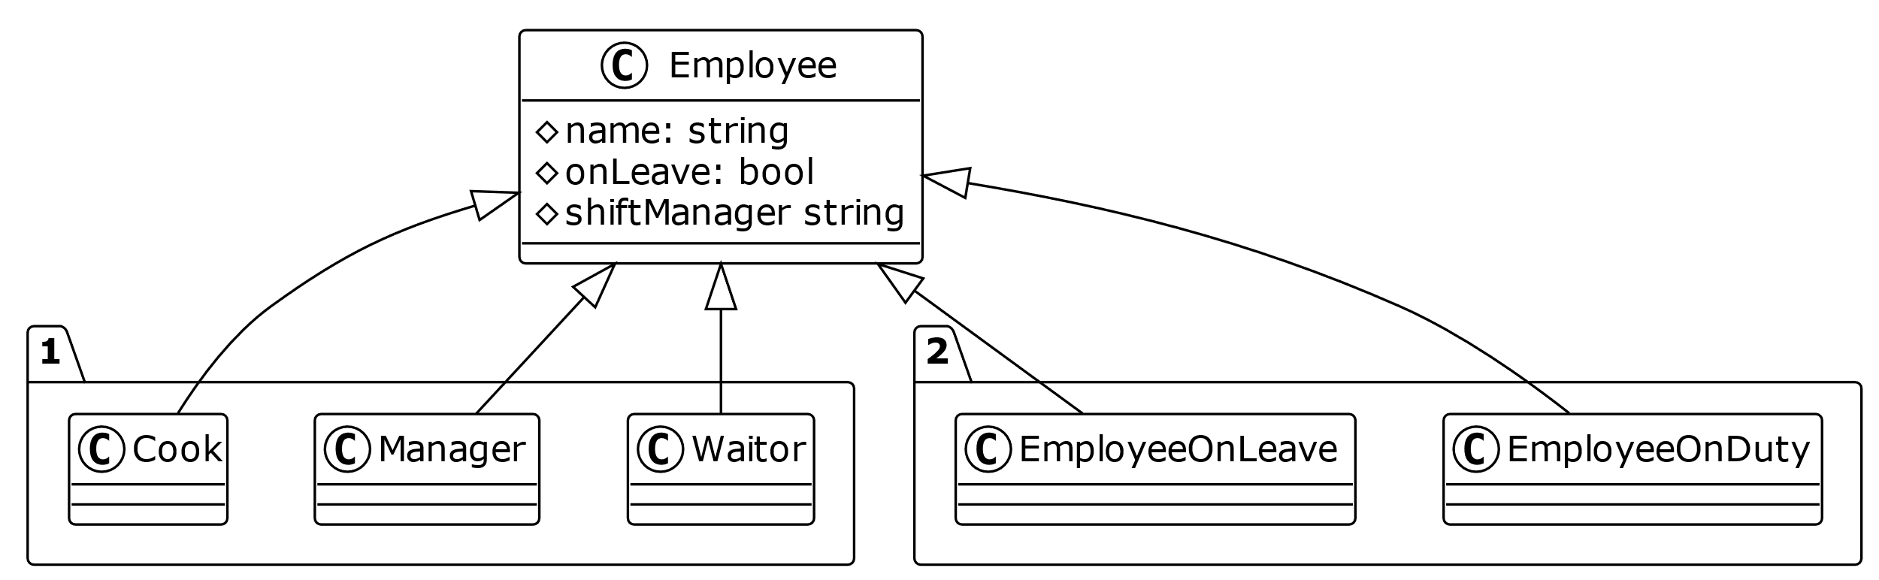
04. Limitations - Dual Hierarchy
Before
After
We have a very simple while reasonable class hierarchy, as pictured.
Now, if we are trying to apply the technique Replace Type Code with Subclasses on class Employee to remove the type code onLeave, we will definitely run into trouble because the most direct way we have just discussed will result in what the picture looks like.
"If you already have an existing class hierarchy, you cannot create a dual hierarchy through inheritance." In this case, simply create another subclass to replace the type code -> dual hierarchy, generally undesirable.
As you can see, the dual hierarchy kicks in, which is clearly not what we want.
Notes:
`

Slide 12
04. Limitations - The values of type code can change
class Payment {
public:
static const int CREDIT_CARD =1;
static const int PAYPAL =2;
static const int BANK_TRANSFER =3;
private:
int paymentType;
public:
explicit Payment(int type) :
paymentType(type) {}
void setPaymentType(int type) {
paymentType = type;
}
double calculateFee(double amount) const {
switch (paymentType) {
case CREDIT_CARD:
return amount *0.02;
case PAYPAL:
return amount *0.03;
case BANK_TRANSFER:
return5.0;
default:
throw std::
invalid_argument("Invalid payment type");
}
}
};
Replacing typecode with subclasses doesn't work when it changes after the object is created.
Because the object's class cannot be dynamically replaced.
In this example, each of the three type codes represents a different payment method(credit card, paypal, and bank transfer). Each payment method has its own fee calculation logic.
To address the issue of role changes while retaining the object entity, we use the Strategy pattern.

Slide 13
04. Limitations - The values of type code can change
The steps are as follows:
3
Modify the main class
class Payment {
private:
std::unique_ptr<PaymentStrategy> paymentStrategy;
public:
Payment(std::unique_ptr<PaymentStrategy> strategy) : paymentStrategy(std::move(strategy)) {}
voidsetPaymentStrategy(std::unique_ptr<PaymentStrategy> strategy) {
paymentStrategy =std::move(strategy);
}
double calculateFee(double amount) const {
returnpaymentStrategy->calculateFee(amount);
}
};
1
Define the strategy interface
class PaymentStrategy {
public:
virtual ~PaymentStrategy() =default;
virtualdouble calculateFee(double amount) const=0;
};
2
Implement specific strategy classes
class PaymentStrategy {
public:
virtual ~PaymentStrategy() =default;
virtualdouble calculateFee(double amount) const=0;
};
classCreditCardPayment : public PaymentStrategy {
public:
double calculateFee(double amount) const override {
return amount *0.02;
}
};
class PayPalPayment : public PaymentStrategy {
public:
double calculateFee(double amount) const override {
return amount *0.03;
}
};
class BankTransferPayment : public PaymentStrategy {
public:
double calculateFee(double amount) const override {
return 5.0;
}
};
4
Usage example
int main() {
Payment payment(std::make_unique<CreditCardPayment>());
double amount =1000.0;
std::cout <<"Credit Card Fee: "<<payment.calculateFee(amount) <<std::endl;
payment.setPaymentStrategy(std::make_unique<PayPalPayment>());
std::cout <<"PayPal Fee: "<<payment.calculateFee(amount) <<std::endl;
payment.setPaymentStrategy(std::make_unique<BankTransferPayment>());
std::cout <<"Bank Transfer Fee: "<<payment.calculateFee(amount) <<std::endl;
return0;
}
The output is as follows:
Credit Card Fee: 20
PayPal Fee: 30
Bank Transfer Fee: 5

Slide 14
05. Pros & cons—Benefits
Eliminate conditional statements
Enhance scalability
only need to create a new subclass without modifying existing code when a new type is added
follow the Open/Closed Principle
Different behaviors for different types are handled by their respective subclasses
no need for if-else or switch-case statements to check types
Concentrate responsibilities
Improve the readability and
maintainability
Each subclass is responsible for the behavior related to its specific type
aligned with the Single Responsibility Principle
avoid centralized conditional logic by separating type-related behaviors into specific subclasses
Each subclass has clear and independent behavior

Slide 15
05. Pros & cons—Benefits
01
02
03
Increase the number of classes
Excessive inheritance
High refactoring cost
A rapid increase in the number of classes and add complexity to class management and maintenance
Require frequent modifications to subclasses, or introduce multiple levels of inheritance
Especially in legacy systems where type codes are widely used and tightly coupled with other modules

Slide 16
Thanks for listening!
TEAM 18
2153085 马立欣
2252551 徐俊逸
2154284 杨骏昊
2253744 林觉凯
2151422 武芷朵

