Slide 1
MeetWave
Biskup Szabolcs
Fledrich Gergő
Földvári Alex

Slide 2

About the project

Slide 3




Tech Stack

Slide 4
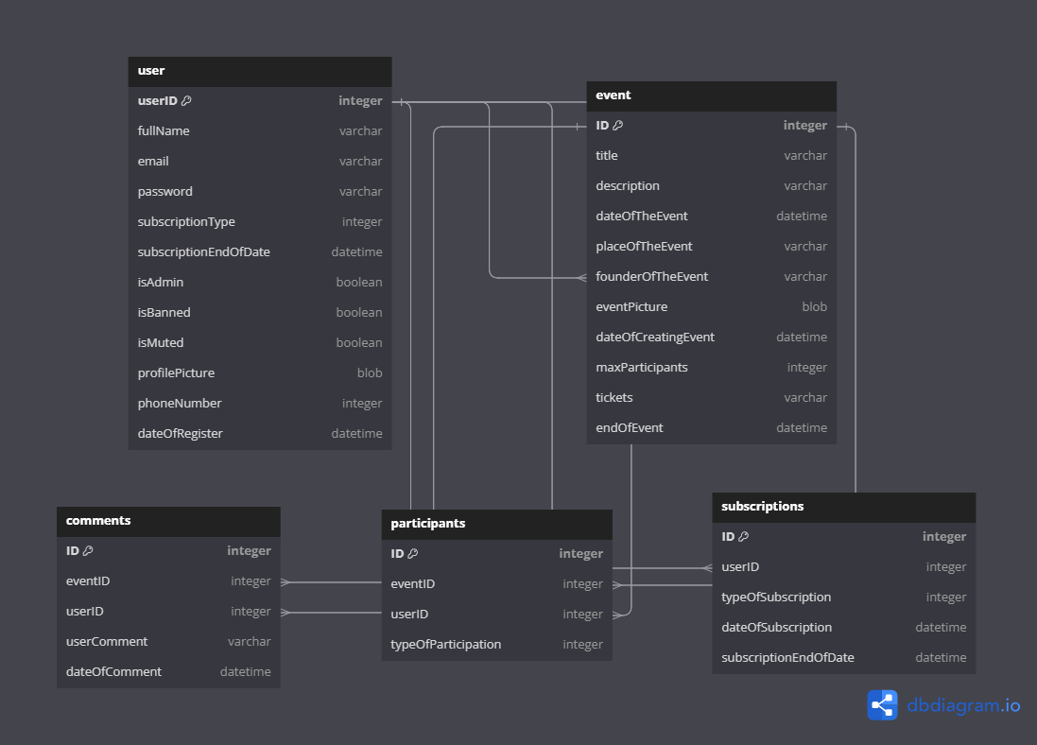
Database model

Slide 5
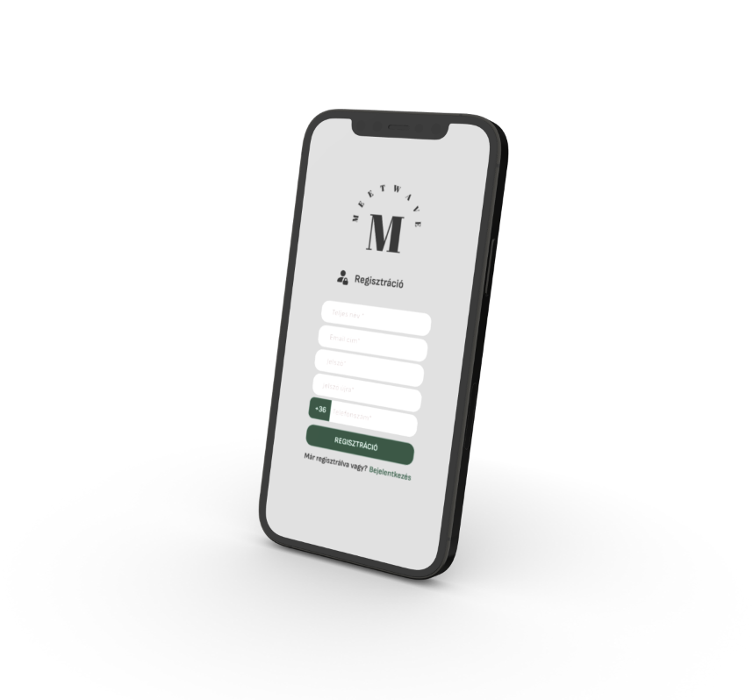
About the website

Slide 6


