Slide 1




VABO: Violation-Aware Bayesian Optimization for Closed-Loop Control Performance Optimization with Unmodeled Constraints
Wenjie Xu^{1,2}, Colin N. Jones¹
Bratislav Svetozarevic²
1
2
Christopher R. Laughman³, Ankush Chakrabarty³
3
Notes:
Hello, I’m Wenjie. Today I’m going to talk about VABO: violation-aware Bayesian optimization for closed-loop control performance optimization with unmodeled constraints.

Slide 2
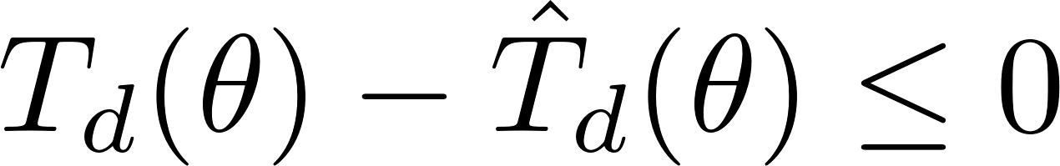
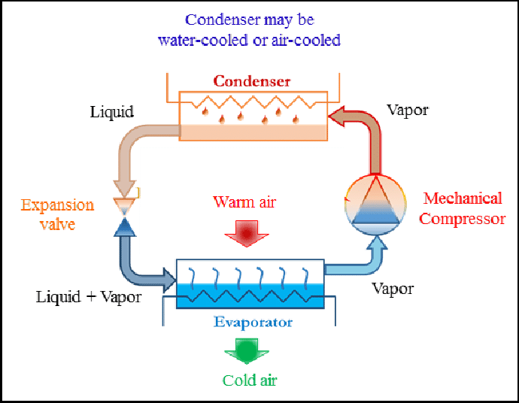


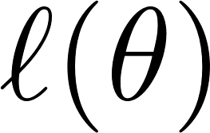
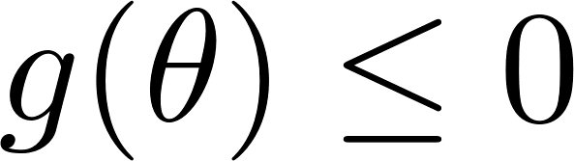
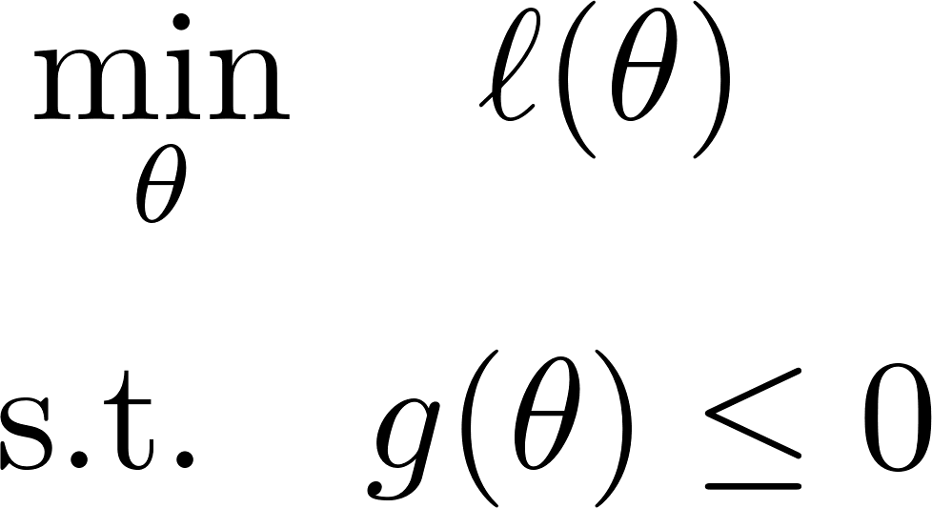
Closed-Loop Performance Optimization in HVAC System
Steady state power
+
Physical constraints
set points
Simulator with 10,000+ equations
~ 10 minutes for each evaluation
Observation: Small short-term violation is tolerable.
Idea: Trading tolerable violation for faster convergence to better solution.
Can we take humans out of the loop?
Challenges:
Black-box modelling
Constraint management
Sample efficiency
VCS Figure Source: https://www.researchgate.net/figure/Schematic-diagram-of-a-typical-vapor-compression-refrigeration-cycle-17_fig1_326272160
Notes:
So what is closed-loop performance optimization.
Let me give an example of vapor compression system.

Slide 3
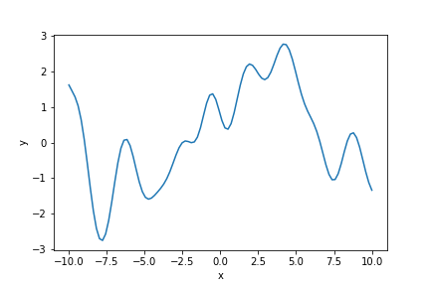
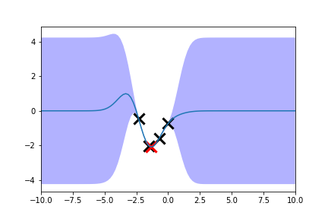
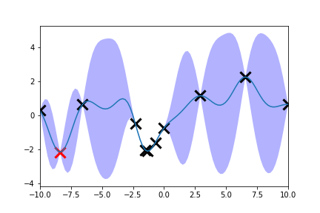
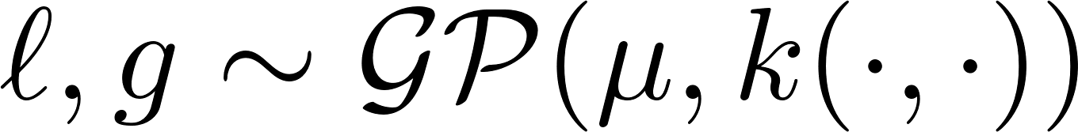
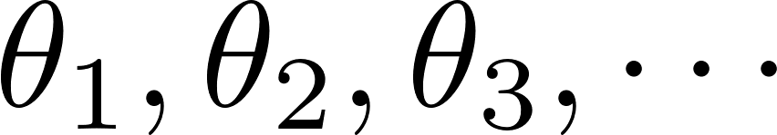
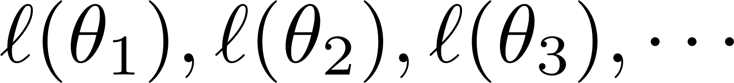
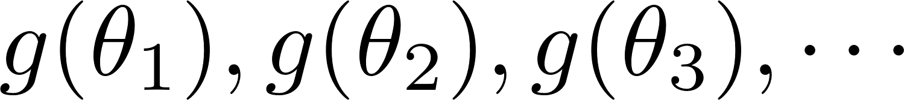
Violation-Aware Bayesian Optimization

Slide 4
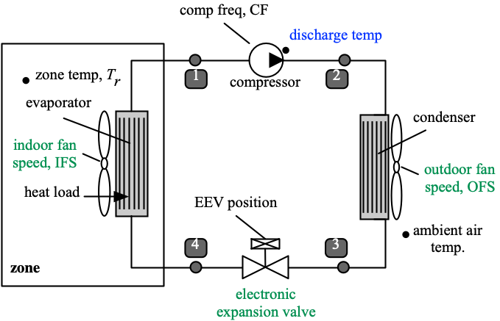
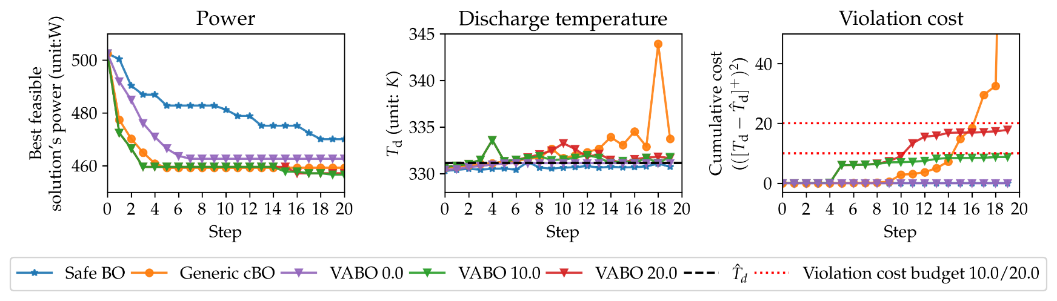
Performance Comparison on Vapor Compression System
Vapor compression system (VCS)
Internal variables to be assigned:
expansion valve position
indoor fan speed
outdoor fan speed
VABO
Power (objective)
Discharge Temperature (constrained variable)
9%

