Slide 1
Symmetric and Asymmetric Key Algorithms
Dr. Bhawana Rudra
NITK

Slide 2
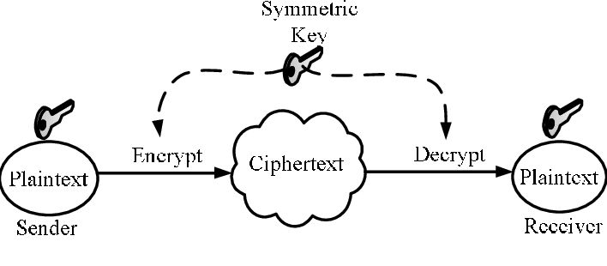
Symmetric Key Encryption

Slide 3
Traditional private/secret/single key cryptography uses one key
Key is shared by both sender and receiver
if the key is disclosed communications are compromised
also known as symmetric, both parties are equal
  hence does not protect sender from receiver forging a message & claiming is sent by sender

Slide 4
AES | DES
AES stands for Advanced Encryption Standard | DES stands for Data Encryption Standard
Date of creation is 1999. | Date of creation is 1976.
Key length can be of 128-bits, 192-bits and 256-bits. | Key length is 56 bits in DES.
Number of rounds depends on key length : 10(128-bits), 12(192-bits) or 14(256-bits) | DES involves 16 rounds of identical operations
The structure is based on substitution-permutation network. | The structure is based in feistal network.
The design rational for AES is open. | The design rational for AES is closed.
The selection process for this is secret but accepted open public comment. | The selection process for this is secret.

Slide 5
AES is more secure than the DES cipher and is the de facto world standard. | DES can be broken easily as it has known vulnerabilities. 3DES(Triple DES) is a variation of DES which is secure than the usual DES.
The rounds in AES are : Byte Substitution, Shift Row, Mix Column and Key Addition | The rounds in DES are : Expansion, XOR operation with round key, Substitution and Permutation
AES can encrypt 128 bits of plaintext. | DES can encrypt 64 bits of plaintext.
AES cipher is derived from square cipher. | DES cipher is derived from Lucifer cipher.
AES was designed by Vincent Rijmen and Joan Daemen. | DES was designed by IBM.
No known crypt-analytical attacks against AES but side channel attacks against AES implementations possible. Biclique attack have better complexity than brute-force but still ineffective. | Known attacks against DES include : Brute-force, Linear crypt-analysis and Differential crypt-analysis.

Slide 6
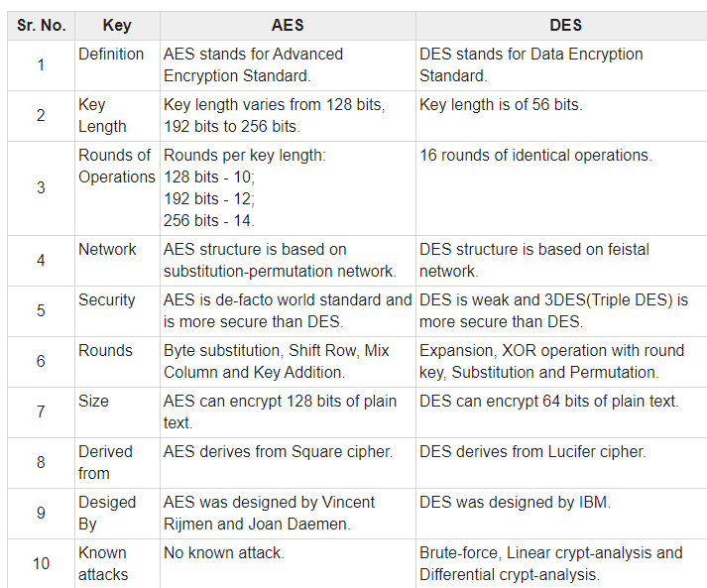

Slide 7
Asymmetric Encryption
Probably most significant advance in the 3000 year history of cryptography
uses two keys – a public key and a private key
asymmetric since parties are not equal
uses clever application of number theory concepts to function
complements rather than replaces private key cryptography

Slide 8
public-key/two-key/asymmetric cryptography involves the use of two keys:
  a public-key, which may be known by anybody, and can be used to encrypt messages, and verify signatures
  a private-key, known only to the recipient, used to decrypt messages, and sign (create) signatures
is asymmetric because
  those who encrypt messages or verify signatures cannot decrypt messages or create signatures

Slide 9
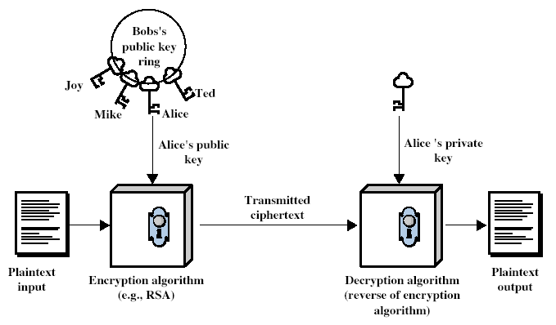

Slide 10
developed to address two key issues:
  key distribution – how to have secure communications in general without having to trust a KDC with your key
  digital signatures – how to verify a message comes intact from the claimed sender
public invention due to Whitfield Diffie & Martin Hellman at Stanford U. in 1976
  known earlier in classified community

Slide 11
Public-Key algorithms rely on two keys with the characteristics that it is:
  computationally infeasible to find decryption key knowing only algorithm & encryption key
  computationally easy to en/decrypt messages when the relevant (en/decrypt) key is known
  either of the two related keys can be used for encryption, with the other used for decryption (in some schemes)

Slide 12
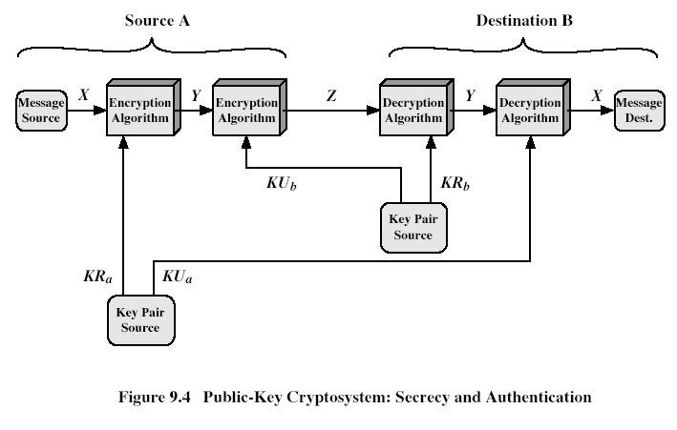

Slide 13
can classify uses into 3 categories:
  encryption/decryption (provide secrecy)
  digital signatures (provide authentication)
  key exchange (of session keys)
some algorithms are suitable for all uses, others are specific to one

Slide 14
like private key schemes brute force exhaustive search attack is always theoretically possible
but keys used are too large (>512bits)
security relies on a large enough difference in difficulty between easy (en/decrypt) and hard (cryptanalyse) problems
more generally the hard problem is known, its just made too hard to do in practise
requires the use of very large numbers
hence is slow compared to private key schemes

Slide 15
RSA
by Rivest, Shamir & Adleman of MIT in 1977
best known & widely used public-key scheme
based on exponentiation in a finite (Galois) field over integers modulo a prime
  nb. exponentiation takes O((log n)³) operations (easy)
uses large integers (eg. 1024 bits)
security due to cost of factoring large numbers
  nb. factorization takes O(e ^{log n log log n}) operations (hard)

Slide 16
each user generates a public/private key pair by:
selecting two large primes at random - p, q
computing their system modulus N=p.q
  note ø(N)=(p-1)(q-1)
selecting at random the encryption key e
    where 1<e<ø(N), gcd(e,ø(N))=1
solve following equation to find decryption key d
  e.d=1 mod ø(N) and 0≤d≤N
publish their public encryption key: KU={e,N}
keep secret private decryption key: KR={d,p,q}

Slide 17
to encrypt a message M the sender:
  obtains public key of recipient KU={e,N}
  computes: C=Me mod N, where 0≤M<N
to decrypt the ciphertext C the owner:
  uses their private key KR={d,p,q}
  computes: M=C^{d} mod N
note that the message M must be smaller than the modulus N (block if needed)

Slide 18
because of Euler's Theorem:
a^{ø(n)}mod N = 1
  where gcd(a,N)=1
in RSA have:
  N=p.q
  ø(N)=(p-1)(q-1)
  carefully chosen e & d to be inverses mod ø(N)
  hence e.d=1+k.ø(N) for some k
hence :
C^{d} = (Me)^{d} = M^{1+k.ø(N)} = M¹.(M^{ø(N)})^{q} = M¹.(1)^{q} = M¹ = M mod N

Slide 19
Select primes: p=17 & q=11
Compute n = pq =17×11=187
Compute ø(n)=(p–1)(q-1)=16×10=160
Select e : gcd(e,160)=1; choose e=7
Determine d: de=1 mod 160 and d < 160 Value is d=23 since 23×7=161= 10×160+1
Publish public key KU={7,187}
Keep secret private key KR={23,17,11}

Slide 20
sample RSA encryption/decryption is:
given message M = 88 (nb. 88<187)
encryption:
  C = 88⁷ mod 187 = 11
decryption:
  M = 11²³ mod 187 = 88

Slide 21
can use the Square and Multiply Algorithm
a fast, efficient algorithm for exponentiation
concept is based on repeatedly squaring base
and multiplying in the ones that are needed to compute the result
look at binary representation of exponent
only takes O(log₂ n) multiples for number n
  eg. 7⁵ = 7⁴.7¹ = 3.7 = 10 mod 11
  eg. 3¹²⁹ = 3¹²⁸.3¹ = 5.3 = 4 mod 11

Slide 22
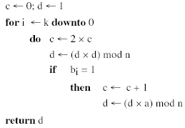

Slide 23
users of RSA must:
  determine two primes at random - p, q
  select either e or d and compute the other
primes p,q must not be easily derived from modulus N=p.q
  means must be sufficiently large
  typically guess and use probabilistic test
exponents e, d are inverses, so use Inverse algorithm to compute the other

Slide 24
RSA Security
three approaches to attacking RSA:
  brute force key search (infeasible given size of numbers)
  mathematical attacks (based on difficulty of computing ø(N), by factoring modulus N)
  timing attacks (on running of decryption)

Slide 25
Factoring problem
mathematical approach takes 3 forms:
  factor N=p.q, hence find ø(N) and then d
  determine ø(N) directly and find d
  find d directly
currently believe all equivalent to factoring
  have seen slow improvements over the years
    as of Aug-99 best is 130 decimal digits (512) bit with GNFS
  biggest improvement comes from improved algorithm
    cf “Quadratic Sieve” to “Generalized Number Field Sieve”
  barring dramatic breakthrough 1024+ bit RSA secure
    ensure p, q of similar size and matching other constraints

Slide 26
Timing Attacks
developed in mid-1990’s
exploit timing variations in operations
  eg. multiplying by small vs large number
  or IF's varying which instructions executed
infer operand size based on time taken
RSA exploits time taken in exponentiation
countermeasures
  use constant exponentiation time
  add random delays
  blind values used in calculations

