Slide 2
What is Incident Response
Incident response is a coordinated and structured approach to go from incident detection to resolution.
Incident response may include activities that:
Confirm whether or not an incident occurred
Provide rapid detection and containment
Determine and document the scope of the incident
Prevent a disjointed, nonc ohesive response
Determine and promote facts and actual information
Minimize disruption to business and network operations
Minimize the damage to the compromised organization
Restore normal operations
Manage the public perception of the incident
Allow for criminal or civil actions against perpetrators
Educate senior management
Enhance the security posture of a compromised entity against future incidents

Slide 3
WHAT ARE THE GOALS OF INCIDENT RESPONSE
The primary goal of incident response is to effectively remove a threat from the organization’s computing environment, while minimizing damages and restoring normal operations as quickly as possible.
This goal is accomplished through two main activities:
Investigate
Determine the initial attack vector
Determine malware and tools used
Determine what systems were affected, and how
Determine what the attacker accomplished (damage assessment)
Determine if the incident is ongoing
Establish the time frame of the incident
Remediate
Using the information obtained from the investigation, develop and implement a remediation plan

Slide 4
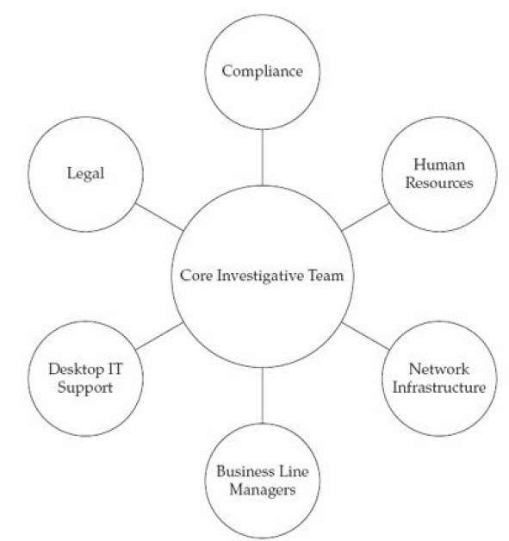
Who are involved in this

