Slide 1
International Summer School on “Smart Objects Applications”
Human – Smart Objects Interaction
Silvia Mirri
Department of Computer Science and Engineering
University of Bologna

Slide 2
Human-Computer Interaction: Concepts and Definitions

Slide 3
Questions
What is a «user interface»?
What does «interaction» means?

Slide 4
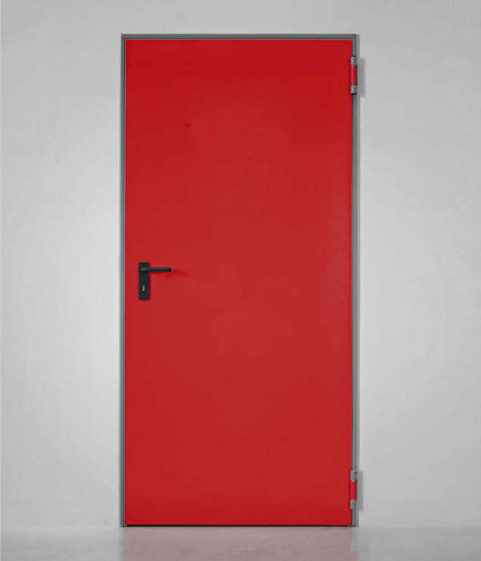
About doors …

Slide 5
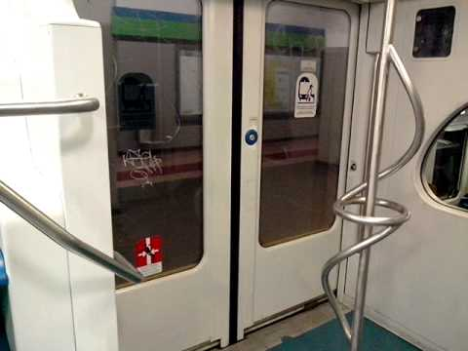
About doors …
5

Slide 6
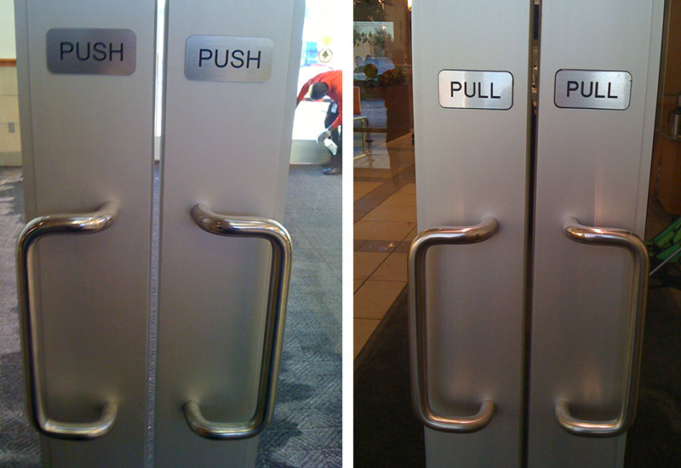
About doors …
6

Slide 7
About doors …
7

Slide 8
About doors …
8

Slide 9
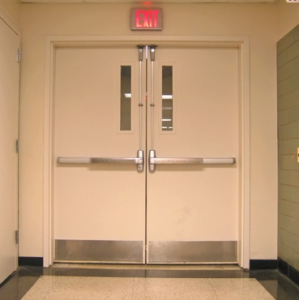
About doors …
9

Slide 10
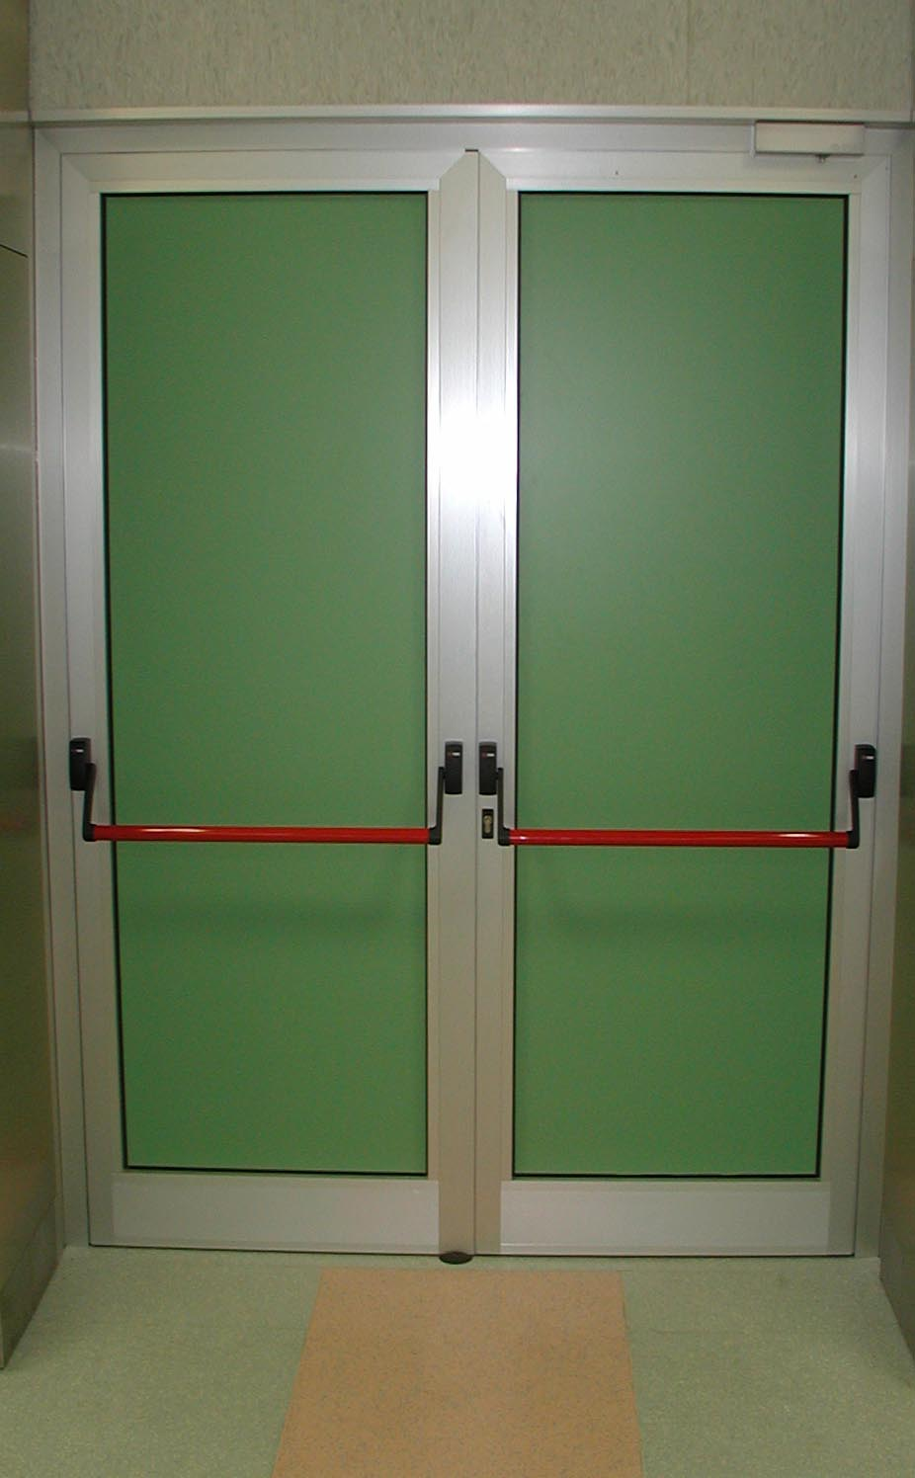
About doors …
10

Slide 11
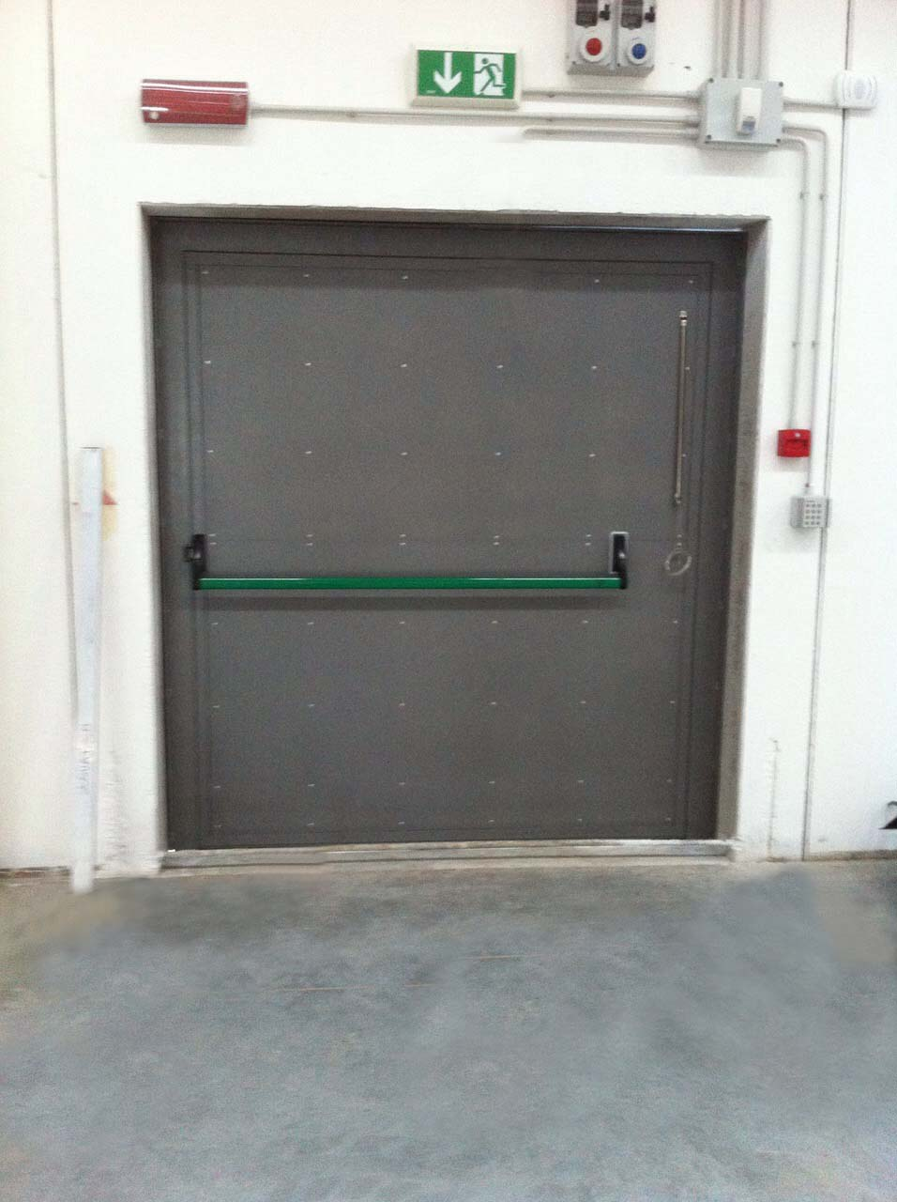
About doors …
11

Slide 12
Bad doors and Norman’s doors
It's not you. Bad doors are everywhere:
https://www.youtube.com/watch?v=yY96hTb8WgI
12

Slide 13
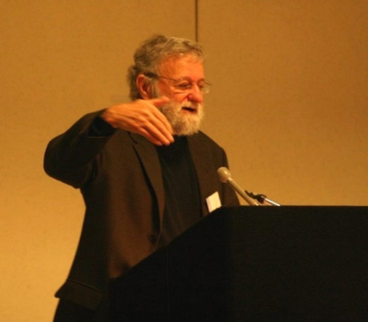
Donald Norman?
Bachelor degree in Engineering at the MIT
Master degree and PhD at the Pennsylvania University
He is best known for his books on design, especially The Design of Everyday Things. He is widely regarded for his expertise in the fields of design, usability engineering, and cognitive science.
He is also a co-founder and consultant with the Nielsen Norman Group.
Much of his work involves the advocacy of user-centered design.
Di jordanfischer - http://flickr.com/photos/jordanfischer/61429449/, CC BY 2.0, https://commons.wikimedia.org/w/index.php?curid=2618273
13

Slide 14
Donald Norman?
His books all have the underlying purpose of furthering the field of design, from doors to computers.
Norman has taken a controversial stance in saying that the design research community has had little impact in the innovation of products, and that while academics can help in refining existing products, it is technologists that accomplish the breakthroughs.
Di jordanfischer - http://flickr.com/photos/jordanfischer/61429449/, CC BY 2.0, https://commons.wikimedia.org/w/index.php?curid=2618273
14

Slide 15
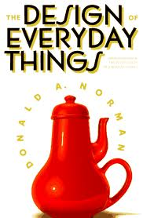
The Design of Everyday Things
Have you ever tried to open a door by pushing it instead of pulling it?
Have you ever gave up washing your hands because it was impossible (or at least no easy at all) to understand how to make the tap work properly?
How did you feel?
be aware that it is not your fault (or user’s fault), it is a fault of the object interface.
This is true for any object, with any interface and requiring any interaction: from a door to a tap, from a remote control to a mobile phone, from a car to a computer.
La Caffettiera del Masochista
By Source, Fair use, https://en.wikipedia.org/w/index.php?curid=34029875
15

Slide 16
HCI
HCI → Human Computer Interaction
Two realms (or system):
Humans
Machine
16

Slide 17
European acts
90/270/EEC
https://osha.europa.eu/en/legislation/directives/5
Software should be:
adequate
Easy to be used
Adaptable
It should give feedbacks about its functionalities
Compliant with ergonimics principles
17

Slide 18
Definitions
Human performance: 50’, 60’. Machine interface, instead of Computer or application interface.
https://en.wikipedia.org/wiki/Human_performance_technology
www.businessdictionary.com: accomplishment of a task in accordance with agreed upon standards of accuracy, completeness, and efficiency.
The accent is on the idea that I have to exploit the «human» part. It refers to Performance Improvement.
It could have a more positive tone if referred to learning activities, education, sports activities, etc.
18

Slide 19
Definitions
Ergonomics: study of designing equipment and devices that fit the human body and its cognitive abilities https://en.wikipedia.org/wiki/Human_factors_and_ergonomics
Confort design and functional design.
Practice of taking into proper account the interaction between systems and people.
19

Slide 20
Human Factors
Proper ergonomic design is necessary to prevent repetitive strain injuries and other musculoskeletal disorders, which can develop over time and can lead to long-term disability.
Human factors and ergonomics is concerned with the "fit" between the user, equipment and their environments. It takes account of the user's capabilities and limitations in seeking to ensure that tasks, functions, information and the environment suit each user
https://en.wikipedia.org/wiki/Human_factors_and_ergonomics
20

Slide 21
Human Factors
Scientific principles and facts about human bio-medial and psychological characterizes, with application in areas of human engineering, performance evaluation, selection and training, life-support systems, etc.
www.businessdictionary.com
21

Slide 22
Interface and Interaction
Interface:
A point of interaction, a tool for interaction
The area where you touch or connect, where you interact
An exchange point
Interaction:
Communication (verbal or not verbal, standard or not standard)
An activity starting from the user side and aimed at a purpose
22

Slide 23
Definitions
Man-machine interaction
During ‘70, ergonimics was intended from two different points of view: one was based on studies about design applied to everyday life (e.g. chairs), the other one was based on usability of work tools and objects (e.g. machines, computers, etc.). This latter one was then called Man (or Human)-Machine Interaction
Human-computer interaction
During ‘80, computers were getting more and more important and commonly used in work and daily activities, hence human-computer interaction identified a specific field of studies, related to software & hardware design
23

Slide 24
Definitions
User interface
It is related to the aspects and the characteristics of the applications used by the users. From this the term «user friendliness» is derived
Interaction Design (IXD)
It is related to a multidisciplinary approach applied to the design of each interaction among humans and computer/digital systems
User Experience (UX)
It is related to users’ satisfaction
It derives from the marketing field
24

Slide 25
User Experience (UX)
ISO 9241-210
According to ISO 9241-210, User Experience, or UX, is “a person's perceptions and responses that result from the use or anticipated use of a product, system or service”. ... User experience highlights the experiential, affective, meaningful and valuable aspects of human-computer interaction and product
25

Slide 26
User Experience (UX)
Donald Norman & Jakob Nielsen
"User experience" encompasses all aspects of the end-user's interaction with the company, its services, and its products
The first requirement for an exemplary user experience is to meet the exact needs of the customer, without fuss or bother. Next comes simplicity and elegance that produce products that are a joy to own, a joy to use. True user experience goes far beyond giving customers what they say they want, or providing checklist features. In order to achieve high-quality user experience in a company's offerings there must be a seamless merging of the services of multiple disciplines, including engineering, marketing, graphical and industrial design, and interface design
It's important to distinguish the total user experience from the user interface (UI), even though the UI is an important part of the design
Example: consider a website with movie reviews. Even if the UI for finding a film is perfect, the UX will be poor for a user who wants information about a small independent release if the underlying database only contains movies from the major studios
https://www.nngroup.com/articles/definition-user-experience/
26

Slide 27
User Experience (UX)
Hassenzahl & Tractinsky (User experience - a research agenda)
UX is about technology that fulfils more than just instrumental needs in a way that acknowledges its use as a subjective, situated, complex and dynamic encounter.
UX is a consequence of:
a user’s internal state (predispositions, expectations, needs, motivation, mood, etc.),
the characteristics of the designed system (e.g. complexity, purpose, usability, functionality, etc.)
and the context (or the environment) within which the interaction occurs (e.g. organisational/social setting, meaningfulness of the activity, voluntariness of use, etc.).
This creates innumerable design and experience opportunities.
27

Slide 28

Who is Jacob Nielsen?
He is a Danish web usability consultant
He holds a Ph.D. in human–computer interaction from the Technical University of Denmark in Copenhagen
Nielsen has also defined the five quality components of his "Usability Goals", which are:
Learnability
Efficiency
Memorability
Errors (as in low error rate)
Satisfaction
Di docsearls - Flickr, CC BY-SA 2.0, https://commons.wikimedia.org/w/index.php?curid=1328081
28

Slide 29
Usability
Wikipedia
the ease of use and learnability of a human-made object such as a tool or device.
In software engineering, usability is the degree to which a software can be used by specified consumers to achieve quantified objectives with effectiveness, efficiency, and satisfaction in a quantified context of use.
https://en.wikipedia.org/wiki/Usability
29

Slide 30
Usability
Usability.net
Usability means making products and systems easier to use, and matching them more closely to user needs and requirements
http://www.usabilitynet.org/management/b_what.htm
ISO 9241-11
The extent to which a product can be used by specified users to achieve specified goals with effectiveness, efficiency and satisfaction in a specified context of use.
https://www.iso.org/obp/ui/#iso:std:iso:9241:-11:ed-1:v1:en
30

Slide 31
ISO vs Nielsen
ISO 9241-11
Effectiveness - can users complete tasks, achieve goals with the product, i.e. do what they want to do?
Efficiency - how much effort do users require to do this? (Often measured in time)
Satisfaction – what do users think about the products ease of use?
31

Slide 32
ISO vs Nielsen
Nielsen
Learnability: How easy is it for users to accomplish basic tasks the first time they encounter the design?
Efficiency: Once users have learned the design, how quickly can they perform tasks?
Memorability: When users return to the design after a period of not using it, how easily can they re-establish proficiency?
Errors: How many errors do users make, how severe are these errors, and how easily can they recover from the errors?
Satisfaction: How pleasant is it to use the design?
32

Slide 33
User-Centered Design (UCD)
A framework of processes in which the needs, wants, and limitations of end users of a product, service or process are given extensive attention at each stage of the design process
It can be characterized as a multi-stage problem solving process that it requires designers to:
analyze and foresee how users are likely to use a product
test the validity of their assumptions with regard to user behavior in real world tests with actual users at each stage of the process from requirements, concepts, pre-production models, mid production and post production creating an iterative process.
Tests are necessary because it is very difficult for the designers of a product to understand intuitively what a first-time user of their design experiences, and what each user's learning curve may look like
33

Slide 34
User-Centered Design (UCD)
In particular, it has to take into account the following users’ characteristics:
Skills and expertise
Abilities
Level of attention
Motivations
This design methodology is mainly based on the involvement of users in a very active way and on the understating of users’ requirements and preferences and of tasks
34

Slide 35
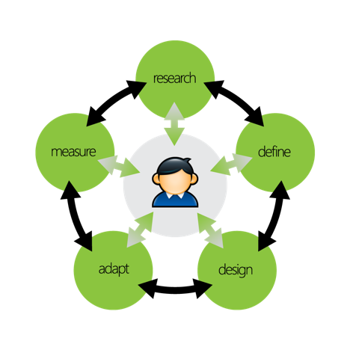
UCD: an iterative process
Tasks and users analysis
Design
Evaluation
Test
Iteration
Iteration is essensial …
Mash Mallow Challenge: http://www.ted.com/talks/tom_wujec_build_a_tower?language
35

Slide 36
Interface Development principles
Some main principles in User Interface Development
KISS and «Less is more»
Responsive Design
Mobile First
Use of graphical elements (including colors) according to standards and behaviours
36

Slide 37
KISS
KISS stands for Keep It Simple Stupid
It is a design principle noted by the U.S. Navy in 1960
The KISS principle states that most systems work best if they are kept simple rather than made complicated
Simplicity should be a key goal in design and unnecessary complexity should be avoided
The phrase has been associated with a aircraft engineer
Variations on the phrase include
"Keep it Simple, Silly"
"keep it short and simple”
"keep it simple and straightforward”
"keep it small and simple"
37

Slide 38
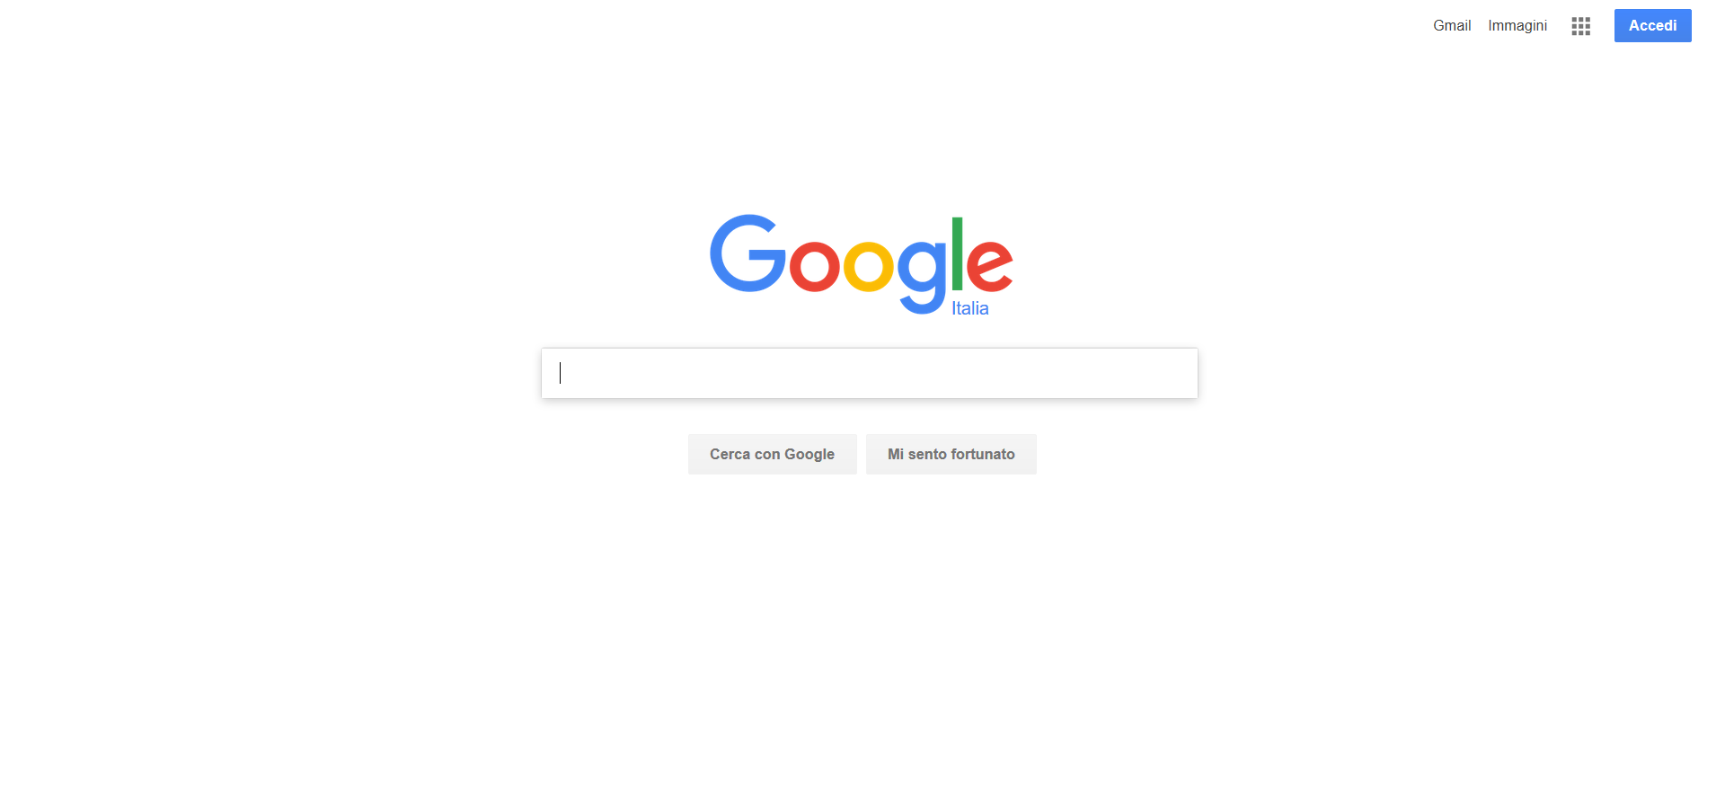
Less is More
It is strongly related to the «KISS» principle
It has been defined by Jakob Nielsen, inspired by the same motto in Minimalism
It based on the idea that in order to obtain an effective interface it is necessary to delete all the elements which are not necessary to the user interaction
Example: Google home page
38

Slide 39
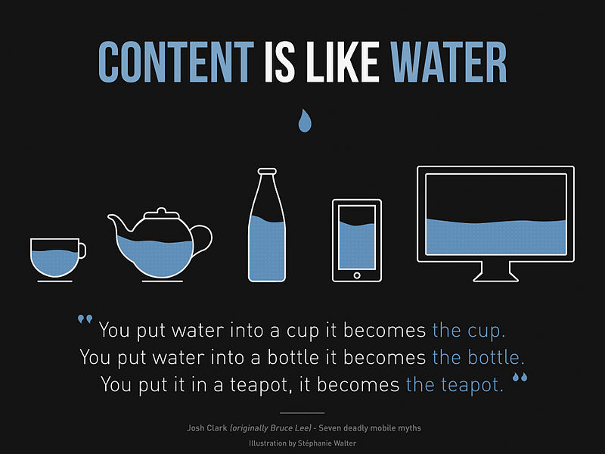
Responsive Design
Responsive design (also known as Responsive Web Design, RWD) is an approach to web design aimed at allowing desktop webpages to be viewed in response to the size of the screen or web browser one is viewing with
39

Slide 40
Responsive Design
A site designed with RWD adapts the layout to the viewing environment by using fluid, proportion-based grids, flexible images, media queries:
The fluid grid concept calls for page element sizing to be in relative units like percentages, rather than absolute units like pixels or points
Flexible images are also sized in relative units, so as to prevent them from displaying outside their containing element
Media queries allow the page to use different CSS style rules based on characteristics of the device the site is being displayed on, most commonly the width of the browser
40

Slide 41
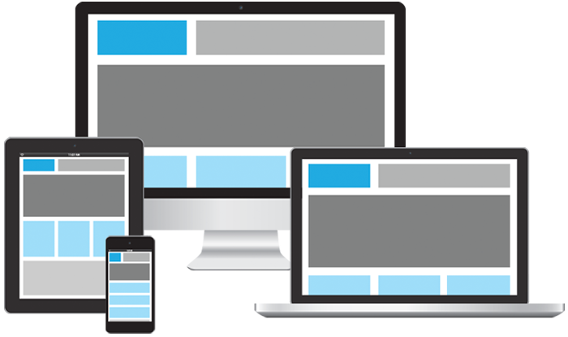
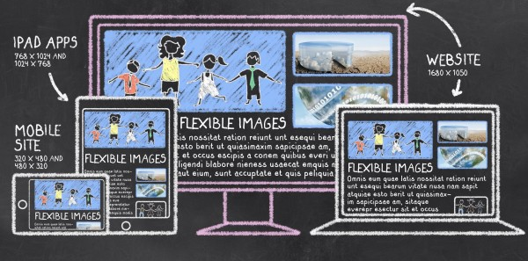
Responsive Design
Responsive Design goal: improving users’ experience
41

Slide 42
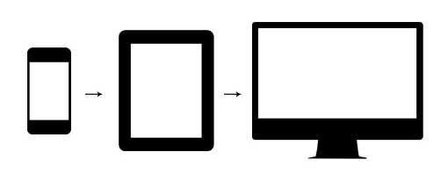
Mobile First
It is related to the «Responsive Design» principle and to the “Progressive Enhancement” concept:
designing the user interface for those devices with limited characteristics (in terms of display dimensions, input mechanisms, computing capabilities, connectivity), such as mobile devices, smart phones
It would be simpler designing user interface for other devices (with not so limited characteristics)
It has become a common and well-known principle with the diffusion of Web Apps and native applications for mobile devices
42

Slide 43
Progressive enhancement
It is a strategy for web design that emphasizes core webpage content first
This strategy then progressively adds more nuanced and technically rigorous layers of presentation and features on top of the content as the end-user's browser/internet connection allow
The proposed benefits of this strategy are that it allows everyone to access the basic content and functionality of a web page, using any browser or Internet connection, while also providing an enhanced version of the page to those with more advanced browser software or greater bandwidth
43

Slide 44
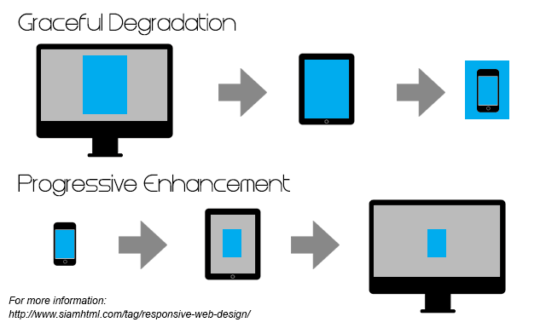
Progressive enhancement
Progressive enhancement vs graceful degradation
44

Slide 45







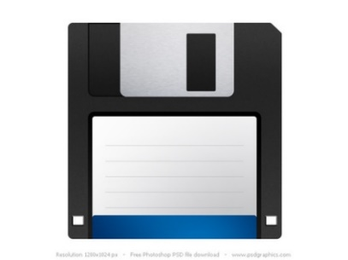



Use of graphical and interaction elements
Use of graphical elements (including colors) according to standards and common behaviours
Which are the meanings of the following icons?
45

Slide 46




Use of graphical and interaction elements
Which are the common meanings usually «assigned» to the following colors?
46

Slide 47
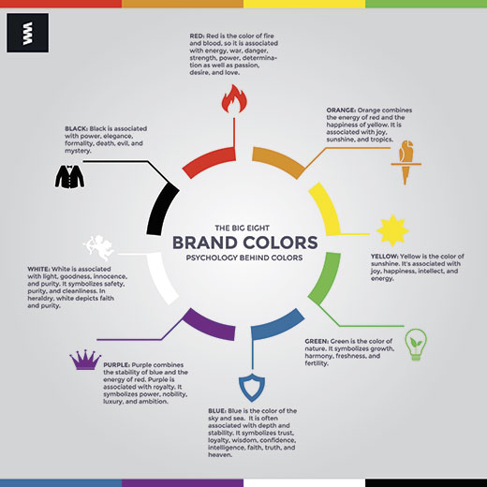
Color Meanings
47

Slide 48
Material Design
It is a Google project that aims to create a visual language for our users that synthesizes the classic principles of good design with the innovation and possibility of technology and science
https://material.io/ This specification is a living document that will be updated as Google continues to develop the tenets and specifics of material design
48

Slide 49
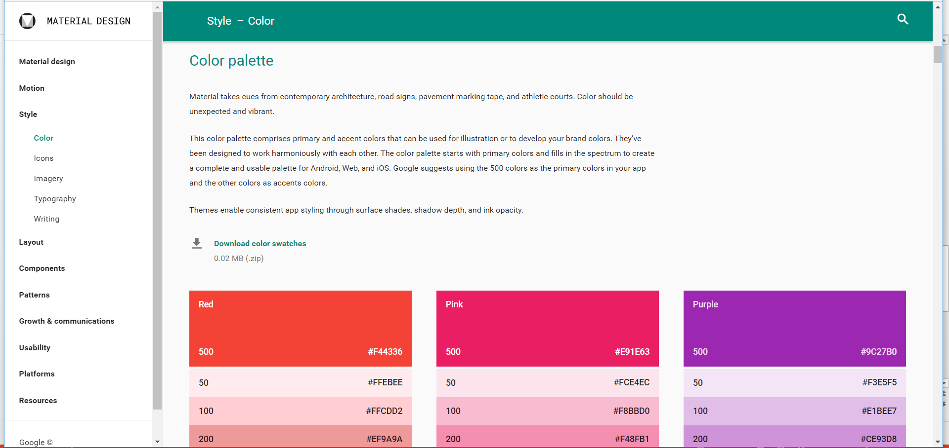
Material Design: colors
49

Slide 50





Use of graphical and interaction elements
Which are the common meanings/use of the following interaction elements?
50

Slide 51
Ergonomics of human-system interaction
UNI ISO 9241-201
Part 210: Human-centered design for interactive systems
Fitting Industry 4.0 and IoT-based scenarios
Requirements and recommendations for human-centered design principles and activities throughout the life cycle of computer-based interactive systems
It addresses technical human factors and ergonomics issues to the extent necessary to allow such individuals to understand their relevance and importance in the design process as a whole
It provides a framework for human factors and usability professionals involved in human-centered design
51

Slide 52
Ergonomics of human-system interaction
Rationale for adopting human-centered design
substantial economic and social benefits for users, employers and suppliers
Highly usable systems and products tend to be more successful both technically and commercially
Support and help-desk costs are reduced when users can understand and use products without additional assistance
Increasing the productivity of users and the operational efficiency of organizations
Reducing training and support costs, being easier to understand and use
52

Slide 53
Ergonomics of human-system interaction
Examples of outputs from human-centered design activities
Activities | Outputs from human-centered design
Understand and specify the context of use | Context of use description
Specify the user requirements | Context of use specification User needs description User requirements specification
Produce design solutions to meet these requirements | User interaction specification User interface specification Implemented user interface
Evaluate the design against requirements | Evaluation results Conformance test results Long-term monitoring results
53

Slide 54
Ergonomics of human-system interaction
Principles of human-centered design
The design is based upon an explicit understanding of users, tasks and environments
Users are involved throughout design and development
The design is driven and refined by user-centered evaluation
The process is iterative
The design addresses the whole user experience
The design team includes multidisciplinary skills and perspectives
54

Slide 55
Ergonomics of human-system interaction
a. The design is based upon an explicit understanding of users, tasks and environments
Taking into account: people who will use the system/service/product, stakeholder groups, people who might be affected by its use
Users and stakeholder groups should be identified
Users can have specified goals, perform specified tasks in a specified environment (context of use)
55

Slide 56
Ergonomics of human-system interaction
b. Users are involved throughout design and development
People involved in the design and development phases should have capabilities, characteristics and experience that reflect the range of users for whom the system is being design
The nature and frequency of this involvement can vary throughout design and development, depending on the type of project
The effectiveness of user involvement increases as the interaction between the developers and the users increases
56

Slide 57
Ergonomics of human-system interaction
c. The design is driven and refined by user-centered evaluation
Feedback from users is a critical source of information in human-centered design
Evaluations with users provides an effective means of minimizing the risk of a system not meeting user or organizational needs
Preliminary design solutions can be tested against «real world» scenarios
Feedback from users during operational use identifies long-term issues and provides input to future design
57

Slide 58
Ergonomics of human-system interaction
d. The process is iterative
The most appropriate design for an interactive system cannot typically be achieved without iteraction
Iteraction should be used to progressively eliminate uncertainty during the development of interactive systems
It implies revising and refining descriptions, specifications and prototypes when new information is obtained, so as to minimize the risk of the system under development failing to meet user requirements
The complexity of human-computer interaction means that it is impossible to specify completely and accurately every detail of every aspect of the interaction at the beginning of development
Users needs and expectation can emerge during the development
58

Slide 59
Ergonomics of human-system interaction
e. The design addresses the whole users experience
Designing for user’s experience involves considering organizational impacts, documentation, online help, support and maintenance, training, long-term use, product packaging, etc.
The user’s experience of previous or other systems and issues such as branding and advertising should also be considered
Users’ strenghts, limitations, preferences and expectations should be taken into account when specifying which activities are carried out by the users and which functions are carried out by the technology
The resulting human activities should form a set of tasks that is meaningful as a whole to the users
59

Slide 60
Ergonomics of human-system interaction
f. The design team includes multidisciplinary skills and perspectives
Human-centered design teams should not be large, but the team should be sufficiently diverse to collaborate over design and implementation trade-off decisions at appropriate times
Projects benefit from additional creativity and ideas from the interaction and collaboration of team members
60

Slide 61
Ergonomics of human-system interaction
Planning of human-centered design
Identifying appropriate methods and resources for the human-centered design activities
Defining procedure for integrating these activities and their outputs with other system development activities
Identifying the individuals and the organizations responsible for the human-centered design activities and the range of skills and viewpoints they provide
Developing effective procedures for establishing feedback and communication on human-centered design activies as they affect other design activies and «trade-offs», and methods for documenting outputs from these activities
Agreeing on appropriate milestones for human-centered activities that are integrated into the overall design and development process
Agreeing on suitable timescales to allow iteration, use of feedback and possible design changes to be incorporated into the project schedule
61

Slide 62
Ergonomics of human-system interaction
Integration with project plan
Human-centered design activities should be a part integrated in the overall project plan
The plan for human-centered design should be subject to the same project disciplines (responsabilities, change control, etc.)
The human-centered design aspects of the project plan should be reviewed and revised as requirements change throughout the life of the project
62

Slide 63
Ergonomics of human-system interaction
Timing and resources
Time and resouces should be allocated for human-centered (HC) activities, including
Incorporation of users feedback
Evaluating whether the design solution satisfies the user requirements
Communication among design team members
Reconciling potential conflicts and trade-offs that involve human-system issues
HC design activities should start at the earliest stage of the project (so as to formulate initial concept of the product or system)
HC design continues throughout the whole life of project
63

Slide 64
Ergonomics of human-system interaction
Human-centered design activities
Understanding and specifying the context of use
Specifying the user requirements
Producing design solutions
Evaluating the design
They can be applied to obtain feedback on initial design concepts before requirements are finalized
Evaluating rough prototypes and mock-ups of potential designs will help obtain a deeper understanding of user needs, as well as providing initial feedback on the design concepts
They can also be applied during revisions to an interactive system and can be useful in evaluting systems in routing operation
64

Slide 65
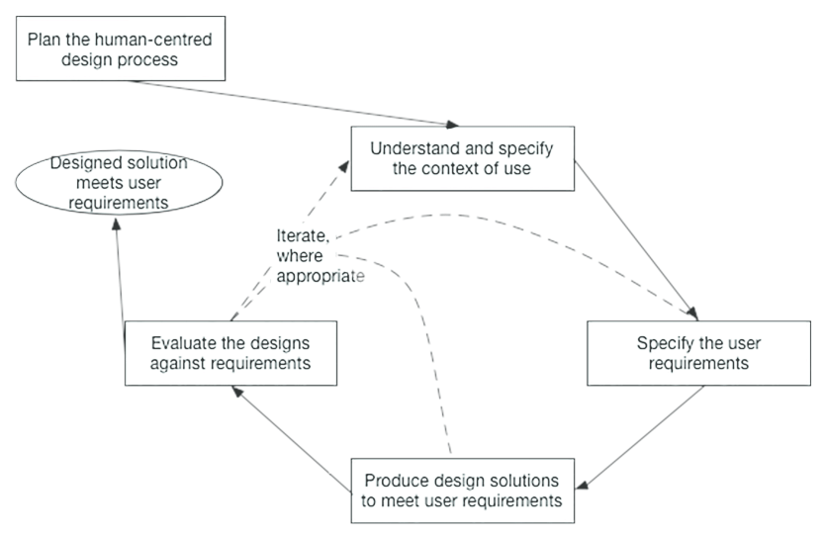
Ergonomics of human-system interaction
65

Slide 66
Ergonomics of human-system interaction
Human-centered design activities
Challenges and risks
Different user groups and stakeholders, their needs have to be taken into account
The context of use can be diverse and can vary from user group to user group and between different tasks
Requirements captured at the beginning of a project are unlikely to be exhaustive
Some requirements could emerge only once a proposed solution is available
User requirements can be diverse and potentially contradictory to each other and to those of other stakeholders
Initial design solutions rarely satisfy all the user needs
66

Slide 67
Ergonomics of human-system interaction
Understanding and specifying the context of use
Context of use description, including
Users and other stakeholder groups
Characteristics of the users of groups of users
Goals and tasks of the users
Environments of the system
67

Slide 68
Ergonomics of human-system interaction
Specifying the user requirements
Identifying user and other stakeholder needs
Deriving user requirements
Resolving trade-offs between user requirements
Ensuring the quality of user requirements specifications
68

Slide 69
Ergonomics of human-system interaction
Producing design solutions
Designing user tasks, user-system interaction and user interface to meet user requirements, taking into account the whole user experience
Making the design solutions more concrete (e.g. making use of scenarios, simulations, prototypes or mock-ups)
Altering the design solutions in response to user-centered evaluation and feedback
Communicating the design solutions to those responsible for their implementation
69

Slide 70
Ergonomics of human-system interaction
Advantages of evaluating the design:
Collect new information about user needs
Provide feedback on strenghts and weaknesses of the design solution from the user’s perspective (to improve the design)
Assess whether user requirements have been achieved (including assessing conformity to international, national, local, corporate or statutory standards)
Establish baselines or make comparisons between designs
70

Slide 71
Ergonomics of human-system interaction
Conformance to UNI ISO 9241-201 - Part 210: Human-centered design for interactive systems:
Satisfying all the requirements
Identifying applicable recommendations
Explaining why particular recommendations are not applicable
Stating whether or not the applicable recommendations have been followed
Verified by means of a checklist, which provides basis for
Determining which of the recommendations are applicable
Determining wheter requirements have been met and wether application recommendations have been followed
Providing a list in support of a claim of conformance showing that all the requirements have been met
71

Slide 72
HCI and IoT
Interaction through and with the «things» (instead of the «traditional» input/output devices) and with the «environment» (smart home, smart building)
Embedded interaction: ordinary objects are enhanced with input and output facilities so that they perform their original function as well as providing a way for data to be collected about the user behaviour.
Combining data from several objects and interaction with them over time can result in emergent knowledge available to the user or the context aware environment to make suggestions for lifestyle improvements.
72

Slide 73
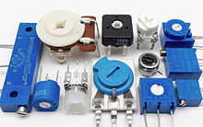
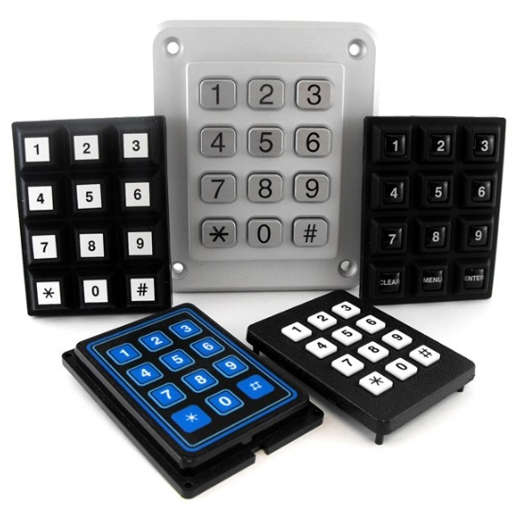
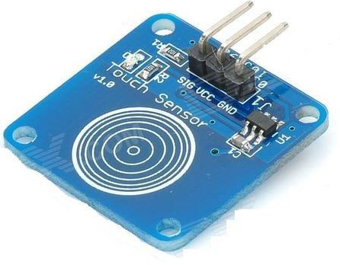
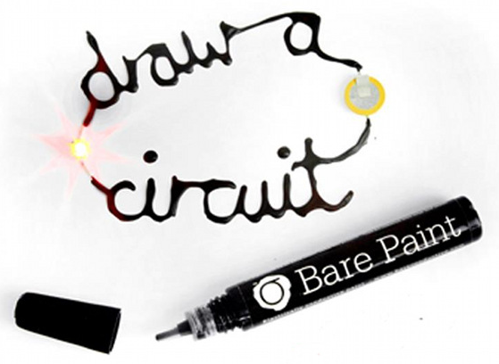
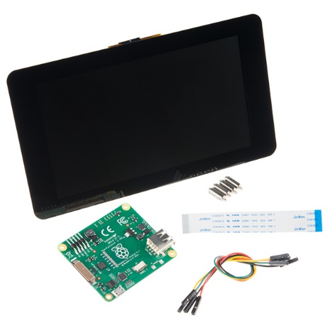
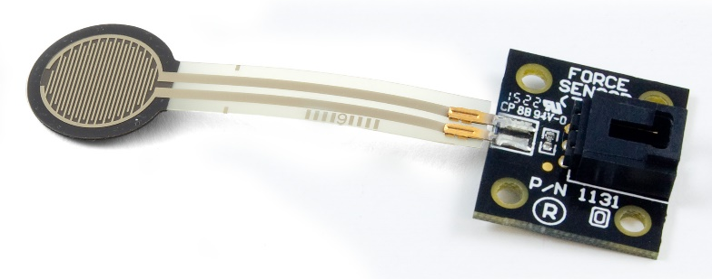
Touch devices
Keypads
Potentiometers
Touch sensors
Bare conductive pens
Force sensors
Joysticks
Touch screens
73

Slide 74
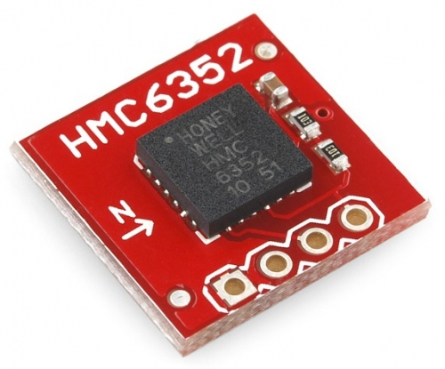
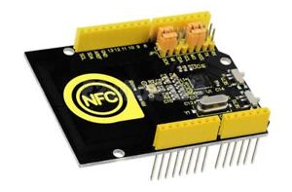
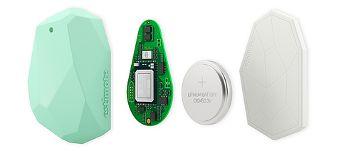
Touchless devices
Microphones
Compass
NFC/RFID controller shield
Passive IR Proximity sensors
BLE Devices (eBeacons)
74

Slide 75
HCI and IoT
Creating a link between the physical and digital worlds
Embedding interaction behaviours into existing objects
Providing meaning from large amounts of data gathered (through proper visualization and interaction with the data)
Users can be at the same time producers and consumers of data
All the senses can be involved, potentially
75

Slide 76
Properties of tangible interaction
Meaningful representations and controls of the single IoT object connectivity status and IoT object interconnections, as well as of information capture, elaboration and sharing
Rich interactions that exploit the natural human skills, in particular exploiting haptic and peripheral interactions with IoT objects that are situated in the physical world
Persistent physical representations that could last in case of power or connectivity outrage, allowing the user to control the state of an IoT object even when no Internet connection is available.
Spatial interactions that support collaborative setups with multiple IoT objects.
76

Slide 77
Properties of tangible interaction
Immediacy and intuitiveness of the interaction, facilitating the understanding and control of IoT objects with minimal learning time.
Interactions with IoT objects that are integrated in the daily routines, which free users’ cognitive resources and do not disrupt attention.
Facilitated reflections on IoT object meaning and working principles, as well as support for associating and sharing memories.
Long-lasting interactions with IoT objects exploiting emotional durable designs, to cope with electronic waste due to technological obsolescence.
77

Slide 78
Characteristics and Interaction with smart objects
Meaningful Representations and Controls
(Description) Meaningful representations and controls of the IoT object functions and parameters.
(Q1) Can the user understand the IoT object function from its form?
(Q2) Are the most important parameters of the IoT object accessible through physical props?
Rich interactions and human skills
(D) Rich interactions with IoT objects that are situated in the real world, exploiting the natural human skills and senses, such as haptics and hand manipulations.
(Q1) Can interactions be performed on the physical IoT object?
(Q2) Are users exploiting unconventional sensorimotor abilities, beyond those typically used on GUI interfaces?
78

Slide 79
Characteristics and Interaction with smart objects
Persistency
(D) Persistent physical representations that could last in case of power or connectivity outrage, allowing the user to control the state of an IoT object even when no Internet connection is available.
(Q1) Are users able to control the object’ls future behaviour even if it is not connected to the network?
(Q2) Is it possible to change the future behaviour of the object even if the object is turned off?
Spatial interaction and collaboration
(D) Spatial interactions that support collaborative setups with multiple IoT objects.
(Q1) Is the spatial arrangement between object and people relevant for the interaction?
(Q2) Is the spatial arrangement of IoT objects facilitating collaboration?
79

Slide 80
Characteristics and Interaction with smart objects
Immediacy and intuitiveness
(D) Immediacy and intuitiveness of the interaction, facilitating the understanding and control of IoT objects with minimal learning time.
(Q1) Can the user interact with the IoT object without previous learning?
(Q2) Can interactions with the IoT object be completed in less than 4 s (micro-interactions)?
Peripheral interaction
(D) Peripheral interactions with IoT objects that are integrated in the daily routines, that free users’ cognitive resources and do not disrupt attention.
(Q1) Can the user interact with the IoT object while performing another task?
(Q2) Is the IoT object notifying the user at opportune time, without distracting her from other activities?
80

Slide 81
Characteristics and Interaction with smart objects
Reflection and memories
(D) Facilitated reflections on IoT object meaning and working principles, as well as support for associating and sharing memories.
(Q1) Is the IoT object form and behaviour supporting user reflections about socially or individually relevant facts (such as personal health, environmental pollution, etc.)?
(Q2) Does the IoT object support remembering stories and facts, exploiting its physical form as tangible cue for memories?
Long-lasting interactions and emotional bonding
(D) Long-lasting interactions with IoT objects exploiting emotional durable designs, to cope with electronic waste due to technological obsolescence.
(Q1) Can the form and/or unexpected behaviour of the object (e.g., life-like, zoomorphic) help developing an emotional bonding with the user?
(Q2) Is the IoT object supporting appropriation and personalization?
81

Slide 82
Characteristics and Interaction with smart objects
Function
The IoT main functions are clear to understand for the user.
(Q1) Is the IoT object appearance meaningful for the user?
(Q2) Does the IoT object offer easy-to-understand affordances for its use?
Power
(D) The IoT object can be easily switched on/off and power consumption is under control.
(Q1) Can the user easily turn off/unplug the IoT object without any possibility to turn it on from the network?
(Q2) Is the power consumption easy to monitor and to reduce through the interface of the IoT object?
82

Slide 83
Characteristics and Interaction with smart objects
State
(D) Current state/activity of the IoT object is under control.
(D1) Is it easy to understand if the IoT object is turned on and correctly functioning?
(D2) Supposing that the IoT object can have different states or operation modes, can the user easily understand and control these states?
Connectivity
(D) IoT object connectivity can be easily switched on/off and the network links are intelligible.
(Q1) Is it possible to physically disconnect the IoT object from the network (while ensuring its local functioning)?
(Q2) Is it clear which are the other IoT objects and/or people that are (potentially) connected to this object?
83

Slide 84
Characteristics and Interaction with smart objects
Information capture
(D) User has full control and understanding of the environmental/personal information acquired by the IoT object.
(Q1) Has the user a clear understanding of the sensors embedded in the object and of the information collected by these sensors?
(Q2) Can the user easily control which information is acquired by the object?
Information sharing
(D) The user knows and controls to whom acquired information is sent.
(Q1) Does the IoT object inform the user to whom the acquired information is sent, if any?
(Q2) Can the user choose which information can be shared and with whom
84

Slide 85
Characteristics and Interaction with smart objects
Information storage
(D) The user knows and control which information is stored, where and for how long.
(Q1) Can the user choose which information is stored by the object and erase it at any time?
(Q2) Can the user know or choose where the information is stored (internally/on another personal device/on the cloud)?
Access control
(D) The user knows who has access to the IoT object functions and information.
(Q1) Can the user configure who can use the object functions (locally and/or remotely)?
(Q2) Can the user easily understand and control who has access to the information collected or elaborated by the IoT object?
85

Slide 86

Questions?

Slide 87
References: links
https://en.wikipedia.org/wiki/Human%E2%80%93computer_interaction
https://en.wikipedia.org/wiki/Usability
http://www.usabilitynet.org/management/b_what.htm
https://www.iso.org/obp/ui/#iso:std:iso:9241:-11:ed-1:v1:en
Nielsen Norman Group, https://www.nngroup.com/
http://www-ist.massey.ac.nz/plyons/Papers%20(by%20others)/HCI/User%20Experience%20Design/Hassenzahl%20%26%20Tractinsky%202006%20User%20Experience%20Research%20Agenda%20BIT%2025%202%2001449290500330331.pdf

Slide 88
References: books
The Design of Everyday Things (Donald Norman)
Emotional Design (Donald Norman)
Usability Engineering (1993) (ISBN 0-12-518406-9), Jakob Nielsen
Designing Web Usability: The Practice of Simplicity (1999) (ISBN 1-56205-810-X), Jakob Nielsen
E-Commerce User Experience (2001) (ISBN 0-9706072-0-2), Jakob Nielsen, Rolf Molich, Carolyn Snyder, Susan Farrell
Mobile Usability (2012) (ISBN 0-321-88448-5), Jakob Nielsen, Raluca Budiu
2

Slide 89
Silvia Mirri
silvia.mirri@unibo.it

